Slide 1
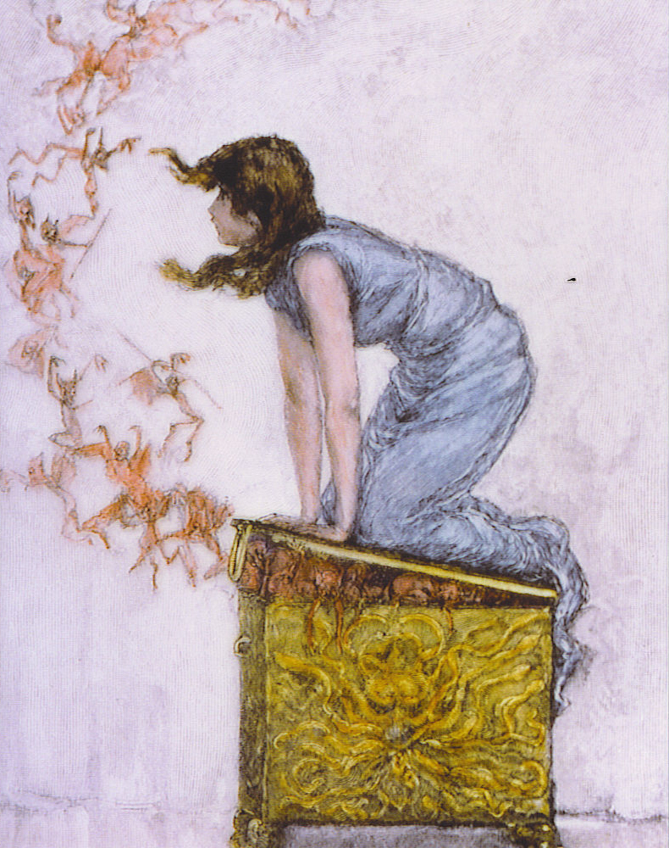
Harvesting Rare Isotopes at NSCL and FRIB
Greg Severin
HRS 2018

Slide 2
Outline
Radiotracing– the concept, and examples.
How NSCL and FRIB expand the radiotracing palette
An example for harvesting: ⁴⁷Sc
Outlook

Slide 3
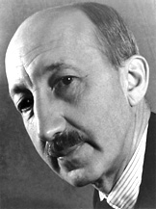
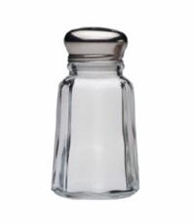

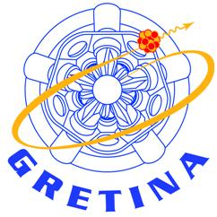
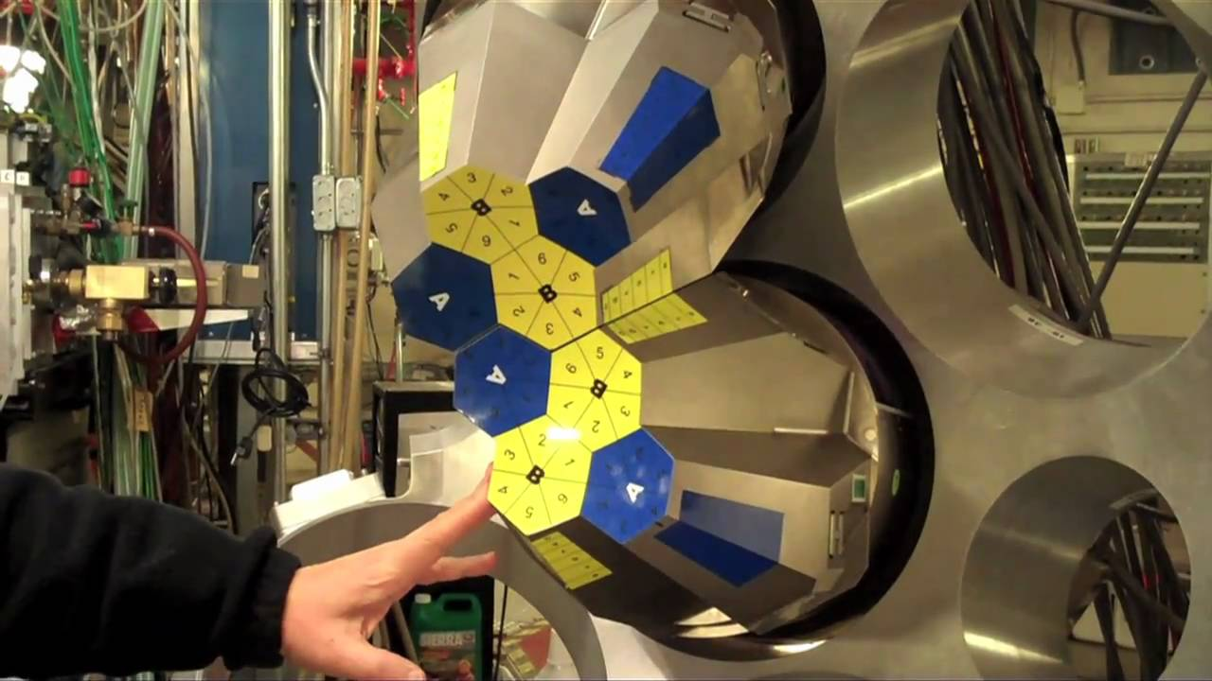
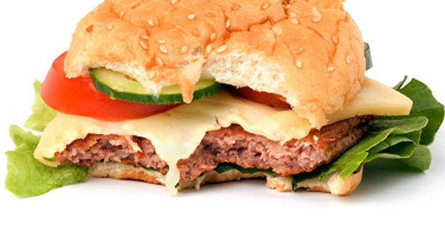
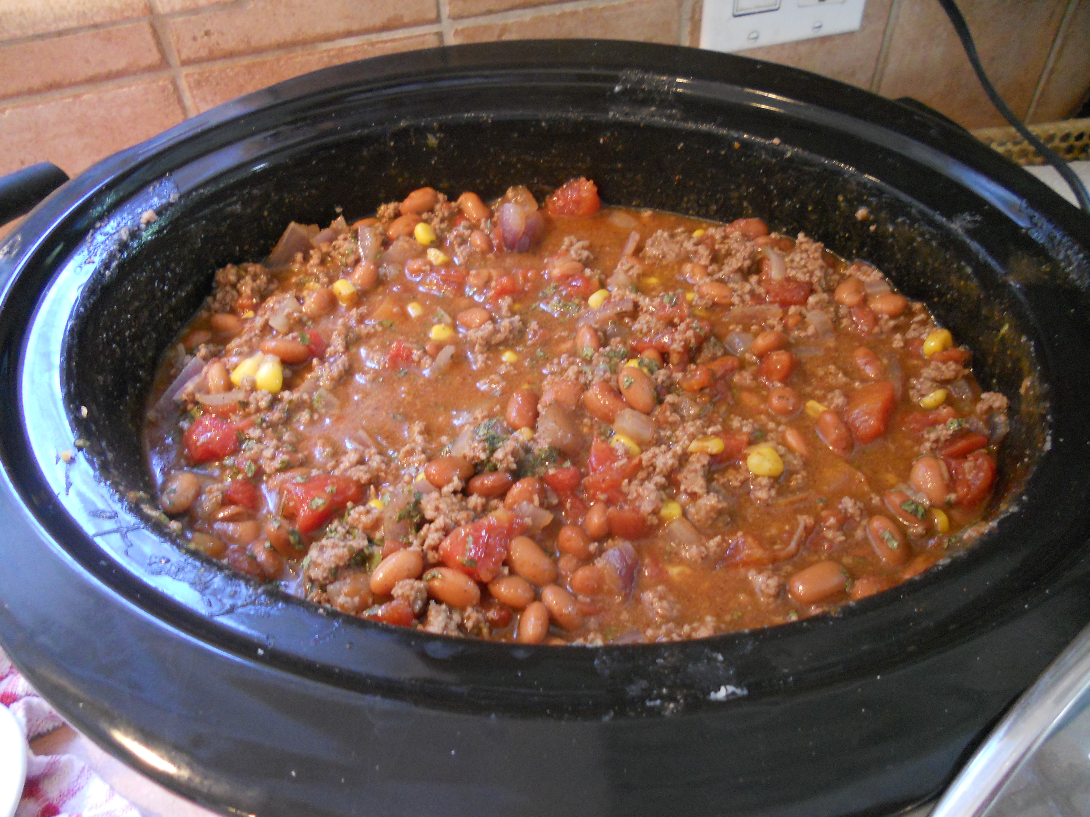

Radiotracing, and the Tracer Principle
George de Hevesy
The Nobel Prize in Chemistry 1943 was awarded to George de Hevesy "for his work on the use of isotopes as tracers in the study of chemical processes".
?

Slide 4
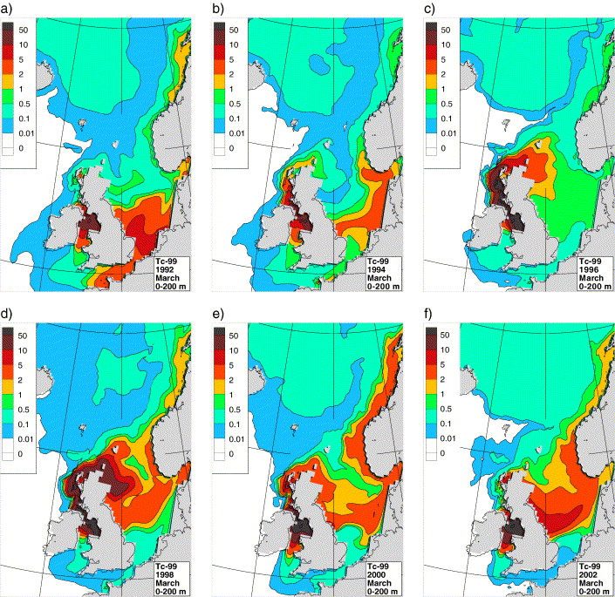
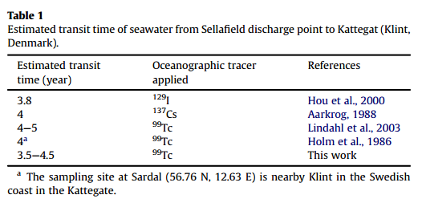
Water flow in the ocean
Nuclear processing plants in Sellafield and La Haugue “salt” the ocean with ^{99g}Tc (t_{1/2}= 211,100 y)
Concentrations of ^{99g}Tc are measured in the northern seas and compared to discharge data to determine ocean currents
Shi, K, et al Estuarine, Coastal and Shelf Science 127 (2013) 24e28
Orre, S, et al Journal of Marine Systems
Volume 68, Issues 1–2, November 2007, Pages 24–38

Slide 5
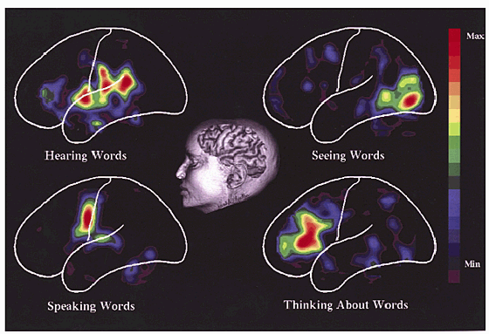
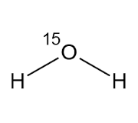
Water flow in the brain
Short-lived ¹⁵O labeled water shows how blood flow changes in the brain under different stimuli.
Nature Medicine 5, 1113 - 1116 (1999)
doi:10.1038/13427Mental illness and the sciences of brain and behavior
Seymour S. Kety

Slide 6
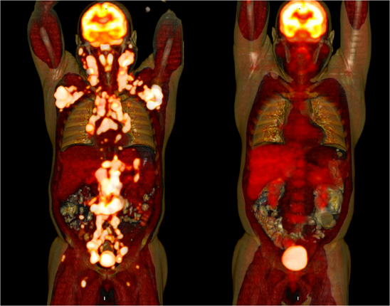
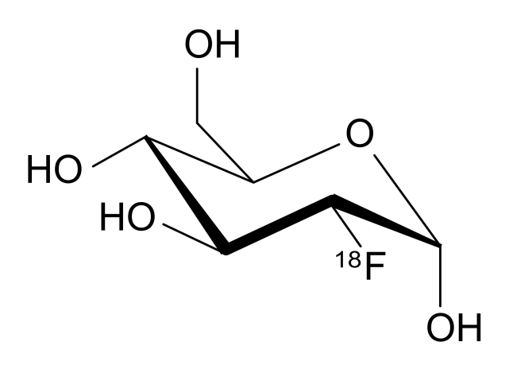
sugar and metabolism
Molecular imaging of tumor metabolism and apoptosis U Haberkorn, A Markert, W Mier, V Askoxylakis and A Altmann Oncogene (2011) 30, 4141–4151
[¹⁸F]FDG
Remission
Before Chemotherapy
After Chemotherapy

Slide 7
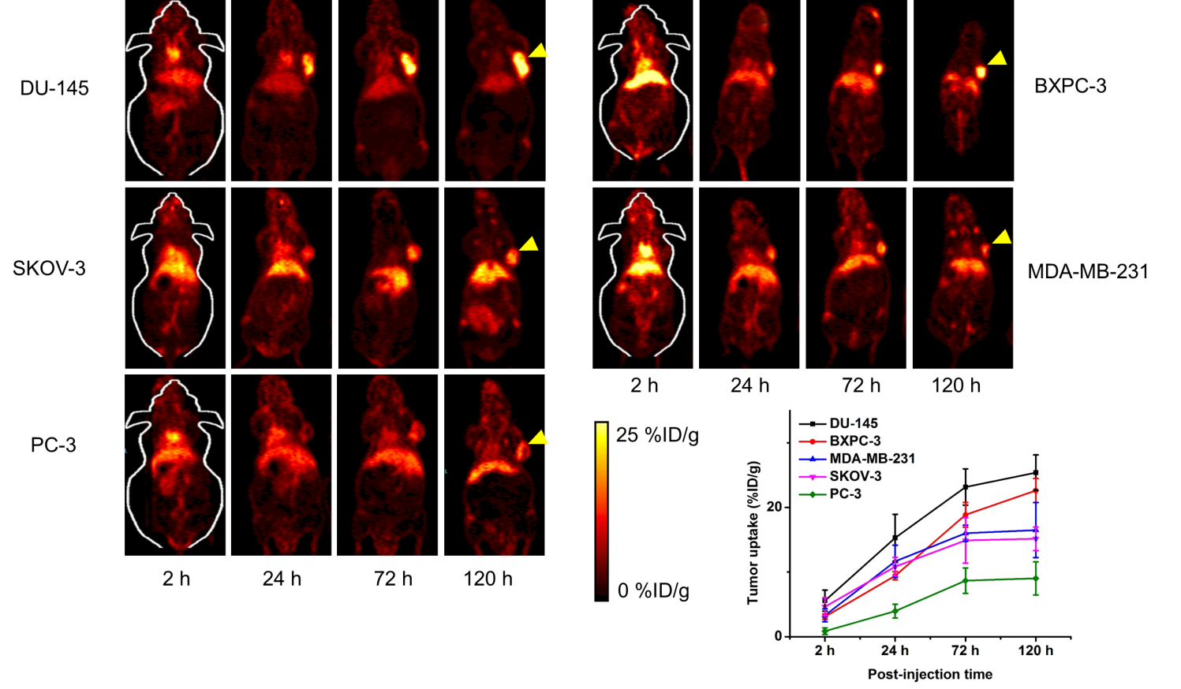
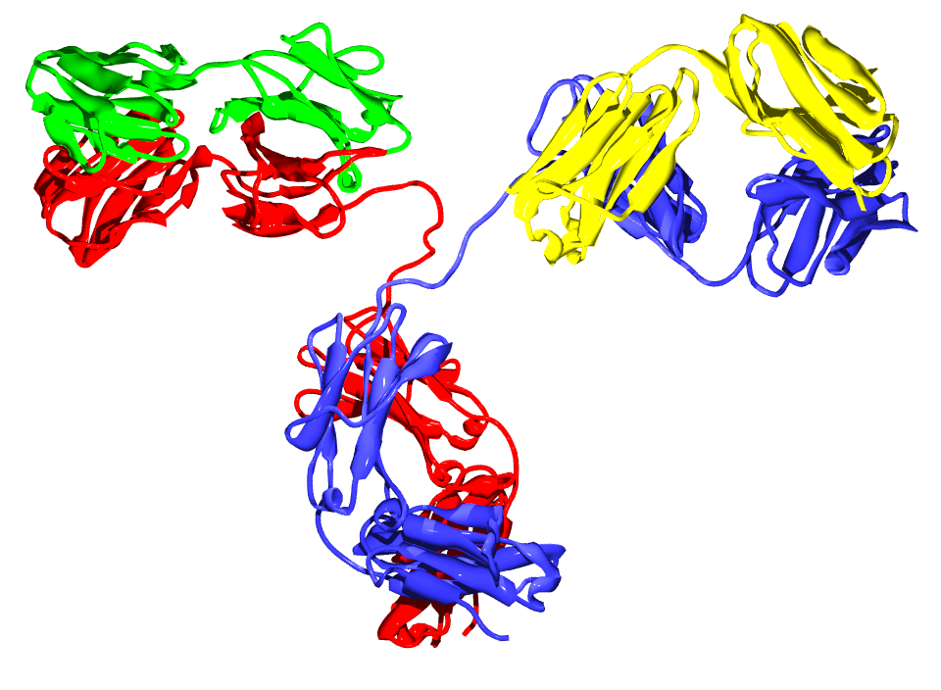
ImmunoPET: engineered antibodies find aggressive metastatic cancer cells!
⁸⁹Zr
Yang, D., Severin, G., Dougherty, C., Lombardi, R., Chen, D., Van Dort, M., Barnhart, T., Ross, B., Mazar, A., & Hong, H. (2016). Antibody-based PET of uPA/uPAR signaling with broad applicability for cancer imaging. Oncotarget, 7(45), 73912-73924.

Slide 8
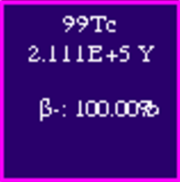
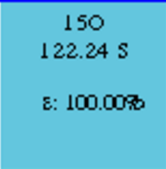
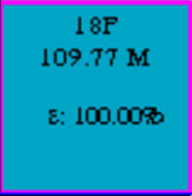
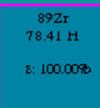
Now we can learn about almost anything
How does global climate change affect ocean currents?
What parts of the brain are involved with language processing?
Which parts of our bodies are most metabolically active?
  How can we identify disease in the body?
Etc. etc. , and with only a few isotopes.
More radionuclides are needed to expand tracing capabilities, and other applications

Slide 9

Some useful radionuclides are hard to make
⁴⁷Sc, ⁷⁶Br, ⁶⁷Cu, ²⁸Mg, ²¹¹Rn, ²²⁹Pa etc.
For example ⁴⁷Sc: for targeted therapy with radioactive antibodies.
  ⁴⁷Sc’s low energy beta emissions give an appropriate dose to small metastases
  ATN-291 targets cells that are forming metastases
⁴⁷Sc

Slide 10
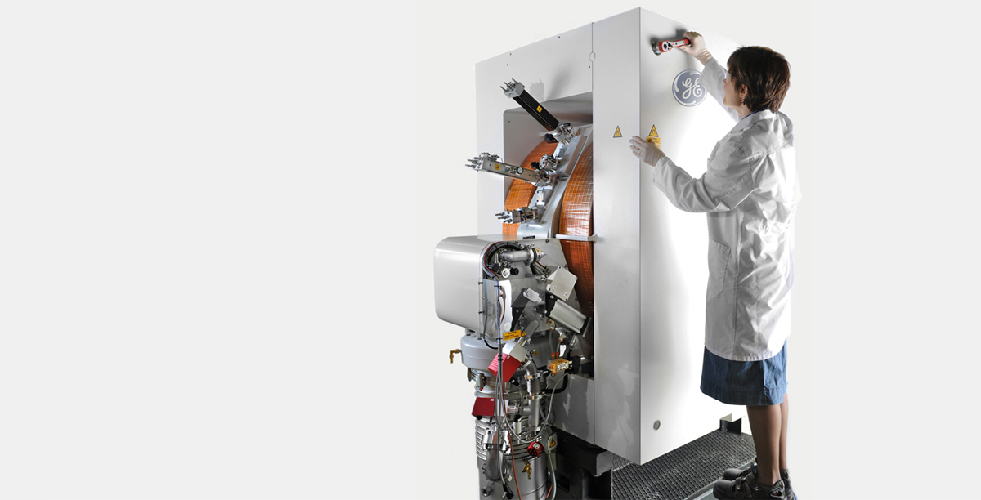
How do we make tracer radionuclides?
Normally: Small proton-only cyclotrons
(are very good at p,n reactions, for example to make ⁴⁵Ti from ⁴⁵Sc)

Slide 11
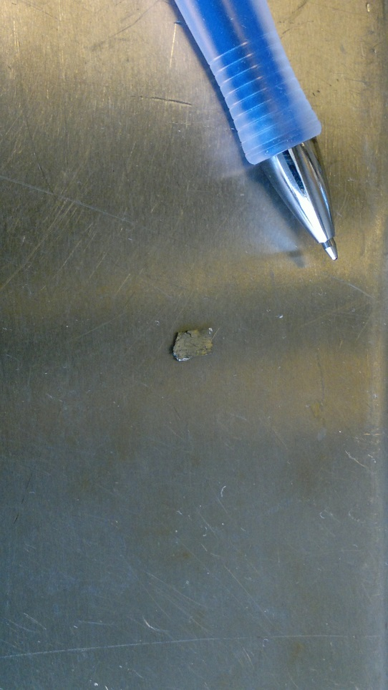
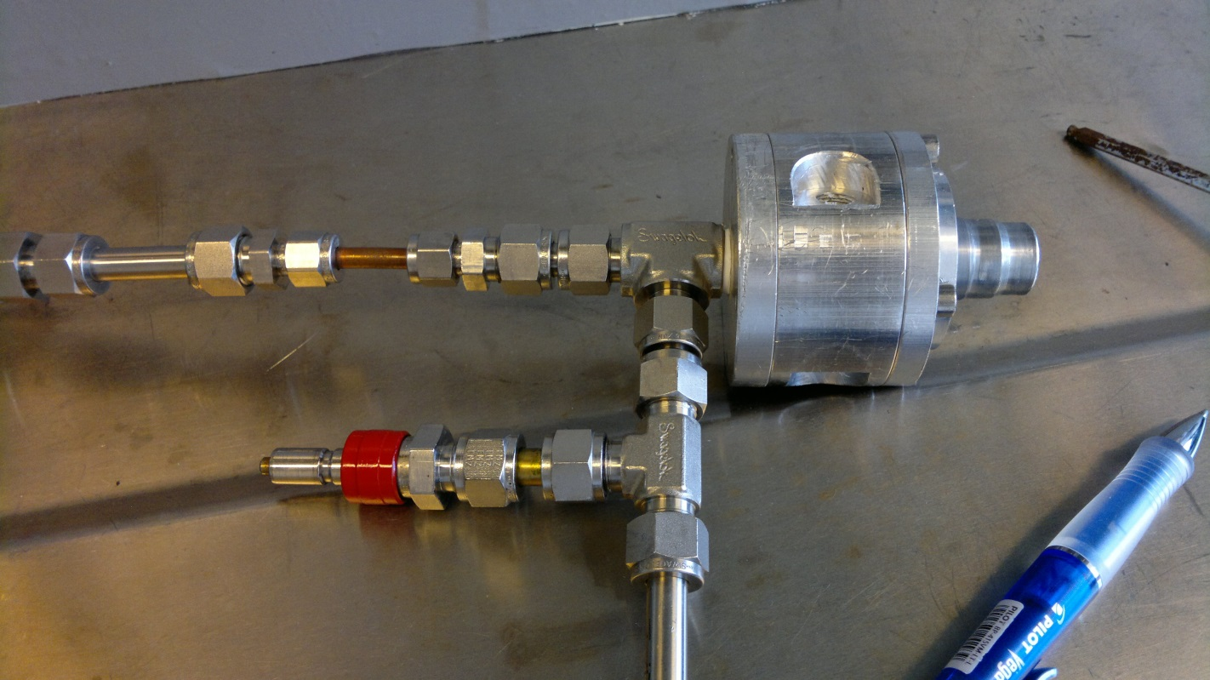
⁴⁵Ti Production at a small cyclotron
22mg Sc foil, 250µm
H+
Water In
(Cyclotron)
Water out
Silver backing
Cyclotron beamport

Slide 12
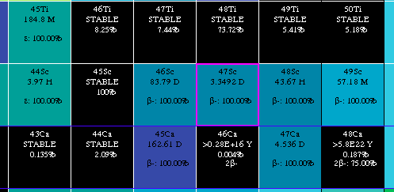
⁴⁵Ti is easy to make, ⁴⁷Sc isn’t
At NSCL, ⁴⁷Ca is being produced, abundantly, (and is left to decay) every time ⁴⁸Ca beams are run!!
-N
P
-N
P
Beta-
NSCL
+N

Slide 13
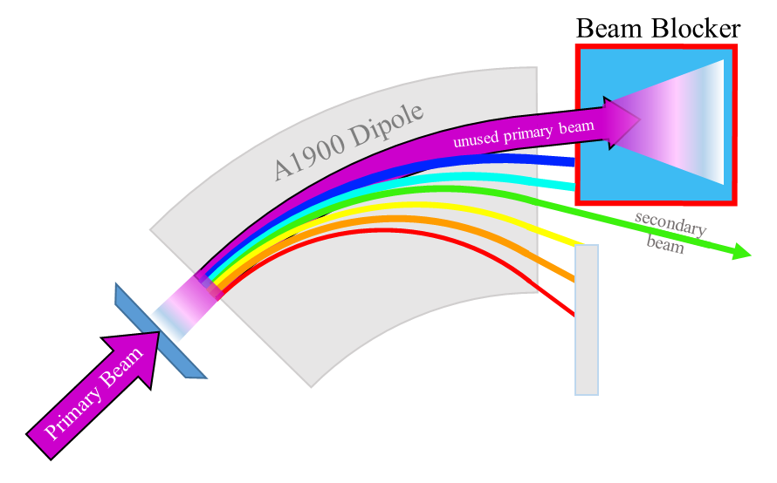
Harvesting at NSCL

Slide 14
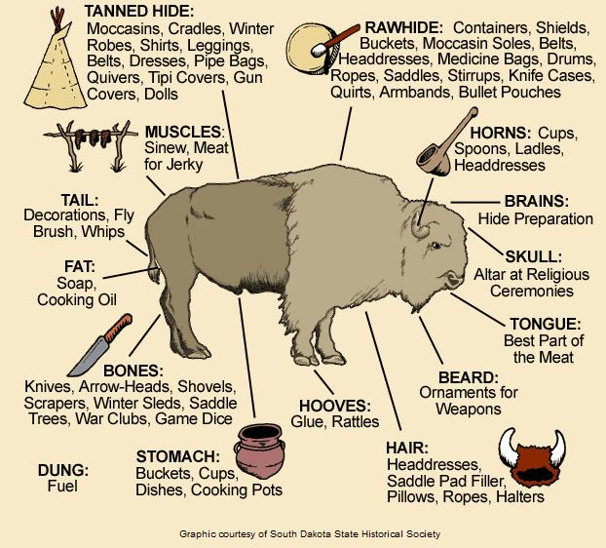
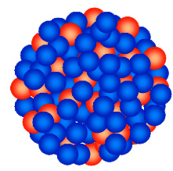
Use the whole buffalo
⁷⁶Kr/⁷⁶Br- PET halogenation
²²⁹Pa - EDM
¹³²Sn – Fast Beam
134Ce – PET/MR
⁴⁴Ti - Astrophysics
⁴⁷Sc - radioimmunotherapy

Slide 15
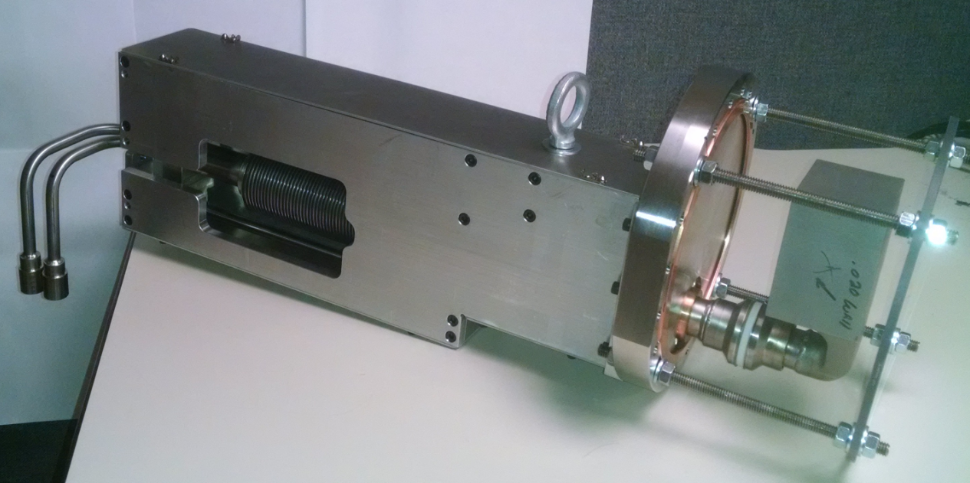
Beam Blocker (credit Dave M, Patrick G, etc):
Rebuild using Titanium (to match FRIB beamstop material)
Beam blocker pictures
Water in
Water out
Beam hits here
Water in
Water out

Slide 16
Cooling Water Harvesting
Heat Exchange
Gas/Liquid Separator
Pump
Ion Exchange

Slide 17

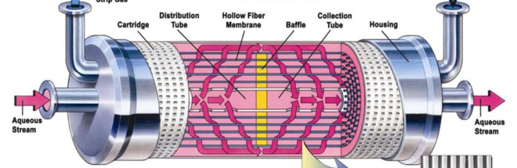
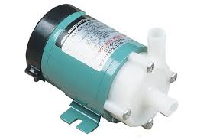
Cool
Warm, Contaminated
Degassed
Beam
Deionized

Slide 18
⁴⁸Ca beam (75pnA), one day on, one day off
element | isotope | Activity (mCi)
K | 43 | 8.820
Ca | 47 | 8.433
K | 42 | 5.645
Na | 24 | 1.794
Sc | 47 | 1.393
Be | 7 | 1.287
P | 32 | 1.139
Sc | 48 | 0.928
P | 33 | 0.629
Sc | 44 | 0.600
Sc | 44m | 0.566
Mg | 28 | 0.481
Ca | 45 | 0.157
Sc | 46 | 0.061
Si | 31 | 0.017
Sc | 43 | 0.012
S | 38 | 0.009
Na | 22 | 0.006
Ni | 57 | 0.004
V | 48 | 0.003
Cr | 51 | 0.002
Mn | 52 | 0.002
Can’t harvest ⁴⁷Sc, it’s contaminated with ⁴⁸Sc! (et al)
Co-collected, but do not generate contaminating radiometals
(I want ⁴⁷Sc for radioimmunotherapy)

Slide 19
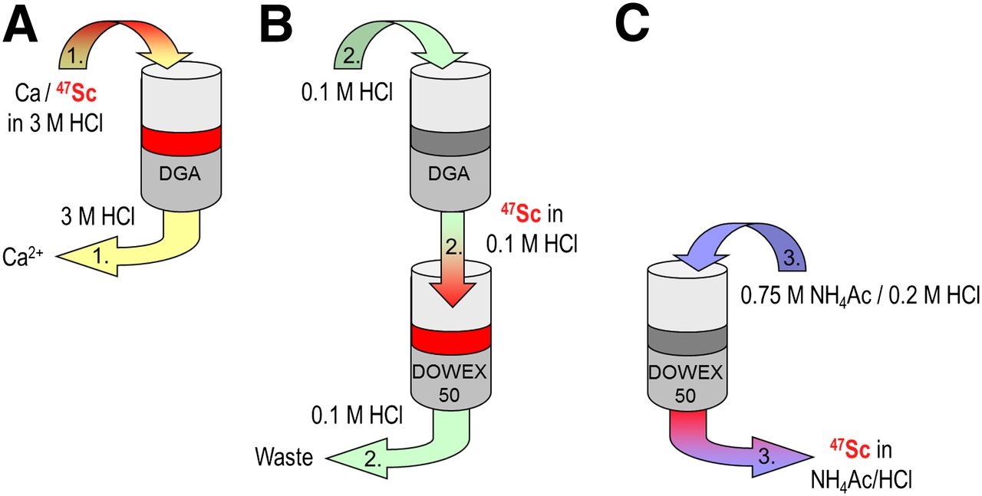
Collect on ion exchange beds, separate by ion exchange “chromatography”.
(i.e. exploit differences in aqueous chemistry of Ca²⁺ and Sc³⁺⁾
Mueller, Vermeulen 2014

Slide 20
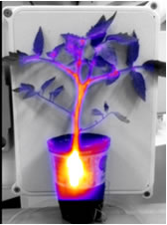
Other plans, NSCL
⁷⁶Br from ⁷⁶Kr generator --- medicine, e.g. brominated DHT w/Indiana
⁵²Fe, ^{44m}Sc, ⁹⁰Mo, ⁴⁸V --- trace metal studies in plants w/MSU plant sciences
⁴⁸Cr, ⁸⁸Zr --- stockpile stewardship w/LLNL
Etc. --- each incident beam creates a totally different spectrum of available nuclides.

Slide 21
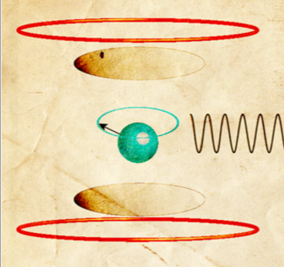
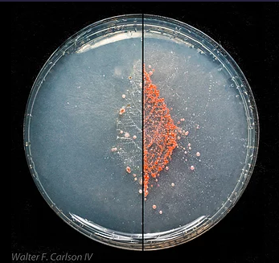
Plans for harvesting at FRIB
²²⁹Pa and ²²⁵Ra for EDM experiments w/Jaideep and ANL
²¹¹Rn/²¹¹At generator for alpha therapy w/UAB, UW
Radiolanthanides for methylotroph research w/MSU microbio
Radiolanthanides for MRI contrast quantification w/MSU radiology
Etc.

Slide 22
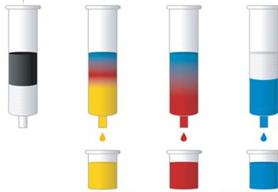
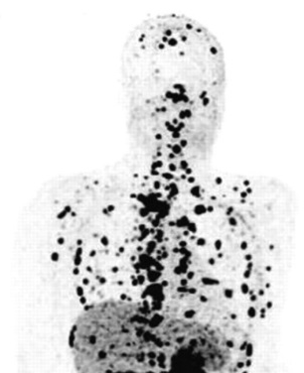
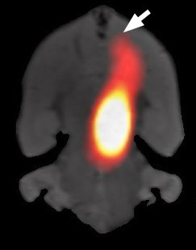
Harvesting
Group:
Paige Abel & Hannah Clause (grad students)
Nicholas Dronchi (undergrad)
Thanks for the opportunity and for the support!

