Slide 1
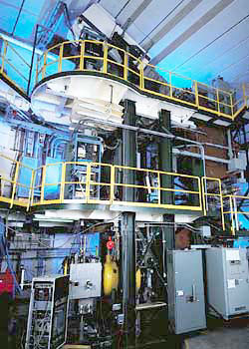
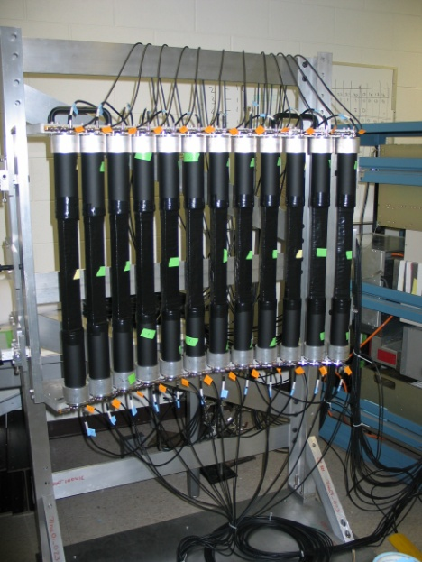
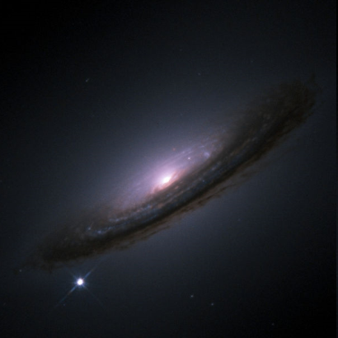
From nuclei to supernovae
Remco G.T. Zegers

Slide 2
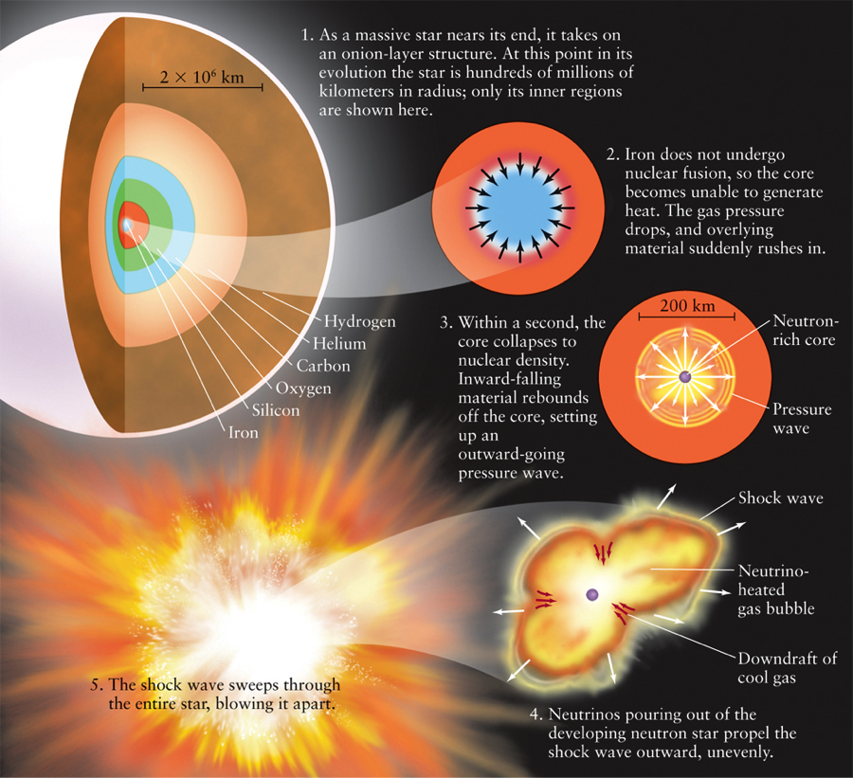
Core-collapse supernovae

Slide 3
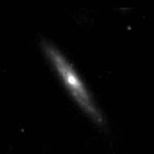
Core-Collapse (Type II) Supernovae
What is the explosion mechanism? How to energize the shockwave?
Sn1998dh Core-Collapse Supernovae

Slide 4
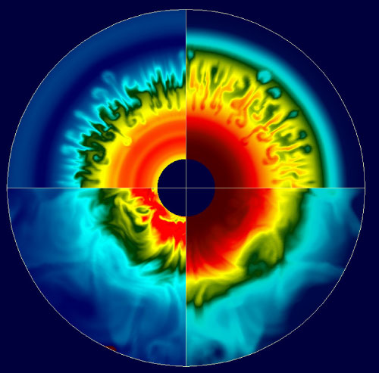
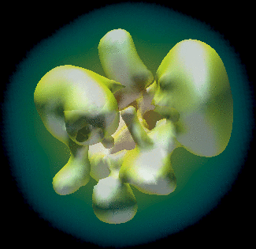
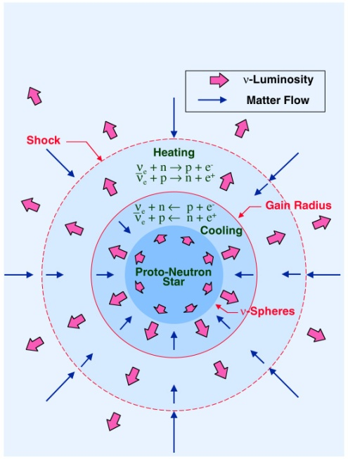
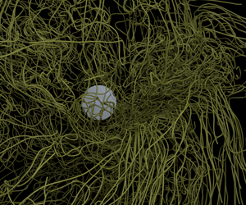
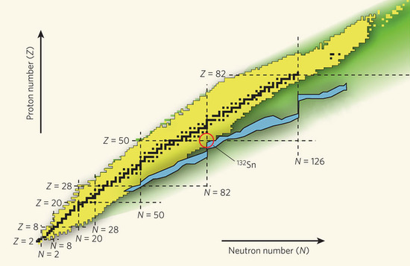
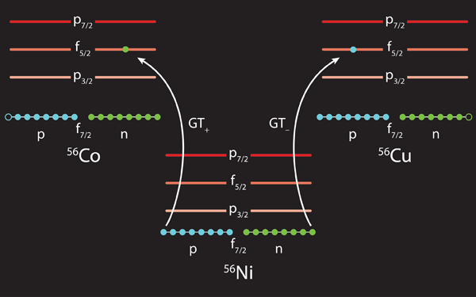
Multi-physics problem
Hydrodynamics – Convection, Turbulence
Multi-Dimensional Effects - Asymmetries
Neutrino physics (transport/ oscillations / interactions)
Müller, E. and Janka, H.-T.
A&A 317, 140–163, (1997)
Magnetic fields
Fryer, C. L., & Warren, M. S. 2002, ApJ, 574, L65
r-process
Reactions mediated by the weak nuclear force
electron captures
Pugmire et al., ORNL
P. Cottle Nature 465, 430–431 (2010)
K. Langanke, Physics 4, 91 (2011)

Slide 5
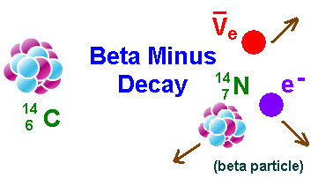
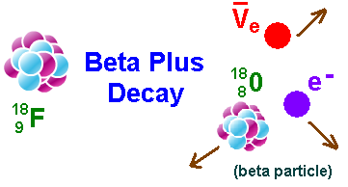
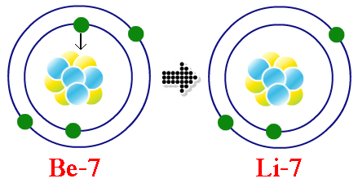
weak interactions
e+
Electron-capture decay
v_{e}

Slide 6
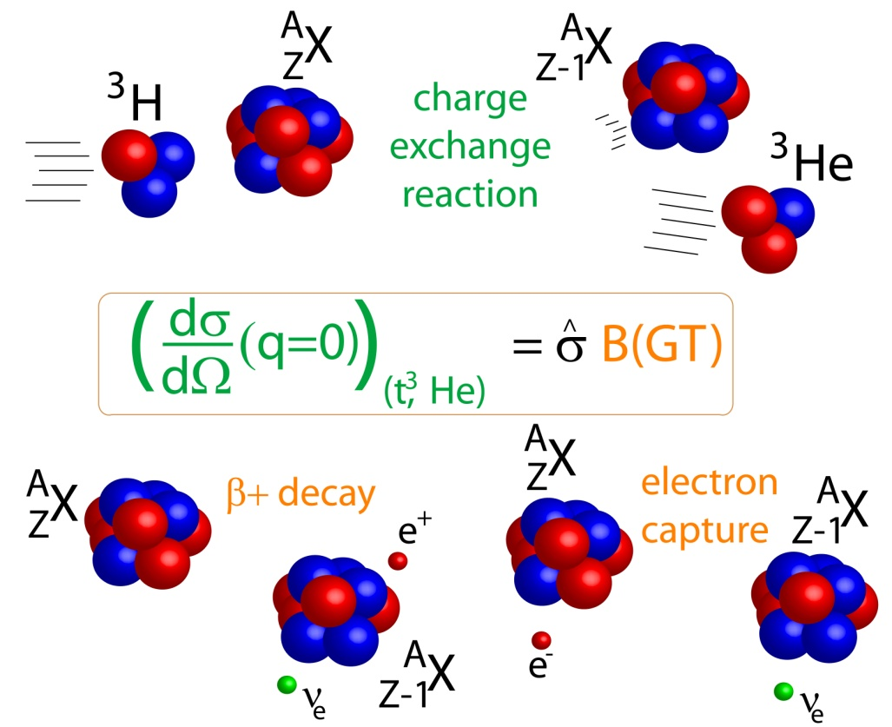
nature is kind: nuclear charge-exchange reactions as a probe of weak transition strengths
A,Z+1
β⁻
(³He,t)
A,Z
e-capture/β⁺
(t,³He)
A,Z-1
Charge-exchange reactions connect the same initial and final states as in weak interactions and are mediated through similar spin and isospin transfer operators
Proportionality holds at ~10% level – beam energies must be ~100 MeV/A or above
Applied to a variety of charge-exchange probes: (p,n)/(n,p), (³He,t)/(t,³He),(d,²He),(⁷Li,⁷Be) etc.

Slide 7
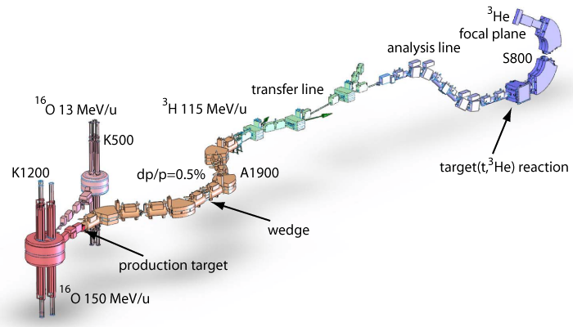
Producing a triton beam for (t,³He) experiments
Primary ¹⁶O beam 150 MeV/n
rate @ A1900 FP 1.2x10⁷pps @ 130 pnA ¹⁶O
transmission to S800 spectrometer ~70%
³H rate at S800: 10⁷ pps
S800 spectrometer
Reconstruct momentum
and angle of ³He particle
Extract excitation-energy and center-of-mass scattering angle from two-body kinematics
Without wedge
Thin wedge is needed to remove ⁶He (⁹Li)
Background channel ⁶He->³He + 3n
G.W. Hitt Nucl. Instr. and Meth. A 566 (2006), 264.

Slide 8
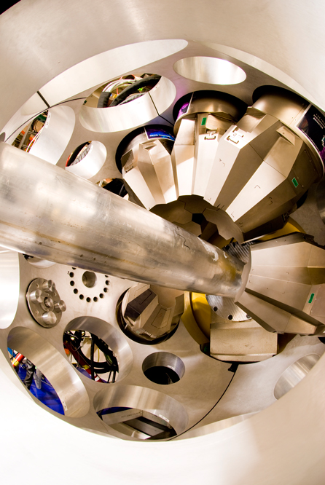
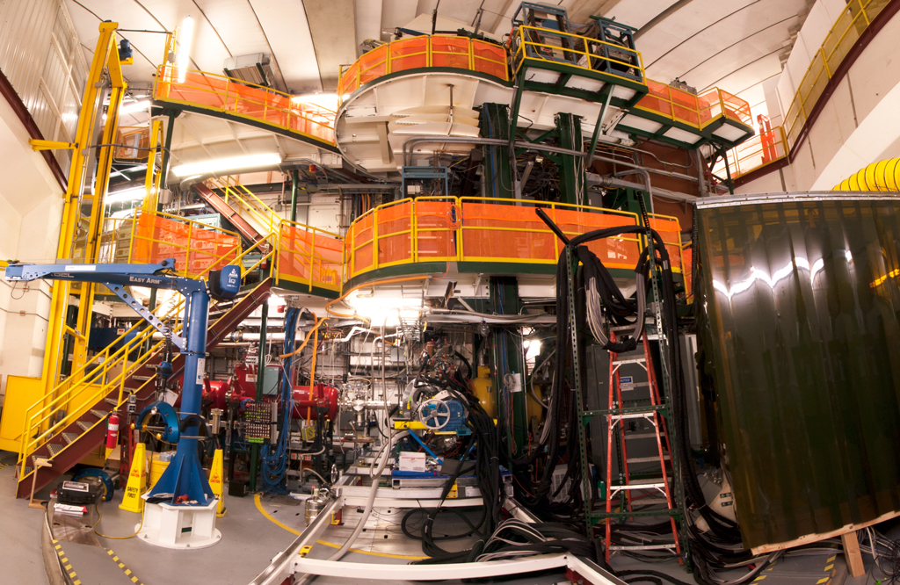
(t,³He) & (t,³He+γ) S800 Spectrograph (+Gretina)
Gretina
γ-detection
Gamma-Ray Energy Tracking In-beam Nuclear Array
³He ejectiles
S800
³H (100 MeV/u)
~10M pps
target (~10 mg/cm²)

Slide 9
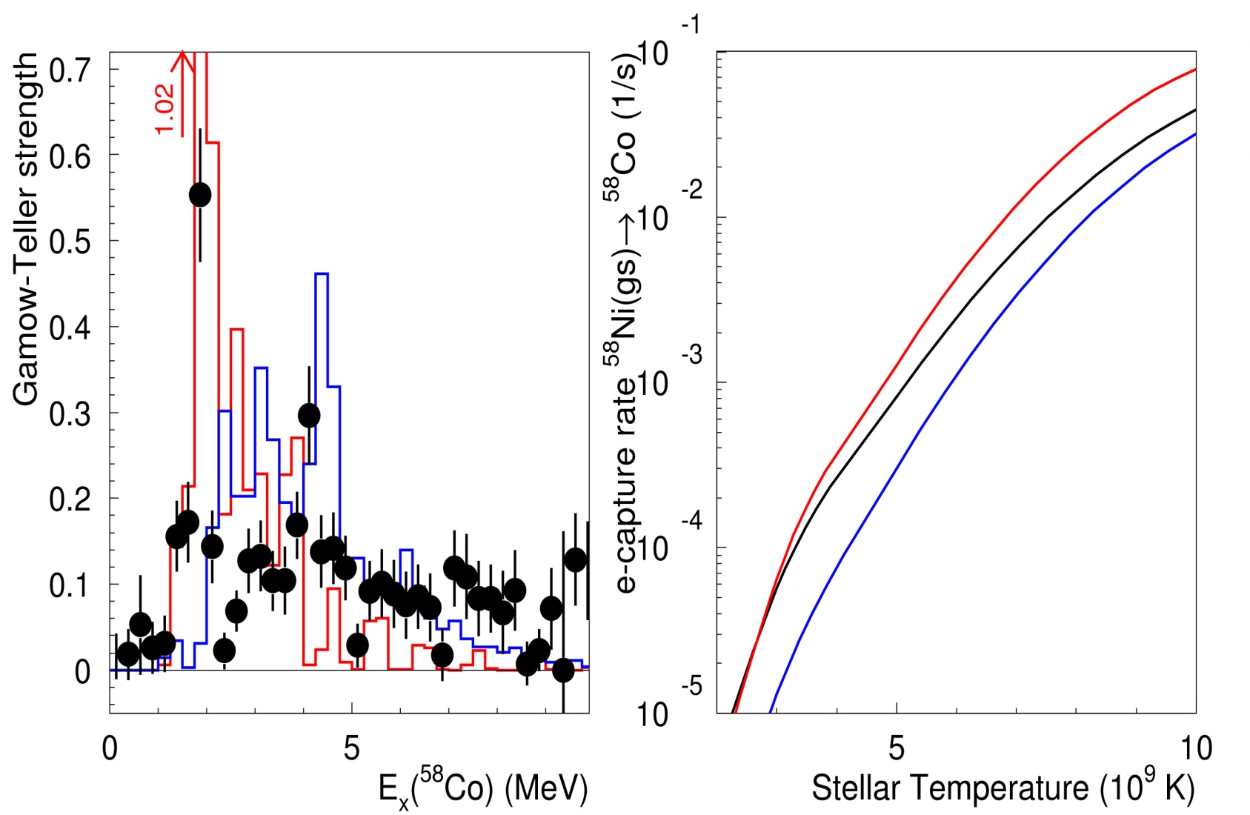
Example ⁵⁸Ni→⁵⁸Co
(t,³He) data
GXPF1 calc
KB3G calc
early in
pre-collapse
ρY_{e}=10⁷ g/cm³
Phase-space
Transition strength
A. L. Cole et al., Phys. Rev. C. 74, 034333 (2006)

Slide 10
How to study nuclei that immediately fall apart?

Slide 11
Going to terra incognita
Add 1 proton,
remove a neutron
Protons
N=Z
Neutrons

Slide 12
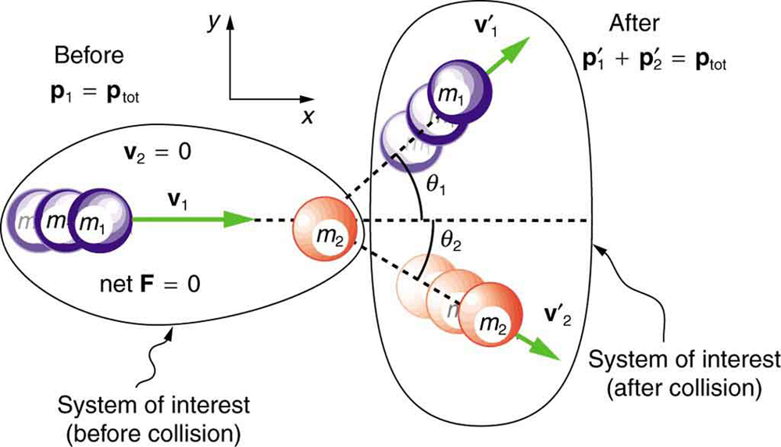
Playing billiards with nuclei
¹²O
¹²N
p
n
Measure this neutron!!

Slide 13
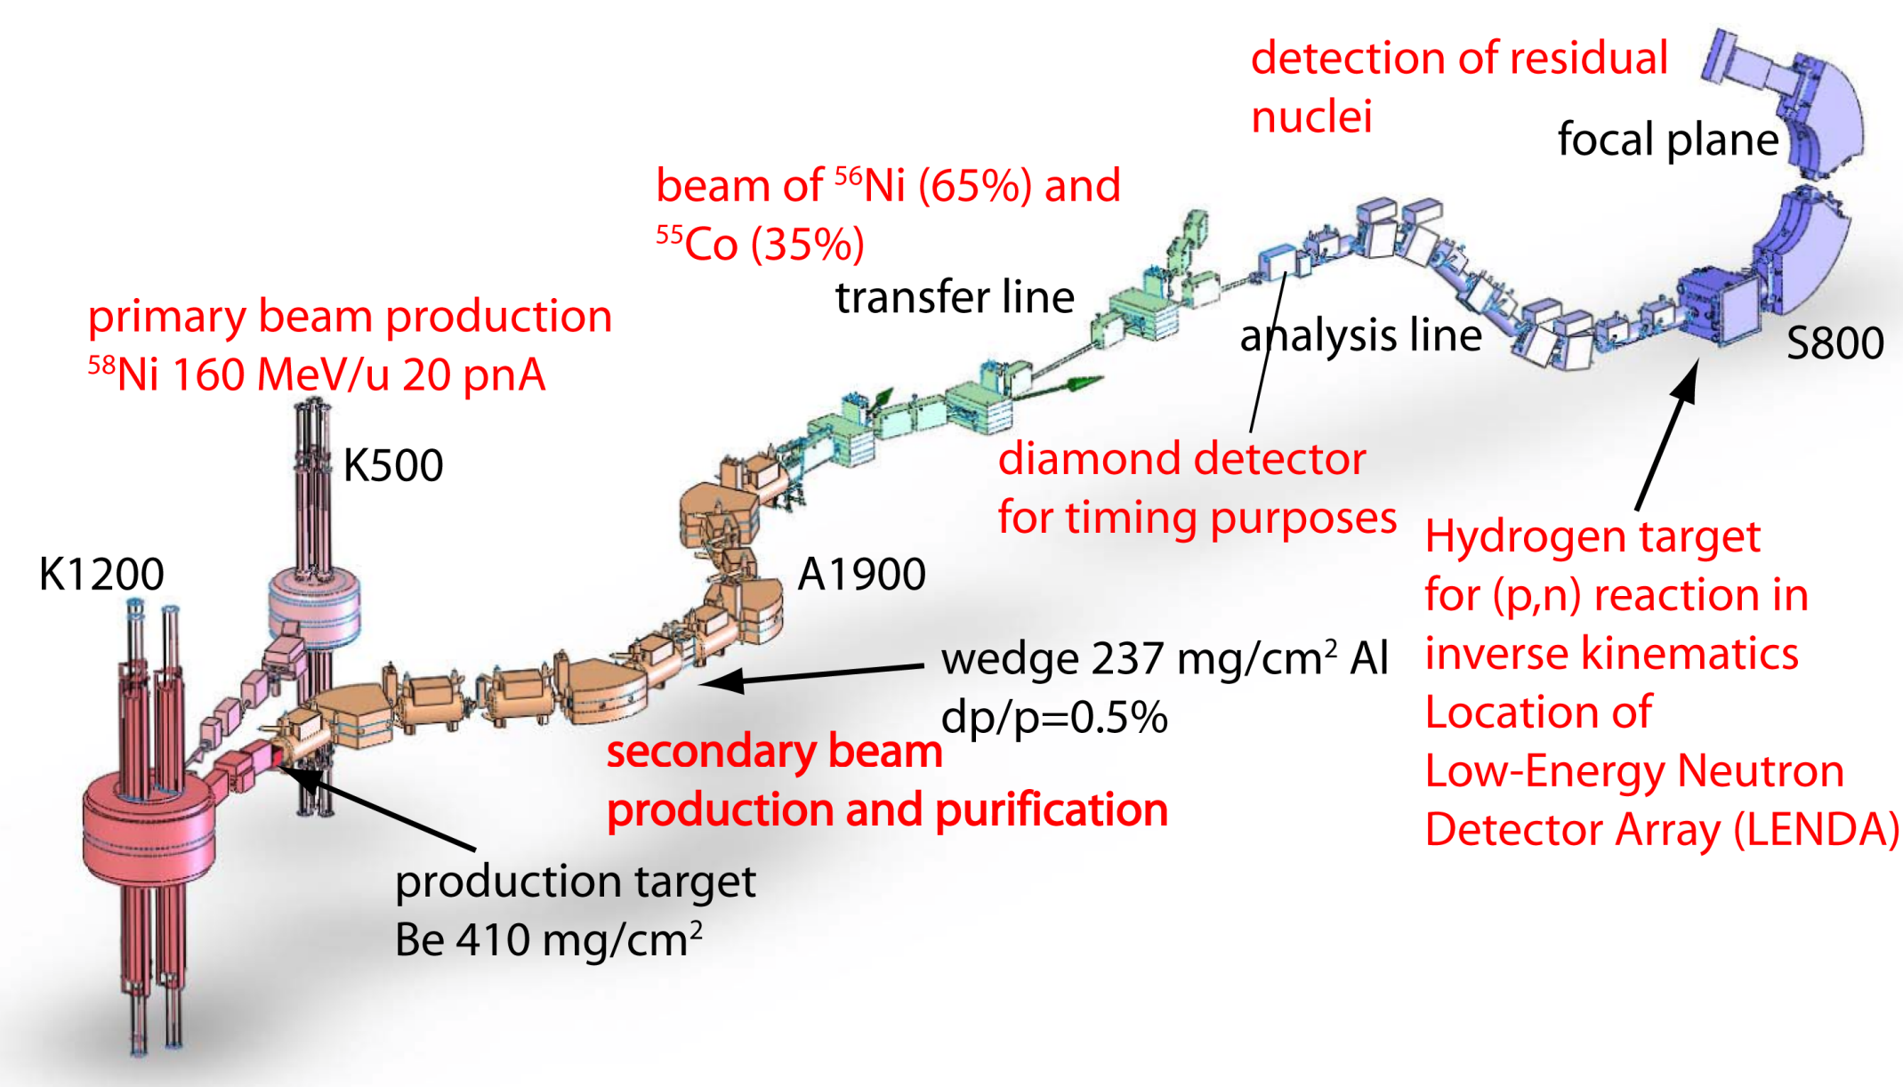
¹²O(p,n) experiment inverse kinematics
¹²O & ¹¹N secondary beam
¹⁶O primary beam

Slide 14
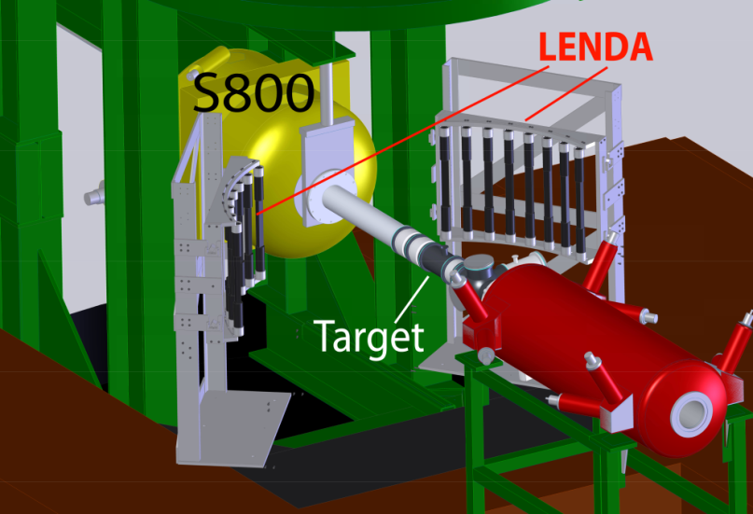
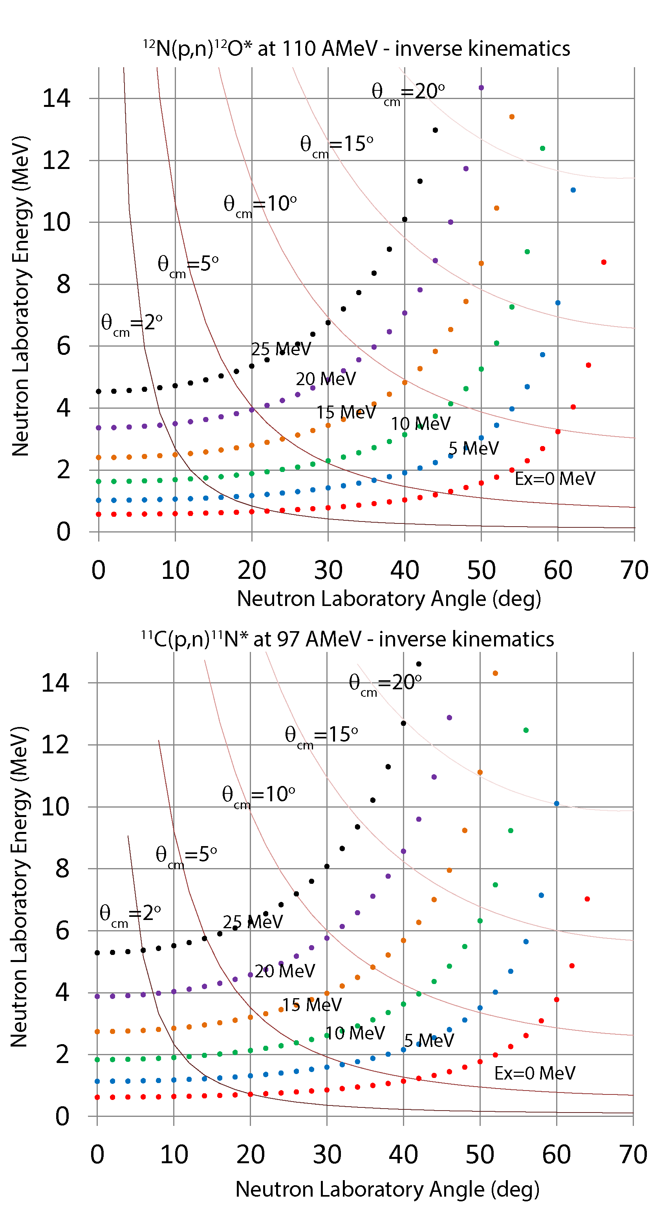
E17018 - The (p,n) charge-exchange reaction at ~100 AMeV as a new tool for studying proton-rich exotic nuclei: the cases of ¹²O and ¹¹N.
S800 spectrometer
Heavy residue collection
Bρ< 4 Tm /130º bend
Particle identification
30 cm
Diamond detector
Beam particle timing
Low Energy Neutron
Detector Array (LENDA)
neutron detection
Plastic scintillator
Added long bars from Notre Dame
n
RI beam
Liquid Hydrogen target
“proton” target
65 mg/cm² (~7 mm)
~3.5 cm diameter
T=20 K ~1 atm

Slide 15
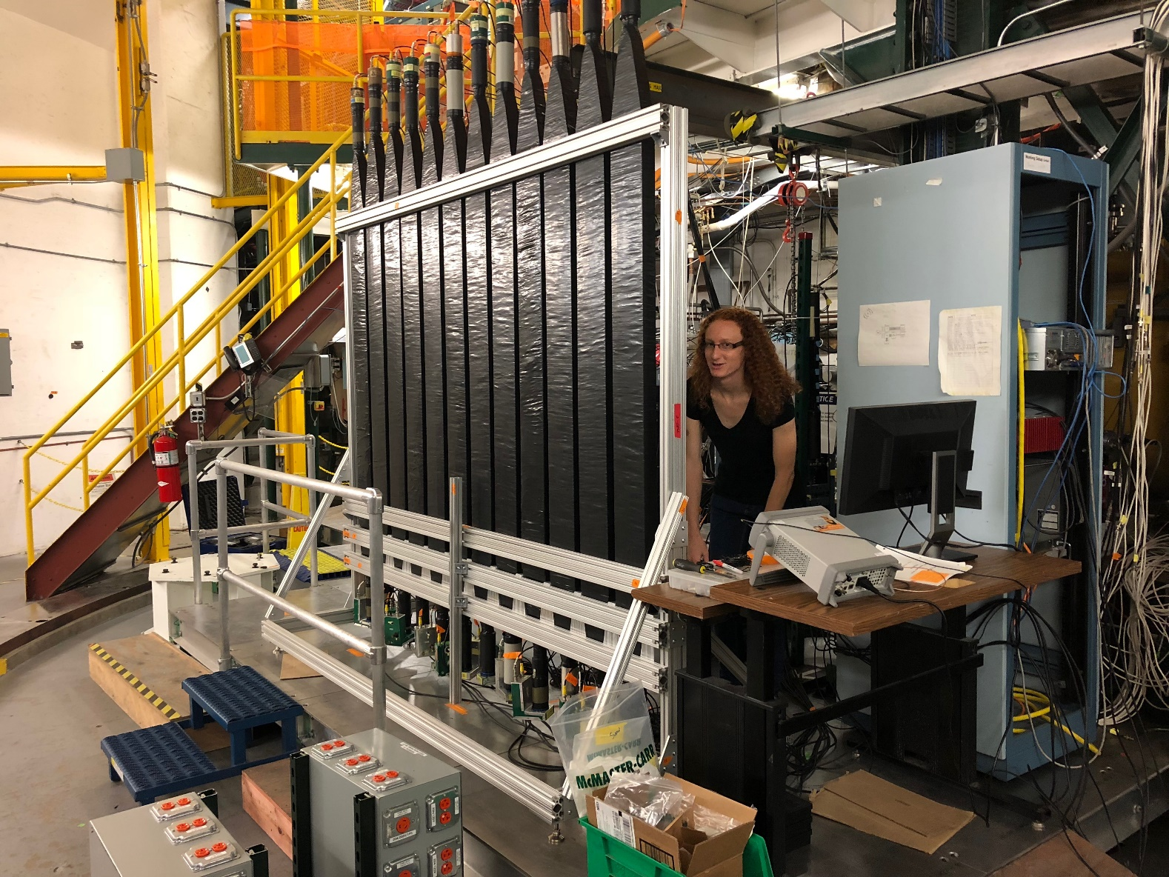
Experiment in November!

