Slide 1
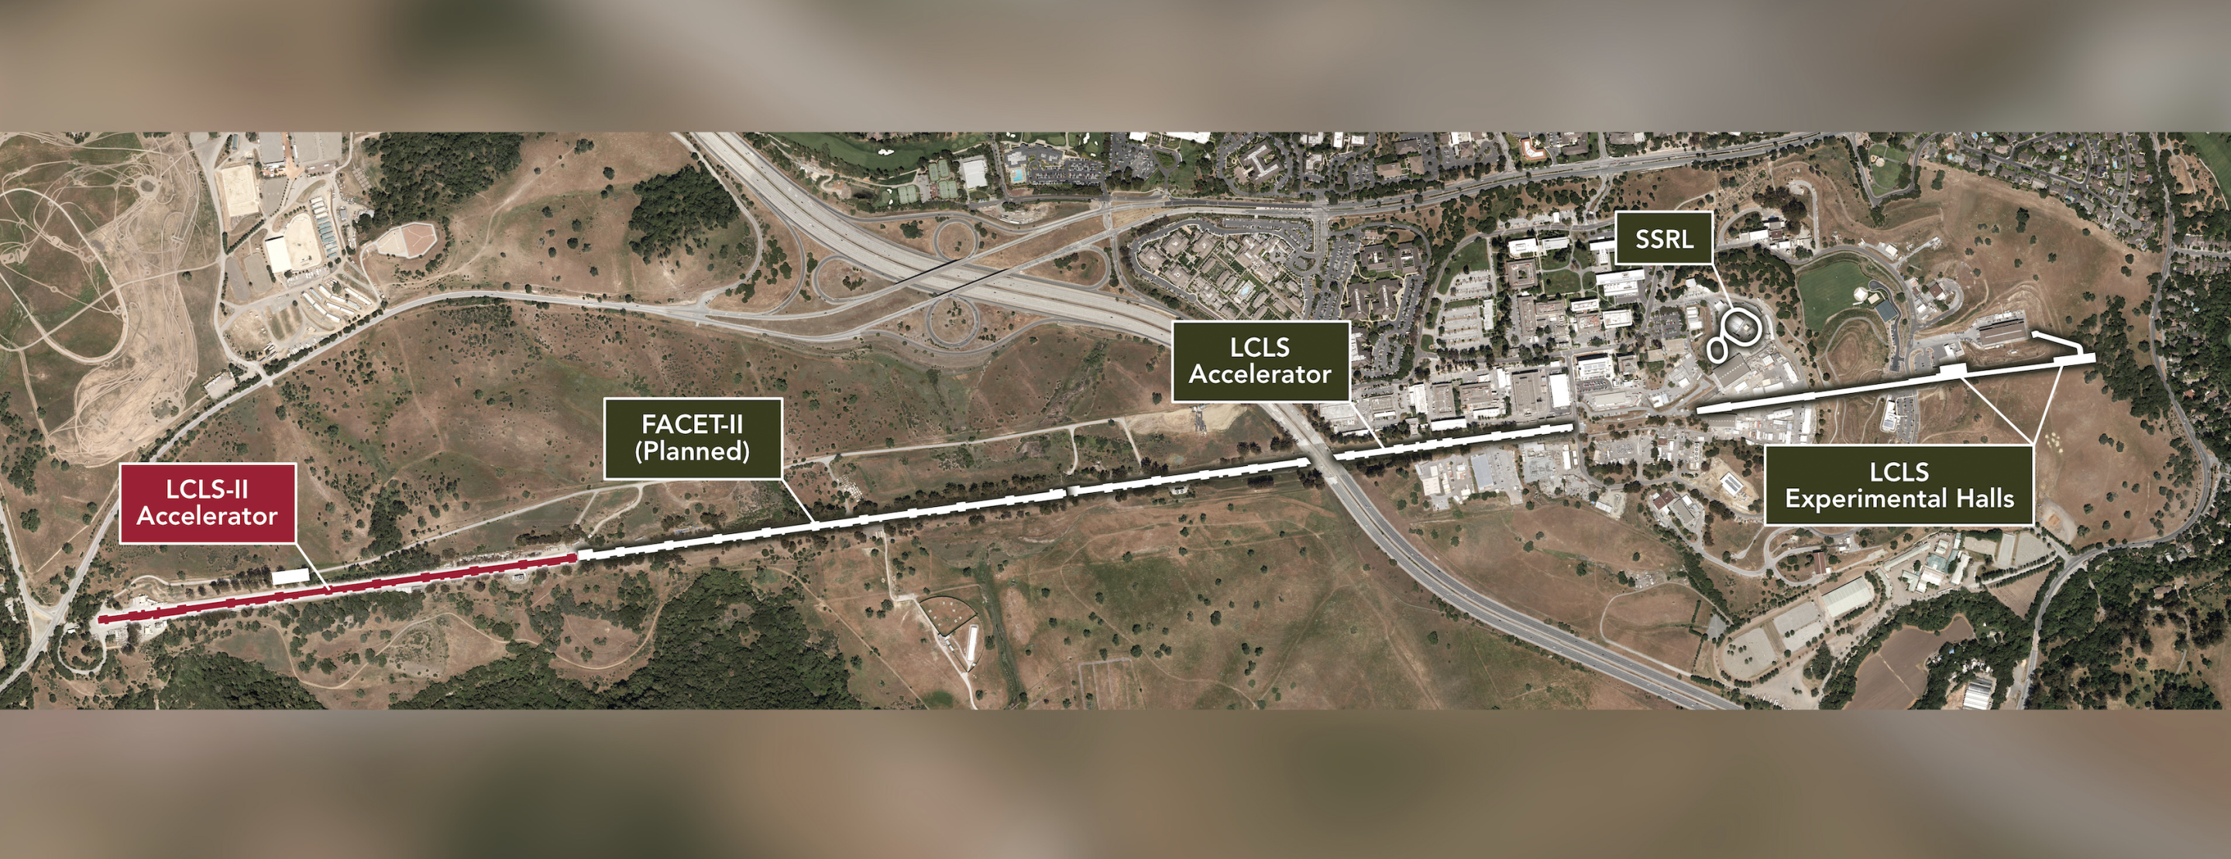
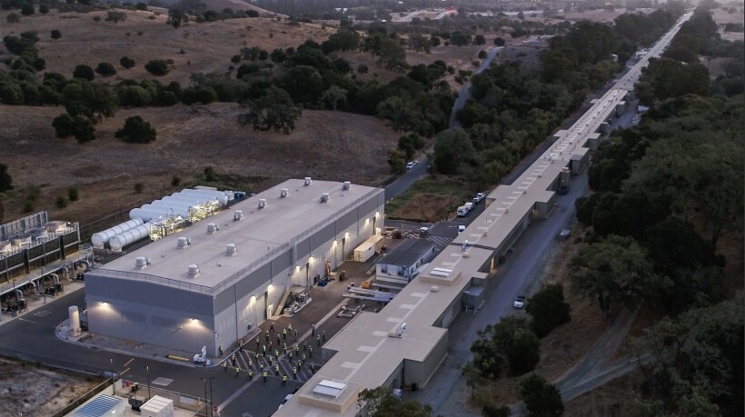
Introduction to Free Electron Lasers
PHY 862
December 2023
Holly Matthews
“Linac Coherent Light Source: SLAC National Accelerator Laboratory.”
Am. J. Phys., Vol. 51, No. 3, March 1983

Slide 2
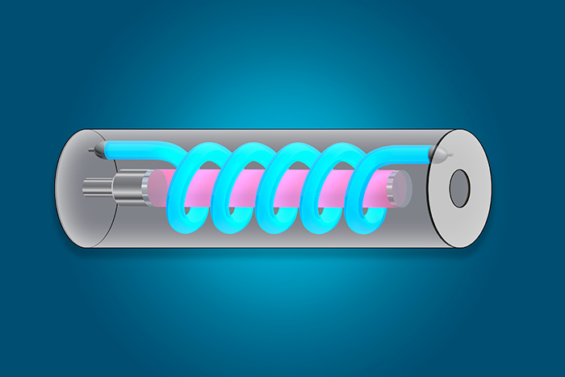
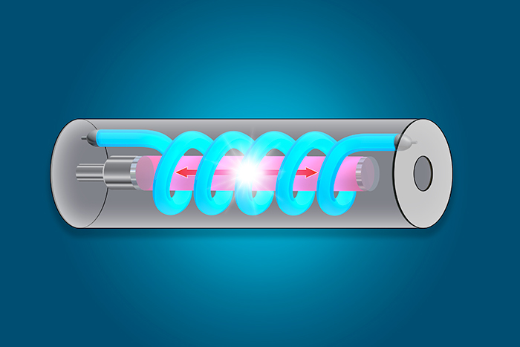
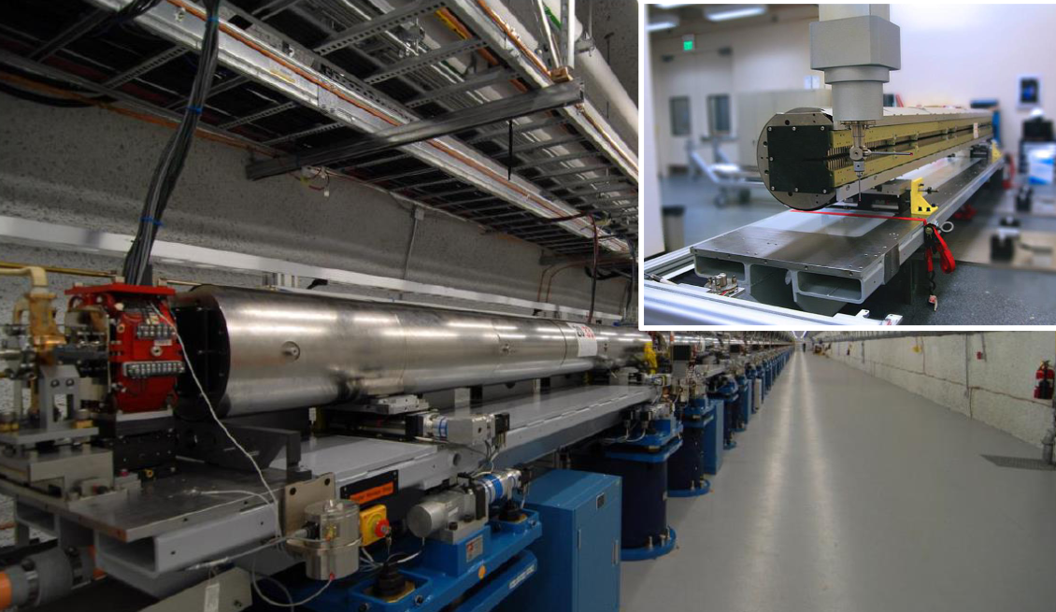
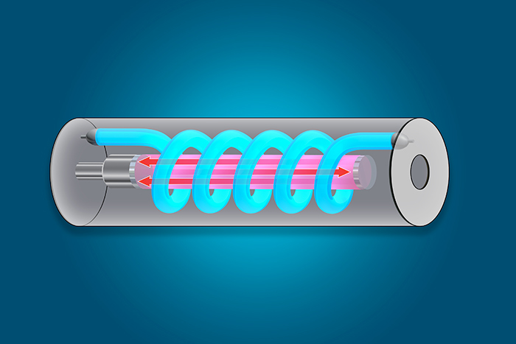
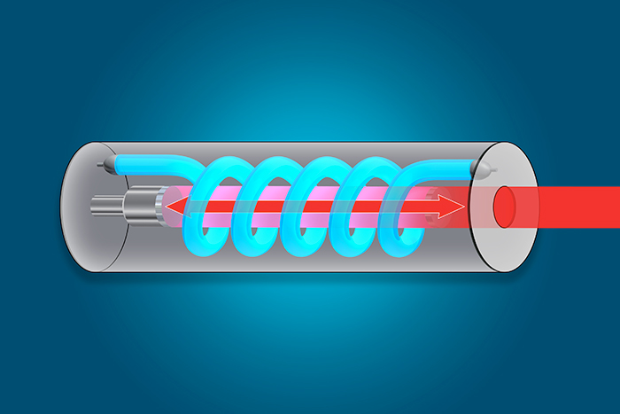
Conventional Lasers
FELs
Light Amplification by Stimulated Emission of Radiation
Optical gain medium materials like glass or gas
Optical cavity to release coherent light
Accelerated electrons as optical gain medium
Undulators/wiggler magnets generate radiation
Beat waves to release coherent light
Coherent
Incoherent
“NIF’s Guide to How Lasers Work.” lasers.llnl.gov/education/how-lasers-work.
Notes:
Important properties: collimated, coherent, HeNe laser

Slide 3
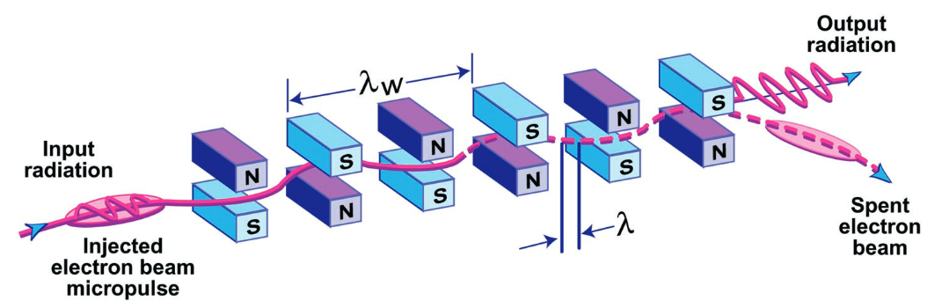
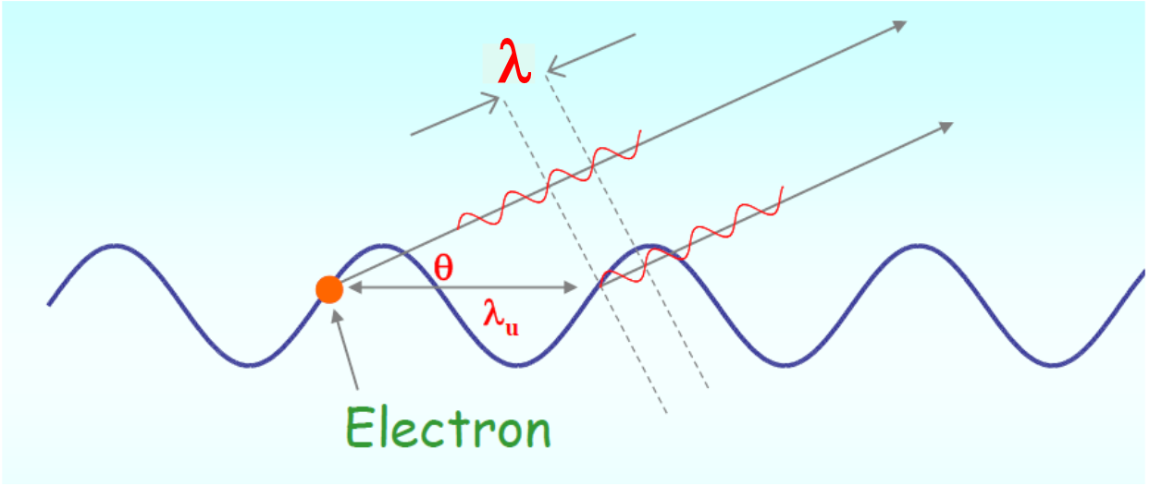
Generating Synchrotron Radiation
Key Principles
Light is radiated by accelerating charges
(Larmor Formula/Lienard-Wiechart Potentials)
$λ_{rad}∝\frac{1}{γ^{2}}$
(O’Shea & Freund, 2001)
Emission angle
$$λ=\frac{λ_{w}}{2γ^{2}}\left(1+\frac{K^{2}}{2}+γ^{2}θ^{2}\right)$$
$$K=\frac{ⅇB_{0}λ_{w}}{2πm_{0}c}$$
Relativistic gamma
Kincaid Factor
(Nguyen & Marksteiner, 2014)

Slide 4
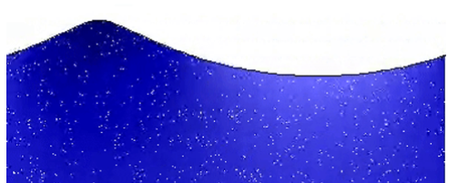
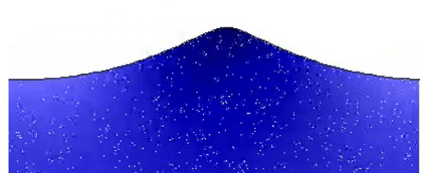
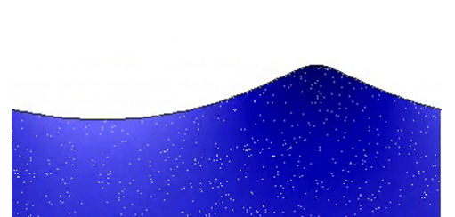
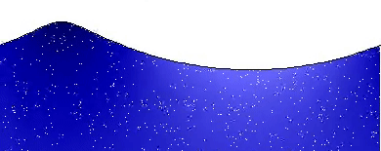
Interaction of Electrons and Radiation
Electrons in sinusoidal path
Radiation E&M wave
Mediated by undulator
Can we use electrons to “push” radiation?
Surfing Condition
$v_{light}={c≠v}_{beam}$
$$v_{surfer}=0$$
$$v_{surfer}=v_{wave}$$
Image Sources: https://en.m.wikipedia.org/wiki/File:Deep_water_wave.gif, png image from pngtree.com

Slide 5
Generating Coherent Radiation
Resonance condition
Light ‘slips’ ahead by one wavelength
Energy Exchange
Surfing condition
(Nguyen & Marksteiner, 2014)
$\left(1\right) \dot{W}=−e\left(v∙E\right)$ ${\left(2\right) v}_{x}\sim \cos\left(k_{u}z\right) \left(3\right) E_{x}\sim \cos\left(kz−wt\right)$
$\dot{W}\sim$ $−cos\left(k_{u}z\right)\cos\left(kz−wt\right)\sim −\frac{1}{2}\left[\cos\left(k_{u}z+kz−wt\right)+\cos\left(k_{u}z−kz+wt\right)\right]$
Wave traveling to the left
$$v_{beat}=\frac{ω_{radiation}}{k+k_{u}}=v_{beam}$$

Slide 6
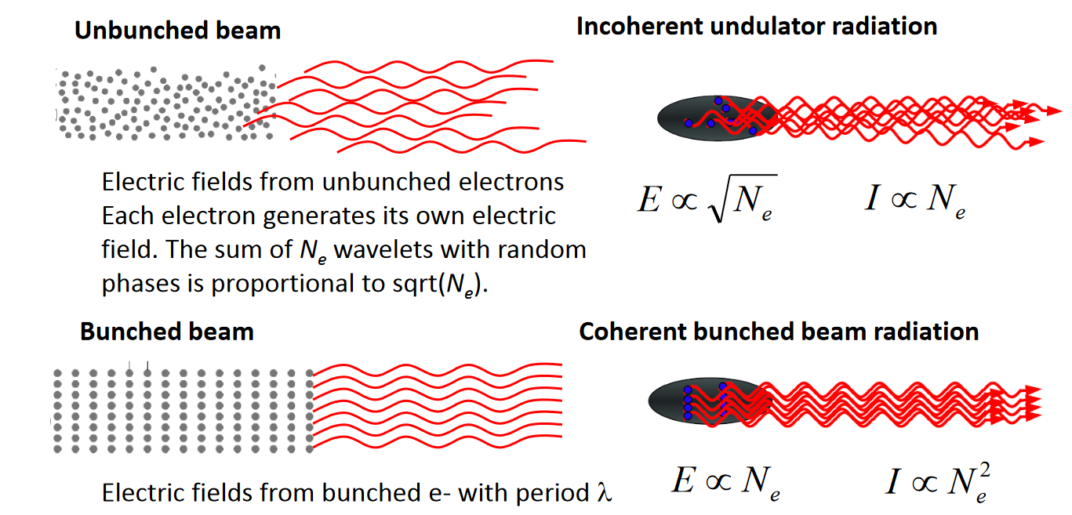
Generating Coherent Radiation
Bonus: bunching!
$\left[0,\frac{π}{2}\right]$ electrons lose energy
$\left[−\frac{π}{2},0\right]$ electrons gain energy
(Nguyen & Marksteiner, 2014)

Slide 7
Challenges of Fourth Generation Sources
Lasing Conditions
Electron energy spread must be nearly exact
Beam radius and spread must be similar to radiation beam
Currently ~20 um beam compared to nm light
Gain must be larger than losses from diffraction of radiation
High charge density, low emittance
Losses due to electron collisions (Touschek effect)
Bunch instabilities
Higher electron energy for hard X-rays
Increases size and cost
Notes:
Better brightness, bigger challenges

Slide 8
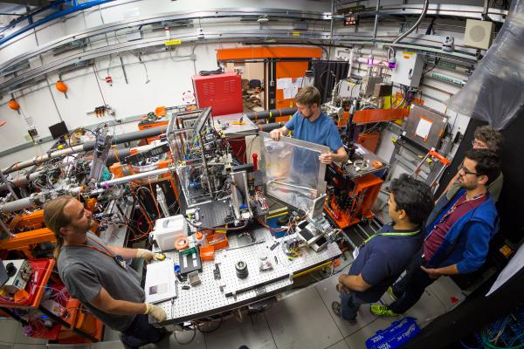
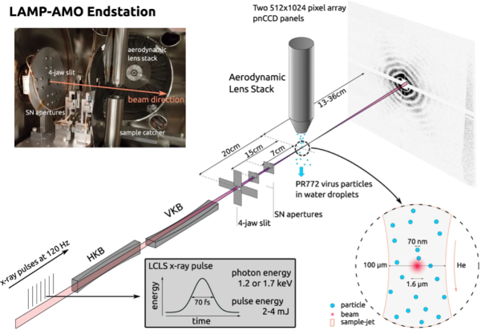
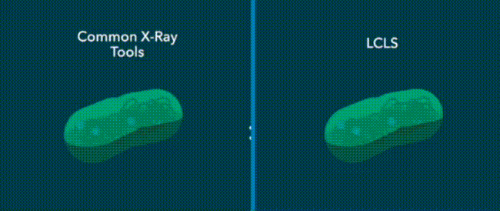
Advantages and Applications
Power (2 kW in near infrared)
Material processing ex. Surface enhancements of polymers
Brightness 13 orders higher than conventional x-ray tubes
Tunability (Continuous spectrum- microwave to ultraviolet)
Far infrared
Principle excitations in condensed matter, Biomolecule frequency modes
X-ray
Resolution scale of molecular bonds, single molecule imaging
Pulse Speed Ultra-Fast Physics
Time scale of molecular vibrations
dynamics of proteins
“Linac Coherent Light Source: SLAC National Accelerator Laboratory.”
Notes:
Emphasize reasons for FEL vs conventional techniques

Slide 9
References
Lidia, Steve. “Light Sources and Free Electron Lasers.” Nov. 2023, Michigan State University.
“Linac Coherent Light Source: SLAC National Accelerator Laboratory.” LCLS, lcls.slac.stanford.edu/. Accessed 3 Dec. 2023.
Nguyen, D. C., & Marksteiner, Q. R. (2014). Physics of Free-Electron Lasers Introduction. https://uspas.fnal.gov/materials/14UNM/1_Introduction.pdf
“NIF’s Guide to How Lasers Work.” National Ignition Facility & Photon Science, Lawrence Livermore National Laboratory, lasers.llnl.gov/education/how-lasers-work. Accessed 28 Nov. 2023.
O’Shea, P. G., & Freund, H. P. (2001). Free-Electron Lasers: Status and Applications. https://doi.org/10.1126/science.1055718
Winick, H. (1998). Fourth Generation Light Sources. https://doi.org/10.1109/PAC.1997.749539

