Slide 1
Heavy Ion Storage Rings
Ethan Fletcher Graduate Assistant fletcher@frib.msu.edu
13 December 2023

Slide 2
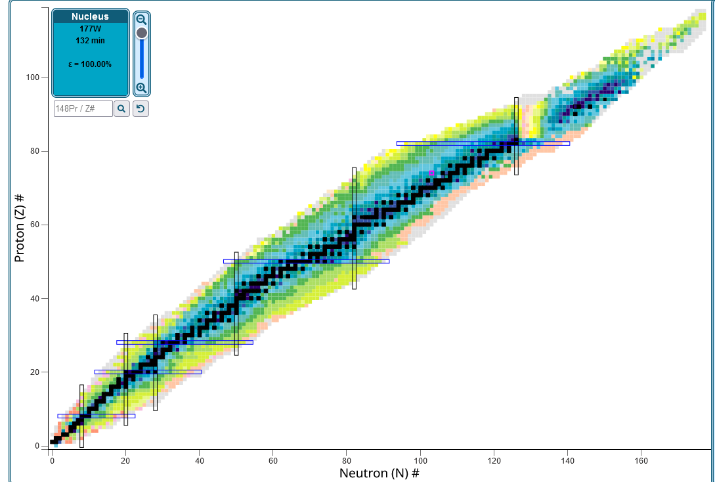
The Problem
Want to study rare isotopes and exotic ions
1. Expand our understanding of nuclear structure and processes
2. Relevance to astrophysics- extreme processes that create elements
Difficulties
Lifetimes of these isotopes/ions can be very short
Require large energies to create
Energies and environment required for creation of ions/isotopes can be recreated in an accelerator
Producing rare nuclides and ion states requires dedicated facilities separate from the primary beam line

Slide 3
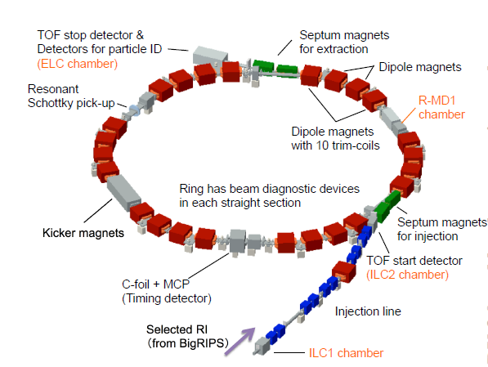
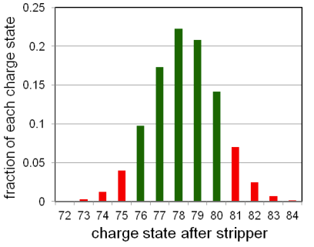
The Solution- Heavy Ion Storage Rings
Store and accumulate ions at very high currents
Stable ions and exotic, unstable nuclides
Allows for precision measurements of unstable nuclei
Rare isotopes/ions produced via interaction with some sort of target
For charged ions, sent through a charge stripper
For other nuclei of interest, interaction with target removes nucleons
High probability of neutron deficient nuclei
In-flight fission reaction using 238 U produces more neutron rich nuclei
RARE-RI ring at RIKEN
Notes:
Neutron rich isotopes created using fission because uranium has a high neutron to proton ration, and subsequently produced nuclei will have similar neutron-proton ratios
Accelerated primary beam is used efficiently in a storage ring because effective intensity is increased due to the revolution frequency

Slide 4
Beam-Target interactions
All reactions, atomic and nuclear, will be accompanied by contaminants
For highly charged ions, these are ions of the same element, but in a different charge state
For rare nuclides, there is a distribution of different nuclei produced which require in-flight separation
How do we isolate beams of interest?
For highly charged ions, use a dipole magnet
After stripping, ions travel with similar velocities and energy -> angular straggling is small
Rare nuclides require dedicated separator facilities
The Bρ-ΔE-Bρ method: Use energy degraders, analyze rigidity before/after degrader
May lead to phase space enlargement of the beams
CRYRING at ESR
Notes:
Bethe-Bloch formula for reduction of KE in a path length of matter- Energy degradation
Dipole magnet separates orbits possibly?- Read paper on this method

Slide 5
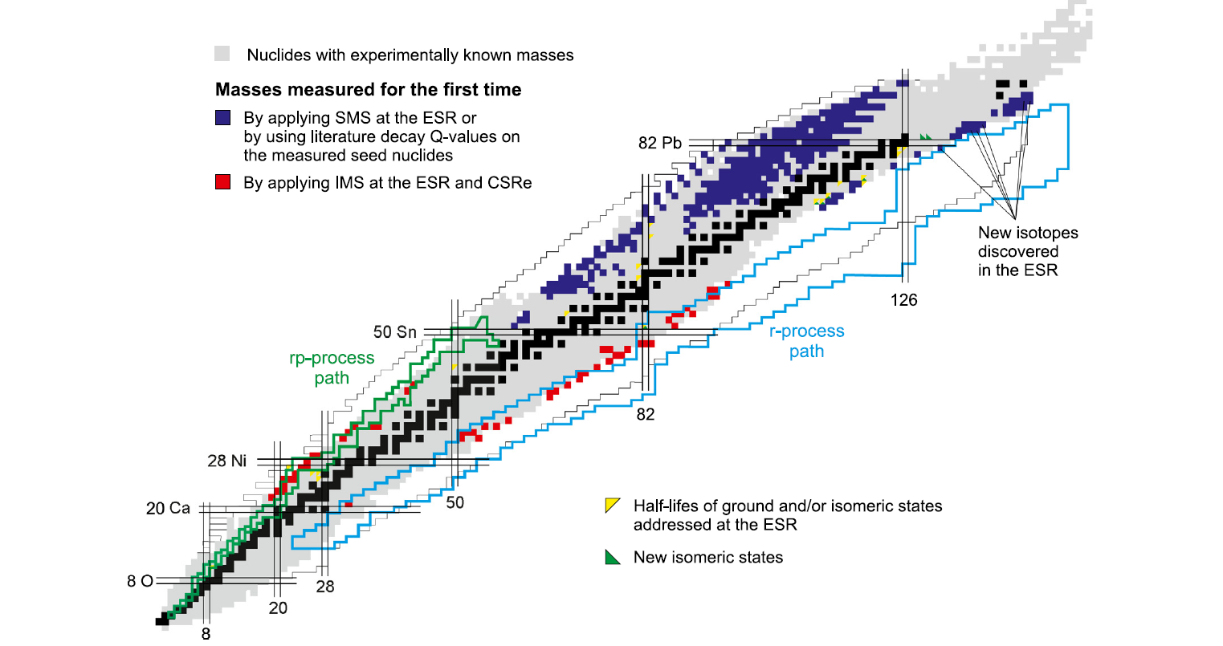
Experiments at heavy ion storage rings- Storage Ring Mass Spectometry
Interplay of strong, weak, and EM interactions complicate measurements
Connection to mass demonstrated through binding energy
Need precision mass measurements of exotic nuclei
Measured by relative mass accuracy,
Charge-Mass ratios are directly related to revolution frequency
Second term uses velocity spread which determines mass resolving power
Must minimize
Schottky Mass Spectometry
Isochronous Mass Spectrometry
Notes:
Alpha is the momentum compaction factor of the ring. Nu is the momentum slip factor.
Momentum compaction factor is the momentum dependence of the path length for an object in a closed orbit
The slip factor tells us how much more time, relative to the ideal circulation time, it takes a particle with a momentum deviation to complete an orbit

Slide 6
Schottky Mass Spectometry
Utilizes beam cooling using electrons and/or stochastic cooling
High emittance of secondary beam causes large velocity spread
Allows simultaneous injection and storage of multiple ion species with varying M/Q but similar v
This allows for matching of magnetic rigidity to that of the selected injection Bρ of the ring
Analyze the revolution frequencies with well-known and unknown masses
Advantage: High sensitivity to single stored ions with on the order of 10⁻⁷
Disadvantage: Relatively long time period for cooling ~1 s
Longer than some nuclei lifetime
Notes:
Electron cooling: Interaction between ion beam and cooler e-beam to reduce emittance -> reduced transverse beam size and divergence, and reduce momentum spread
Stochastic cooling: utilizes the electrical signals produced by individual particles in a bunch to drive a device (kicker) that will kick the bunch to reduce the erroneous momentum of a particle. Keeps particles from moving away from each other
Use of stochastic cooling followed by electron cooling for short-lived nuclei
dM/M is relative mass accuracy

Slide 7
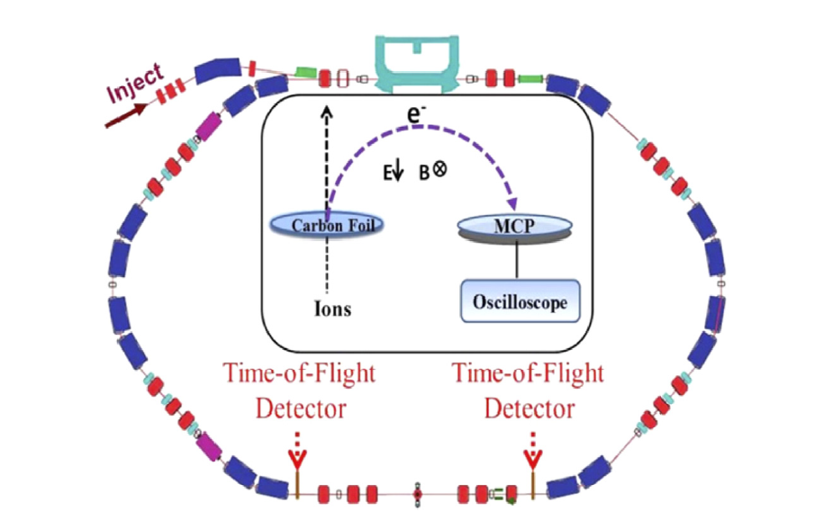
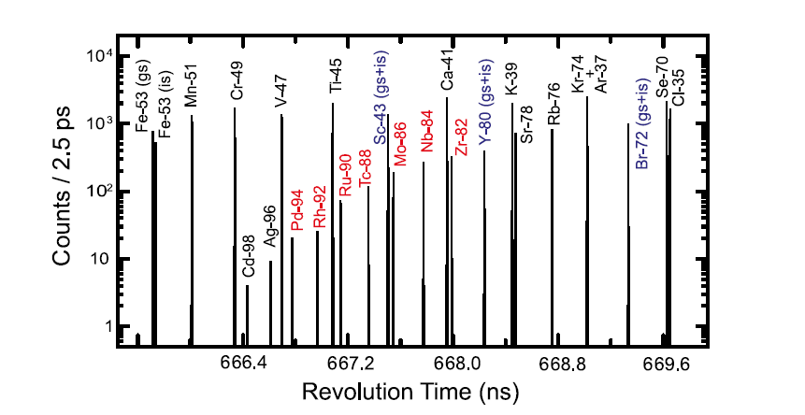
Isochronous Mass Spectrometry
Used at the RARE-RI Ring at RIKEN
Ions of interest injected with energies corresponding to transition energy
The idea:
The faster ion of a particular ion species travels on a longer orbit than a slower ion of similar species
Thus, the velocity spread of the ions is compensated by the lengths of their respective orbits
Therefore, the $\frac{∆β}{β}$ term is eliminated to first order
Revolution frequencies are similar and only depend on M/Q
Measured by TOF detectors
Notes:
When ions pass through the thin foils, they lose energy
This changes their orbit
Amplitudes of signals depend on the Q of the ions and can be used to separate events from nuclides with very close M/Q values
Time stamps are then assigned to individual ions

Slide 8
Additional capabilities
Used to test fundamental interactions and probe symmetries
Investigate nuclear reactions at various beam energies from low to high
Analyze several-body decays of highly charged ions
Probe hyperfine structure
Nuclear lifetime spectroscopy
Measurement of decay rates
Precision testing of bound-state quantum electrodynamics
Study of hydrogen like ions in very strong EM fields
In short, heavy ion storage rings have, currently are, and will continue to prove extremely useful in unlocking the secrets of atomic nuclear physics

Slide 9
References
M. Steck, Y.A. Litvinov, Heavy-ion storage rings and their use in precision experiments with highly charged ions, Prog Part Nucl Phys, 115 (2020), Article 103811
Y. Yamaguchi, Y. Abe, The rare-ri ring at riken RI beam factory, Proceedings of HIAT 2015, Yokohama, Japan, https://accelconf.web.cern.ch/HIAT2015/papers/tum1c03.pdf
P. Butler, K. Blaum, T. Davinson, K. Flanagan, S. Freeman, M. Grieser, I. Lazarus, Y. Litvinov, G. Lotay, R. Page, R. Raabe, E. Siesling, F. Wenander, P. Woods, TSR: A storage and cooling ring for HIE-ISOLDE, Nucl. Instrum. Methods Phys. Res. B 376 (2016) 270–274, http://dx.doi.org/10.1016/j.nimb.2015.12.006
https://www.nndc.bnl.gov/nudat3/

