Slide 1
Beam Cooling Methods
Carlos Sarabia Cardenas
13 December 2023
v

Slide 2
What is Beam Cooling & Why Do We Need It?
Beam cooling is the process of reducing the size and energy spread of a particle beam.
Noisy processes increase size end energy spread of beams as they operate. Caused by:
Noise in RF & Magnets
Lattice imperfections
Intra-beam Scattering
Need for beam cooling
Preservation of beam quality
Want to keep your beam
Improvement of interaction rate and resolution (luminosity)
Accumulation of rare particles
Historical Example: Antiproton Accumulator at CERN
Future Example: Muon Collider
Notes:
While hadrons colliders are running and experiments are beign conducted and data is collected, there is particles loss because of burn-off from collisions and other losses. This leads to increased beam size (larger phase-space volume or emittance) which is exacerbated by noise like processes and other imperfections.
Pres of BQ –
Impr L – factor of x3 for Tevatron
- factor of x10 for EIC (Necessay)
Rare part – AA (~80s) details are:
- muon collider, after production muons are in a large spread and hot, so shrink beam and cool it as you do so, however due to short lifetime (2.2 μs), none of the methods I’ll present on will be used

Slide 3
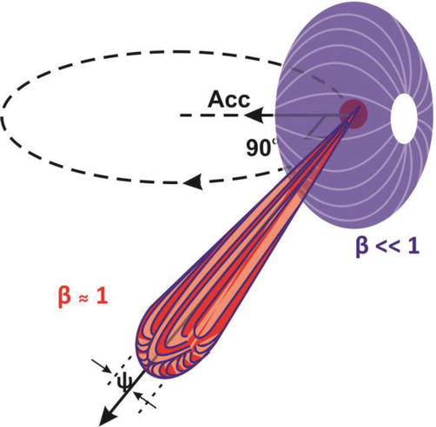
Synchrotron Cooling
Cooling that comes about as a consequence of synchrotron radiation.
Mostly in electron rings
Has been observed in LHC because the energy for protons is finally high enough
The effect was small, having a longitudinal damping time of 13 hours for 7 TeV protons
Only appreciably appear at the many TeV level
Would play a role in future hadron colliders on the energy frontier.

Slide 4
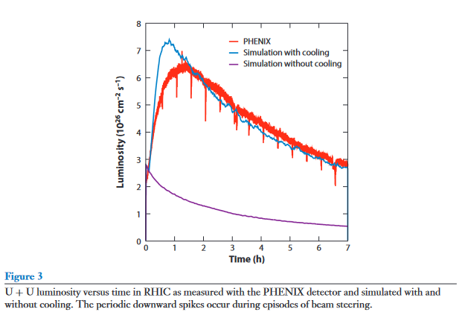
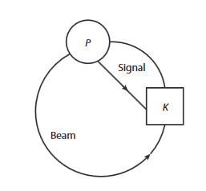
Stochastic Cooling
Measure the beam at one location (Pickup) and apply a kick in another location (kicker) to damp the betatron oscillation oscillation
This process is slow. Taking place over many hours with incremental improvements
Maximum damping rate given by:
$$\frac{1}{τ}≈\frac{2Wσ_{s}}{NC}$$
Notes:
Need to arrive at same time. Signal path is shorter.
The beam signal is sampled by the pickup. The beam and signal propagate from the pickup to the kicker, and a kick derived from the pickup signal is given to the beam.
Transverse pickups and kickers are used to reduce the transverse emittance. A transverse pickup
measures the product of the beam current and beam offset, the dipole moment. The dipole signal
is processed and sent to a kicker. The pickup and kicker locations are chosen so that offsets at the
pickup propagate, via the magnetic lattice, to angles at the kicker. The kicker corrects the angle,
reducing the emittance. After that, the argument is similar to the one for energy cooling. The
resulting cooling rate is half of Equation 3 because the pickup measures only the position and the
kick changes only the angle. In any case, these formulas are rules of thumb. For coasting beams, it
is possible to obtain damped diffusion equations that are amenable to obtaining accurate solutions
on a computer
Great use in AA for SPS and useful for Tevatron

Slide 5
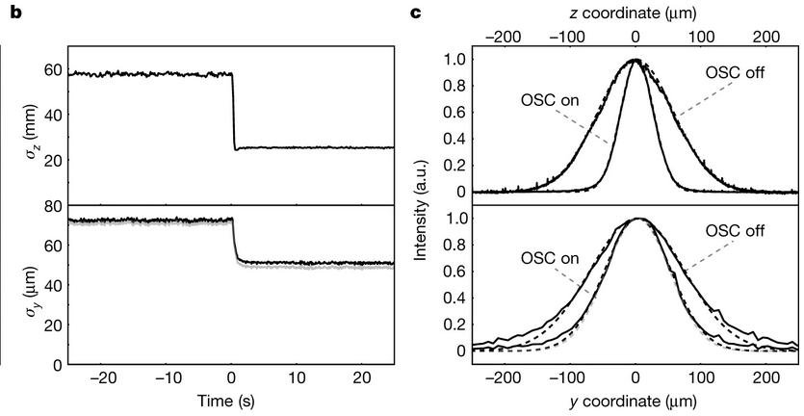
Optical Stochastic Cooling
Based off of stochastic cooling, but takes advantage of higher bandwidth of lasers so that it can be applied to much higher bunch densities
Could increase cooling by 3-4 orders of magnitude
Successes in the method are recent and not seen much wide scale use
$$\frac{1}{τ}≈\frac{2Wσ_{s}}{NC}$$
b, The r.m.s. beam sizes from Gaussian fits of the raw projections. c, Distributions averaged over time (solid lines) and their Gaussian fits (dotted lines) for the OSC-off and OSC-on states for the intervals of [−20, −10] s and [10, 20] s
Notes:
Fermi National Accelerator Laboratory’s Integrable Optics Test Accelerator^{9,10}. The experiment used 100-MeV electrons and a non-amplified configuration of OSC with a radiation wavelength of 950 nm, and achieved strong, simultaneous cooling of the beam in all degrees of freedom. This realization of SC at optical frequencies serves as a foundation for more advanced experiments with high-gain optical amplification, and advances opportunities for future operational OSC systems with potential benefit to a broad user community in the accelerator-based sciences.
Cant use Sto Cool for the beams, so need this technique not widely used, this is a consideration for high energy hadron beams, due to larger bandwidth.
Note that efficiency of transverse
kicks is much smaller and therefore the OSC is based on the longitudinal kicks only. Cooling in
other planes is based on the plane-to-plane coupling of particle motion. A magnetic chicane is
used to make space for an OA and to bring the particle and its amplified radiation together in the
kicker undulator.
New cooling method of choice for Tevatron (before it got axed)

Slide 6
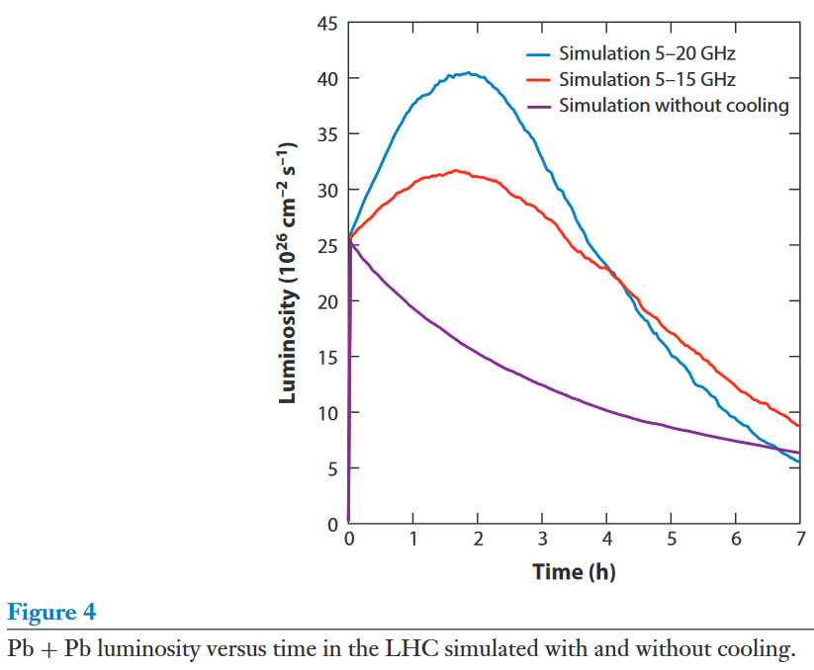
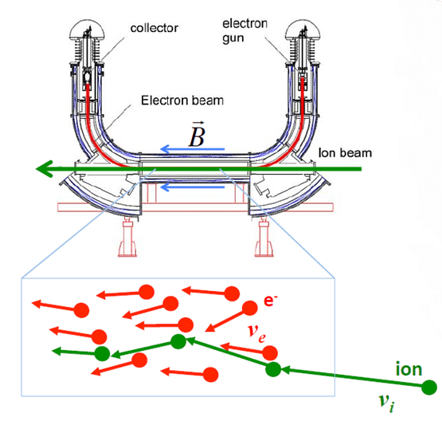
Electron Cooling
Introduce a cold electron beam into a hot ion beam to cool the ion beam (and heat the electron beam)
Heat exchange (velocity exchange through a collision)
Specifically for low energy hadron beams
Highest energy has been 8-10 GeV at Brookhaven
Friction force (or drag) on the ions

Slide 7
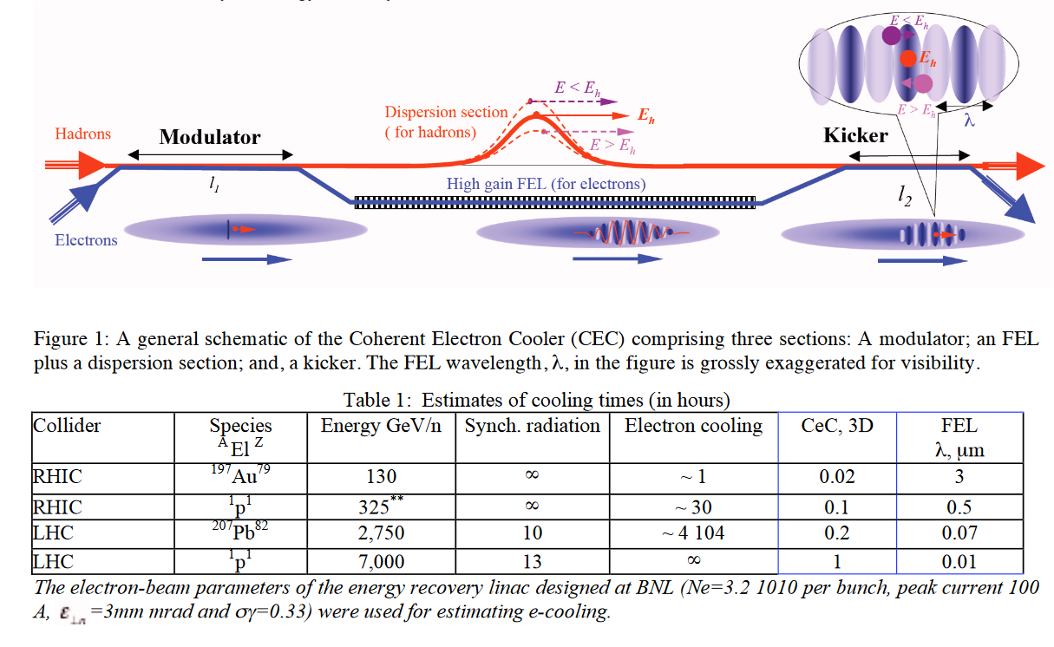
Coherent Electron Cooling
Modification to electron cooling to work at high energies
Based off of the electrostatic interaction between electrons and hadrons (like electron cooling)
But this effect is amplified by a high gain Free Electron Laser, making the scheme also similar to stochastic cooling
FEL has a huge bandwidth

Slide 8
References
M. Blaskiewicz, Annual Review of Nuclear and Particle Science 64, 299 (2014).
Jarvis, J., Lebedev, V., Romanov, A. et al. Experimental demonstration of optical stochastic cooling. Nature 608, 287–292 (2022). https://doi.org/10.1038/s41586-022-04969-7
Bharti, A., & Goyal, N. (2019). Fundamental of Synchrotron Radiations. IntechOpen. doi: 10.5772/intechopen.82202
Hunt, James. (2019). Beam Quality Characterisation and the Optimisation of Next Generation Antimatter Facilities.
V. Lebedev, Optical Stochastic Cooling in Tevatron. ICFA, https://doi.org/10.48550/arXiv.1207.7042
1 V.N. Litvinenko and Y.S. Derbenev, Physical Review Letters 102, (2009).
V V Parkhomchuk and Aleksandr N Skrinskiĭ 2000 Phys.-Usp. 43 433
The CERN Accelerator School: Antiprotons for Colliding Beam Facilities (1983), D Mohl, Stochastic Cooling for Beginners,

Slide 9
What Cooling Methods are Used Where?
EIC – Coherent Electron Cooling (Maybe???)
Tevatron – Stochastic Cooling / e cool
Was going to use Optical Stochastic cooling
FL – working on Optical Stochastic Cooling
2022 finally cooled, low gain need to imporve
Jlab – Electron Cooling / Stochastic Cooling

