Slide 1
Cryogenic Sub-systems
Austin Grake

Slide 2
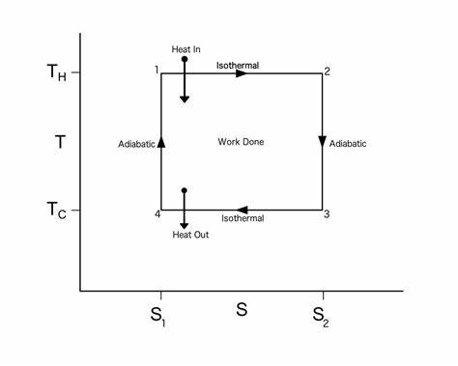
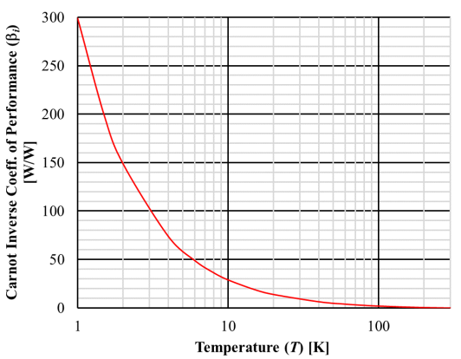
Isothermal Refrigeration – Carnot (Thermodynamic) Cycle
$$β=\frac{Q_{c}}{Wnet}$$
$$βi={COP}_{inv}= \frac{T0}{T}−1$$
Notes:
B = coefficent of performace​ - exponential increase in W for same amount of cooling
Bi = coefficient of performance inverse
Qc = we want to take out the amx heat Qc
, ratio of net input power to cooling provided to the load
A universal standard of quality is needed. The most natural and convenient standard is the maximum work which can be obtained from a given form of energy using the environmental parameters as the reference state.
Higher COPs equate to higher efficiency, lower energy (power) consumption and thus lower operating costs. The COP is used in thermodynamics.

Slide 3
Liquefaction and Refrigeration Equivalence
Determine on an equal exergy (in Watts) basis how many Watts of isothermal refrigeration is equal to 1 g/s of liquefaction for (a) and (b) at 1 bar (saturation conditions); i.e., what is the equivalent refrigeration load to 1 g/s of liquefaction; with the ‘equivalence’ meaning both require the same amount of reversible input power. Assume normal hydrogen at 1 bar 300 K as the feed gas. Then consider two cases for the liquefied gas: (a) Helium, (b) “normal” Hydrogen.

Slide 4
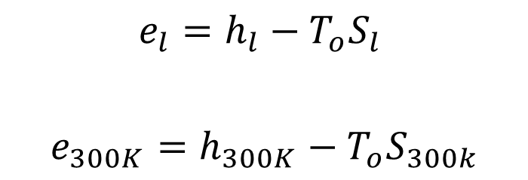
Liquefaction
e_{300K}
1 bar
300K
1 g/s
$$e_{l}=h_{l}−T_{o}S_{l}$$
$$e_{300K}=h_{300K}−T_{o}S_{300k}$$
$$\dot{E}liq=\dot{m}liq∆e=\dot{m}liq(e300k−el)$$
1 bar
Tsat
1 g/s
e_{l}
Notes:
Enters vapor at 300k into cold box leaves sat liquid at 20.3K

Slide 5
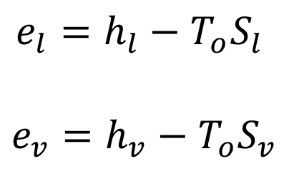
Isothermal Refrigeration
$$e_{l}=h_{l}−T_{o}S_{l}$$
$$e_{v}=h_{v}−T_{o}S_{v}$$
e_{l}
e_{V}
1 bar
Tsat
$$\dot{m}ref$$
$$h_{l}$$
$$h_{v}$$
$\dot{E}=\dot{m}ref∆e={\dot{m}ref(e}_{l}−e_{v}$)
$$q= \dot{m}ref(h_{v}−h_{l})$$
q

Slide 6
Equivalence
Liquefaction
$$\dot{E}liq=\dot{E}ref$$
Refrigeration
$$\dot{E}liq=\dot{m}liq∆e=\dot{m}liq(e300K−el)$$
$$\dot{E}ref=\dot{m}ref∆e=\dot{m}ref(el−ev)$$
$$\dot{m}ref=\dot{m}liq\frac{(e300K−el) }{(el−ev) }$$
$$q= \dot{m}ref(h_{v}−h_{l})$$
(A) 79 W (B) 879 W
Notes:
Enters vapor at 300k leaves sat liquid at 20.3K

Slide 7
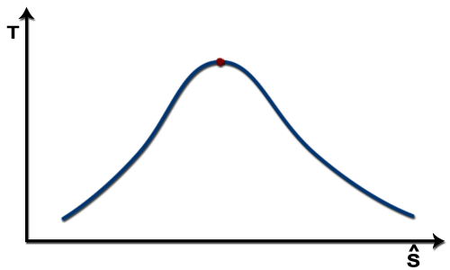
Ratio of Latent to Total Cooling
For the previous problem, determine (1) the ratio of the latent portion of the cooling to the total cooling (latent and sensible), and (2) the ratio of the reversible input power required for the latent cooling to the total reversible input power. As in the previous problem, consider two cases for the saturation condition: (a) Helium (b) “normal” Hydrogen
Notes:
So for latent only making up 11% of heat, it requires 51% of the exergy to cool this portion to liquid

Slide 8
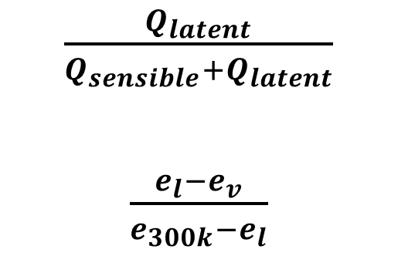
Ratio of Latent to Total Cooling
$\frac{Q_{latent}}{Q_{sensible}+Q_{latent}}$
$\frac{e_{l}−e_{v}}{e_{300k}−e_{l}}$
1
Vapor
300K
1 bar
Q_{sensible}
Q_{latent}
3
2
Liquid
20.2K
1 bar
Vapor
20.2K
1 bar
(a) Q_{ratio} = 1%
E_{ratio} = 21%
(b) Q_{ratio} = 10%
(b) E_{ratio} = 49%
Notes:
Liquid has more exergy as it can store more heat , greater exergy for latent to maintain isentropic conditions
H has higher latent heat due to hydrogen bonds

Slide 9
References
•Hasan, M. Nusair. “Lecture on Cryogenic Systems” Nov. 2023, Michigan State University.
H. Bell, J. Wronski, S. Quoilin, and V. Lemort, "Pure and Pseudo-pure Fluid Thermophysical Property Evaluation and the Open-Source Thermophysical Property Library CoolProp," Industrial & Engineering Chemistry Research, vol. 53, no. 6, pp. 2498–2508, 2014. DOI: 10.1021/ie4033999.
Notes:
Isothermal expansion. Heat (as an energy) is transferred reversibly from hot temperature reservoir at constant temperature T_{H} to the gas at temperature infinitesimally less than T_{H} (to allow heat transfer to the gas without practically changing the gas temperature so isothermal heat addition or absorption). During this step (1 to 2 on Figure 1, A to B in Figure 2), the gas is thermally in contact with the hot temperature reservoir (while thermally isolated from the cold temperature reservoir) and the gas is allowed to expand, doing work on the surroundings by gas pushing up the piston (stage 1 figure, right). Although the pressure drops from points 1 to 2 (figure 1) the temperature of the gas does not change during the process because the heat transferred from the hot temperature reservoir to the gas is exactly used to do work on the surroundings by the gas, so no gas internal energy changes (no gas temperature change for an ideal gas). Heat Q_{H} > 0 is absorbed from the hot temperature reservoir, resulting in an increase in the entropy � of the gas by the amount Δ��=��/��.
Isentropic (reversible adiabatic) expansion of the gas (isentropic work output). For this step (2 to 3 on Figure 1, B to C in Figure 2) the gas in the engine is thermally insulated from both the hot and cold reservoirs, thus they neither gain nor lose heat, an 'adiabatic' process. The gas continues to expand with reduction of its pressure, doing work on the surroundings (raising the piston; stage 2 figure, right), and losing an amount of internal energy equal to the work done. The gas expansion without heat input causes the gas to cool to the "cold" temperature (by losing its internal energy), that is infinitesimally higher than the cold reservoir temperature T_{C}. The entropy remains unchanged as no heat Q transfers (Q = 0) between the system (the gas) and its surroundings, so an isentropic process, meaning no entropy change in the process).
Isothermal compression. Heat transferred reversibly to low temperature reservoir at constant temperature T_{C} (isothermal heat rejection). In this step (3 to 4 on Figure 1, C to D on Figure 2), the gas in the engine is in thermal contact with the cold reservoir at temperature T_{C} (while thermally isolated from the hot temperature reservoir) and the gas temperature is infinitesimally higher than this temperature (to allow heat transfer from the gas to the cold reservoir without practically changing the gas temperature). The surroundings do work on the gas, pushing the piston down (stage 3 figure, right). An amount of energy earned by the gas from this work exactly transfers as a heat energy Q_{C} < 0 (negative as leaving from the system, according to the universal convention in thermodynamics) to the cold reservoir so the entropy of the system decreases by the amount Δ��=��/��.^{[1]} Δ��<0 because the isothermal compression decreases the multiplicity of the gas.
Isentropic compression. (4 to 1 on Figure 1, D to A on Figure 2) Once again the gas in the engine is thermally insulated from the hot and cold reservoirs, and the engine is assumed to be frictionless and the process is slow enough, hence reversible. During this step, the surroundings do work on the gas, pushing the piston down further (stage 4 figure, right), increasing its internal energy, compressing it, and causing its temperature to rise back to the temperature infinitesimally less than T_{H} due solely to the work added to the system, but the entropy remains unchanged. At this point the gas is in the same state as at the start of step 1.

