Slide 1
Eddy Currents in Accelerator Magnets
Paul Schulman, PHY 862

Slide 2
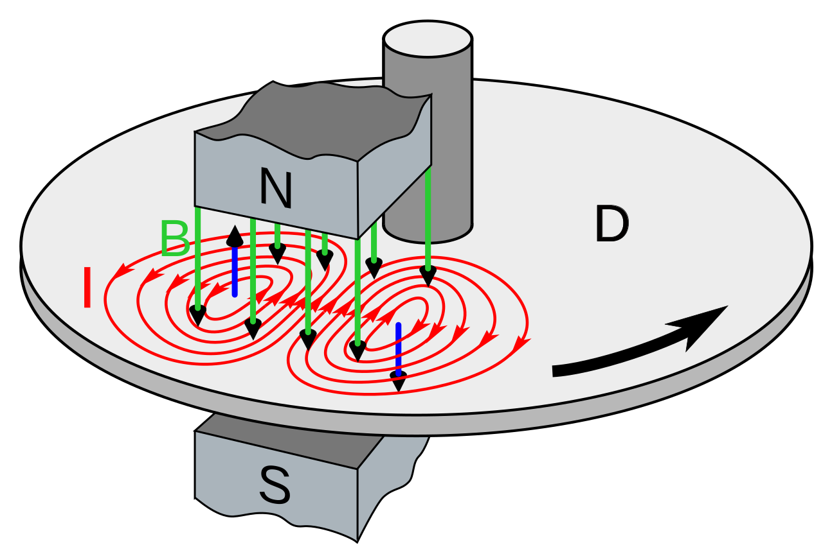
Outline
What are eddy currents?
Consequences of eddy currents
Field modification
Power loss
Governing equations
Maxwell’s equations
Diffusion approach
Small perturbation approach
Applications
Yokes
Coils
Mechanical structures
Beam pipes
Minimizing eddy current effects
Wikipedia contributors. "Eddy current." Wikipedia, The Free Encyclopedia. Wikipedia, The Free Encyclopedia, 3 Dec. 2023. Web. 7 Dec. 2023.
Notes:
https://www.rosen-group.com/global/company/explore/we-can/technologies/measurement/eddy-current.html

Slide 3
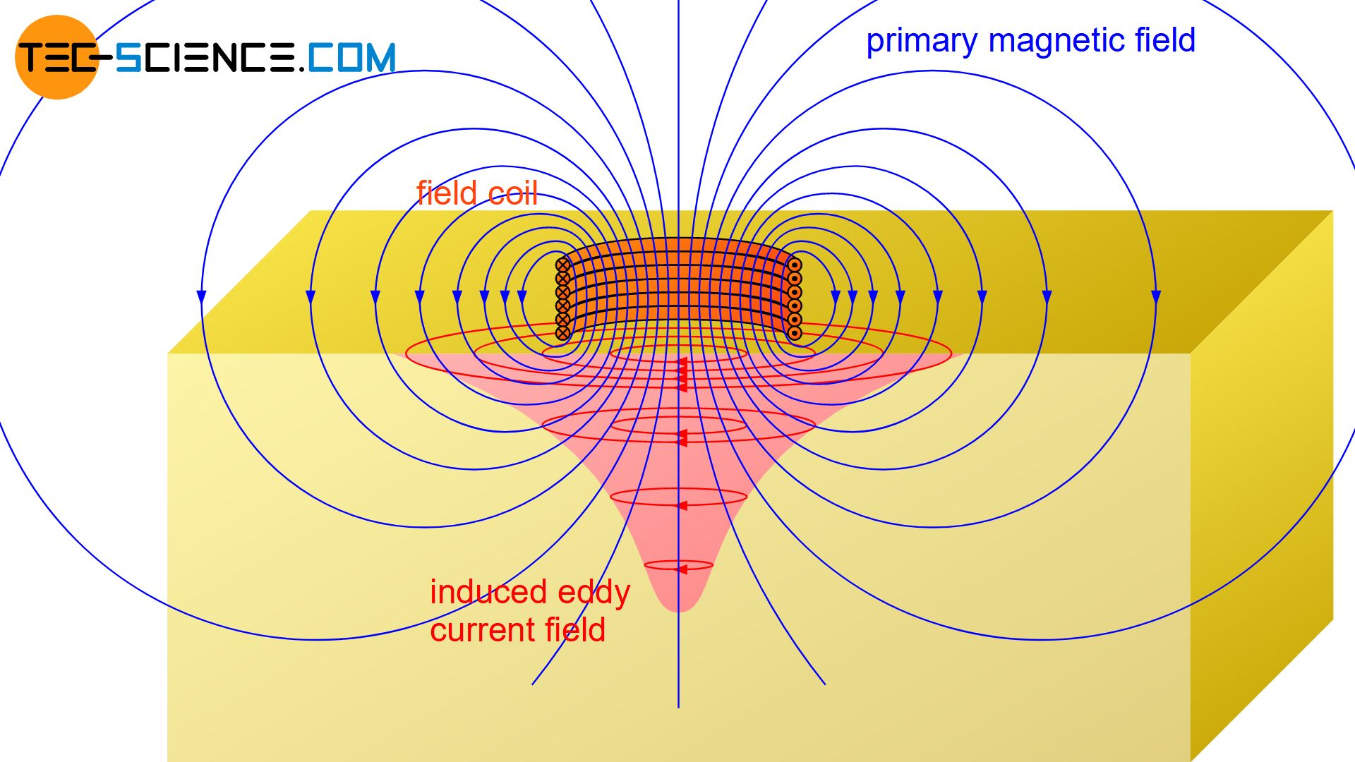
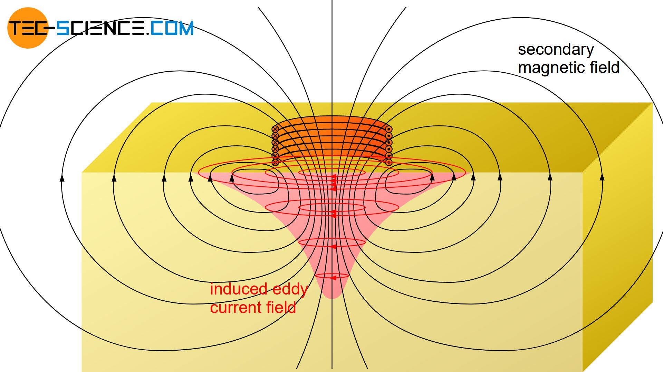
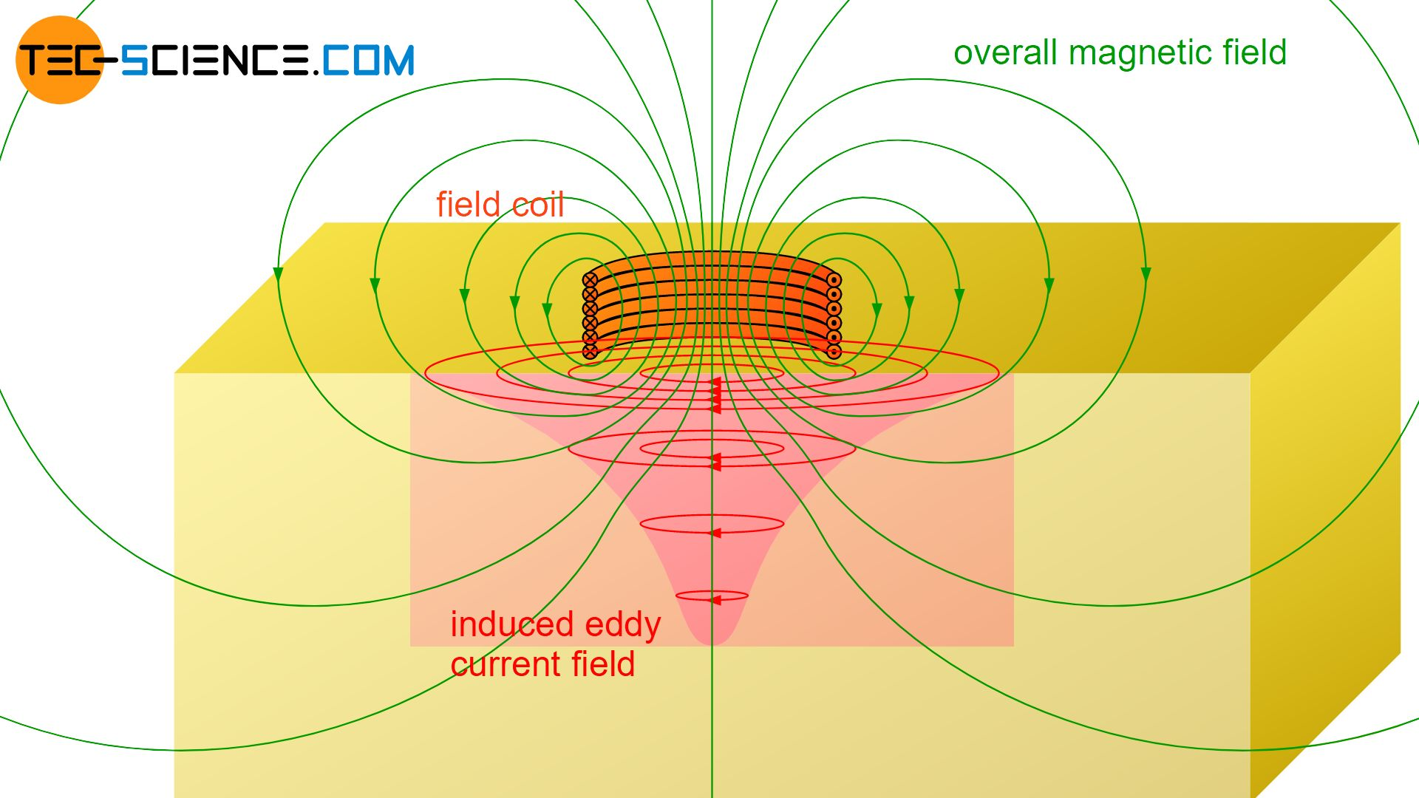
Eddy Currents
Changing magnetic field induces closed-loop currents in conductors
Induces opposing magnetic field
Lenz’s law
“The current induced in a circuit due to a change in a magnetic field is directed to oppose the change in flux and to exert a mechanical force which opposes the motion.”
Modifies the net magnetic field
Generates resistive power losses
tec-science, Eddy Current Testing, 2018, https://www.tec-science.com/material-science/material-testing/eddy-current-testing-ect/
Notes:
https://www.rosen-group.com/global/company/explore/we-can/technologies/measurement/eddy-current.html

Slide 4
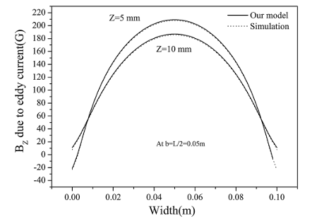
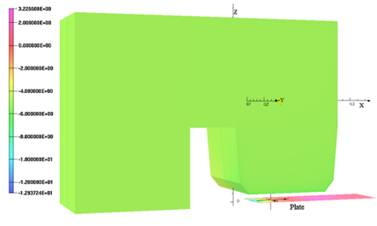
Field Modification
Lenz’s law
Opposing magnetic field
Lag
Must wait for eddy current to disappear
Time and space varying
Complex to model
Sinha, Gautam, and S. S. Prabhu. "Analytical model for estimation of eddy current and power loss in conducting plate and its application." Physical Review Special Topics-Accelerators and Beams 14.6 (2011): 062401.

Slide 5
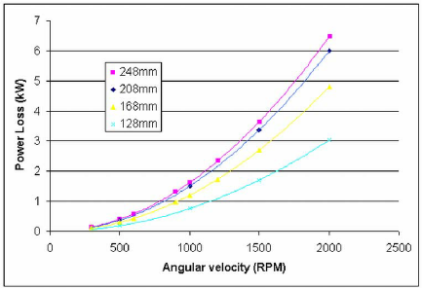
Resistive Power Loss
$P=I^{2}R$
Heating of magnets
Bad for superconducting magnets
Can be damaging to materials
Lorentz’s forces
Material stresses
Jenner, LJ & Bailey, Ian & Clarke, D & Clarke, Jim & Davies, K & Gallagher, A & Gronberg, J & Hagler, Li & Hesselbach, S. & Nelson, C & Piggott, WT & Rochford, James. (2008). A Study of Mechanical and Magnetic Issues for a Prototype Positron Source Target.

Slide 6
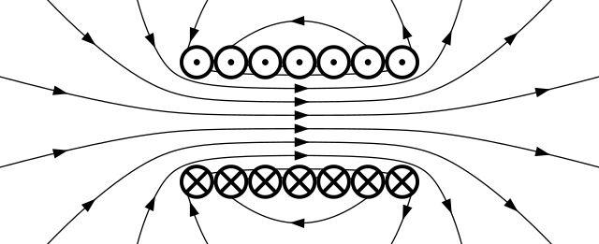
Governing Equations – Maxwell’s Equations
Quasi-stationary
Neglecting displacement
No excess charge
Ampere’s law
$∇×H=j$
Faraday’s law
$∇×E=−\frac{∂B}{∂t}$
$∇∙E=0$
$∇∙B=0$
Materials
$B=μH$
Wikipedia contributors. "Eddy current." Wikipedia, The Free Encyclopedia. Wikipedia, The Free Encyclopedia, 3 Dec. 2023. Web. 7 Dec. 2023.

Slide 7
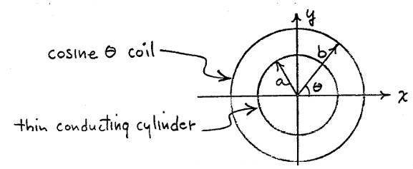
Governing Equations - Diffusion
Lenz’s Law
Magnetic diffusion
$∇^{2}\overset{⃑}{H}=σμ\frac{∂\overset{⃑}{H}}{∂t}$
Magnetic diffusivity
$κ=\frac{1}{σμ}$
Current density with vector potential A
$\overset{⃑}{J}=σ\overset{⃑}{E}=−σ\frac{∂\overset{⃑}{A}}{∂t}$
Numerical software
Opera, ROXIE, ANSYS, LS-DYNA
Moritz, G., “Eddy currents in accelerator magnets”, 2010, CERN Accelerator School, https://cds.cern.ch/record/1158462/files/cern-2010-004.pdf?version=1
Shafer, R. "Eddy currents, dispersion relations, and transient effects in superconducting magnets." IEEE Transactions on Magnetics 17.1 (1981): 722-725.

Slide 8
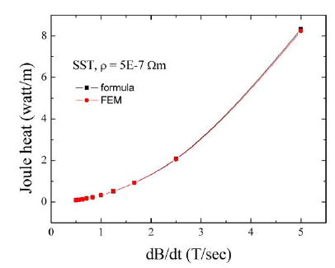
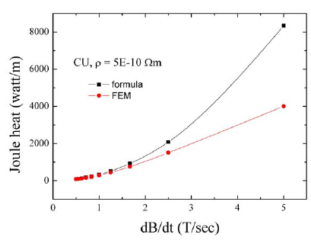
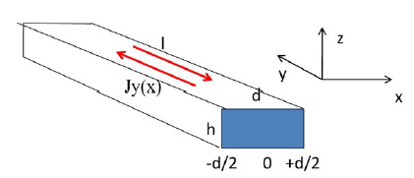
Governing Equations – Small Perturbations
Ignore the eddy-generated magnetic field
Valid for magnetically thin cases
$d≪δ, δ=\sqrt{\frac{2}{ωμσ}}$
Geometrically thin
$d≪h$
Long, neglect ends
$h≪l$
Steady-state conditions

Slide 9
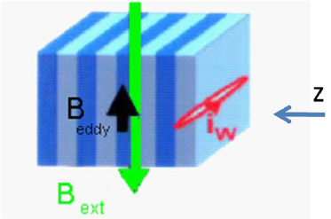
Eddy Currents in Yokes (2-D Analysis)
Assume a long magnet with a constant packing factor,
$\frac{eddy loss}{volume}=\frac{π^{2}v^{2}}{6ρ}B_{p}^{2}d^{2}$
$v=frequency (Hz)$
$d=lamination thickness (m)$
$ρ=resistivity (Ωm)$
$B_{p}=induction amplitude (T)$
Moritz, G., “Eddy currents in accelerator magnets”, 2010, CERN Accelerator School, https://cds.cern.ch/record/1158462/files/cern-2010-004.pdf?version=1
Notes:
https://ietresearch.onlinelibrary.wiley.com/doi/full/10.1049/iet-epa.2018.5559

Slide 10
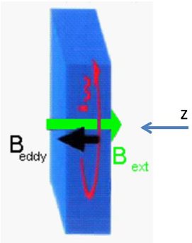
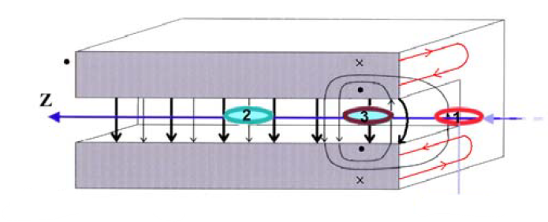
Eddy Currents in Yokes (3-D Analysis)
Anisotropy of laminated yoke
Packing factor
Conductivity
Permeability
3-D effects arise where:
Varying packing factor
Mechanical imperfections
End regions
Lack of ‘neighboring’ eddy currents
2-D
3-D
Moritz, G., “Eddy currents in accelerator magnets”, 2010, CERN Accelerator School, https://cds.cern.ch/record/1158462/files/cern-2010-004.pdf?version=1
Notes:
https://ietresearch.onlinelibrary.wiley.com/doi/full/10.1049/iet-epa.2018.5559

Slide 11
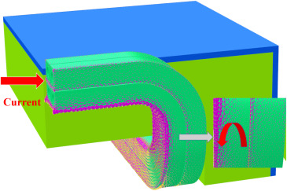
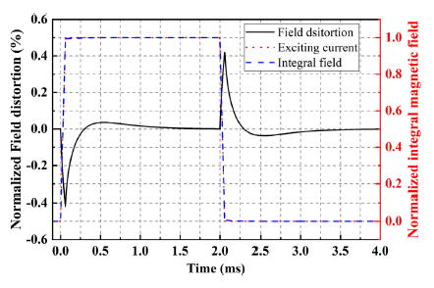
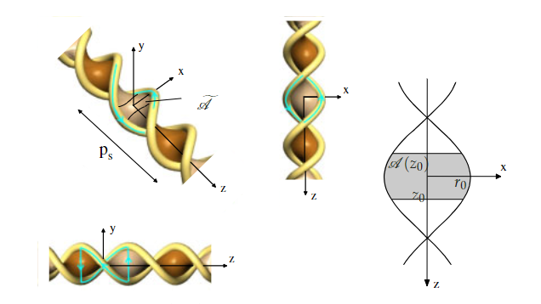
Eddy Currents in Coils
Exciting coils
Rise/fall eddy currents alters current density distribution
Undesired field distortion
Superconducting coil losses
Coupling between filaments
Coupling between cable strands
Wenjie Han, Guanqun Li, Bin Qin, Xu Liu, Dong Li, Qushan Chen, Geng Chen, "Coil induced eddy current analysis of a fast kicker magnet, Nuclear Instruments and Methods in Physics Research Section A: Accelerators, Spectrometers, Detectors and Associated Equipment," Volume 1039, 2022, 167151, ISSN 0168-9002, https://doi.org/10.1016/j.nima.2022.167151.
Russenschuck, S., Field Computation for Accelerator Magnets: Analytical and Numerical Methods for Electromagnetic Design and Optimization, 2010, 9783527407699, https://doi.org/10.1002/9783527635467
Notes:
https://www.researchgate.net/figure/Eddy-currents-induced-in-a-material-by-an-alternating-current-in-a-coil_fig1_263061139

Slide 12
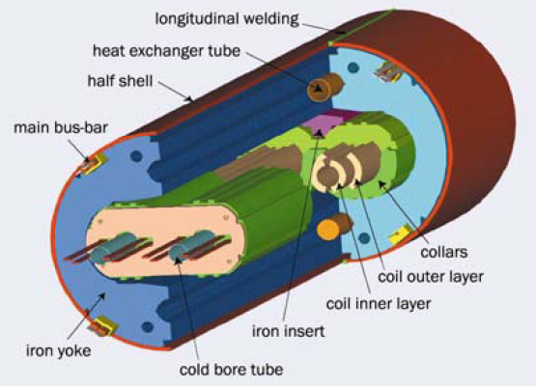
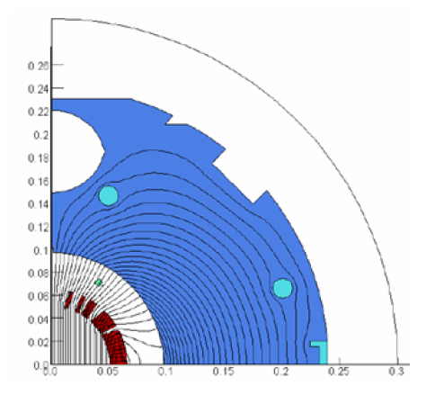
Eddy Currents in Mechanical Structures and Beam Pipes
Brackets, collars, shells, etc.
Rods and pins holding laminated sheets together
Flux loops
Insulate
Minimum flux areas
Eddy currents in beam pipes
Heating of beam pipes
Add cooling lines, ribbing
Eddy currents in cooling lines, ribbing
More losses
Avoid flux loops, electrically insulate
Moritz, G., “Eddy currents in accelerator magnets”, 2010, CERN Accelerator School, https://cds.cern.ch/record/1158462/files/cern-2010-004.pdf?version=1

Slide 13
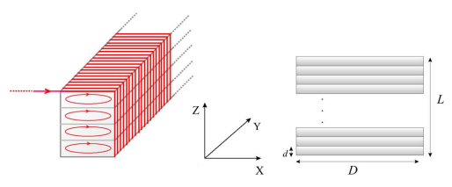
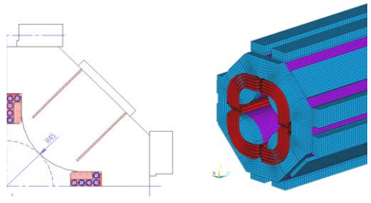
Minimizing Eddy Current Effects
Laminated magnets
Increasing the silicon content of iron
Use non-conductive materials when possible
Avoid saturation
Magnetic end-field region
Middle of magnet
Chamfered edge instead of sharp edge
Slits
Long magnets over short magnets
Low-loss wire in superconducting coils
Bermúdez, Alfredo, Dolores Gómez, and Pilar Salgado. "Eddy-current losses in laminated cores and the computation of an equivalent conductivity." IEEE Transactions on magnetics 44.12 (2008): 4730-4738.
Fischer, Egbert, et al. "3-D transient process calculations for fast cycling superferric accelerator magnets." IEEE transactions on applied superconductivity 16.2 (2006): 407-410.

Slide 14
References
Ammari, H., et al. “A Justification of Eddy Currents Model for the Maxwell Equations.” SIAM Journal on Applied Mathematics, vol. 60, no. 5, 2000, pp. 1805–23. JSTOR, http://www.jstor.org/stable/3061711. Accessed 7 Dec. 2023.
Wikipedia contributors. "Eddy current." Wikipedia, The Free Encyclopedia. Wikipedia, The Free Encyclopedia, 3 Dec. 2023. Web. 7 Dec. 2023.
Bordry, F. et al. (2020). Accelerator Engineering and Technology: Accelerator Technology. In: Myers, S., Schopper, H. (eds) Particle Physics Reference Library . Springer, Cham. https://doi.org/10.1007/978-3-030-34245-6_8
Wenjie Han, Guanqun Li, Bin Qin, Xu Liu, Dong Li, Qushan Chen, Geng Chen, "Coil induced eddy current analysis of a fast kicker magnet, Nuclear Instruments and Methods in Physics Research Section A: Accelerators, Spectrometers, Detectors and Associated Equipment," Volume 1039, 2022, 167151, ISSN 0168-9002, https://doi.org/10.1016/j.nima.2022.167151.
Russenschuck, S., Field Computation for Accelerator Magnets: Analytical and Numerical Methods for Electromagnetic Design and Optimization, 2010, 9783527407699, https://doi.org/10.1002/9783527635467
Shafer, R. "Eddy currents, dispersion relations, and transient effects in superconducting magnets." IEEE Transactions on Magnetics 17.1 (1981): 722-725.
Bermúdez, Alfredo, Dolores Gómez, and Pilar Salgado. "Eddy-current losses in laminated cores and the computation of an equivalent conductivity." IEEE Transactions on magnetics 44.12 (2008): 4730-4738.
Moritz, G., “Eddy currents in accelerator magnets”, 2010, CERN Accelerator School, https://cds.cern.ch/record/1158462/files/cern-2010-004.pdf?version=1
Bertotti, Giorgio. "Physical interpretation of eddy current losses in ferromagnetic materials. I. Theoretical considerations." Journal of applied Physics 57.6 (1985): 2110-2117.
Nan, Xi, and Charles R. Sullivan. "Simplified high-accuracy calculation of eddy-current loss in round-wire windings." 2004 IEEE 35th Annual Power Electronics Specialists Conference (IEEE Cat. No. 04CH37551). Vol. 2. IEEE, 2004.
Fischer, Egbert, et al. "3-D transient process calculations for fast cycling superferric accelerator magnets." IEEE transactions on applied superconductivity 16.2 (2006): 407-410.
Sinha, Gautam, and S. S. Prabhu. "Analytical model for estimation of eddy current and power loss in conducting plate and its application." Physical Review Special Topics-Accelerators and Beams 14.6 (2011): 062401.
Kim, A. A., et al. "Energy loss due to eddy current in linear transformer driver cores." Physical Review Special Topics-Accelerators and Beams 13.7 (2010): 070401.
Jenner, LJ & Bailey, Ian & Clarke, D & Clarke, Jim & Davies, K & Gallagher, A & Gronberg, J & Hagler, Li & Hesselbach, S. & Nelson, C & Piggott, WT & Rochford, James. (2008). A Study of Mechanical and Magnetic Issues for a Prototype Positron Source Target.

Slide 15
Questions?

