Slide 1
Phys 862 Iron Dominated Magnets
By: Luis Garabito
Physics Graduate Student
Michigan State University

Slide 2
Table of Contents
Maxwell Equations In matter/ In vacuum (3-5)
Derivation of Multipole Magnetic Expansion (7-9)
Types of Magnets & uses (11-17)
Hysteresis/Materials/Coil Excitations (19-20)
Conclusion (21)

Slide 3
Maxwell Basics

Slide 4
What is an Iron Dominated Magnet?
A magnet is a material or object that produces a magnetic field.
Iron Dominated means that iron is used to shape the fields inside the magnets (ex. Iron poles shape the fields).
Guides the charged particles consistent with F = qv x B.
The Maxwell equations describe the field in the vacuum aperture and magnet assembly.
The Magnetic Fields can resolve into components x, y, z and multipole expanded.

Slide 5
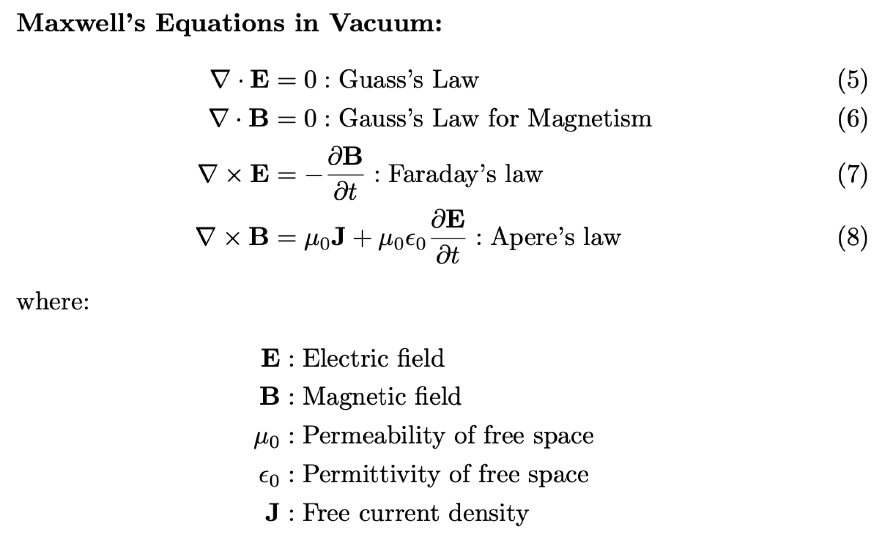
Maxwell Equations in Vacuum &Matter

Slide 6
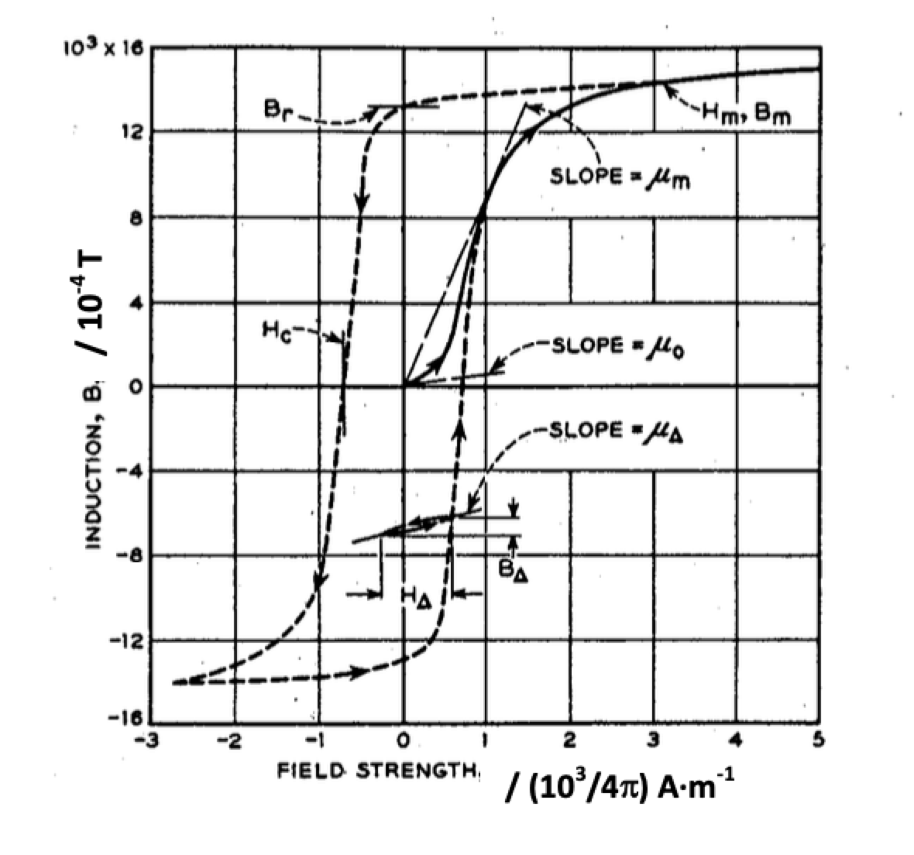
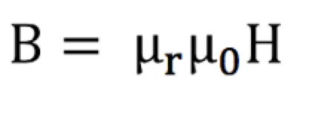
B field
H is the magnetic field
B is the magnetic flux density or magnetic induction
Permeability of free space
Relative permeability
Unlike the permeability of free space, the relative permeability is not a constant but varies with applied field strength. In some materials like Iron there is a curve that represents B density vs H strength
Magnetization curve and hysteresis loop of iron [1]

Slide 7
Development of B fields

Slide 8
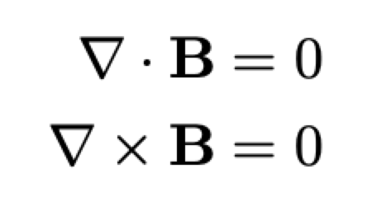
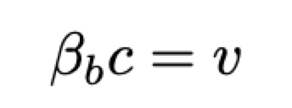
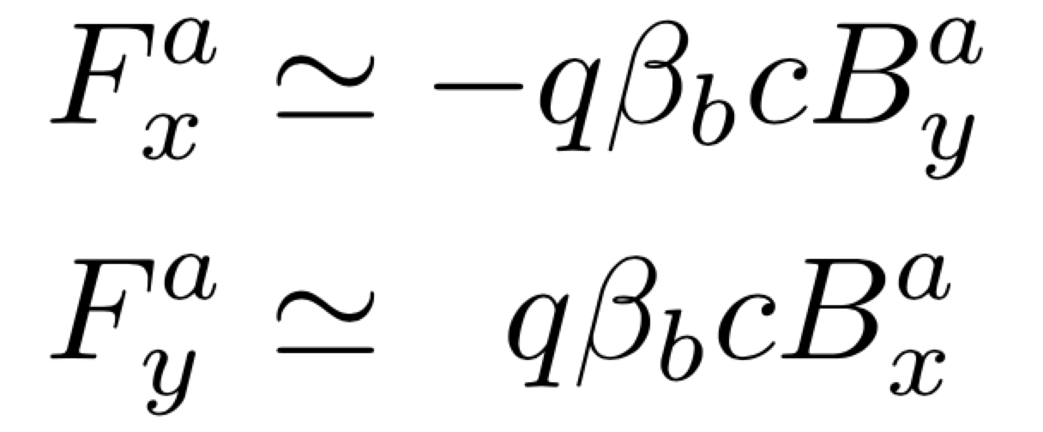
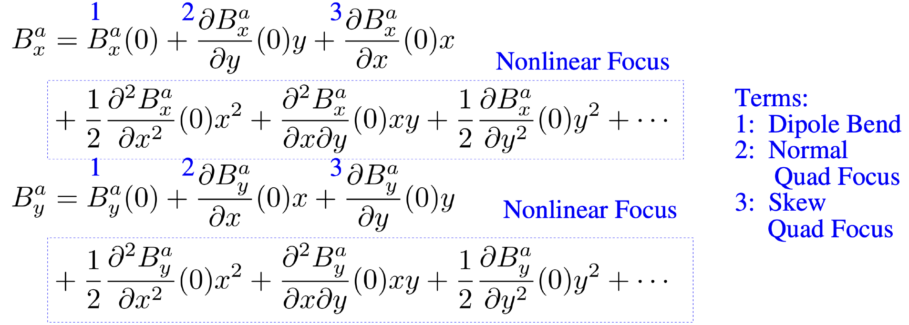
B field: Taylor expansion to obtain Multipole Terms
If the fields are static or sufficiently slowly varying where the time derivatives can be neglected, then the maxwell equations for B in the aperture will satisfy:
The Perpendicular Components of the F and B field are as follows:
We can Expand the B field components using a Tylor series in vacuum aperture
Terms in expansion will depend on the magnet system being analyzed and Initial Conditions
Non-linear terms will have effects. Goal is to minimize in linear optics.
Taylor coefficients not all independent, they must obey Maxwell equations in vacuum

Slide 9
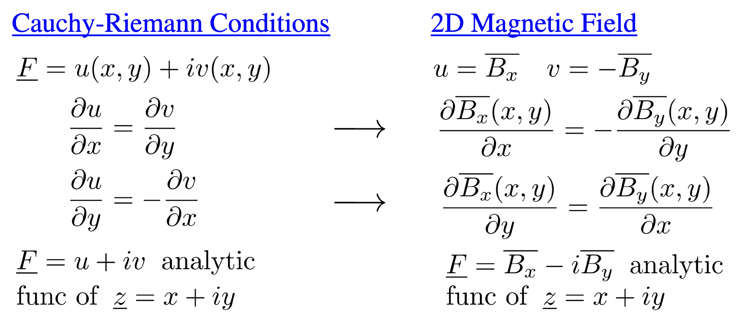
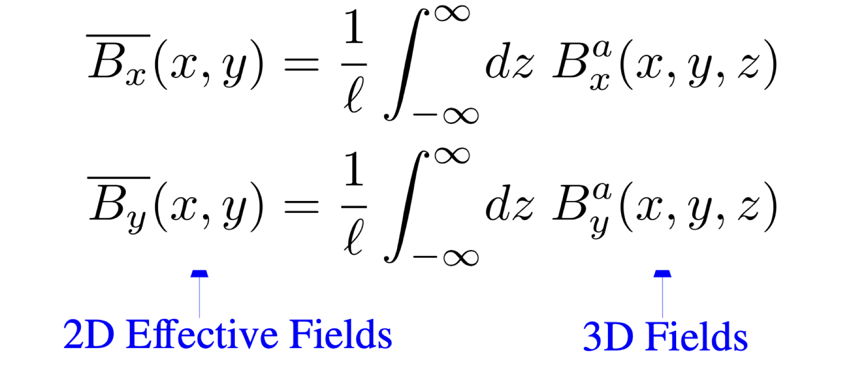
Cauchy Reiman Conditions in B field. B field is an Analytic Function
This B equations satisfy the Maxwell Equations
Laurent Series For B Field
B(x,y,z)
n = multipole index
b_n =const(complex)
[3]

Slide 10
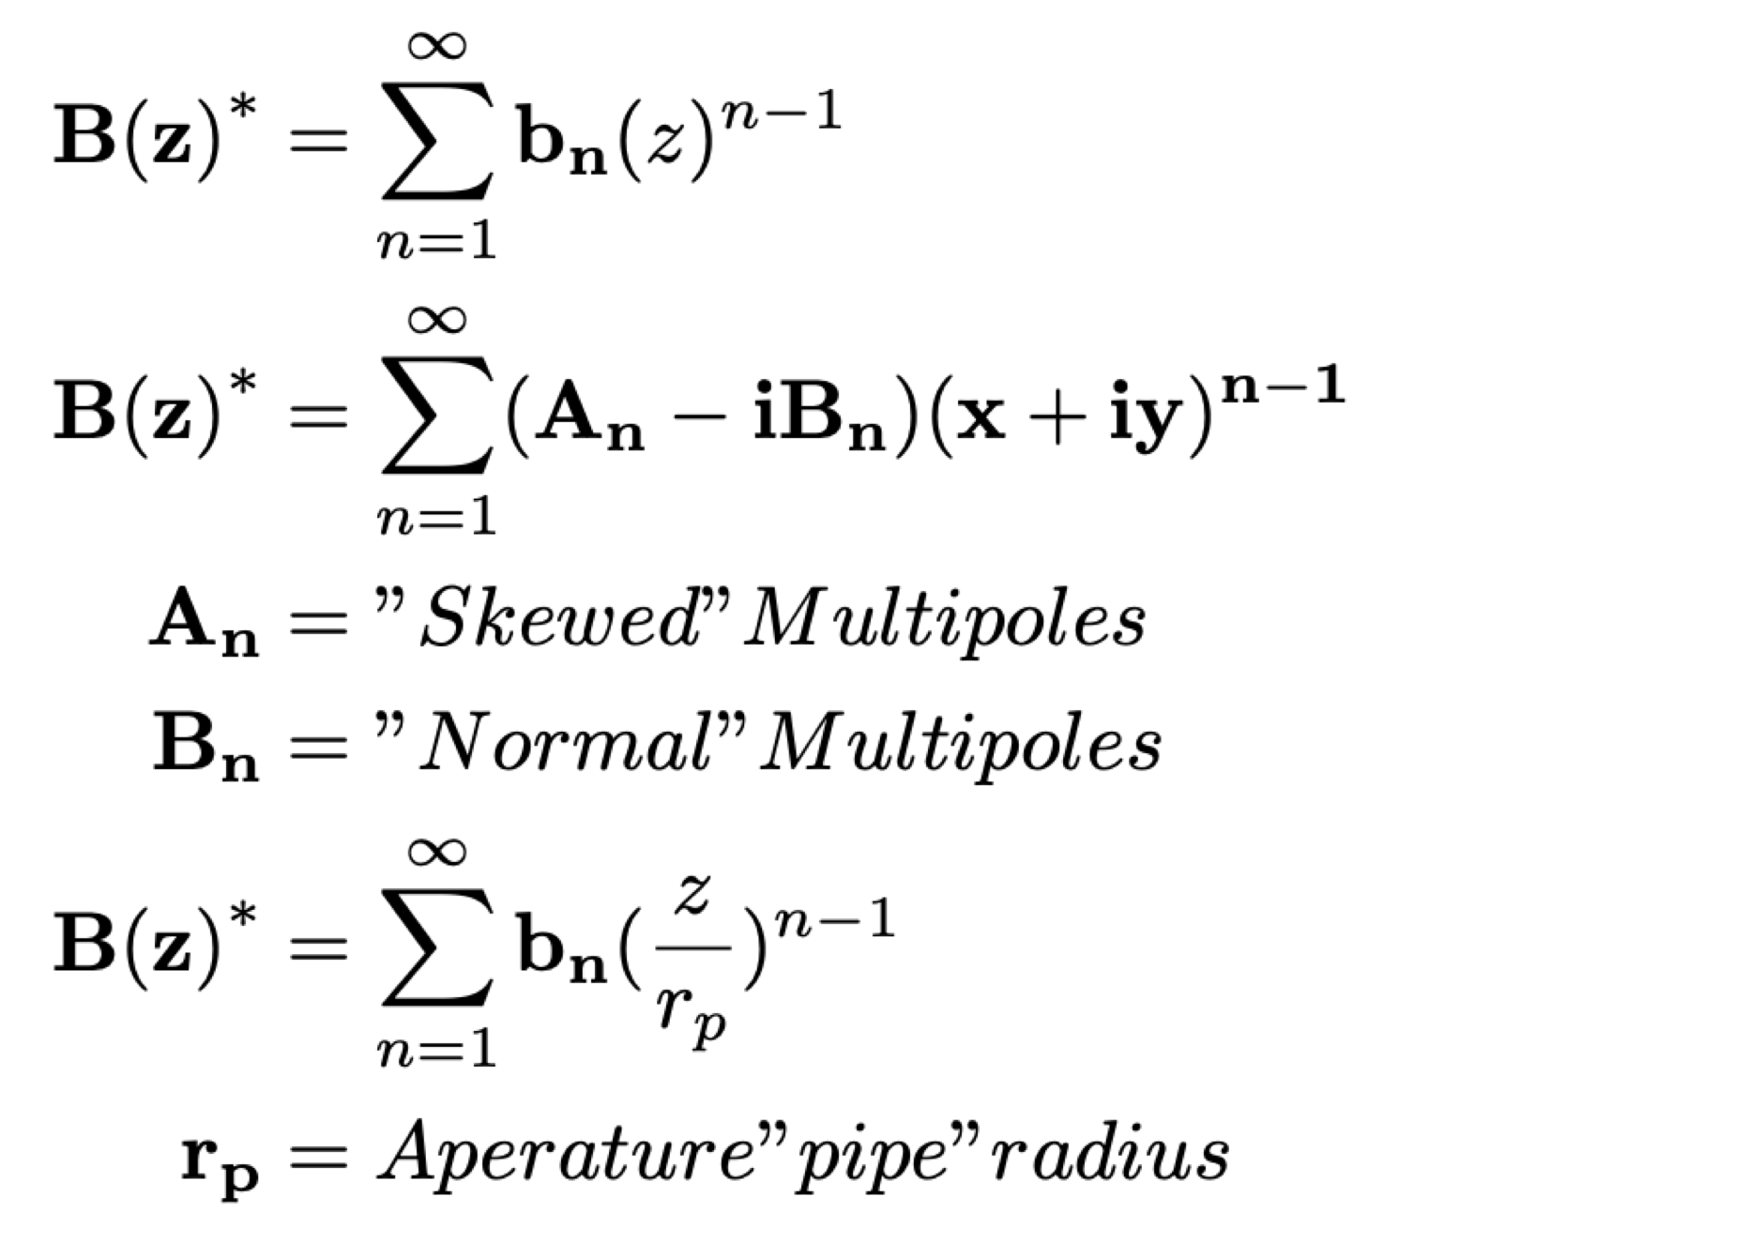
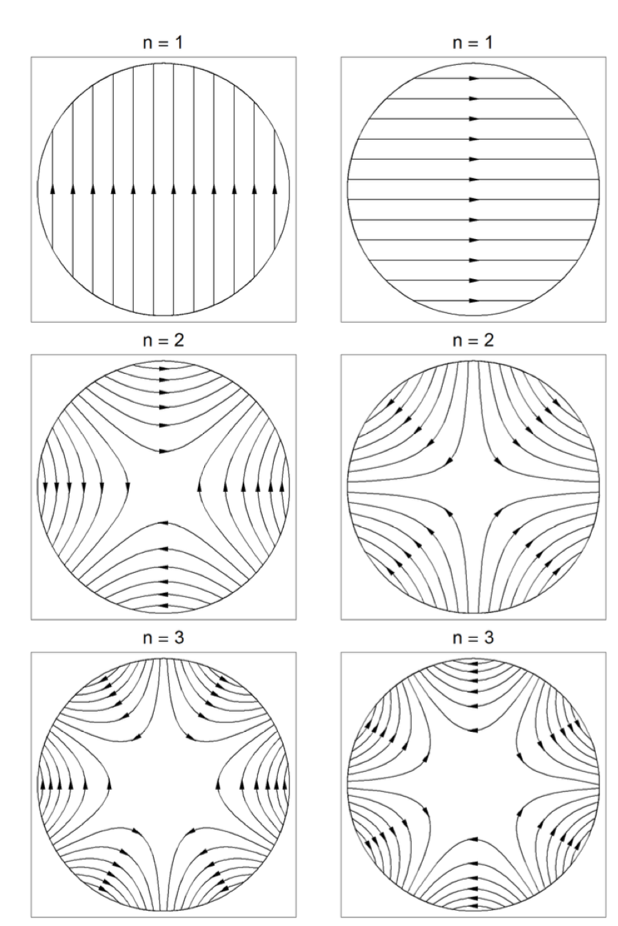
B fields
Multipole Fields Normal Right Skewed Right: [1]
Multipole Equations: The generated fields have different geometric shapes
Rescale bn, resulting in all field units (T)
Skewed: Normal pole rotated by pi/(2n)

Slide 11
Types of Magnets & Designs

Slide 12
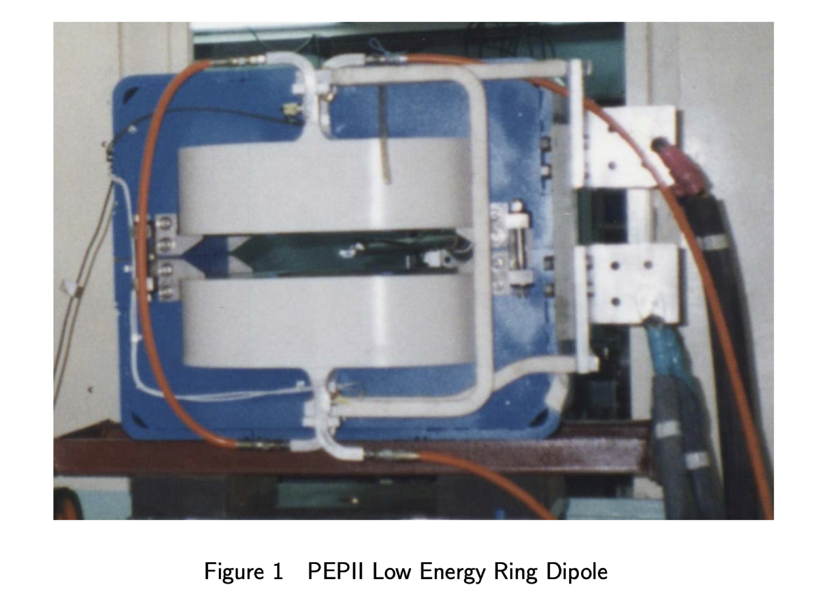
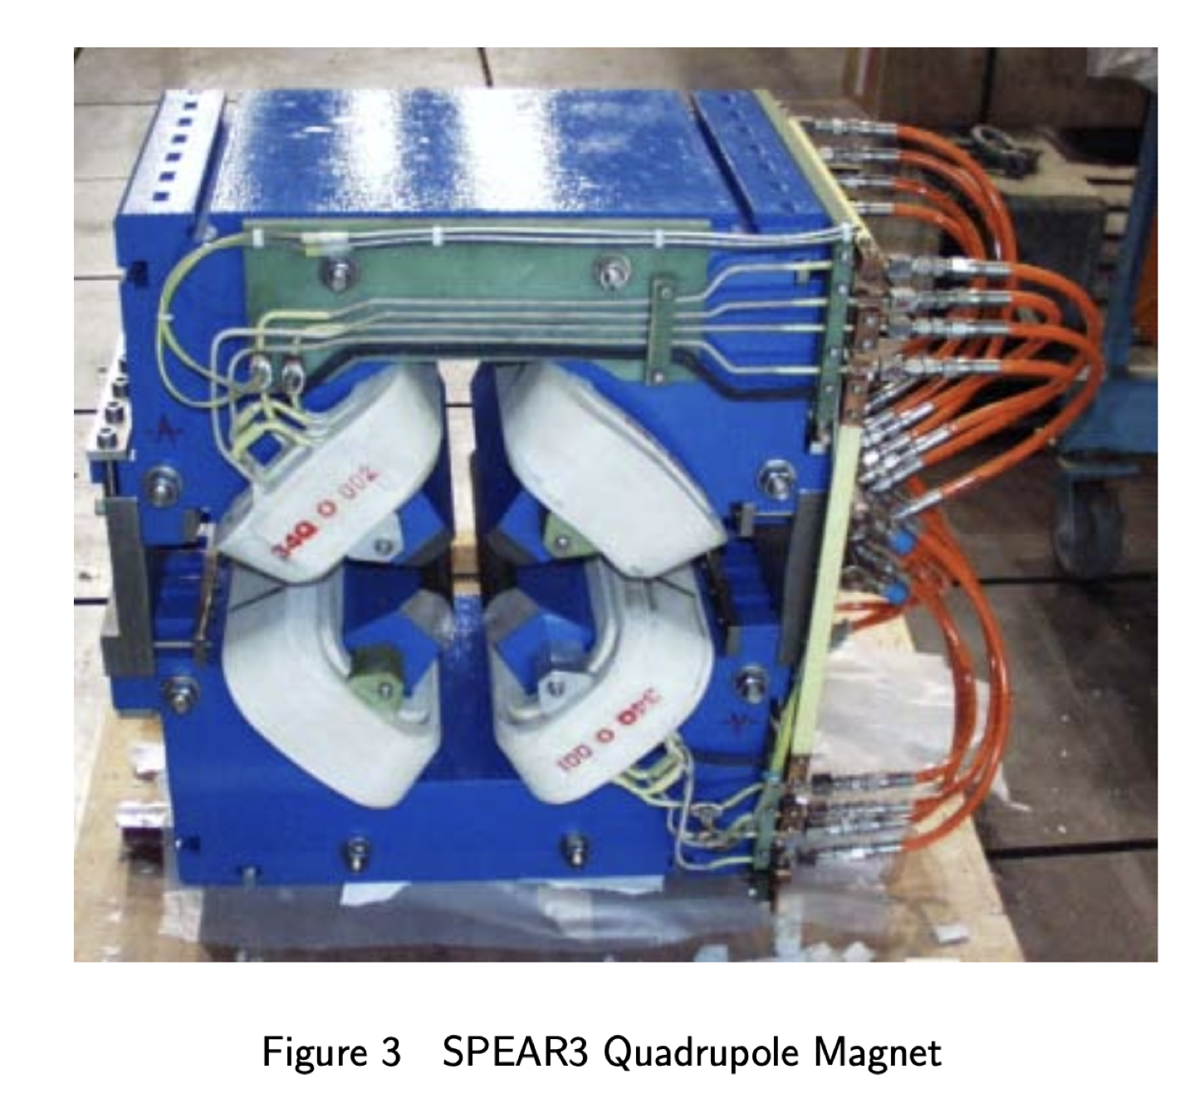
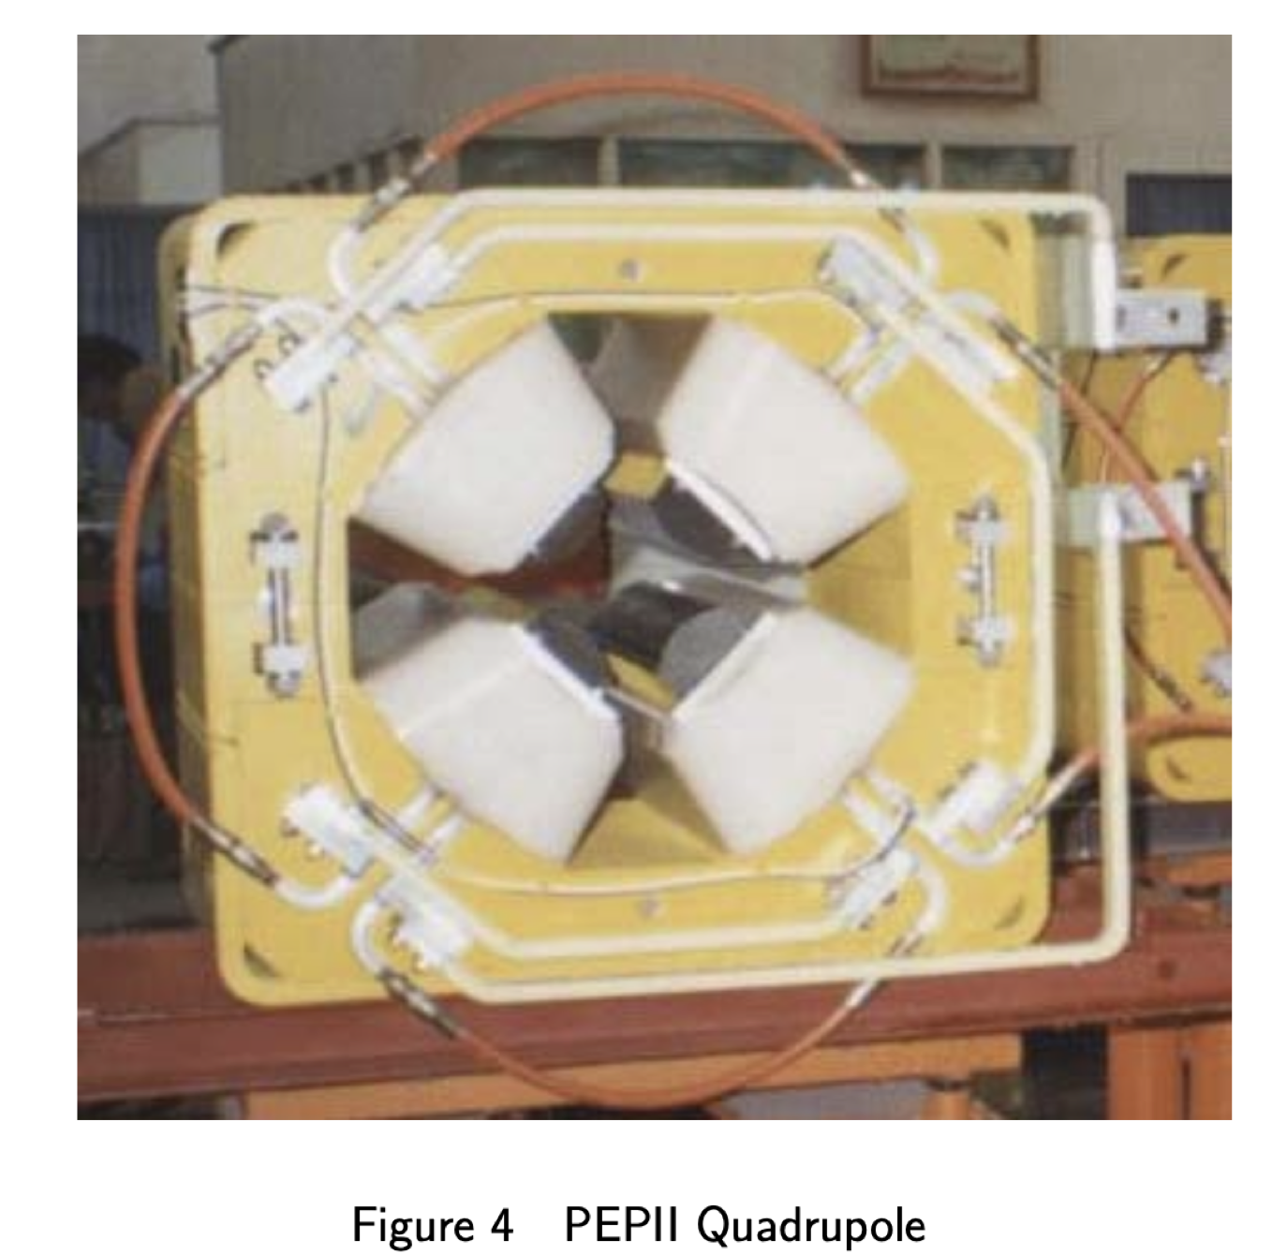
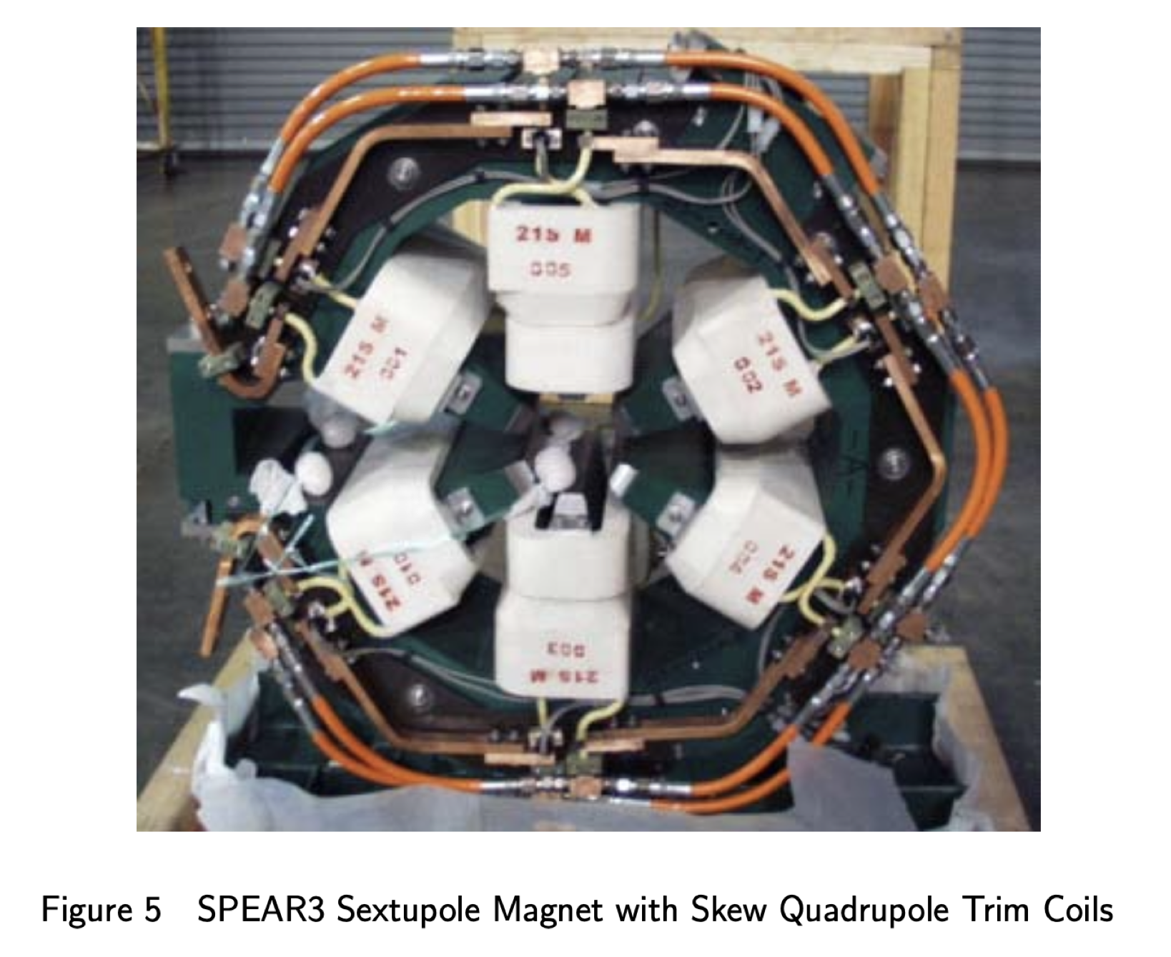
Magnet Types
Some Examples of Iron Dominated Magnets:
Dipole (Bending)
Quadrupole (Focus or Defocus)
Sextuple (correct chromatic aberration due to dispersion in a dipole bends)
Octupole (Damping of the collective Effects)
Examples of magnet designs from PEPII and SPEAR3 (SLAC)
Iron Dominated Magnet: Iron Yoke has coils placed in it. Coils Provide flux in the magnet. Magnet fields shaped by the poles of the iron.
[4]

Slide 13
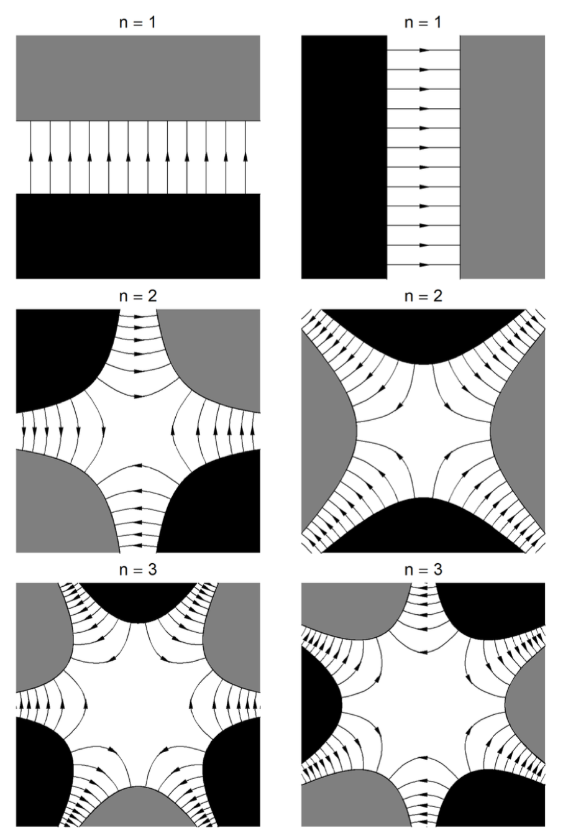
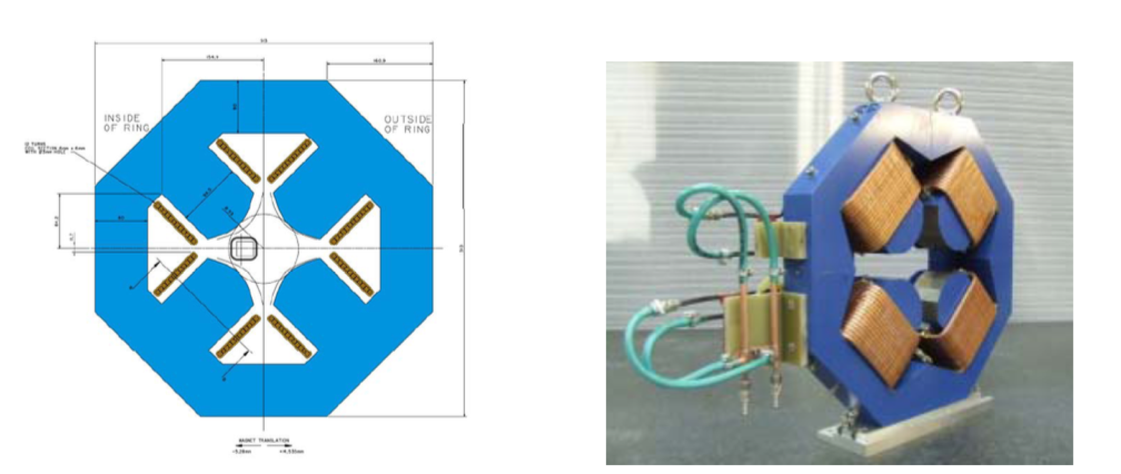
Generating Fields
Ideal/Infinite mu and length
Iron Dominated Quadrupole magnet (EMMA Fixed-Field Alternating Gradient accelerator at Dares- bury Laboratory ) [1]
The fields need to have poles North and South. Coils must be inserted with alternate current directions passing through
strength of the magnetic field is determined by the number of amp-turns in coils providing magnet flux into poles
[1]
Quadrupole provides focusing along one axis and defocusing on the other.
The Iron Poles have hyperbolic contours, B field lines are perpendicular to the contours [4]

Slide 14
Boundary Conditions/Magnetic Potential
In vacuum the equations for B
B can be expressed as the gradient of a scaler magnetic potential.
Plugging back in leads to Laplace’s equation which can be solved, with Boundary conditions.
Geometric designs must satisfy the field gradients and field lines. Truncated Poles and specified geometries etc.

Slide 15
Field errors Non-ideal
The design field is one that is still in some sense ‘ideal’; though the design field for a quadrupole magnet (for example) will contain other multipole components, because the design has to respect practical constraints, i.e., the magnet will have finite longitudinal and trans- verse extent, any currents will flow in wires of non-zero dimension, and any materials present will have finite (and often non-linear) permeability. Usually, one attempts to optimize the design to minimize the strengths of the multipole components apart from the one required: the residual strengths are generally known as systematic multipole errors. [1]
The Errors arise from the real magnet designs. Unlike the ideal case, the magnetic fields aren’t exactly parabolic, straight, and etc. They deviate from the ideal cases. Only certain terms then are allowed due to symmetries. Harmonics of the Multipoles.

Slide 16
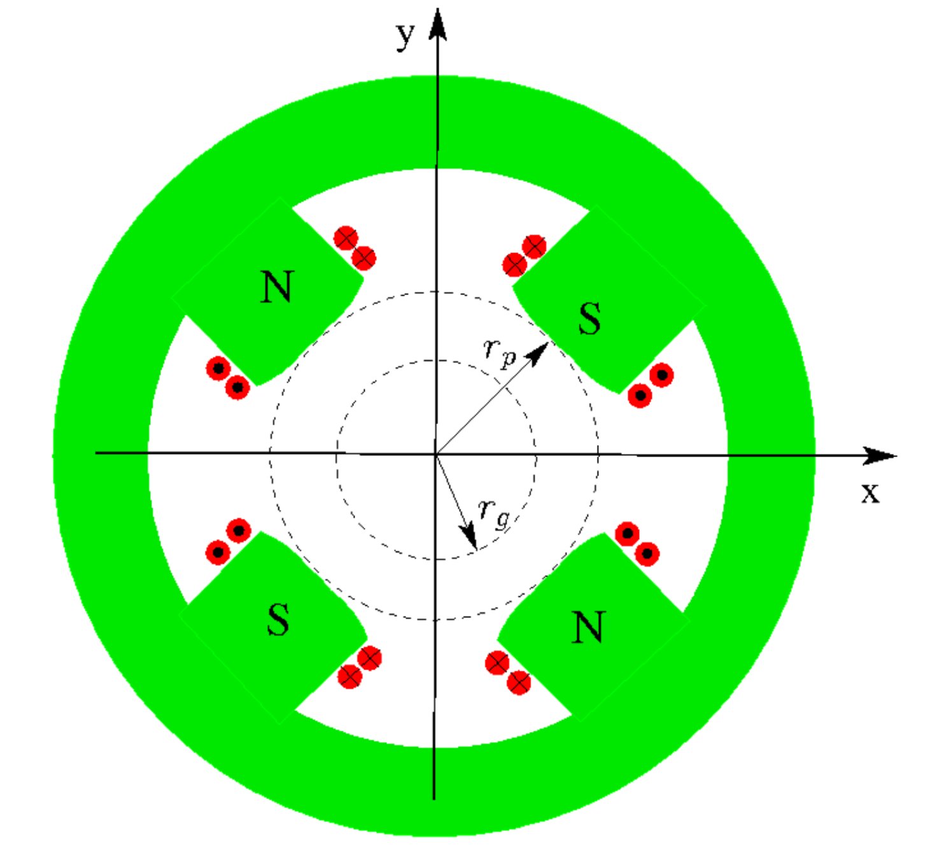
Quadrupole Magnet and Good field Radius
In the expansion Higher order terms lead to nonlinear focusing effects but drop of rapidly with decreasing aperture
Generally, a magnet will be designed with a good field radius where the errors are confined to that region.
In Optimal designs the Good field radius is 70% or more of the the Bore aperture radius.
‘Mitigate the effects of the nonlinear terms by making the Magnet bigger (ie. Increase Bore Radius).
Have more tight focus control over the beam.
Good field region can be circular, elliptical, rectangular and takes into account the maximum beam size [4].
[3]

Slide 17
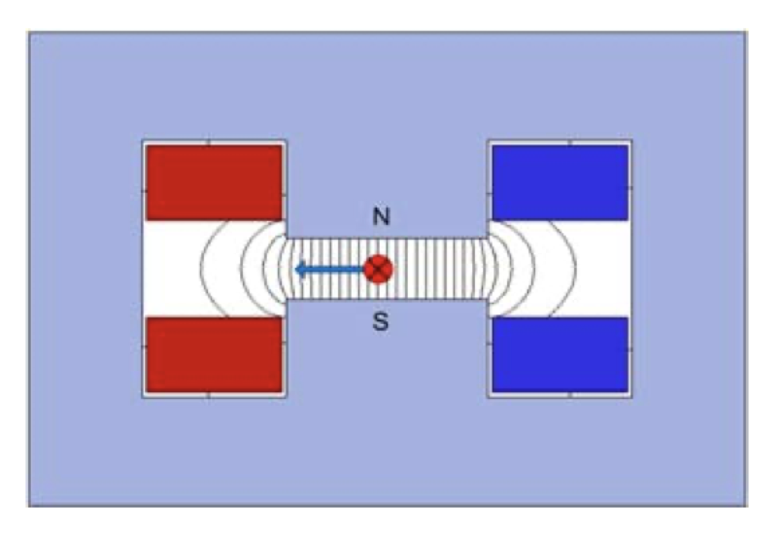
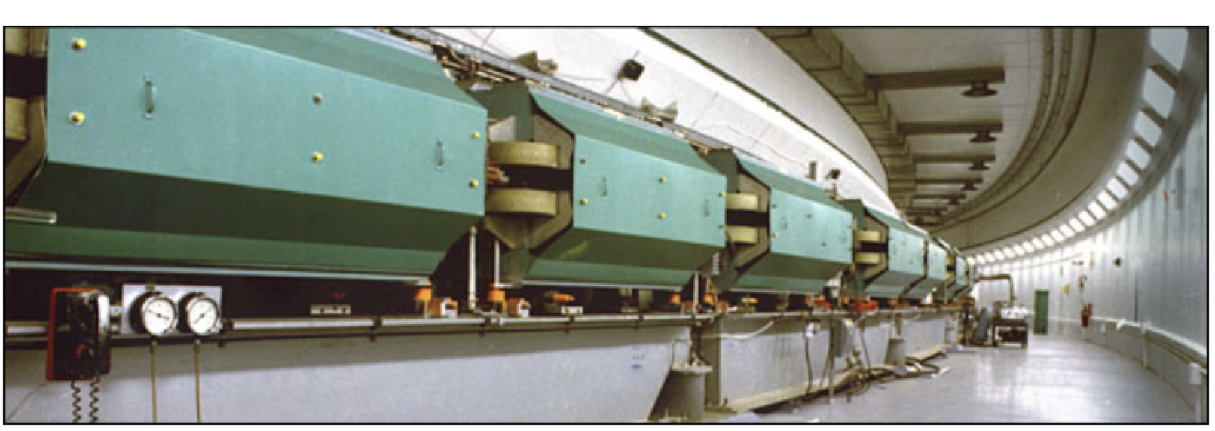
Dipoles Magnets
[6]
H magnet is standard in many accelerators. Hard to access but has good mechanical stability and a symmetric field quality.
Window frame or O type magnets. Produce uniform fields. Top uses racetrack coils while bottom uses saddle coils.
C magnet. Provides good accessibility to beam pipes.
Large Yoke Volume compared to H magnet [4]
AGS Dipole Magnets [2]
Alternating Gradient Synchrotron

Slide 18
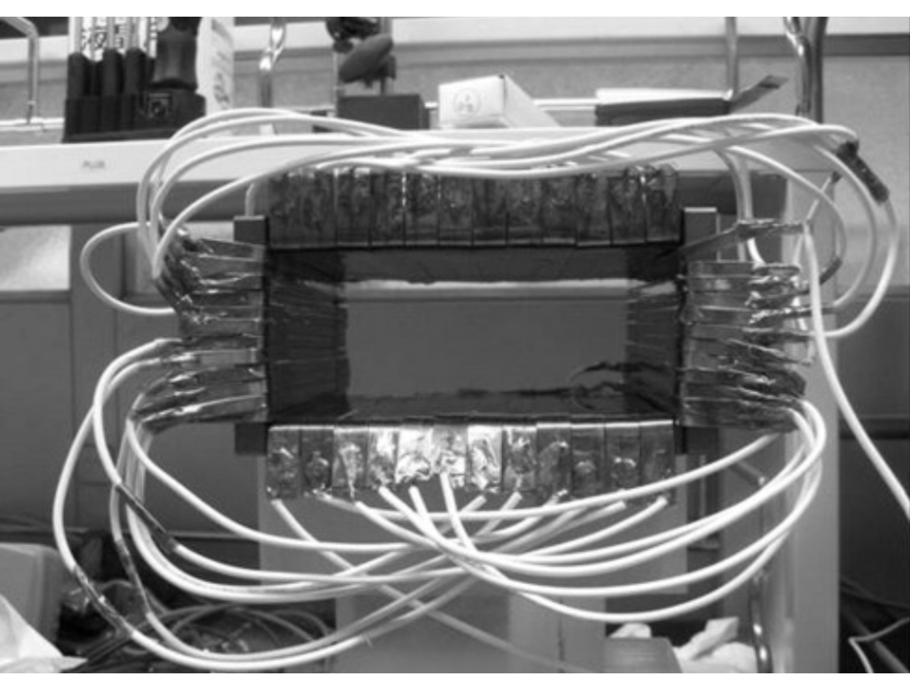
Quadrupole Magnets
a) Standard Type Quadrupole. Provides larger coil windows and less saturation in pole roots
b) Collins Type. Expensive to make
Easily Accessible
c)Panofsky, Like window frame magnet, Excellent field quality, but only used as a corrector
[4]
*Not really and Iron Dominated Magnet since
Field is determined by current distribution
in the coper conductors and not the iron yoke. [4]

Slide 19
Coil Excitation/Hysteresis

Slide 20
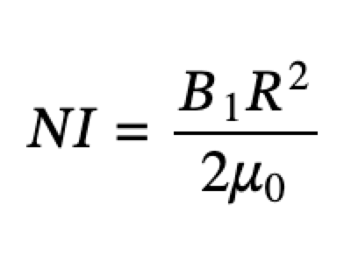
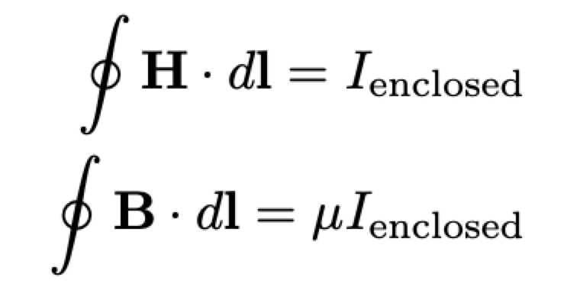
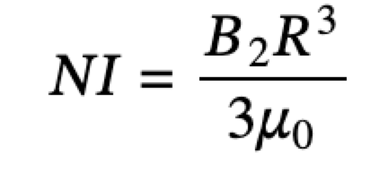
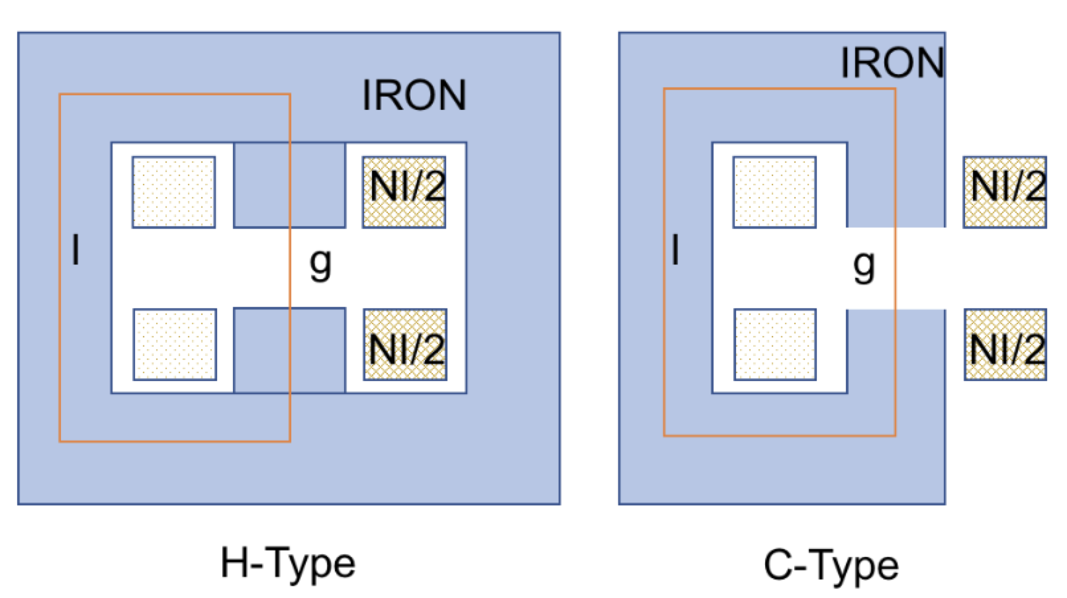
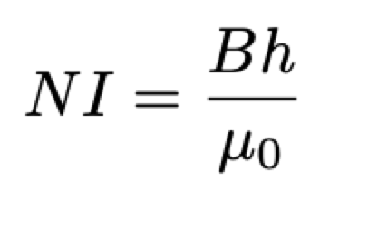
Coil Excitations For Dipole, Quad, Sextupole
Apply Amperes Loop law along the Iron magnet to obtain the needed current to the coils to provided the desired Magnetic Flux or field in the magnet.
n = 2 Quadrupole
[2]
n = 3 Sextupole
[2]
n = 1 Dipole
Window
Magnet

Slide 21
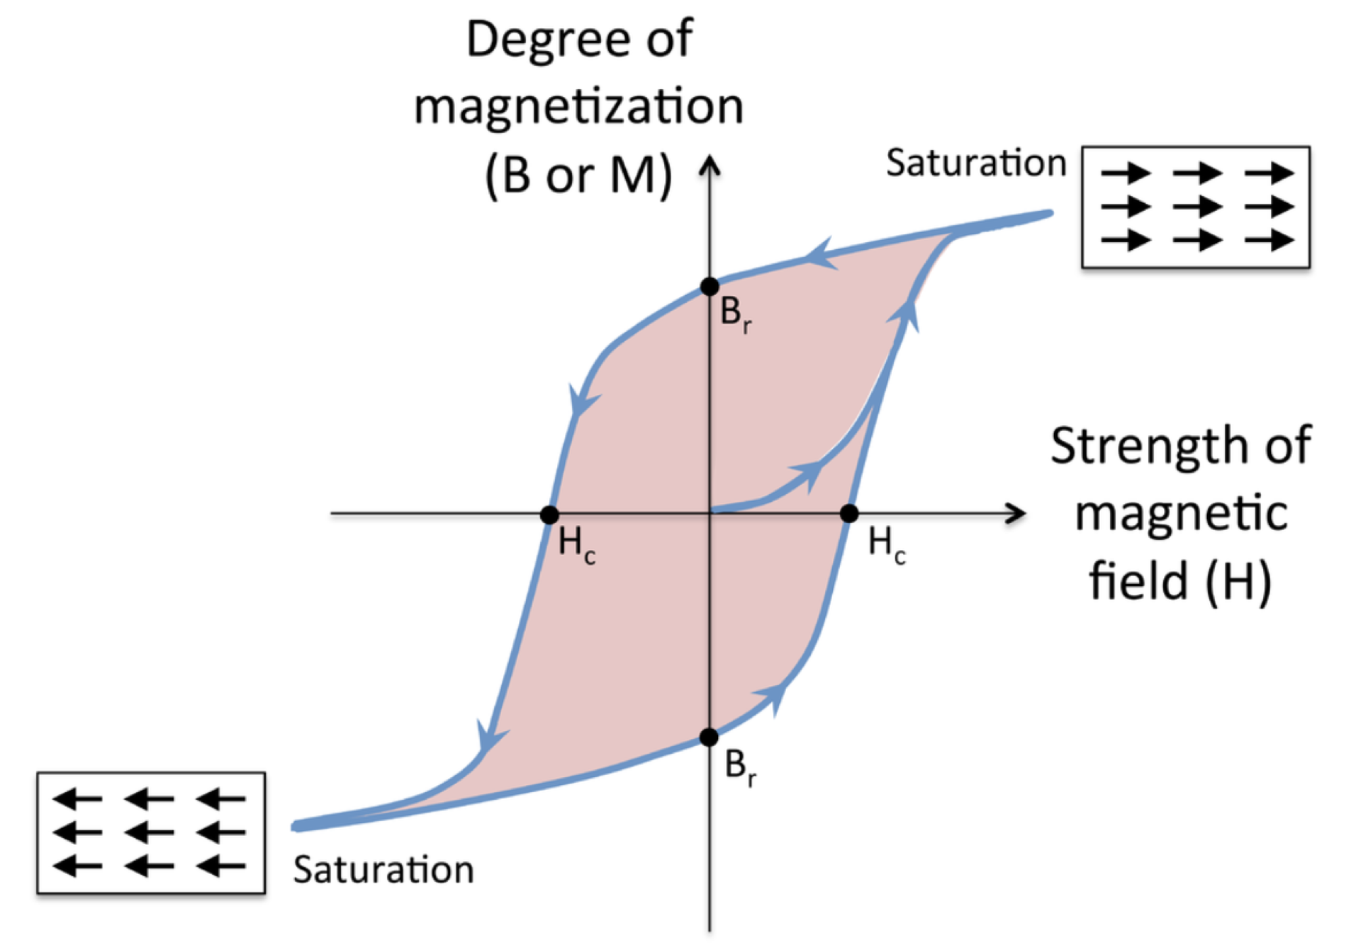
Hysteresis B(H) curves
Flux induction B(H) as a function of field strength is different when
Increasing or decreasing strength
When the current is switched off some magnetic polarizaition of iron Remains (Remanent Field)
Width of the curve is determined by the coercive force Hc.
Hc < 1000 A/m Soft Magnetic ex Electro Steel
Hc > 1000 A/m hard magnetic ex permanent magnets [4]
Electro Steel - It is an iron alloy with silicon as the main additive element (instead of carbon). [5]
[1]
[2]
When driving a magnet from an unmagnetized state to a magnetized state toward designed point

Slide 22
Conclusion
Magnets are more complicated than they seem

Slide 23
References
[1] Brandt, D. (2009, July 16-25). ORGANISATION EUROPÉENNE POUR LA RECHERCHE NUCLÉAIRE CERN EUROPEAN ORGANIZATION FOR NUCLEAR RESEARCH. CAS, Burges, Belgium. https://cds.cern.ch/record/1158462/files/cern2010-004.pdf?version=1
[2] Hao, Y. (n.d.). Overview of accelerator magnets¶. magnets. https://people.nscl.msu.edu/~haoy/teaching/AP_course_materials/magnets/magnets.html
[3] Lund, S. (2022, June 6- July 1). US Particle Accelerator School (USPAS) Lectures on “Beam Physics with Intese Space-Charge” [Online Presentation] https://people.nscl.msu.edu/~lund/uspas/bpisc_2020/lec_set_02/tpd_ho.pdf
[4] Tanabe, J. (2005) Iron Dominated Electromagnets Design, Fabrication, Assembly and Measurements. https://www.slac.stanford.edu/pubs/slacreports/reports16/slac-r-754.pdf, SLAC-R-754.
[5]Wikimedia Foundation. (2023, June 5). Electrical steel. Wikipedia. https://en.wikipedia.org/wiki/Electrical_steel
[6] Zickler, Th. (2010) Basic design and engineering of normal-conducting, iron-dominated electromagnets. CERN, Geneva, Switzerland. https://doi.org/10.48550/arXiv.1103.1119, CERN, 004, 65-102

