Slide 1
Electron Guns
Malachi Keener
Phys 862: Accelerator Systems

Slide 2
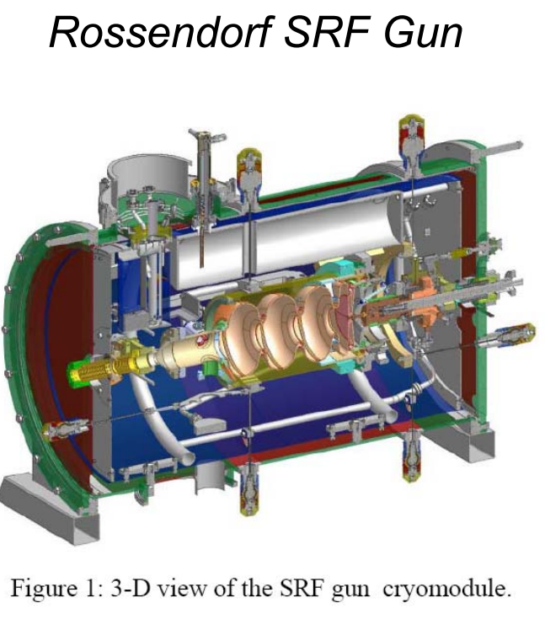
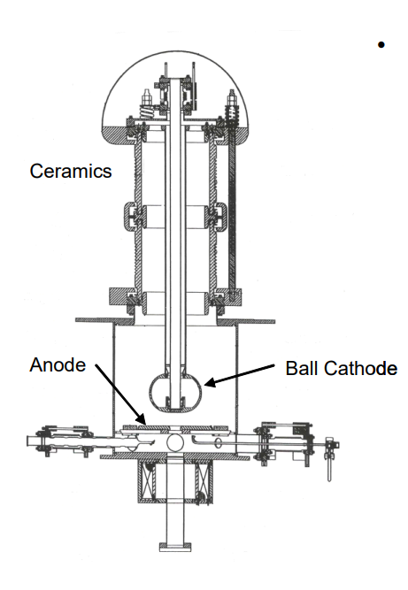
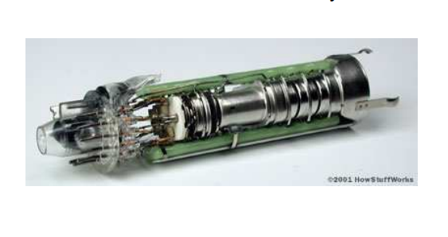
Outline
Electron Emission
How it works
Properties of materials
Materials
Types of electron emission
Thermionic
Photoemission
Field emission
RF vs DC
RF
DC
Comparison
Jefferson lab DC photocathode
Notes:
Jefferson DC photocathode descendent of SLAC polarized e beam

Slide 3
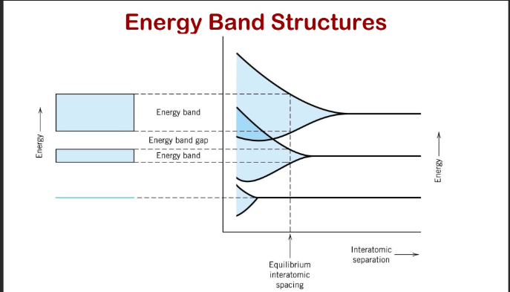
Electron Emission
Atoms Energy band structure
e- pairs spin and fill discrete energy quantities/bands. e- will move energy bands by absorbing or emitting energy
Dirac –Fermi distribution
Describes probability of finding an electron at a certain energy
Fermi level
Hypothetical energy state holding a 50% chance of being inhabited.
Work function
Describes minimum energy to promote electron to vacuum.
Notes:
The first photo illustrates the concept of energy bands namely how they overlap and can easily move between bands by gaining or releasing energy (for certain interatomic spacing).
The equations show distribution probabilities for fermions and bosons the key here is the simplicity in the Maxwell botlzmann vs fermi dirac.
Electron pairs spin and fill discrete energy quantities or energy bands. As electrons orbit the nucleus they will experience changes in their energy levels by absorption or emission of discrete energy quantities. As these changes in energy happen somewhat randomly a probability function was proposed to describe the likelihood electrons fall in distinct energy states.
Since electrons are fermions (1/2 integer spins/ multiple can fill one level) They follow the Dirac- Fermi distribution within a given material – a function that describes the probability an electron inhabits an energy state. In this distribution is an energy state called the fermi level (dependent on temperature) which hypothetically holds a 50% probability of being inhabited by electrons.
For electrons to become free of the material they must be moved from these fermi levels to vacuum this is known as the work function

Slide 4
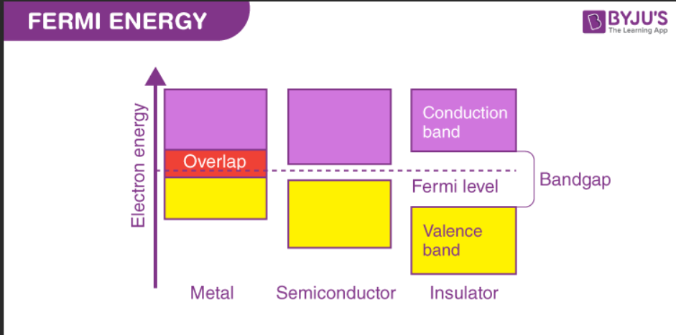
Material properties
Energy band gaps
Electrons can inhabit quantized energy states.
Sometimes they are very close together and form a continuum.
Other times there are energy states an e- cannot inhabit i.e Bandgaps
Material fermi level bandgaps
Some materials have bandgaps between their fermi level and vacuum.
Insulators: have large gaps
Dielectrics: have relatively smaller gaps
Metals: have no gap
SIDE NOTE: Fermi levels in different material
When materials with different fermi levels are put in contact e-s flow until an equilibrium is reach
Notes:
The first photo illustrates how different materials fermi levels distribute relative to the vacuum
The second shows different work functions of metals and also those metals melting points
Electron energy bands often (especially in metals) overlap and form something of a continuum where travelling to another energy band only requires energy absorption/emission.
However, in the continuum of possible energy levels there exists bandgaps – where electrons are not able to inhabit. These bandgaps mean a precise quantum of energy, and no lower, must be imparted to an electron to inhabit a higher band, or it will stay in the same band it presently exists in. The fermi level band gap blocking electrons from vacuum is large for insulators, appreciable for dielectrics, and basically nonexistent for metals as their bands overlap.
%%The Fermi level of a material is temperature dependent but also can be changed by being put into contact with another material of a different fermi level, in such a case electrons will flow between them until an equilibrium and new fermi level is achieved.

Slide 5
Types of field emission
Each emission type requires excitation energy
Thermionic- Heat
Photoelectric- light photons
Field emission- High Electric field
Emittance
Area occupied by beam in a position/ momentum phase space.
Beam size x Divergence
Thermionic emission closely related to heat energy
Perveance
Space charge created by extracted e- limits number of additional e- that can be extracted
Notes:
The equation for thermal emittance illustrates an important concept that emittance rises with thermal energy. Sigma is rms beam size.
Each type of electron emission requires sources of energy to excite electrons above a materials work function. In order for electrons to escape it needs to have sufficient kinetic energy in direction of the barrier.
Some important beam quality components are emittance.
Emittance- Area occupied by beam in a position/ momentum phase space. Basically a product of beam size and divergence .
Perveance- Space charge created by the e- already extracted from surface limits number of additional e- that can be extracted.

Slide 6
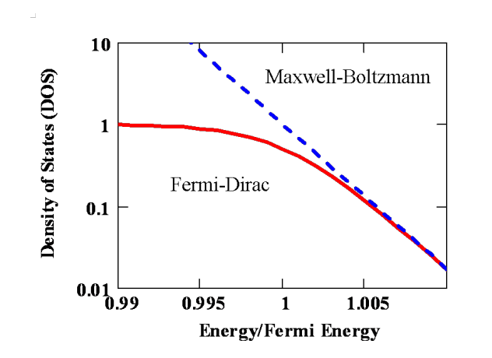
Thermionic
How heat is used?
Heat is added to a material decreasing its work function.
Current produced
Current exponentially related to heat energy applied.
Energy spread
Energy spread varies widely from cold to hot (bound vs unbound)
Initial spread in transverse direction gives angular divergence
Notes:
For high enough energies the Fermi dirac probabilities can be switched for Maxwell Boltzman distributions which can be utilized to derive the Richard Dushman equations.
The second image is the Richardson dushman equation which illustrate the current excited from thermionic emission is exponentially dependent on the temperature.
In thermionic emission heat is added to a materials lattice and then is transferred to all the valence/conduction electrons. decreasing the work function. Exponential dependence of the current on the temperature. This type of emission is most useful for narrow Bandgap (preferably zero) thermal excitation at low energy applications.
Energy spread varies greatly with temperature for copper rising from.02eV at room temp to .2 eV at 2500k the energy needed to release bound e-
Initial spread in transverse velocity due to electron temperature gives beam angular divergence and hence its thermionic emittance
assume Large enough field to remove electrons from surface i.e no space charge effects, but not high enough so that barrier effects occur i.e Schottky
Nio wave uses a Thermionic system has the need high intensity but not necessarily precise emittance.

Slide 7
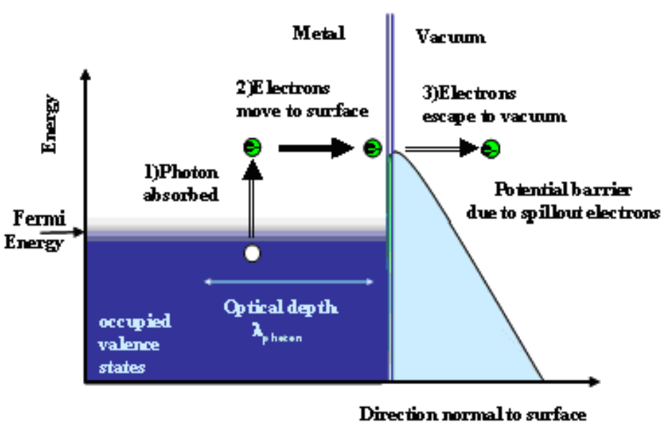
Photoemission
Photoelectric emission
A Photon strikes a material causing it to emit an electron
Energy Requirements
Energy of photon must be enough to overcome the work function and provide enough kinetic energy to escape the barrier.
Scattering
Electron- Electron
Electron-phonon
Notes:
The first image details the photoemission process- photon absorption, electron transport to the surface, escape from the barrier. It differs from thermionic as energy is received by the e- itself and not to the entirety of the atom it belongs to. ???? Check this
The second photo is the equation for the energy needed to overcome the work function and kinetic energy needed to escape the barrier both being supplied by the incident photon. Plancks and velocity.
In photoelectric electron emission a photon strikes a material and causes it to emit a electron based on the photoelectric effect. The photon energy described as the product of plancks constant and the waves velocity must provide energy to overcome the work function and electrons kinetic energy to break the barrier. If above the threshold the electron will break free to vacuum if its not enough scattering occurs. Scattering can either be electron- electron as it is for metals or electron phonon where electron interacts with energized lattice such as the case for dielectrics. Depending on the incident waves penetration depth an electron can scatter 2-3 times before even reaching the surface.

Slide 8
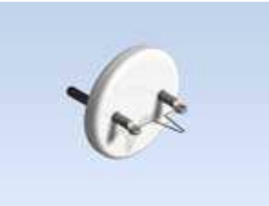
Often used materials
Cathode
Material from which electrons are extracted
Metal cathodes
PROS
High electron density
Low work function
Prompt response time
Long lifetime, tolerant of poor vacuum
CONS
Highly inefficient (QE)
Dielectrics
PROS
High efficiency (1-10% QE)
Delay emission
CONS
Require high vacuum
Slow response
Low life times
Notes:
Picture explanation- The top is Gallium arsenic dieletric often used for its low thermal emittance and delayed electron emission. Has high quantum yield making useful for photoemission but is very sensitive to vacuum and has short lifetime of 100’s of hours. Cesium may be added to lower work function
Tungsten- Is often used for metal cathodes due to its high metling point but its work function is higher than most metals
Cathode - material from which the electrons are extracted
Mostly applied to photocathodes
Due to their low work function coupled with their high conduction band electron density of 10^23 metals such as copper were among the first cathodes used for free electron production. They are used mostly in high gradient applications for their long lifetime(with some maintenance;ncan last years), tolerance of poor vacuum and prompt response time. But are highly inefficient
Semiconductors on the other hand have higher work functions but can be lot more efficient- between 1-10% QE for photocathodes- and can have delayed e- emission Meaning electron phonon interactions occur and the lattice reached equilibrium before emitting at a well known emittance . Dielectrics require high vacuum have a slow response and are generally complicated to manufacture E.g GaAs(Cs) has delayed electron emission and low thermal emittance but is very sensitive to vacuum and has very limited lifetime of 100’s hours
Often used for its helicity properties and its ability to match an incident photons polarization

Slide 9
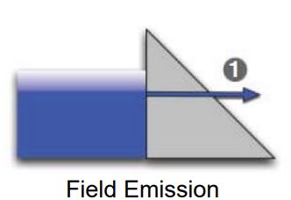
Field Emission
Field emission
Schottky effect- external field is applied which lowers the barrier suppression
Requires fields in excess of 10^9 V/m
Field requirements
The amount of current is dependent on the amount of field.
Any appreciable current needs very high Fields
Combining field emission types
Thermionic and Field emission
Notes:
The first image demonstrates the uniquity of field emission electron sources – the energy does not make the electrons overcome the work barrier but tunnel straight through it. Machicoane slide 16
The second exemplifies the importance of very precise, dimensionally small (point-like) apertures and its impact on field . Field generation can be extremely limited by the geometry of the source. Machicoane slide 32
In field emission Electrons are forced through the barrier by the Schottky effect where an external field is applied which lowers the barrier suppression. The schottky effect requires a field in the order of 10^9 V/m and the current from field emission is exponentially dependent on the external field. Therefore in order to produce these high fields it becomes necessary to have very minimal small tips for the applied field aperture .
Often Field emission can be combine with other types of emission such as thermionic since high fields are harder to produce than heat.
Thermionic emission typically causes emittance about 10 times higher than that of a photocathode.

Slide 10
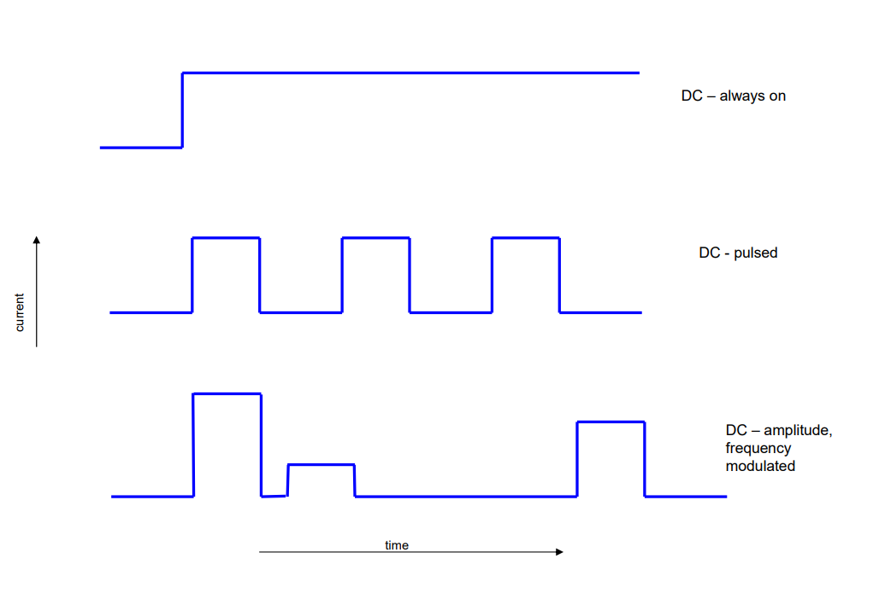
RF v DC
Bunch charges vs Duty Cycle
High bunch charge applications (nC range) -> RF
Continuous wave (Constant acceleration) -> DC
Notes:
Hoff lectures images the key thing here is Higher charge bunches are in RF but only occurs in pulse mode at much lower frequency then that of the rf source. The DC can have continuous field allowing longer bunches and frees from time dependent forces. Slide 4 hoff lectures

Slide 11
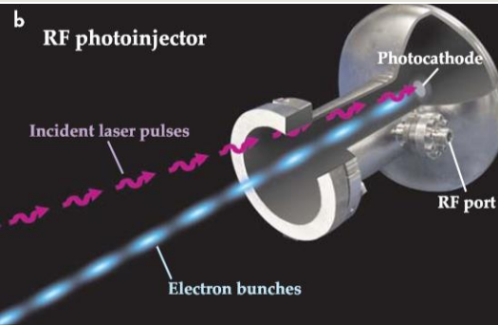
RF
Why use RF?
Higher bunch charge (nC)
High accelerating gradient (>150 MV/m)
High Rigidity/Brightness
Ease of design
Limitations
Limited average current
Overheating is a major issue
How to avoid limitations
Lower frequency of acceleration
SRF cavities
Notes:
The first picture illustrates the concept of high charge bunches being emitted that highly accelerate but are not continuous Machicoane slide 48
The second is a another example of a warm rf gun it illustrates the relatively simple design, without the booster/bunching cavities which is associated with DC
Slide 1 (fnal.gov) slide 11
Typically chosen to produce higher bunch charge than DC- up to nC’s of charge when pulsed-, high accelerating gradient in >150 MV/m range over cm’s with low emittance, high rigidity, high brightness, and immunity to space charge effects. They are relatively simple to design and do not require the use of booster/ bunching cavities (which are utilized in DC to get high charge bunches). However, it can be difficult to reach high average current as it is difficult to get the necessary rf power into the cavity without overheating. There are ways to overcome this 1 is by lower rf cycle and the other by utilizing SC cavities .

Slide 12
DC
Why use DC?
Long lifetimes at High Voltage
Excellent vacuum performance
High average current
Limitations
Low Gradient (5MV/m)
Limited charge density
Low peak current/ peak brightness
Where utilized
DC guns provide constant fields which supports continuous operation
Examples
SLAC: polarized beam source
Electron recovery linacs/ Free electron lasers
Notes:
The picture is of SLACs polarized electron source which utilized GaAs (Cs) as its cathode for low thermal emittance and helicity matching the incident photons. The Dc source here was well suited for the application as its accelerating fields are constant and create a continuous source.
Slide 1 (fnal.gov) slide 41
DC guns are utilized for their long lifetimes (years of use), excellent vacuum performance, and relatively high average current due to their continuous operation. However, due to their low gradient near 5MV/m they are limited in their current density which subjects them to space charge issues and makes it difficult to achieve high peak and high brightness. Dc guns have been used in SLACs polarized electron beam source due to its constant fields, which allow continuous acceleration, and its reliable vacuum performance. FEL’s from Electron recovery Linacs utilized DC guns for their continuous fields. However, DC FEL’s are limited in their intensity due to voltage limitations .

Slide 13
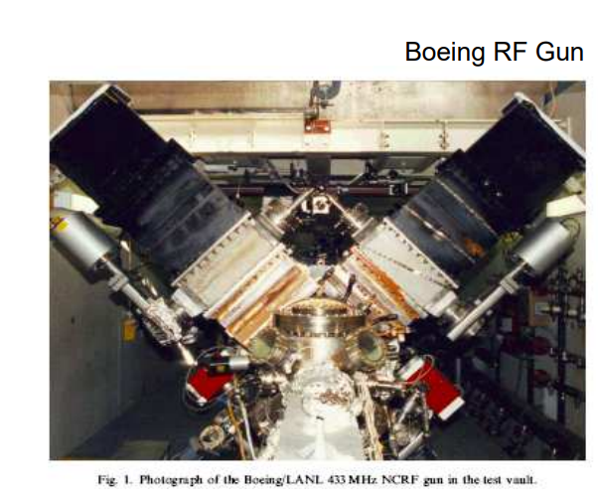
Comparison
Why use DC/ RF?
DC continuous operation
RF high charge density/ high gradient
What makes a good gun?
High Vacuum, High voltage, High intensity, Continuous operation
Low frequency RF
One way to avoid heating/ ohmic loss is by decreasing the frequency of the RF acceleration
SRF Cavities
High frequency gradient without overheating
Notes:
Photo explanation- Example diagram of the SCRF gun similar to that produced by the rossendorf group around 2008 which opened the gateway to many of the consideration of SCRF guns for continuous runs.
Bottom – Is the Boening LANL which was shown to operate at 25% duty cycle at a peak current of 45-132 and was the standard of high duty cycle Normal conducting RF gun
As discussed previously DC guns are when used in continuous low current situations such as polarized beams or Electron recovery linac FEL’s . RF with its high gradient is good for high intensity situations due its duty cycle limitations and heating issues.
The question becomes how to achieve sustained high duty cycle RF with high intensity/brightness?
One may be lowering the duty cycle such has boenings LANL gun which lowered the rf cycle to achieve 25% duty factor but this limits the field gradient.
Another answer may be SCRF cavities which can cool the cavities and allow high frequency fields.
Studies from Cornell Laboratory for Accelerator-based Sciences and Education indicate superior performance for high emittance cathodes (where high fields are needed) .
There are some technical issues of thermal isolation of the SC cavity and the cathode but it the upcoming years it may prove to be valuable area of study.

Slide 14
References
[1] D. Dowell Stanford, “LECTURE 2: ELECTRON EMISSION AND CATHODE EMITTANCE.” Accessed: Dec. 11, 2023. [Online]. Available: https://uspas.fnal.gov/materials/08UCSC/Lecture2_EmissionStatisticsCathodeEmittance.pdf
[2]Guillaume Machicoane, “Facility for Rare Isotope Beams PHY862 Introduction to Electron Sources.” Accessed: Dec. 11, 2023. [Online]. Available: https://people.nscl.msu.edu/~ostroumo/MSU/Lectures_2023/Electron_Sources_2023_Lecture%2013.pdf
[3]B. Dunham, “Introduction to Electron Guns for Accelerators,” 2008. Accessed: Dec. 11, 2023. [Online]. Available: https://www.classe.cornell.edu/~hoff/LECTURES/08S_688/08S_688_080225.pdf
[4]D. Dowell, S. Lidia, and J. Schmerge, “High Brightness Electron Injectors for Light Sources - Lecture 11: Classes of Electron Guns and Injectors,” 2007. Accessed: Dec. 11, 2023. [Online]. Available: https://uspas.fnal.gov/materials/08UCSC/HBl11_Classes_of%20_Injectors.pdf
[5] J. Smedley, M. Poelker, and T. Austin, “USPAS Course on Photocathode Physics Lecture 4,” 2011. Accessed: Dec. 11, 2023. [Online]. Available: https://uspas.fnal.gov/materials/12UTA/Cathode_4.pdf

Slide 15
References cont.
[6]I. V. Bazarov, A. Kim, M. N. Lakshmanan, and J. M. Maxson, “Comparison of dc and superconducting rf photoemission guns for high brightness high average current beam production,” Physical Review Special Topics - Accelerators and Beams, vol. 14, no. 7, Jul. 2011, doi: https://doi.org/10.1103/physrevstab.14.072001
[7]“Fermi level | physics,” Encyclopedia Britannica. https://www.britannica.com/science/Fermi-level]
[8]“How to cool ion beams using electron pulses,” Physics World, Jan. 18, 2021. https://physicsworld.com/a/how-to-cool-ion-beams-using-electron-pulses/ (accessed Dec. 11, 2023)
[9]R. Outreach, “Free Electron Lasers: The Biggest and Brightest Light Sources,” Research Outreach, Nov. 03, 2020. https://researchoutreach.org/articles/free-electron-lasers-biggest-brightest-light-sources
[10]“CLASSE: Energy Recovery Linac,” www.classe.cornell.edu. https://www.classe.cornell.edu/Research/ERL/ (accessed Dec. 11, 2023).

