Slide 1
Laser Driven Acceleration
Brooke Rickey BECOLA Graduate Student

Slide 2
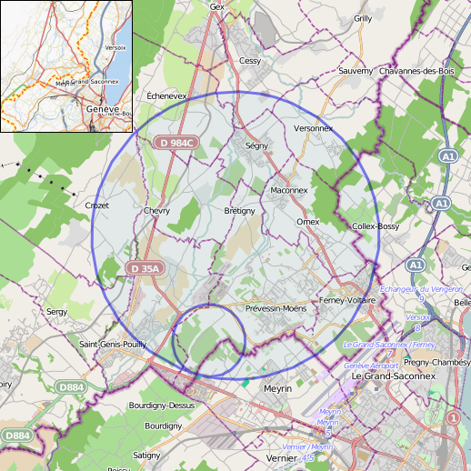
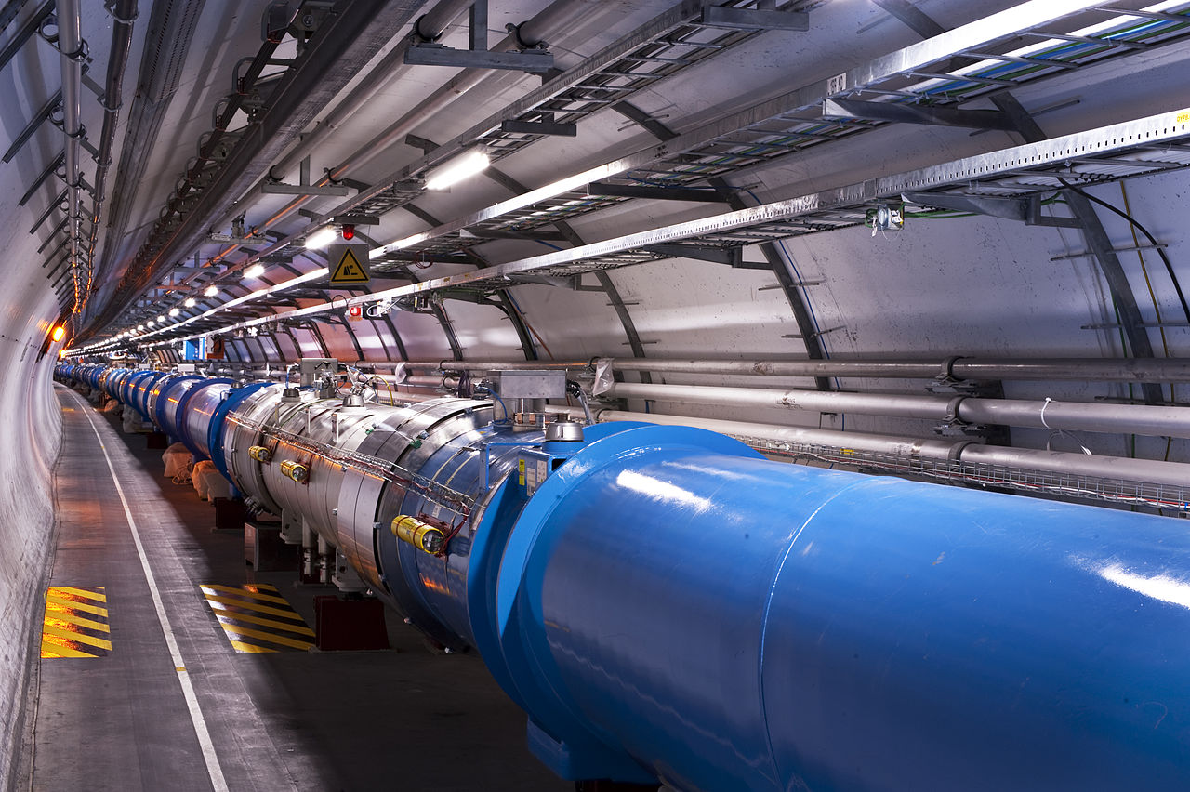
A “Common” Acceleration Method
High-energy particle accelerators driven by a radio-frequency electromagnetic field
Largest being the Large Hadron Collider (LHC) at CERN – a 27 km ring
Large size needed to combat limits on the acceleration field strength
Able to accelerate protons to 7 TeV energies
Cost over $4.7 billion
Hortala, Thomas (19 May 2021). CERN. Retrieved 20 May 2023.
Notes:
Fast ions spend less time in the acceleration region and gain less velocity than slower ions

Slide 3
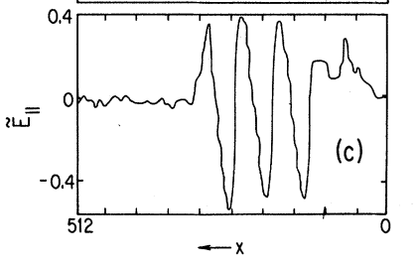
Laser Electron Accelerator
The first pioneering paper was published in 1979 by T. Tajima and J. M. Dawson^{[1]}
Predicts acceleration gradients 1000 times higher than the capabilities of radio-frequency machines
Proposed a mechanism to utilize high-power electromagnetic radiation from lasers to accelerate electrons to high energy in a short distance
Longitudinal E field
[1]Tajima, T., & Dawson, J. M. (1979). Laser electron accelerator. Physical review letters, 43(4), 267.
Notes:
specify atomic

Slide 4
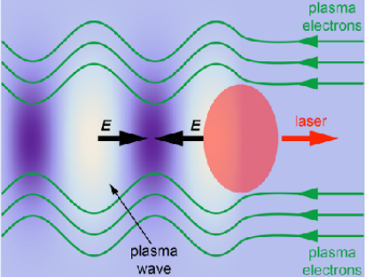
Laser Electron Accelerator
Utilized the Ponderomotive force
A cycle-averaged force experienced by a charged particle in a non-uniform EM field^{[2]}
Sending a laser pulse into a plasma creates a Langmuir wave
A traveling plasma wakefield
In the region of the laser pulse, the laser is intense enough to expel electrons, forming a trailing plasma wakefield
Electric fields within the wakefield (which moves at the speed of the laser pulse) can accelerate charged particles
[2] Simon Hooker, University of Oxford Advanced Accelerator Physics Royal Holloway, 14th September 2017
Notes:
specify atomic

Slide 5
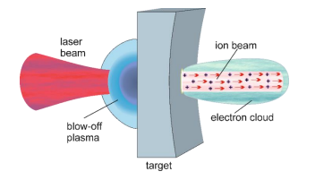
Laser Driven Ion Accelerator
Short-pulse high-intensity laser is aimed at a target inside a vacuum chamber
The laser field partially separates electrons from ions, between the electrons and ions a very strong electric field is produced^{[3]}
The ions follow the electron layer being pulled by the field
The field strength can
reach extremely high values (up to tens or even hundreds GeV/cm) and, as a result, the ions can be
accelerated to high energies over sub-mm distances, by many orders of magnitude shorter than
required in conventional RF-driven accelerators.
Laser
Beam
Ion Beam
Blow-off
Plasma
Electron Cloud
Target
J Badziak 2018 J. Phys.: Conf. Ser. 959 012001

Slide 6
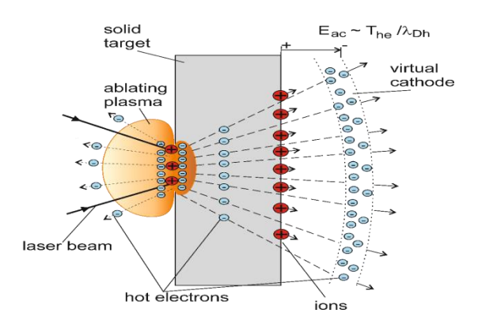
TNSA
short laser pulse interacting with the target front surface produces plasma and hot electrons with a temperature of Th ~ 0.1 – 10 MeV. The electrons penetrate through the target and on the target rear surface they form a Debye sheath playing the role of a virtual cathode. The electric field induced by the cathode: Eac ~ Th/eλDh ~ 1 – 100 GeV/cm ionises atoms at the rear surface and accelerates the produced ions over the distance Lac ~ 10 - 50 m to the energies Ei ~ zeLacEac ~ 1 – 100 MeV (λDh is the Debye length and z is the ion charge state). The ions are accelerated mostly along the rear surface normal and, as a result, the angular divergence of the ion beam is relatively small.
Target Normal Sheath Acceleration
Short laser pulse enters to interact with the targets ‘front’ surface to produce a plasma and hot electrons
J Badziak 2018 J. Phys.: Conf. Ser. 959 012001

Slide 7
TNSA
short laser pulse interacting with the target front surface produces plasma and hot electrons with a temperature of Th ~ 0.1 – 10 MeV. The electrons penetrate through the target and on the target rear surface they form a Debye sheath playing the role of a virtual cathode. The electric field induced by the cathode: Eac ~ Th/eλDh ~ 1 – 100 GeV/cm ionises atoms at the rear surface and accelerates the produced ions over the distance Lac ~ 10 - 50 m to the energies Ei ~ zeLacEac ~ 1 – 100 MeV (λDh is the Debye length and z is the ion charge state). The ions are accelerated mostly along the rear surface normal and, as a result, the angular divergence of the ion beam is relatively small.
Target Normal Sheath Acceleration
The electrons are able to penetrate through the target and on the ‘rear’ side they form a sheath that acts as a virtual cathode
J Badziak 2018 J. Phys.: Conf. Ser. 959 012001

Slide 8
TNSA
Target Normal Sheath Acceleration
The induced electric field by the sheath/ virtual cathode ionizes atoms on the ‘rear’ surface and then accelerates them along the normal to the surface
J Badziak 2018 J. Phys.: Conf. Ser. 959 012001

Slide 9
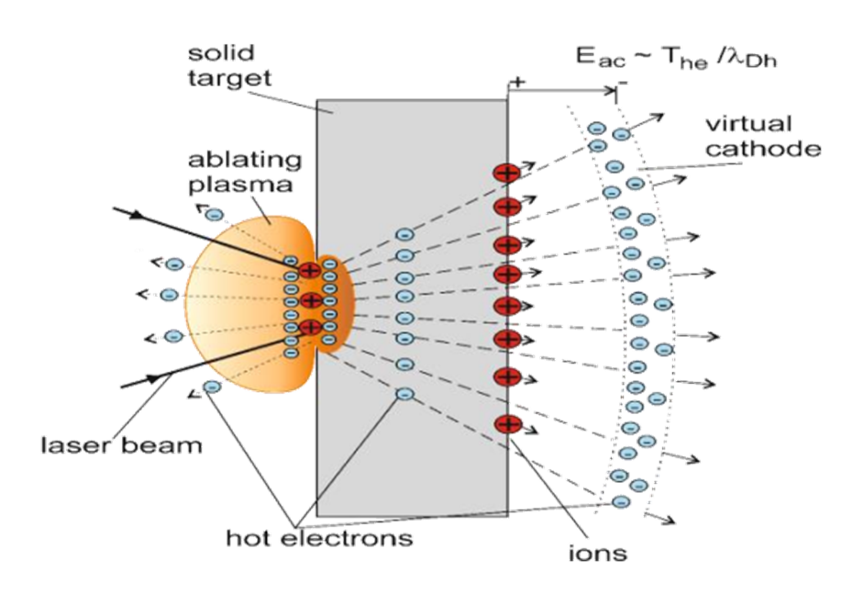
TNSA
Target Normal Sheath Acceleration
Both plastic and metal targets can be used, metal targets work better
Most effective in accelerating light ions, especially protons
The targets rear surface must be high enough quality as to not be disturbed by the shock wave caused by the laser entering the target
Target thickness varies from 1 µm to tens of µm with respective sub ps to 1-10 ps laser pulse durations
J Badziak 2018 J. Phys.: Conf. Ser. 959 012001

Slide 10
TNSA
Advantages
Small spread in the transverse distribution of the intensity of the beam
Low emittance of the beam in the transverse direction
Relatively moderate requirements for the laser beam quality and intensity as a result, proton beams with energies of tens of MeV can be produced with currently attainable laser intensities
Disadvantages
A large spread in energy over the ions produced
Relatively small areal ion density at the source resulting in relatively low ion beam intensity
Relatively low laser-to-ions energy conversion efficiency
High sensitivity of the ion beam parameters on the target rear surface quality

Slide 11
RPA
Radiation Pressure Acceleration is a unique more intense mechanism of acceleration
Different from TNSA by forming a double layer with a large potential drop that produces a strong electric field to accelerate the ions
Preplasma
Target
Laser Beam
[3] J Badziak 2018 J. Phys.: Conf. Ser. 959 012001

Slide 12
RPA
Radiation Pressure Acceleration is a unique more intense mechanism of acceleration
A ponderomotive force forward and back are produced by a laser pulse interacting with the preplasma near the critical plasma surface
Preplasma
Target
Laser Beam
[3] J Badziak 2018 J. Phys.: Conf. Ser. 959 012001

Slide 13
RPA
Radiation Pressure Acceleration is a unique more intense mechanism of acceleration
Both forces act on the plasma electrons, pushing them in the direction of the respective force, separating them from the plasma ions
Preplasma
Target
Laser Beam
[3] J Badziak 2018 J. Phys.: Conf. Ser. 959 012001

Slide 14
RPA
Radiation Pressure Acceleration is a unique more intense mechanism of acceleration
The ion and electron layers form a double layer which contain a region of non-neutral plasma with a large potential drop, this produces a strong electric field that accelerates the ions
Preplasma
Target
Laser Beam
[3] J Badziak 2018 J. Phys.: Conf. Ser. 959 012001

Slide 15
RPA
Can be split into two stages – hole boring stage
Ions from the target front surface are accelerated towards the target interior by the ponderomotive forces, terminating when the accelerated ions reach the target rear surface
Preplasma
Target
Laser Beam
[3] J Badziak 2018 J. Phys.: Conf. Ser. 959 012001

Slide 16
RPA
Can be split into two stages – light sail stage
The plasma bunch containing the ions and electrons cross through the rear section of the target and are accelerated by the electric field
Preplasma
Target
Laser Beam
[3] J Badziak 2018 J. Phys.: Conf. Ser. 959 012001

Slide 17
RPA
Advantages
High conversion efficiency
High areal ion density at the source (high intensity ion beam can be produced at moderate ion energies)
Small spread in ion energy
Very short ion pulses can be produced
Both light and heavy ions can be efficiently accelerated
Disadvantages
Very high laser intensities are required for efficient acceleration, preferably circularly polarized or short wavelength
The laser beam must be uniform in the transverse direction
Instabilities can occur and destroy the ion beam
Most RPA properties have not yet been confirmed experimentally

Slide 18
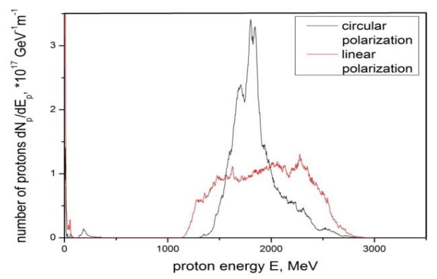
Simulation Results
Simulation work by J Badziak 2018 J. Phys.: Conf. Ser. 959 012001
See the preference for a circular polarized laser beam to be used to reduce energy spread

Slide 19
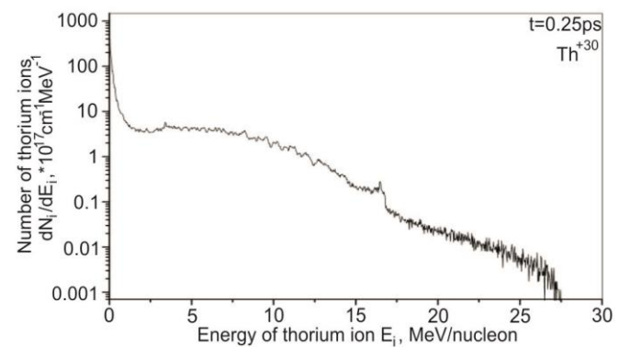
Simulation Results
Simulation work by J Badziak 2018 J. Phys.: Conf. Ser. 959 012001
Heavy elements can be accelerated at respectable energies

Slide 20
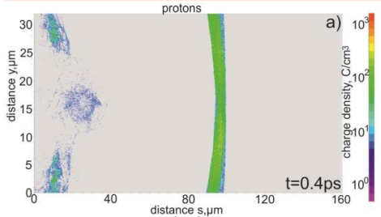
Simulation Results
Simulation work by J Badziak 2018 J. Phys.: Conf. Ser. 959 012001
Compact, high-density proton block that would be prevalent in RPA mechanisms

Slide 21
Simulation Results
Simulation work by J Badziak 2018 J. Phys.: Conf. Ser. 959 012001
When the acceleration time is longer than the pulse duration and the electrons move together with the ions in a relatively collimated form

Slide 22
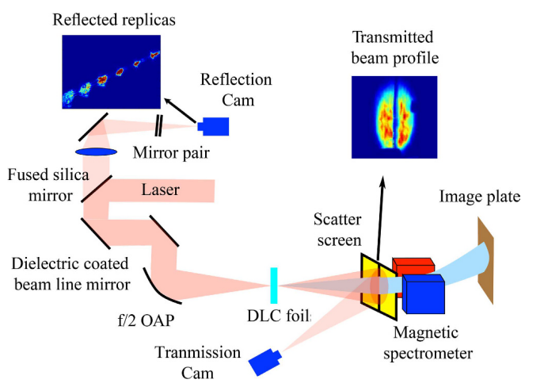
Summary
Laser driven acceleration can provide an alternative to RF driven acceleration in a more compact, less complex, and less expensive setup
Different approached have been designed and are in testing and simulation phases, TNSA and RPA being the most developed
More testing and development of the ideas and designs must occur for the technique to be used in a more variety of ways including nuclear physics, material engineering, medicine, and inertial fission
J. H. Bin, et al. 2017 Nature Scientific Reports, 7(1), 43548.

Slide 23
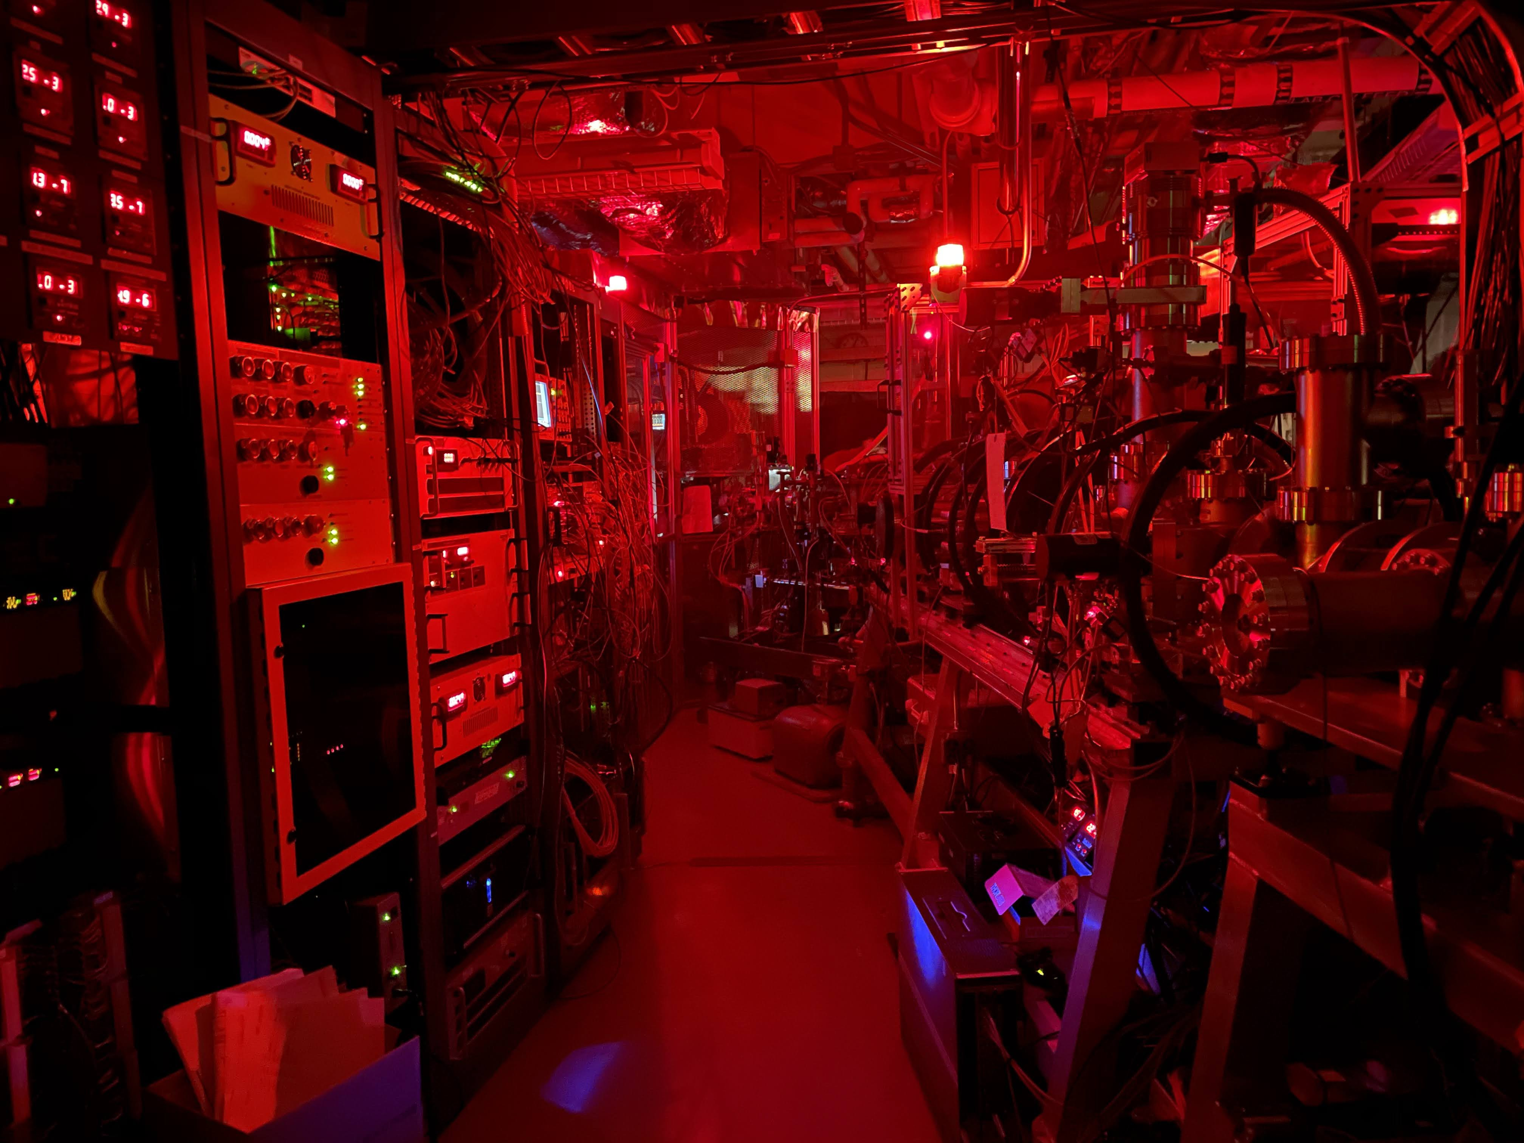
Thank you
Hortala, Thomas (19 May 2021). CERN. Retrieved 20 May 2023
Tajima, T., & Dawson, J. M. (1979). Laser electron accelerator. Physical review letters, 43(4), 267.
Simon Hooker, University of Oxford Advanced Accelerator Physics Royal Holloway, 14th September 2017
J Badziak 2018 J. Phys.: Conf. Ser. 959 012001
J. H. Bin, et al. 2017 Scientific Reports, 7(1), 43548.
Notes:
Add more collaborators?

