Slide 1
Electron Cyclotron Resonance Ion Sources and Future Generations
Charles Martin
PHY 862

Slide 2
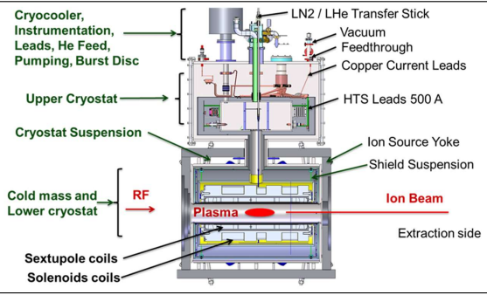
What you need to get started
Solenoids
Sextupole
High Voltage
RF Technology
Ultra High Vacuum
Oven
Cryogenics
These are some of the things you will need to have depending on the type of system you want to construct and what charge state you want to achieve.
[4]

Slide 3
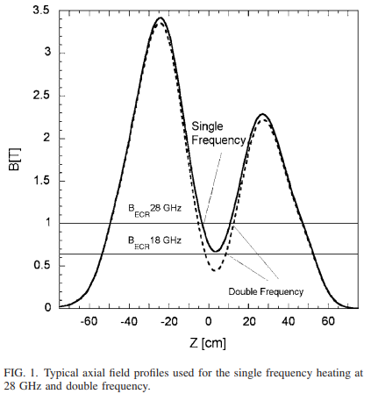
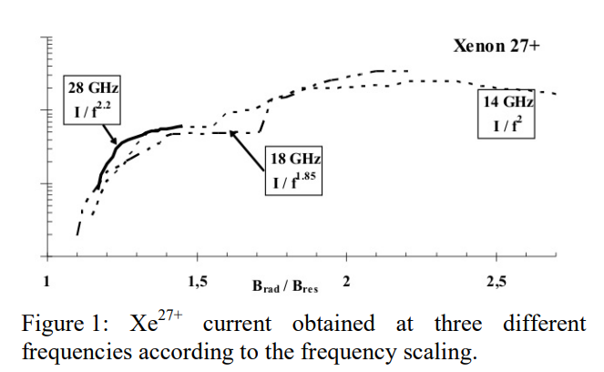
Electron Cyclotron Resonance
From [7]
2.45 GHz, 14 GHz, 18 GHz, 28 GHz, 56 GHz?
When the frequency of the EM wave is equal to the gyrofrequency of the electrons the waves can transfer their energy to the electrons in a selective manner called electron cyclotron resonance (ECR) [8]
According to Geller’s Law, the beam current produced from the source scales with the square of the frequency. [3]
From [3]
[8]

Slide 4
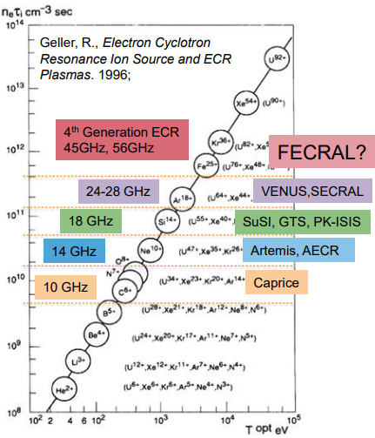
Ion Charge Production
Why the need for different frequencies in ECR Ion Sources?
Charge state scales with frequency scaling in most cases. It is much harder to ionize heavier particles and achieve the desired charge states.
Higher Frequency heating of the ECR plasma can, in theory, lead to better beam quality and higher charge state.
Do the costs outweigh the benefits? Where does the money come from for this development?

Slide 5
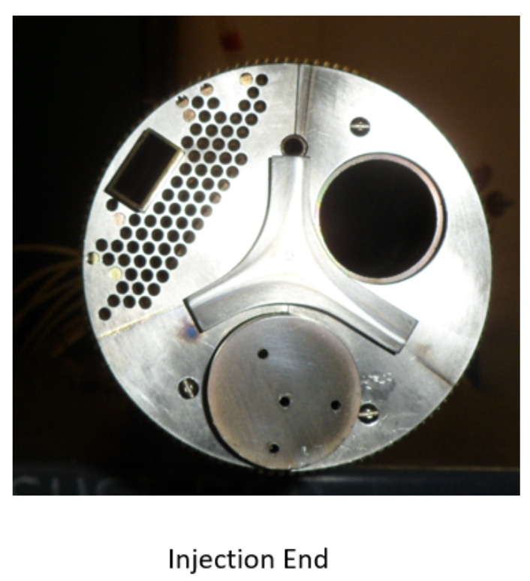
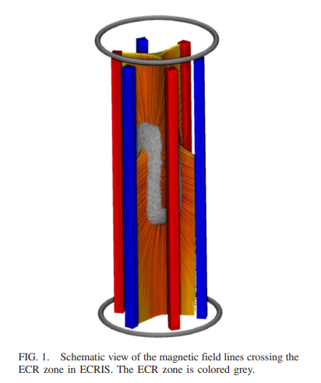
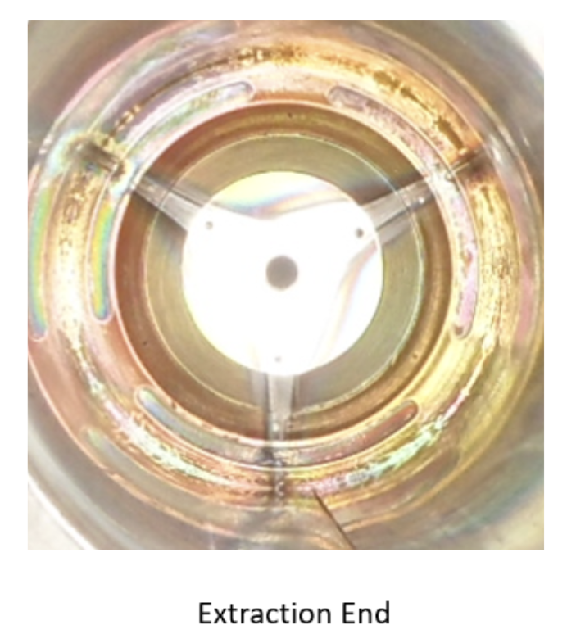
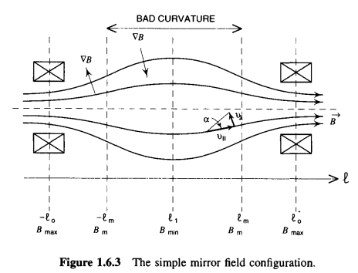
Shape and Containment of the Plasma
Understanding more about the plasma dynamics and the actual shape of it can give a better understanding of the processes involved and what can be improved
The shape of the plasma itself is a combination of both confining magnetic fields and the magnetic mirror effect
The shape is also present in the extraction node, and showcases the effect of the sextupole field
The loss lines for the electrons in the plasma are rotated 60 degrees between injection and extraction

Slide 6
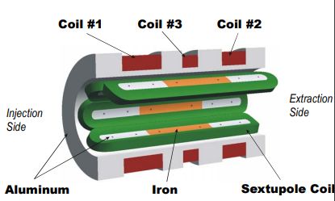
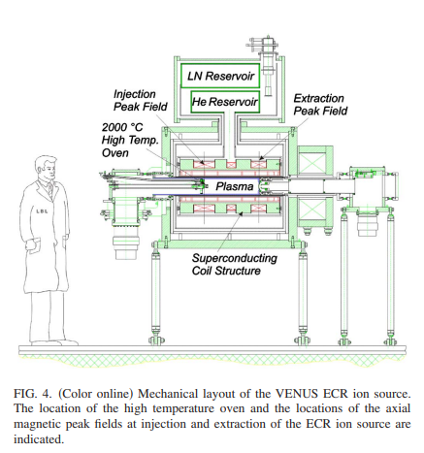
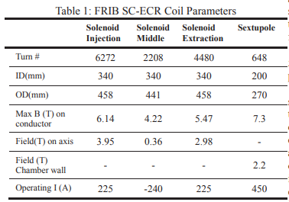
3rd Generation Sources
Examples of these types of sources are the FRIB HP-ECR(MSU), SC-ECR (Riken), and Venus (LBNL).
These sources use superconducting magnets to achieve their minimum B-field confinement.
The VENUS (Versatile ECR ion source for Nuclear Science) utilizes three NbTi solenoids surrounding a sextupole magnet (sextupole-in-solenoid design) [6]
These machines can achieve charge states of up to U³³⁺ U⁵⁵⁺ and Ar¹⁸⁺(VENUS) [7]

Slide 7
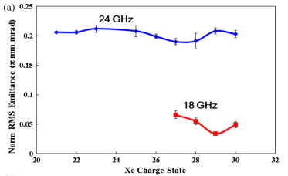
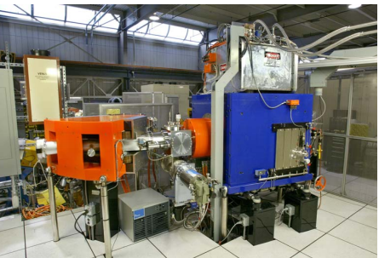
3rd Generation Sources
Accelerator physicists always require higher beam brightness defined by the square of the beam current (I) over the emittance [9]
The ion beam intensities of the third generation ECR ion sources have been enhanced by a factor of 2–10 over the second generation ECR sources, achieved by increasing the magnetic fields and microwave power by a factor of 1.5–2. [9]
Microwave power can be increased by a factor of 4-5 by using a Gyrotron instead of Klystron
Plasma Instabilities can negatively affect beam stability. Many 3rd Generation sources will implement two, or even three, frequency heating patterns at different powers to maintain the source. [9]

Slide 8
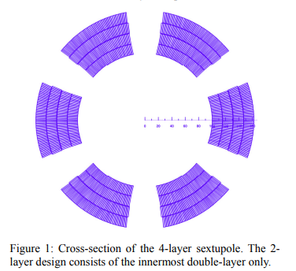
4th Generation?
This is where things get tricky, and it is difficult to see a path where 4th generation ECR ion sources are viable in the near future
As frequency increases in the source, higher magnetic confinement becomes necessary going beyond the current technology of NbTi
Nb₃Sn wire is said to be able to provide up to 15 T of magnetic field, which in turn would allow for 56 GHz electron resonance. [6]
Use of the sextupole-in-solenoid magnetic system is also used to generate the highest field [1]
Some problems with this generation of machine include how difficult they are to manufacture, as well as how brittle the superconducting coils are.

Slide 9
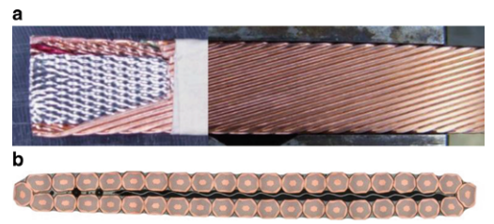
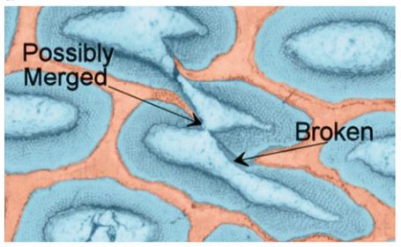
Nb₃Sn and 4th Generation Issues
For the VENUS source, a tantalum x-ray shield was added to the plasma chamber. This is trying to decrease the bremsstrahlung heat load to the cryostat. [7]
The radial and axial magnetic fields in the source will move during operation. This will create friction, which creates heat.
Nb₃Sn wire is also very brittle and it can merge or break during operation.
Higher field parameters require higher current and power, which in turn increases demand for more cooling. If not cooled properly, the magnet will lose superconductive capabilities.
Quench has to be detected very quickly in order to be able to mitigate the damage
[10]

Slide 10
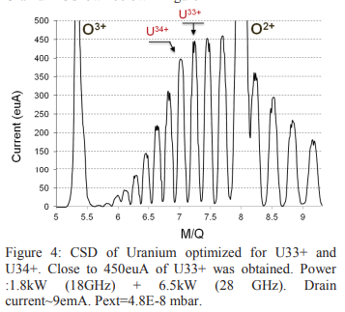
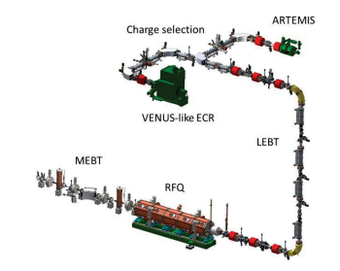
Limitations and Beam Quality
Beam emittance of an ECR ion source operating at higher microwave frequency and power, and higher magnetic fields, could be slightly higher but not significantly than at lower microwave frequency and power, and lower magnetic fields. [9]
Long-term operating stability of beam intensity of days and weeks at high intensity of more than 300 eμA and at high microwave power of >5 kW, still needs demonstration for the third generation ECR ion sources. [9]
[11]

Slide 11
What is next?
The hardest part of creating a new generation of ECR ion sources, is the magnet structure
While the magnets are the most demanding technical challenge — the design studies show it is feasible to build an 4th Generation source at f ≥ 50 GHz [1]
The cost of such a source should only be about 2 or 3% of the cost of a state-of-the-art Rare Isotope Beam facility [1]
LHC is upgrading using Nb₃Sn magnetic structures for high energy physics and this could lead to more developments and funding of research [1]

Slide 12
References
[1].https://accelconf.web.cern.ch/Cyclotrons2010/talks/wem1cio01_talk.pdf
[2].https://pubs.aip.org/aip/rsi/article/67/12/4109/464171/Effects-of-frequency-and-magnetic-field-scaling-on
[3].https://accelconf.web.cern.ch/l06/PAPERS/MO3001.PDF
[4].https://indico.frib.msu.edu/event/9/attachments/115/673/12.05_H_Ren_FRIB_28_GHz_ECR_Ion_Source_Dev.pdf
[5].https://journals.aps.org/prab/pdf/10.1103/PhysRevSTAB.18.123401
[6]. https://accelconf.web.cern.ch/pac2009/papers/mo6pfp068.pdf (Nb3Sn ECR)
[7]. https://pubs.aip.org/aip/rsi/article/79/2/02C710/1068258/High-intensity-production-of-high-and-medium (VENUS)
[8]. Geller R., Electron Cyclotron Resonance Ion Sources and ECR Plasmas by Richard Geller, 1996
[9]. https://journals.aps.org/prab/abstract/10.1103/PhysRevAccelBeams.20.094801(SECRAL)
[10]. https://www.osti.gov/servlets/purl/1843251#:~:text=The%20intermetallic%20compound%20Nb3Sn%2C%20discovered,%25)%20Sn. (Nb3Sn wire)
[11]. https://accelconf.web.cern.ch/ecris2012/papers/thyo03.pdf

