Slide 1
An Algorithm for Accelerator Performance Drifts
Ryan Yeung yeung@frib.msu.edu
PHY 862 Final Presentation
13 December 2023

Slide 2
Overview
Background
The Safe Robust Conjugate Direction Search (RCDS-S) algorithm
Experimental tests
Future work

Slide 3
Background – General
Accelerator settings with high performance needed
Optimization algorithm changes machine control parameters, i.e. tuning knobs, to extremize the objective function
Typically magnet strength settings
Optimization done during accelerator design (“offline optimization”)
vs online optimization

Slide 4
Background – Online Optimization
Needs efficient algorithms
Online optimization algorithms generally lead only to *overall* improvement, i.e. not every step improves performance
Dedicated time for online optimization algorithms, then remain untouched during user operation

Slide 5
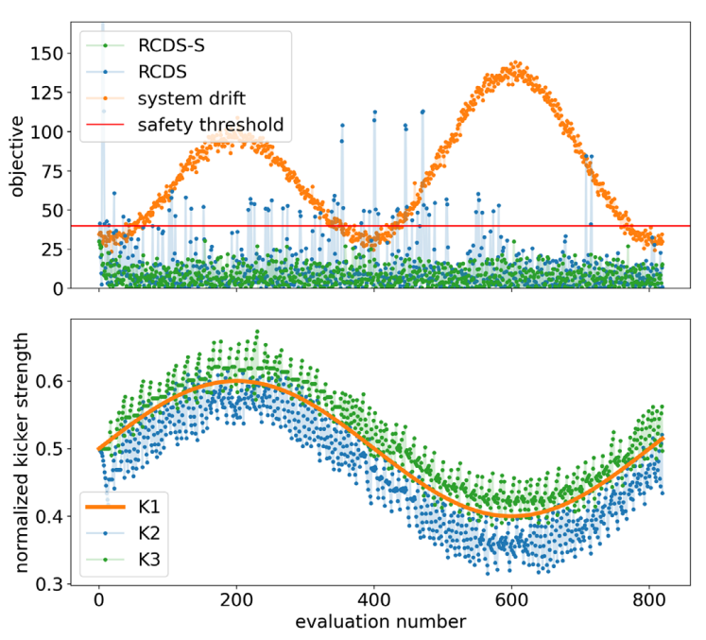
Background – Performance Drift
Variations in environment
Often unknown
Very rarely deterministic enough to control

Slide 6
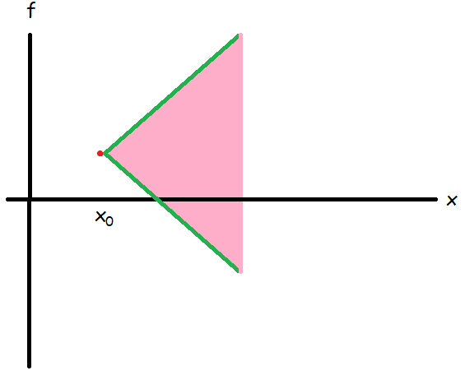
Objective Function
Objective function $f\left(\vec{x}\right)$, with tuning knob values $\vec{x}$
Measured function $y$, variance of measurement errors $σ_{n}^{2}$
$y=f\left(\vec{x}\right)+ε$
$ε∼𝒩\left(0,σ_{n}^{2}\right)$
Require L-Lipschitz continuity:
With noise,
$y≤y_{0}+L⋅\left\|\vec{x}−{\vec{x}}_{0}\right\|+\sqrt{σ^{2}+σ_{0}^{2}}⋅\hat{ε}$

Slide 7
Drift
Time-dependent error $y=f\left(\vec{x}\right)+ε\left(t\right)$
Error due to drift $σ_{t}=\sqrt{t}σ_{d}$
Assume noise and drift uncoupled
Probability of error staying within threshold value (safety probability):
$\text{Given} \text{safety} \text{threshold} h$
$P\left(\vec{x}\right)=\frac{1}{2}\left[1+erf\left(\frac{h−E_{max}\left(\vec{x}\right)}{\sqrt{2\left(2σ_{n}^{2}+tσ_{d}^{2}\right)}}\right)\right]$
Error $\hat{ε}≤\frac{h−E_{max}}{\sqrt{2σ_{n}^{2}+tσ_{d}^{2}}}$

Slide 8
Conjugate Direction Search
Conjugate directions: $\vec{u}⋅\overset{⃡}{H}⋅\vec{v}=0$ where $H_{ij}=∂^{2}f/∂x_{i}∂x_{j}$
$f$ is the objective function
Estimate eigenvectors of $\overset{⃡}{H}$ for efficiency
Start w/ eigenvectors of Hessian
Run safety exploration
Take direction between best solutions of current iteration and previous
Successive search in conjugate direction unspoiled by previous results (orthogonal)
Relatively efficient

Slide 9
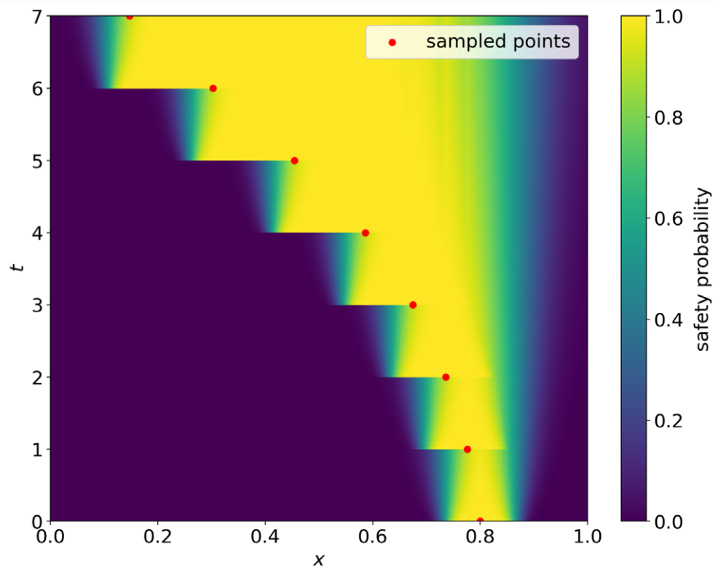
Safety Exploration
Calculate safety probability for all points along conjugate direction
Maximum probability of point is safety probability
Next sample point is edge of safety region
> Expand safety region
Run until:
Success
Aborted (no safe region)
Unsuccessful (maximum trial solution attempts)
Weighs later points more heavily
Fit parabola to sampled points for minimum

Slide 10
RCDS-S
Replace existing direction with new direction (previous min. to new min.)
Can be disabled
Choice of hyperparameters is crucial
Lipschitz constant $L$ (same for all directions if directions are to be replaced)
Smaller: less safe
Larger: slower convergence > could fail to follow drift
Drift rate $σ_{d}$
Both hyperparameters can be obtained through additional measurements / historic data

Slide 11
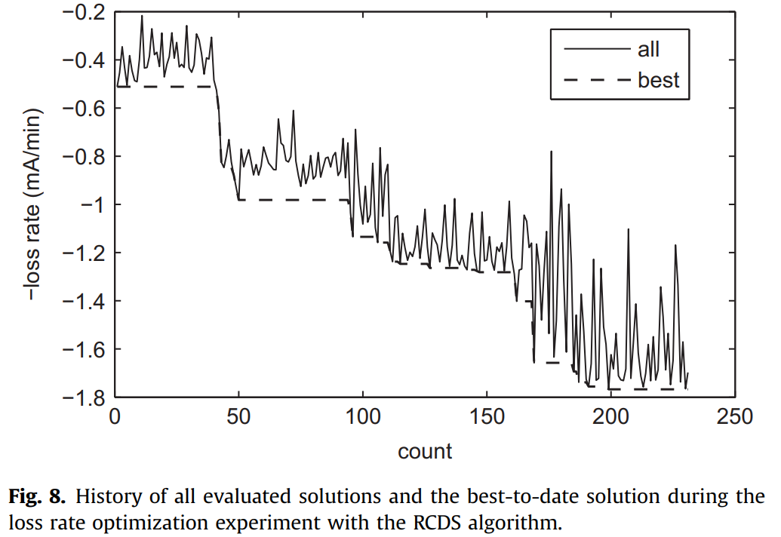
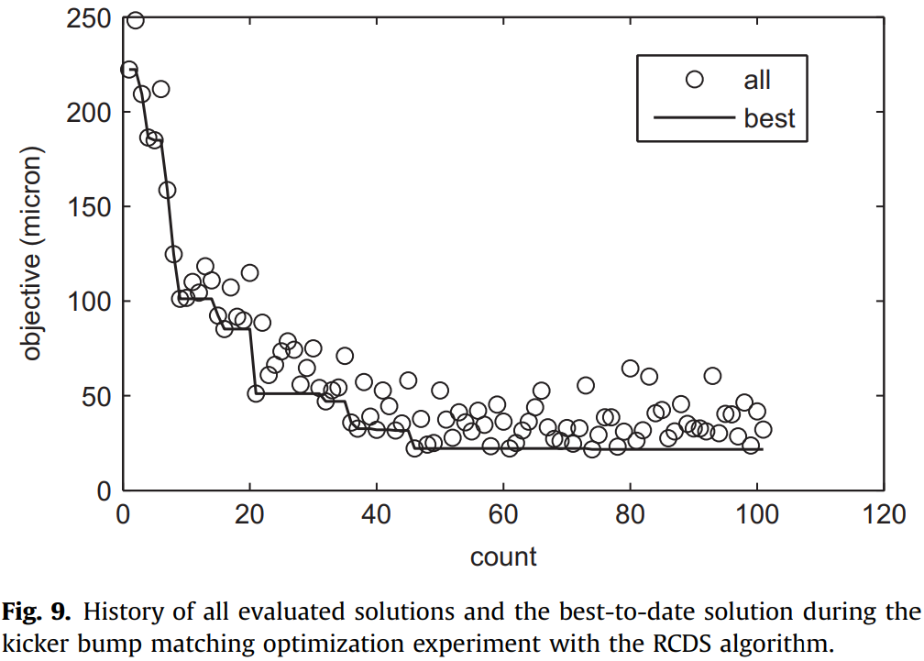
RCDS vs RCDS-S
Some other method of finding parabola minimum
Most steps are not improvements!

Slide 12
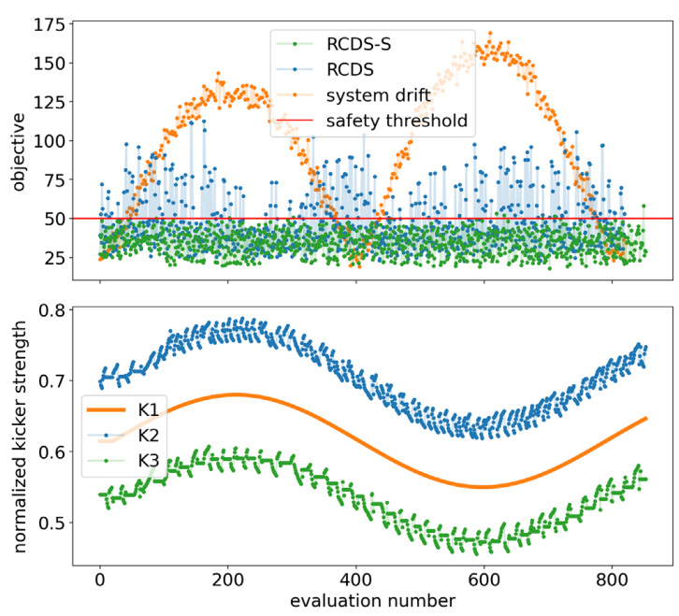
Results – SPEAR3 Kicker-Bump Matching
Minimize residual oscillation
Objective function variance greater than in simulation
Period 800 pts
Noise level 5 μm
Safety threshold 50 μm
Some unsafe solutions returned
Possibly due to Lipschitz constant mismatch between simulation and reality
Larger $L$ reduces violation rate but risks failing to follow drift

Slide 13
Future Work
Only 1-D proof of concept so far
Voltage amplitude for only 1 kicker
Safety exploration requires exponential increase of computing power with number of dimensions
Need to generalize to multiple dimensions (i.e. parameters)
Compare 13 parameters in RCDS optimization of vertical emittance

Slide 14
Conclusion
Promising method for ongoing online optimization
In need of efficient method to generalize to multiple dimensions

Slide 15
References
Zhang, Z., Song, M., & Huang, X. (2022, December 8). Optimization method to compensate accelerator performance drifts. Phys. Rev. Accel. Beams. https://link.aps.org/doi/10.1103/PhysRevAccelBeams.25.122801
Huang, X., Corbett, J., Safranek, J., & Wu, J. (2013). An algorithm for online optimization of accelerators. Nucl. Instrum. Methods Phys. Res. A, 726, 77–83. https://doi.org/10.1016/j.nima.2013.05.046
Ng, C., Akcelik, V., Candel, A., Chen, S., Ge, L., Kabel, A., Lee, L.-Q., Li, Z., Prudencio, E., Schussman, G., Uplenchwar, R., Xiao, L., Ko, K., Austin, T., Cary, J. R., Ovtchinnikov, S., Smith, D. N., Werner, G. R., & Bellantoni, L. (2008). Design and optimization of large accelerator systems through high-fidelity electromagnetic simulations. J. Phys. Conf. Ser., 125, 012003. https://doi.org/10.1088/1742-6596/125/1/012003

