Slide 1
Luminosity in Particle Colliders
PHY862 Final Presentation
Xinfei Huang
13 Dec 2023

Slide 2
Table of Content
Definition and calculation of luminosity
Various corrections
Optimization
Luminous region

Slide 3
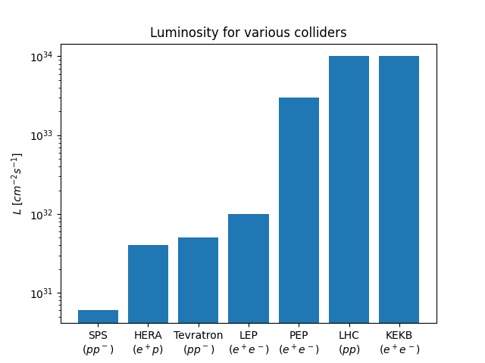
Definition
$L=\frac{1}{σ}\frac{dR}{dt}$ (unit: $cm^{−2}⋅s^{−1}$)
$σ$: cross section
$\frac{dR}{dt}$: # of events per second
$L_{int}⋅σ=σ⋅\int_{0}^{t}{L\left(t^{′}\right) dt^{′}}=$ # of events
Fixed target: $L=Φρl$
$Φ$: beam flux
$ρ$: target density
$l$: target length (thickness)
Notes:
Luminosity measures

Slide 4
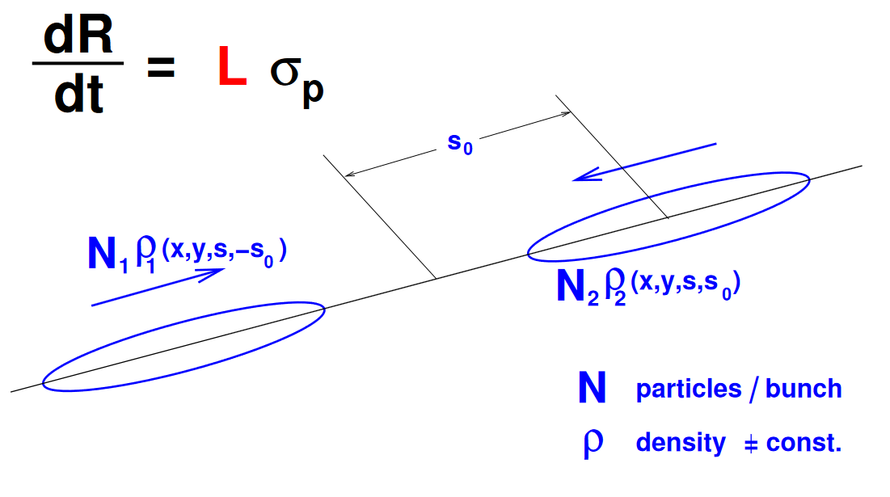
Collider Luminosity
Assuming head-on collisions & uncorrelated positional dependency of each bunch
$L=2N_{1}N_{2}fN_{b}⨌_{−∞}^{∞}{ⅆr^{3}ⅆs_{0} ρ_{1x}\left(x\right)ρ_{1y}\left(y\right)ρ_{1s}\left(s−s_{0}\right)ρ_{2x}\left(x\right)ρ_{2y}\left(y\right)ρ_{2s}\left(s+s_{0}\right)}$
With further assumption of Gaussian distribution
$L=\frac{N_{1}N_{2}fN_{b}}{4πσ_{x}σ_{y}}$
$N_{i}$: # of particles per bunch
$f$: revolution frequency
$N_{b}$: # of bunches per beam
$σ_{j}$: stdev of Gaussian in $x_{j}$

Slide 5
Various Corrections
Crossing angle
Collision offset
Hourglass effect

Slide 6
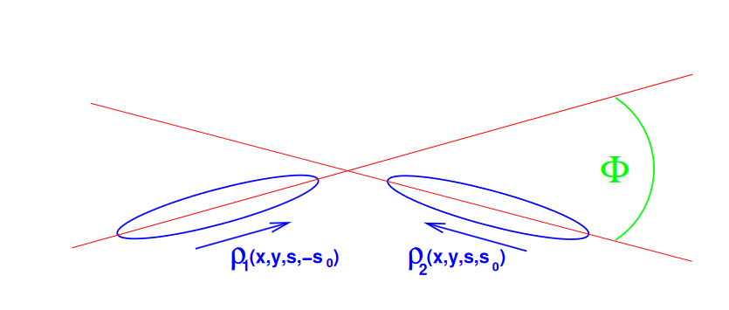
Crossing Angle
Crossing angle is usually used to avoid unwanted collisions for bunched beams (e.g. $300 μrad$ in LHC)
$L=2\cos^{2}\left(\frac{φ}{2}\right)N_{1}N_{2}fN_{b}⨌ρ_{1x}\left(x_{1}\right)ρ_{1y}\left(y_{1}\right)ρ_{1s}\left(s_{1}−s_{0}\right)ρ_{2x}\left(x_{2}\right)ρ_{2y}\left(y_{2}\right)ρ_{2s}\left(s_{2}+s_{0}\right)ⅆxⅆyⅆsⅆs_{0}$
$x_{1}=x⋅cos\frac{φ}{2}−s⋅sin\frac{φ}{2}$
$x_{2}=x⋅cos\frac{φ}{2}+s⋅sin\frac{φ}{2}$
$s_{1}=s⋅cos\frac{φ}{2}−x⋅sin\frac{φ}{2}$
$s_{2}=s⋅cos\frac{φ}{2}+x⋅sin\frac{φ}{2}$

Slide 7
Crossing Angle (2)
For small angle approx. & assuming $σ_{s}≫σ_{x,y}$
$L=S⋅\frac{N_{1}N_{2}fN_{b}}{4πσ_{x}σ_{y}}$
$S≈\frac{1}{\sqrt{1+{\left(\frac{σ_{s}}{σ_{x}}\frac{φ}{2}\right)}^{2}}}$
For LHC ($φ≈300 μrad$), $S≈0.835$
Alternative interpretation
$σ_{eff}=σ⋅\sqrt{1+{\left(\frac{σ_{s}}{σ_{x}}\frac{φ}{2}\right)}^{2}}$

Slide 8
Transverse Offset
Consider transverse offset in addition to crossing angle
$x_{1}=d_{1}+x⋅cos\frac{φ}{2}−s⋅sin\frac{φ}{2}$
$x_{2}=d_{2}+x⋅cos\frac{φ}{2}+s⋅sin\frac{φ}{2}$
$s_{1}=s⋅cos\frac{φ}{2}−x⋅sin\frac{φ}{2}$
$s_{2}=s⋅cos\frac{φ}{2}+x⋅sin\frac{φ}{2}$
$L=W⋅e^{\frac{B^{2}}{A}}⋅S⋅\frac{N_{1}N_{2}fN_{b}}{4πσ_{x}σ_{y}}$
$W=exp(−\frac{1}{4σ_{x}^{2}}{\left(d_{2}−d_{1}\right)}^{2})$
$A=\frac{\sin^{2}\frac{φ}{2}}{σ_{x}^{2}}+\frac{\cos^{2}\frac{φ}{2}}{σ_{s}^{2}}$, $B=\frac{\left(d_{2}−d_{1}\right)sin\frac{φ}{2}}{2σ_{x}^{2}}$

Slide 9
Hourglass Effect
$s$-dependency of beam size $σ$ near IP
$σ\left(s\right)=\sqrt{ε⋅β(s)}$
$β\left(s\right)=β^{∗}+\frac{s^{2}}{β^{∗}}$
The resulted integral usually has to be solved numerically
For LHC with $β_{x}^{∗}=β_{y}^{∗}=0.55 m$, accounting for crossing angle, the luminosity is reduced from $1.000×{10}^{34} {cm}^{−2}s^{−1}$ to $0.993×{10}^{34} {cm}^{−2}s^{−1}$ due to the hourglass effect

Slide 10
Optimization
Goal: maximize integrated luminosity
Assuming $L\left(t\right)=L_{0}⋅e^{−\frac{t}{τ}}$
Maximizing $\left\langle L\right\rangle =\frac{\int_{0}^{t_{r}}{L\left(t\right)ⅆt}}{t_{r}+t_{p}}$ gives $t_{r}≈τ⋅ln(1+\sqrt{\frac{2t_{p}}{τ}}+t_{p}/τ)$
$t_{p}$: time needed for run preparation
$t_{r}$: duration of a luminosity run
For LHC where $t_{p}≈10 h$ and $τ≈15 h$
$t_{r}≈15 h$

Slide 11
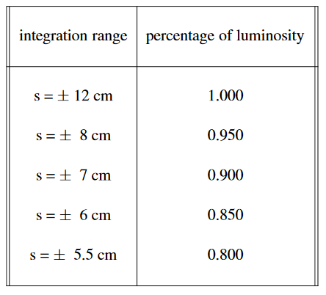
Luminous Region
Distribution of interaction vertices around IP
$L\left(s\right)=\int_{−s}^{s}{L\left(s^{′}\right)ⅆs′}$
Fraction of interaction within $±s$
Detector coverage

Slide 12
References
Herr, W.; Muratori, B. (2006). "Concept of luminosity" (PDF). In Brandt, D. (ed.). CERN Accelerator School: Intermediate Course on Accelerator Physics, Zeuthen, Germany, 15-26 Sep 2003. CERN. pp. 361–378. doi:10.5170/CERN-2006-002. ISBN 978-92-9083-267-6.

