Slide 1
Betatron Oscillations and MAD-X
xxxxx
Phys 862: Accelerator Systems

Slide 2
Outline
Betatron Oscillations in Betatrons
Betatrons
Weak Focusing
Betatron Oscillations in Synchrotrons
Strong Focusing
Twiss Parameters
Beta Function
Mad-X
Program
Twiss Parameter Calculations

Slide 3
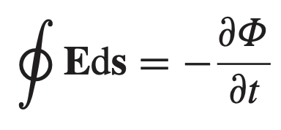
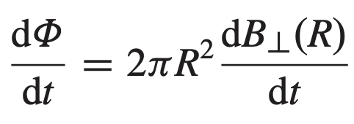
Betatron
Changing Magnetic Fields -> Accelerate and bend beam
Wideroe-1/2/ (Betatron) Condition:
- Condition for dr/dt = 0

Slide 4
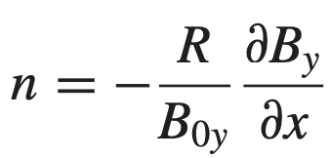
Weak Focusing
For orbits not along ideal orbit R:
r: nonideal orbit
x: small offset from ideal orbit
(r direction)
Taylor Expand around Magnetic field:
Solution: Oscillations in x
Stability condition in x:

Slide 5
Weak Focusing (Cont.)
Similarly for forces in y:
(z direction)
Use Gauss’s law for magnetic field to find field in x:
Solution: Oscillations in y
Stability condition in y:
Steinbeck’s Stability Criterion:
<-- Betatron Oscillations in a Betatron

Slide 6
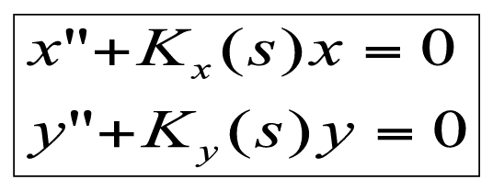
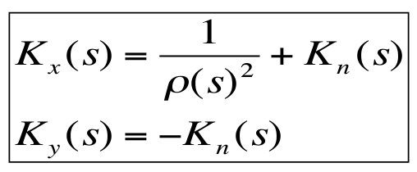
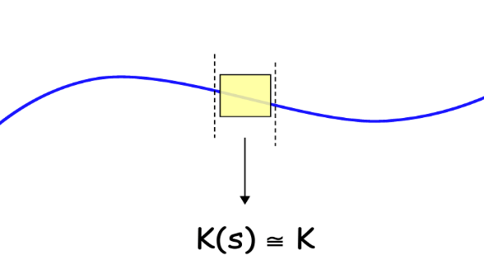
Strong Focusing
Particle trajectory depends on the magnetic field lattice
Oscillation frequency changes
Can show using linear approximations in Magnetic field:
Hill’s Equations
Method 1: Piecewise linear approximation

Slide 7
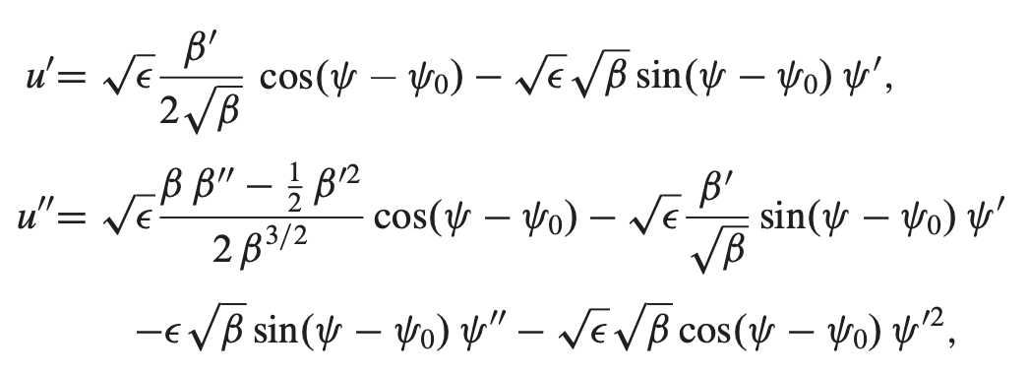
Strong Focusing
Method 2: Variation of Integration
Guess:
Take derivatives:
Plug back into differential equation:
To get two equations:
(s → z)
&
…

Slide 8
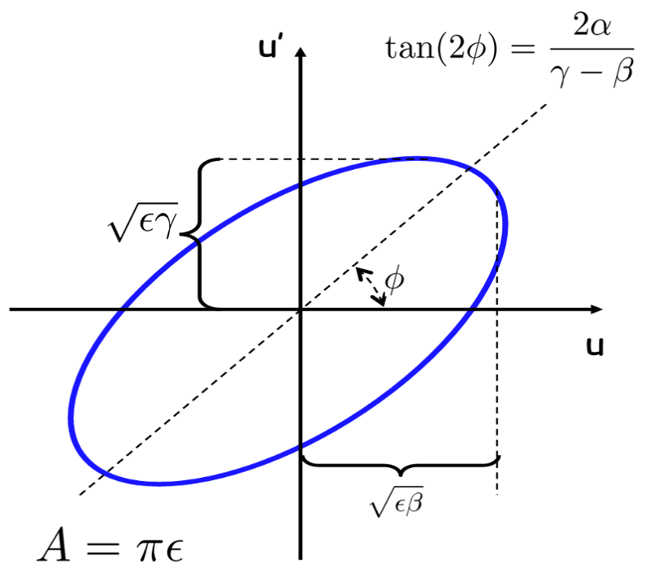
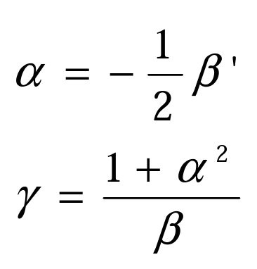
Twiss Parameters
Able to tell us the phase space of the beam at a given point s along the trajectory (Courant-Snyder Invariant)

Slide 9
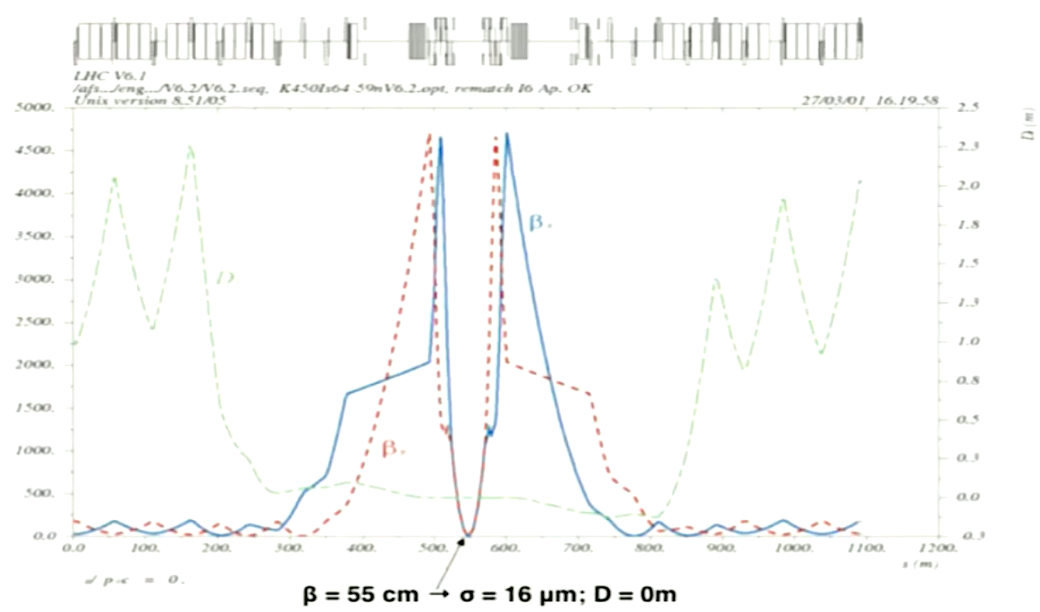
Mad-X
Methodical Accelerator Design
Used at CERN
Written in C, C++, and Fortran
Compatible with Linux, MacOS, Windows
Builds off MAD-8 with Polymorphic Tracking Code (PTC)
Others: BETA, OPA, Tracy, Elegant, etc.
Program example process:
Input: Set up parameters
# Cells
Cell Lengths
Magnets and magnet lengths
Call directives (ex. TWISS)
Outputs:
Beam size, Tune
Twiss parameters
6 x 6 transfer matrices
6 x 6 x 6 second order transfer maps
Etc.
MAD-X example graph at ATLAS
Notes:
Why make beta small?

Slide 10
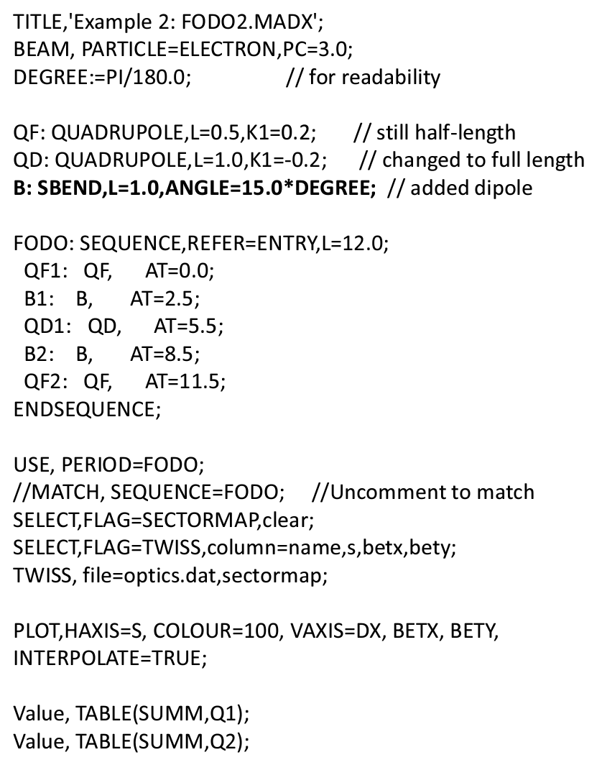
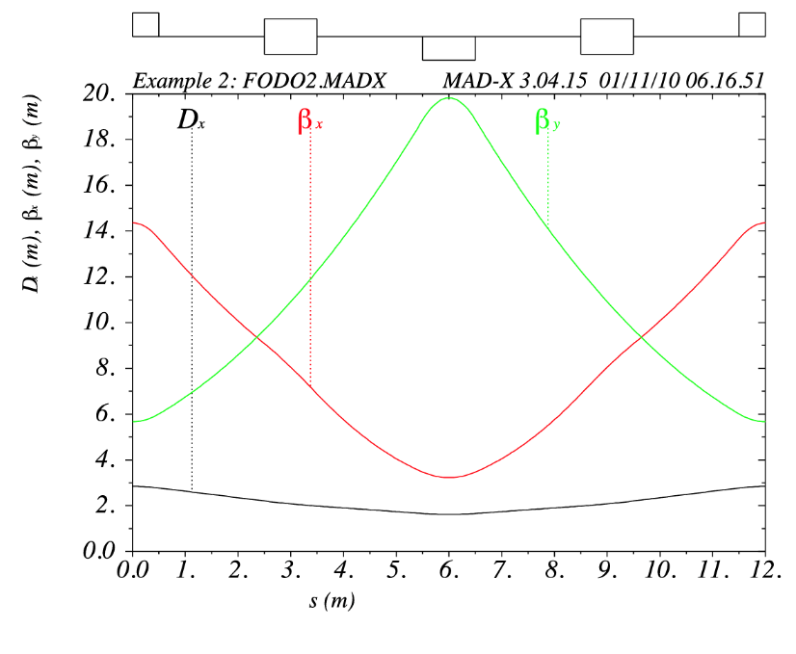
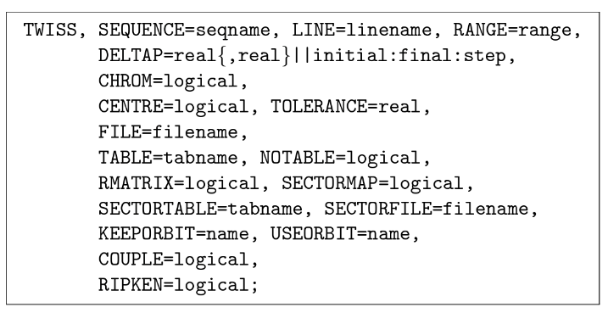
Mad-X Program
…

Slide 11
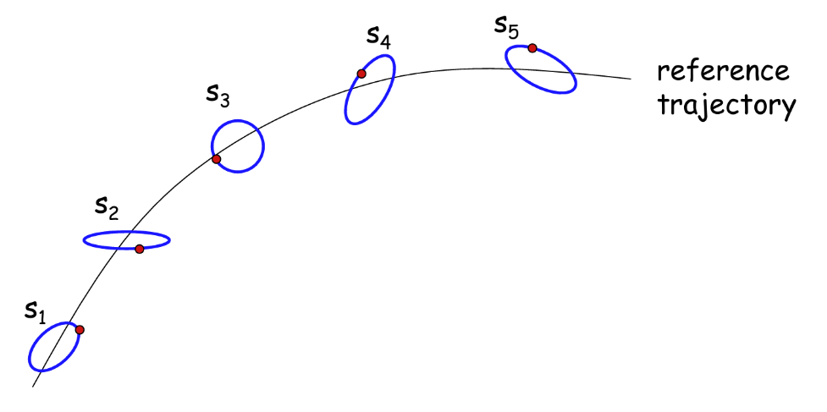
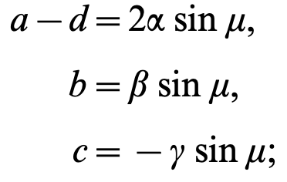
Mad-X Twiss Calculation
Use transport Matrix to calculate beta (Courant and Snyder)
M numerically calculated given position s wrt x or y based on magnets,
But is also given by the transport matrix:
One can show:
Able to solve for the phase advance
Therefore, can calculate the Twiss parameters at every s at different points:

Slide 12
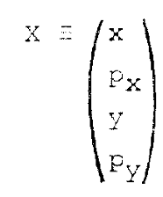
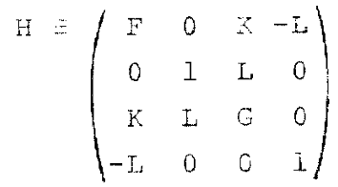
Mad-X Coupled Functions
Only works if Quadrupoles are focusing and defocusing in one direction
What if quadrupoles are skew?
Magnets have some focusing and defocusing in x and y simultaneously: coupled!
Edward & Teng:

Slide 13
References
Courant, E.D, and H.S Snyder. “Theory of the Alternating-Gradient Synchrotron.” Annals of Physics, vol. 3, no. 1, 1958, pp. 1–48., https://doi.org/10.1016/0003-4916(58)90012-5.
Edwards, D A, and L C Teng. “PARAMETERIZATION OF LINEAR COUPLED MOTION IN PERIODIC SYSTEMS.” IEEE, 1973, pp. 885–888.
Grotw, Hans. The MAD-X Program User's Reference Guide. 2016.
Holmes, Jeff. “Transverse Beam Optics, Part I.” USPAS , Jan. 2009, https://uspas.fnal.gov/materials/09VU/Lecture6.pdf.
Holmes, Jeff. “Transverse Beam Optics, Part II.” USPAS, Jan. 2009, https://uspas.fnal.gov/materials/09VU/Lecture7.pdf.
“Lectures.” The Cockcroft Institute, https://www.cockcroft.ac.uk/education/lectures/.
Sheehy, Suzie. “Lecture 7: Lattice Design with MAD-X.” madxlecture2016, 2016.
Wiedemann, Helmut. Particle Accelerator Physics. Springer-Verlag, 2015.

