Slide 1
ELECTRON COOLING FOR LOW-ENERGY HADRON BEAMS
xxxxxxx PHY 862: Accelerator Systems

Slide 2
Content
Outline
Introduction
Proof of Principle: Single Electron Cooling
Proof of Principle: “Friction” Force Approach
Electron Cooling for Low-Energy Hadron Beams
Electron cooling at the TSR (Test Storage Ring)
Challenges
State of the Art

Slide 3
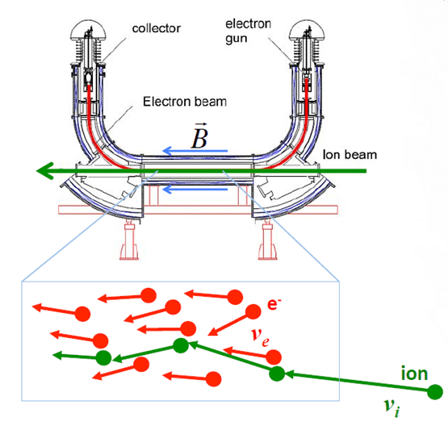
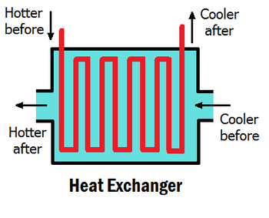
Introduction
Electron Cooling/Heat Exchanger Analogy

Slide 4
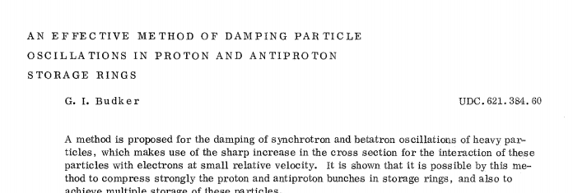
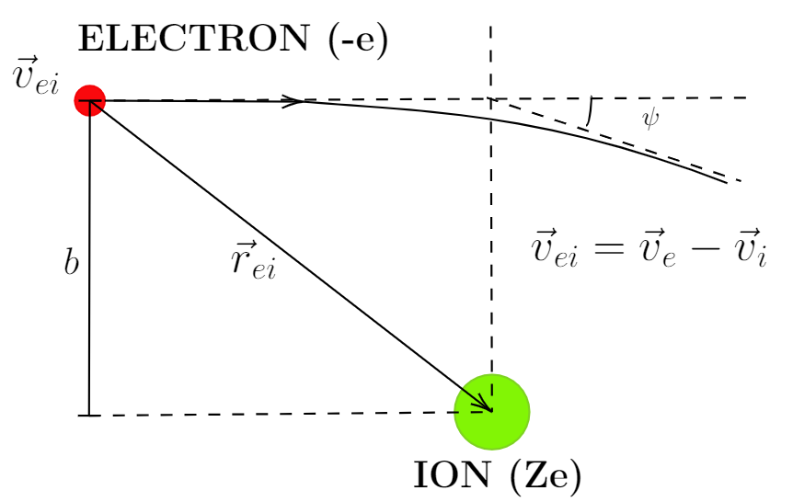
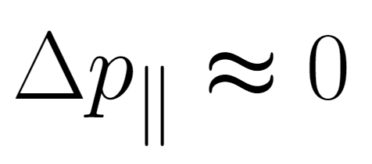
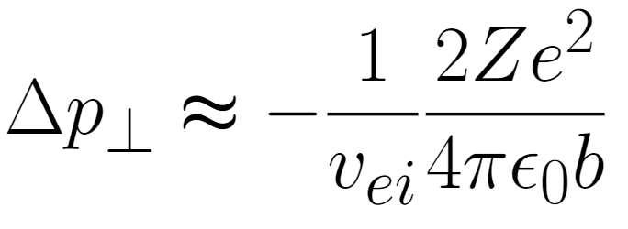
Proof of Principle
Single Electron Cooling
(Dubker, 1967) in Dubna, Russia
“[…] it is possible by this method to compress strongly the proton and antiproton bunches in storage rings, and also to achieve multiple storage of these particles.” (Dubker, 1967)

Slide 5
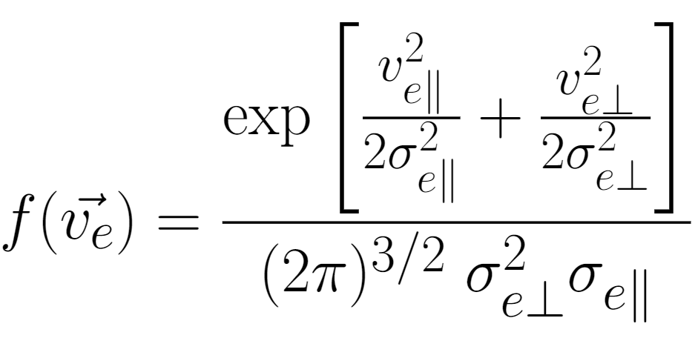
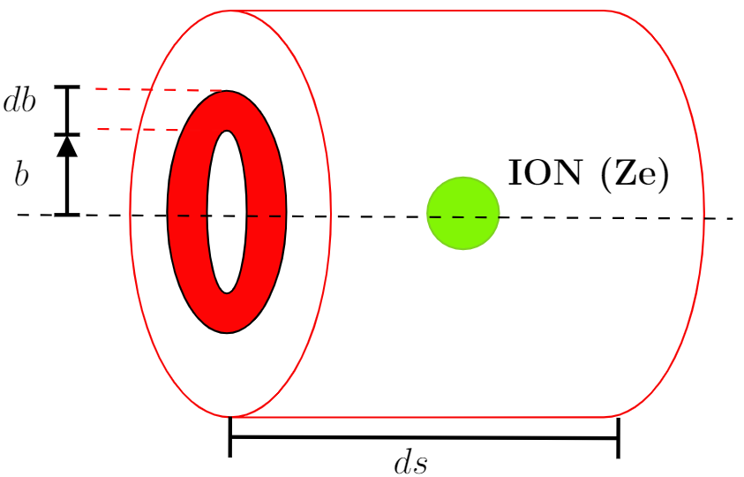
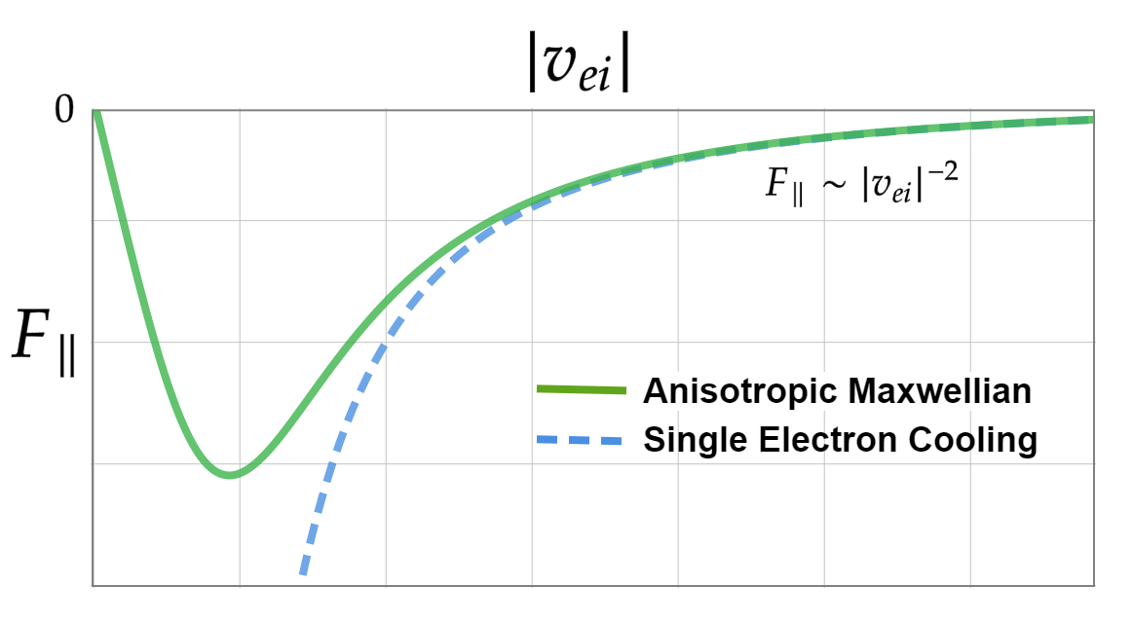
Proof of Principle
Friction Force Approach (Continuum)
Independent of ion beam intensity
Increases with the square of charge state of ions
Increases with electron density

Slide 6
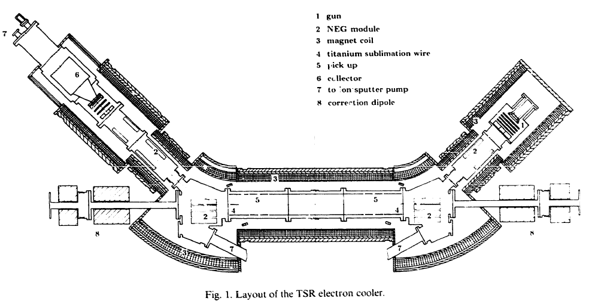
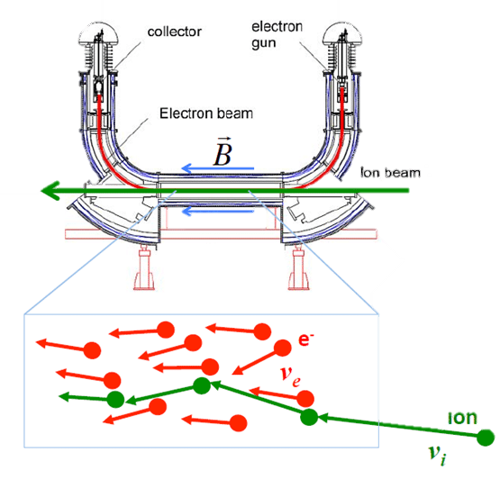
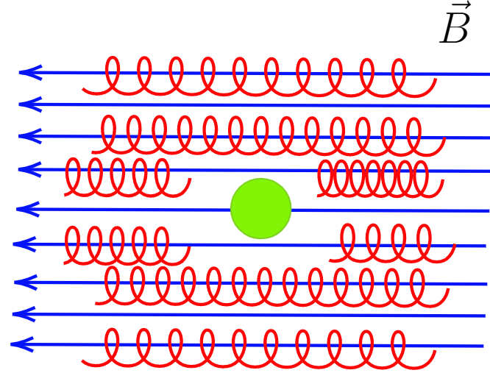
Electron Cooling for Low-Energy Hadron Beams
(Grieser, 2012)
Electron Cooling at the TSR
Electron gun
NEG Pump module (10⁻¹¹ mbar)
Magnet Coil
Pick up
Collector
5
2
1
4
3
2
Magnetic field freezes the transverse motion of electrons
Electron cooling is only limited by longitudinal spread of electrons

Slide 7
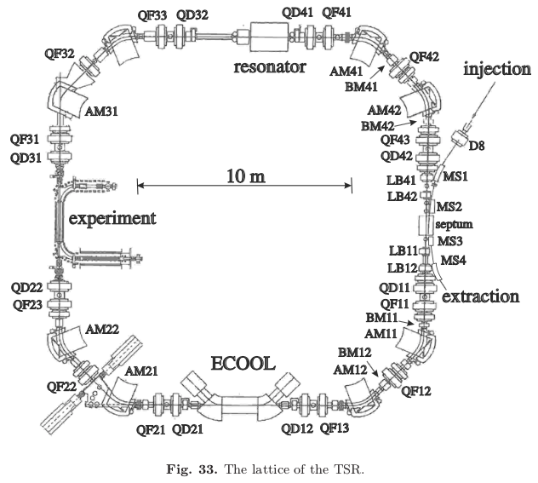
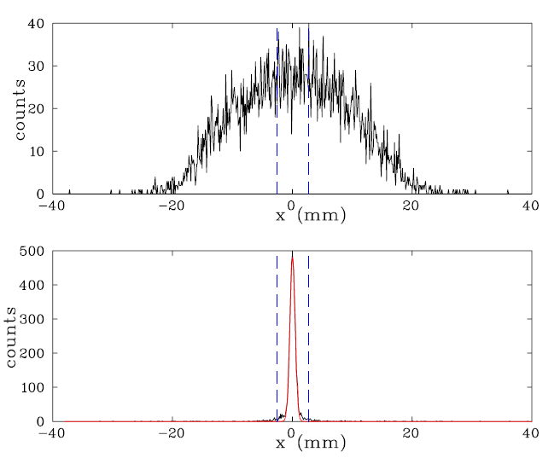
Electron Cooling for Low-Energy Hadron Beams
Electron Cooling at the TSR
Electron cooling of ¹²C⁶⁺ after about 2 s
Revolution Frequency 1 MHz
Why use electron cooling in storage ring or synchrotron?
What are the limitations of ECOOL?

Slide 8
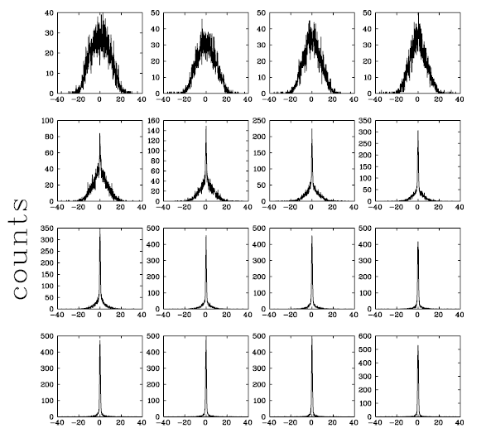
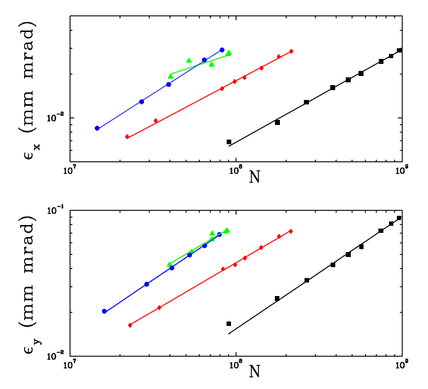
Electron Cooling for Low-Energy Hadron Beams
Electron Cooling at the TSR (Equilibrium emittances)
t=0 s
t=0.1 s
Equilibrium emittances
Electron cooling force
Intra-beam scattering
t=1.6 s

Slide 9
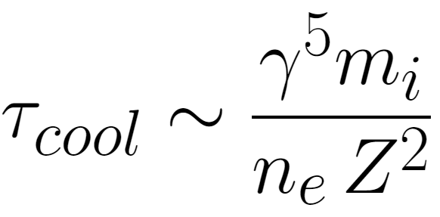
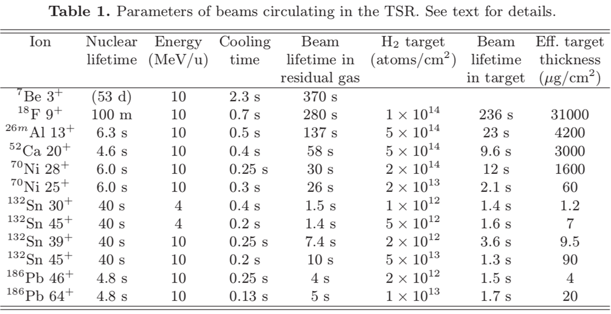
Cooling Rate of Electron Cooling
Cooling time

Slide 10
State of the Art
Upcoming projects and challenges
Projects worldwide (Low Energy)
SIS18 @ GSI (35 keV electron gun)
CRYRING @ GSI (35 keV electron gun)
CSR (Cryogenic Storage Ring) @ Heidelberg (35 keV electron gun)
TSR (Test Storage Ring) @ CERN(?) (20 keV electron gun)
LEAR (Low Energy Antiproton Ring) @ CERN (30 keV electron gun)
Upcoming projects
Bunched electron cooling at EIC (Strong Hadron Cooling for the Electron Ion Collider, Willeke 2019)
Muon Ionization Cooling Experiment (MICE) (Cooling for a future muon collider)
FEL-based Coherent electron Cooling (CeC)

Slide 11
References
Steck, Markus, and Yuri A. Litvinov. “Heavy-Ion Storage Rings and Their Use in Precision Experiments with Highly Charged Ions.” ArXiv.org, 11 Mar. 2020, arxiv.org/abs/2003.05201.
Grieser, M., Litvinov, Y.A., Raabe, R. et al. Storage ring at HIE-ISOLDE. Eur. Phys. J. Spec. Top. 207, 1–117 (2012). https://doi.org/10.1140/epjst/e2012-01599-9
Budker, G.I. An effective method of damping particle oscillations in proton and antiproton storage rings. At Energy 22, 438–440 (1967). https://doi.org/10.1007/BF01175204

Slide 12
Electron Cooling for Low-Energy Hadron Beams
Outline

