Slide 1
Luminosity for Colliders
PHY 862 Fall 2020
Xxxxxx

Slide 2
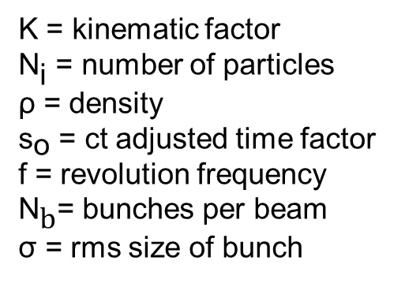
Luminosity Introduction
$${N_{1},ρ}_{1}\left(x,y,s,−s_{o}\right)$$
$${N_{2},ρ}_{2}\left(x,y,s,s_{o}\right)$$
Particles per Area per Second
Proportional to overlap interval [1]
Assuming equal opposed motion $v_{1}=−v_{2}$
Uncorrelated gaussian distributions of density
$$s_{o}$$
$$ℒ∝KN_{1}N_{2}\int{\int{\int{\int_{−∞}^{∞}{ρ_{1}\left(x,y,s,−s_{o}\right)ρ_{2}\left(x,y,s,s_{o}\right)dxdydsds_{o}}}}}$$
K = kinematic factor
${\text{N}}_{\text{i}}$ = number of particles
ρ = density
${\text{s}}_{\text{o}}$ = ct adjusted time factor
f = revolution frequency
${\text{N}}_{\text{b}}$= bunches per beam
σ = rms size of bunch
$$ℒ=\frac{N_{1}N_{2}fN_{b}}{4π\sqrt{{σ_{x,1}}^{2}+{σ_{x,2}}^{2}}\sqrt{{σ_{y,1}}^{2}+{σ_{y,2}}^{2}}}≈\frac{N_{1}N_{2}fN_{b}}{4π{σ_{x}}^{2}{σ_{y}}^{2}}$$

Slide 3
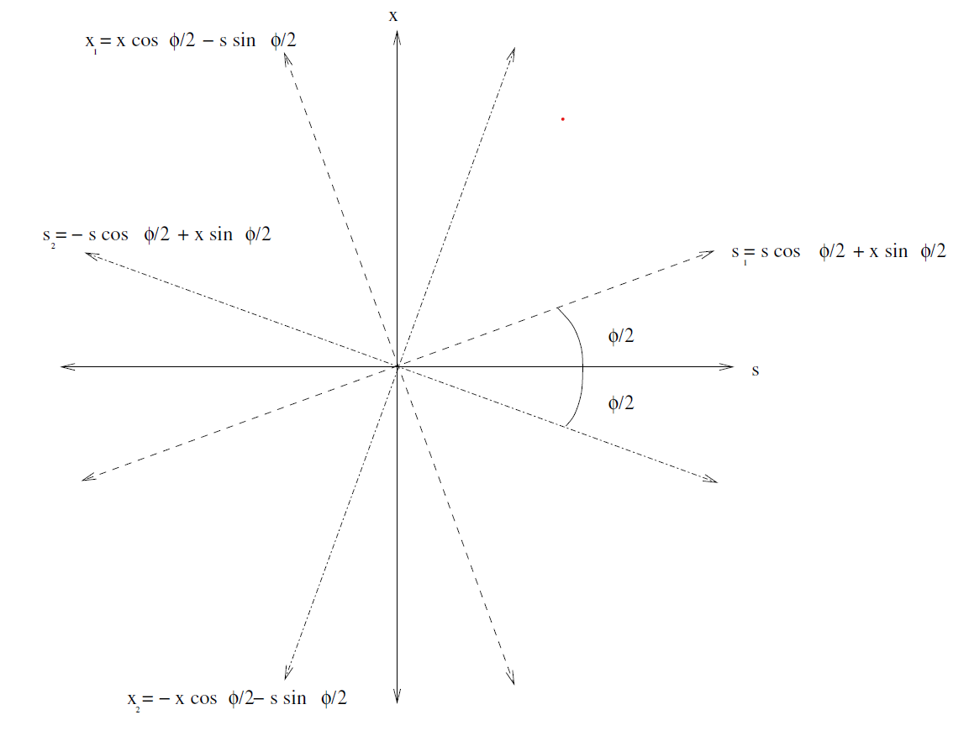


Crossing Angle
$$x_{1}=x\text{cos}\left(\frac{φ}{2}\right)−s\text{sin}\left(\frac{φ}{2}\right)$$
Complications for real machines
Cover three main effects
Largest is Crossing Angle [2]
$$s_{2}=s\text{cos}\left(\frac{φ}{2}\right)−x\text{sin}\left(\frac{φ}{2}\right)$$
$$s_{1}=s\text{cos}\left(\frac{φ}{2}\right)+x\text{sin}\left(\frac{φ}{2}\right)$$
$$ℒ=\frac{N_{1}N_{2}fN_{b}}{4π{σ_{x}}^{2}{σ_{y}}^{2}}S$$
1
2
$$S= \frac{1}{\sqrt{1+{\left(\frac{σ_{s}}{σ_{x}}\tan\left(\frac{φ}{2}\right)\right)}^{2}}}$$
$$x_{2}=x\text{cos}\left(\frac{φ}{2}\right)+s\text{sin}\left(\frac{φ}{2}\right)$$

Slide 4
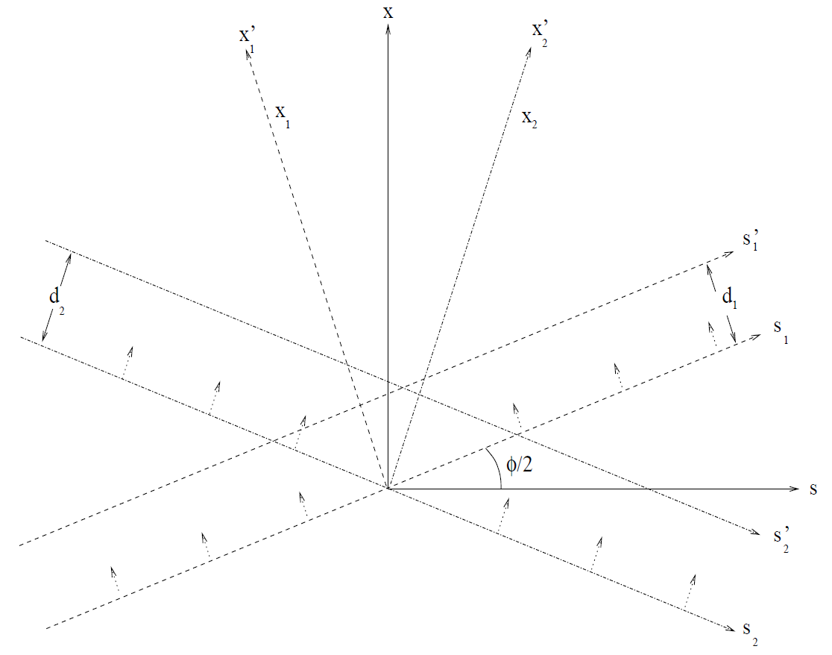
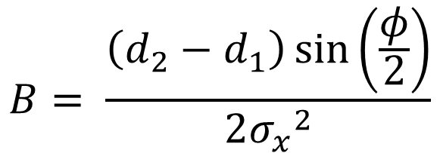
Crossing Angle with Offset
$${x′}_{1}=d_{1}+ x\text{cos}\left(\frac{φ}{2}\right)−s\text{sin}\left(\frac{φ}{2}\right)$$
$${x′}_{2}=d_{2}+ x\text{cos}\left(\frac{φ}{2}\right)+s\text{sin}\left(\frac{φ}{2}\right)$$
Next largest effect
Based on crossing angle and relative offset of beam
$$ℒ=\frac{N_{1}N_{2}fN_{b}}{4π{σ_{x}}^{2}{σ_{y}}^{2}}SWe^{\frac{B^{2}}{A}}$$
1
2
$$W= e^{−\frac{1}{4}{σ_{x}}^{−2}{(d_{2}−d_{1})}^{2}}$$
$$A= \frac{\sin^{2}\left(\frac{φ}{2}\right)}{{σ_{x}}^{2}}+\frac{\cos^{2}\left(\frac{φ}{2}\right)}{{σ_{s}}^{2}}$$
$$B= \frac{\left(d_{2}−d_{1}\right)\sin\left(\frac{φ}{2}\right)}{2{σ_{x}}^{2}}$$

Slide 5
Hourglass Effect
x
β
$$β\left(s\right)=β^{∗}\left(1+{\left(\frac{s}{β^{∗}}\right)}^{2}\right)$$
Smallest Effect Described
Important when $β^{∗}$ is near bunch length
Example values for LHC [2]
Head On Gaussian: $ℒ=1.21×{10}^{34} {cm}^{−2}s^{−1}$
Small Crossing Angle:$ℒ=9.79×{10}^{33} {cm}^{−2}s^{−1}$
Offset Crossing Angle: $ℒ=9.17×{10}^{33} {cm}^{−2}s^{−1}$
Hourglass Effect: $ℒ=9.14×{10}^{33} {cm}^{−2}s^{−1}$
s
x
β
t
s
x
β
s

Slide 6
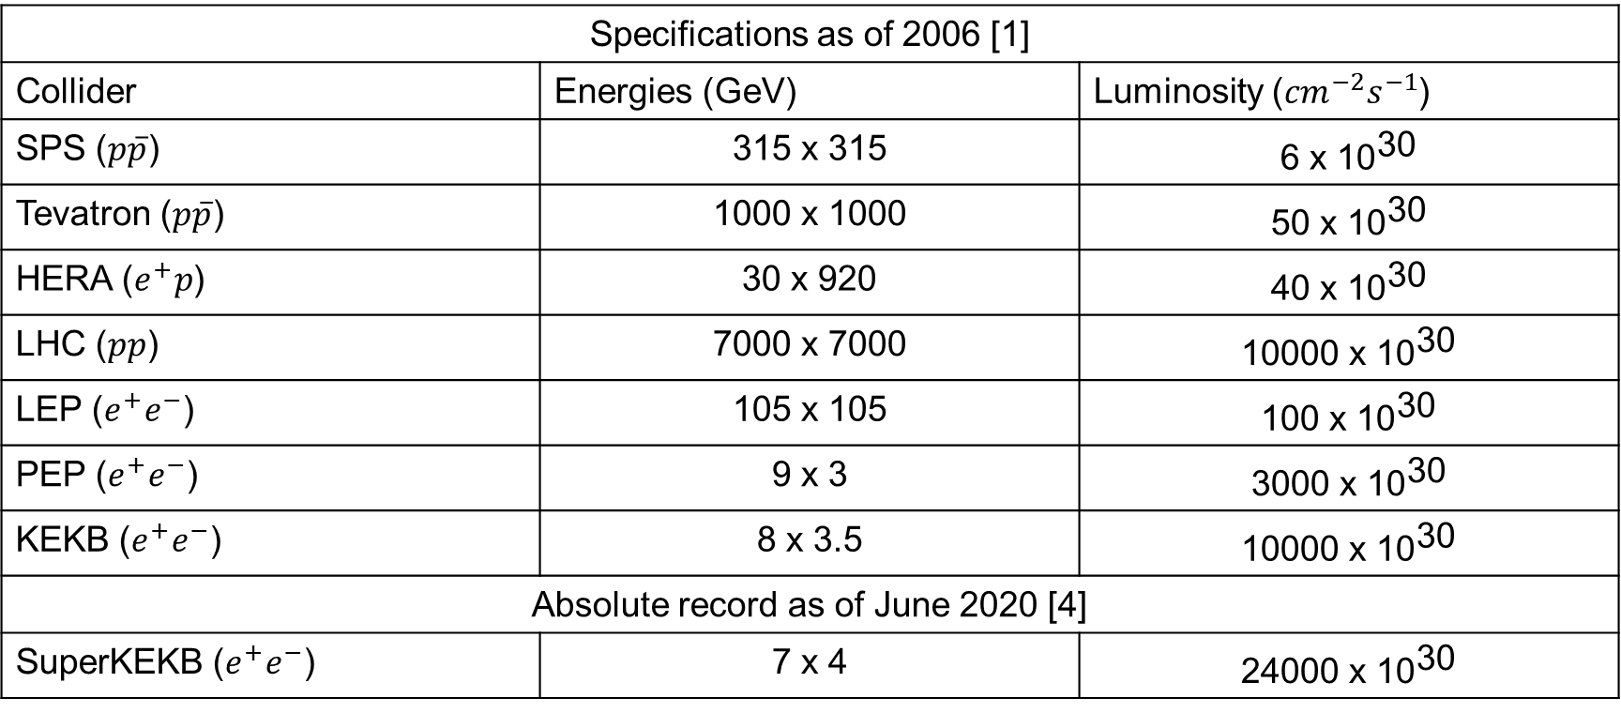
Real World Luminosities
Specifications as of 2006 [1]
Collider | Energies (GeV) | Luminosity (${cm}^{−2}s^{−1}$)
SPS ($p\overline{p}$) | 315 x 315 | 6 x ${\text{10}}^{\text{30}}$
Tevatron ($p\overline{p}$) | 1000 x 1000 | 50 x ${\text{10}}^{\text{30}}$
HERA ($e^{+}p$) | 30 x 920 | 40 x ${\text{10}}^{\text{30}}$
LHC ($pp$) | 7000 x 7000 | 10000 x ${\text{10}}^{\text{30}}$
LEP ($e^{+}e^{−}$) | 105 x 105 | 100 x ${\text{10}}^{\text{30}}$
PEP ($e^{+}e^{−}$) | 9 x 3 | 3000 x ${\text{10}}^{\text{30}}$
KEKB ($e^{+}e^{−}$) | 8 x 3.5 | 10000 x ${\text{10}}^{\text{30}}$
Absolute record as of June 2020 [4]
SuperKEKB ($e^{+}e^{−}$) | 7 x 4 | 24000 x ${\text{10}}^{\text{30}}$

Slide 7


Integrated Luminosity
Luminosity over time
Relevant value for most experiments
Luminosity decays over time – increase in traverse emittance, increase in bunch length, etc. [1]
Like managing pit stops
$$ℒ_{int}=\int_{0}^{T}{ℒ\left(t\right)dt}$$
$$ℒ=ℒ_{o}e^{−\frac{t}{τ}}$$

Slide 8
Luminosity Leveling
Keep consistent luminosity for run
“Spoil” Luminosity and progress to peak luminosity as it decays to keep constant luminosity at interaction point [3]
Offset Leveling
β* leveling
Crab Cavity Leveling

Slide 9
References
[1] W. Herr & B. Muratori, “Concept of Luminosity”, CERN Accelerator School, Zeuthen 2003, in: CERN 2006-002
[2] B. Muratori, “Luminosity in the presence of offsets and a crossing angle”, AB-Note-2003-026 (ABP)
[3] B. Muratori & T. Pieloni, “Luminosity levelling techniques for the LHC”, CERN beam-beam workshop 2013, in: CERN–2014–004
[4] Chalmers, Matthew. “KEK Reclaims Luminosity Record.” CERN Courier, 2 July 2020, cerncourier.com/a/kek-reclaims-luminosity-record/.

Slide 10
Input Parameters for LHC Calculations
$$N_{1}=N_{2}=1.1×{10}^{11}$$
$$N_{b}=2808$$
$$f=11.2455 kHz$$
$$σ_{x}=σ_{y} ≈15.9 μm$$
$$σ_{s}=7.7 cm$$
$$φ=300 μrad$$
$$ε=3.75 μm$$
$${β_{x}}^{∗}={β_{y}}^{∗}=0.5 m$$
$$d_{1}=10.0 μm$$
$$d_{2}=0 μm$$

