Slide 1
Radio Frequency Quadrupoles
Xxxxxx

Slide 2
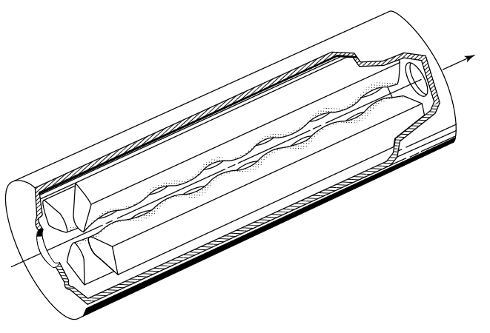
What are RFQs
Focuses, accelerates, and Bunches a beam
Heavy ion, proton beams
0.01c – 0.06c
Often one of the first elements a beam encounters
Initial acceleration affects performance of the entire accelerator
Bunches adiabatically

Slide 3
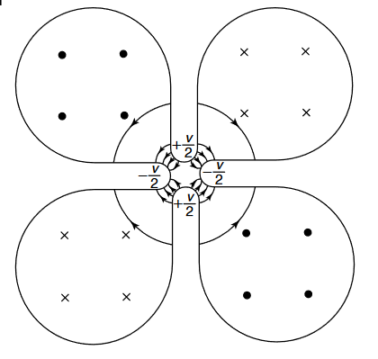
Geometry
Four vanes run the length of the RFQ
Does not have perfect quadrupole symmetry
“ripples” are offset by $\frac{π}{2}$
Need asymmetry to achieve axial potential difference for acceleration
RFQ are typically 1 to 3 meters long

Slide 4
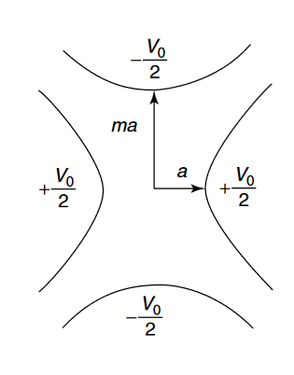
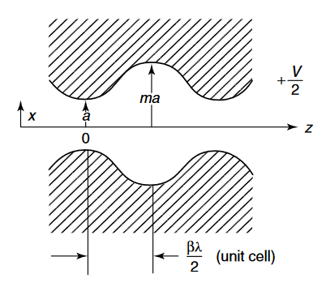

Slide 5
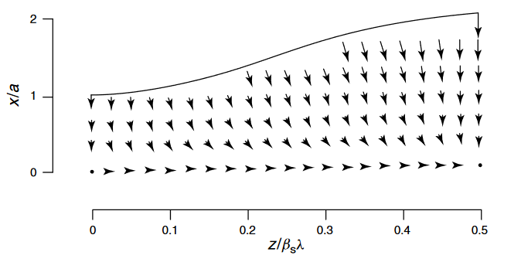
Potential and Electric Field
The Electric field is the primary source of focusing and acceleration
Influence of magnetic field is velocity dependent
Geometry of the vanes shape the field
$E_{z}$ provides acceleration
$E_{x}$ and $E_{y}$ focus
$$U\left(r,θ,z,t\right)=V\left(r,θ,z\right)sin⁡(ωt+φ)$$
$$V\left(r,θ,z\right)=A_{0}r^{2}\cos\left(2θ\right)+A_{10}I_{0}\left(kr\right)cos⁡(kz)$$
Where $k= \frac{2π}{L}$
$$E_{x}= \left[\frac{−XV_{0}}{a^{2}}x−\frac{kAV_{0}}{2}I_{1}(kr)\frac{x}{r}cos⁡(kz)\right]sin⁡(ωt+φ)$$
Quadrupole Focusing
Transverse RF Defocusing
A – Acceleration efficiency
X – Focusing Efficiency

Slide 6
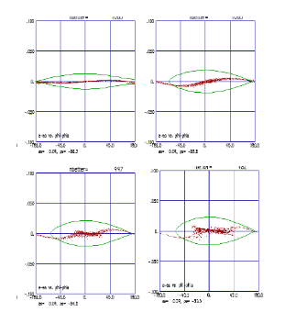
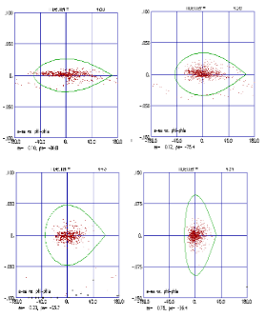
Adiabatic Bunching in the RFQ
Typically bunching is done in RF cavity before the linac
RF fields applied to unbunched beam giving varying accelerations
After a drift the particles are bunched
Comparatively poor efficiency and beam quality to RFQ bunching
Increased beam density and space charge
RFQ bunching reduces issues typical of RF bunching
Low injection energy (typically 50-100 keV), initial $φ_{s}=\frac{−π}{2}$
$φ_{s}$ increases gradually along RFQ as beam accelerate

Slide 7
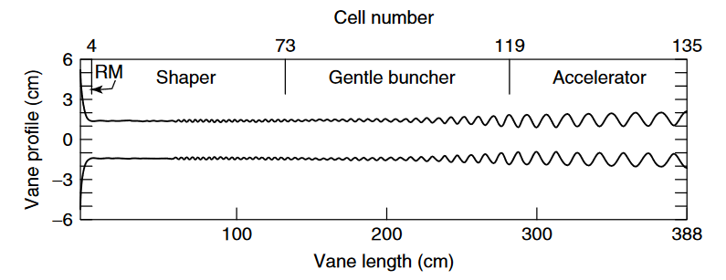
Stages of an RFQ
Radial Matching Section (RM)
“Ease” beam into time dependent field
Not needed if the beam is bunched externally
Shaper Section
Gentle Buncher Section
Where adiabatic bunching occurs
Accelerator Section
Where primary acceleration occurs

Slide 8
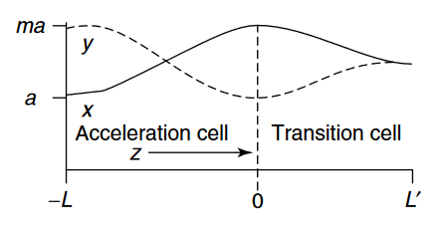
Transition Cells
Vane pairs that are the same distance from the center at the end can cause problems
Time-varying on-axis potential
Variation in output beam energy, asymmetric output beam
Transition cell used after final accelerating cells
Modulation to no modulation (quadrupole symmetry)
Same exit parameters as a regular quadrupole
Parameters chosen so that potential and electric field are continuous
Vane tips slightly extended to help with matching

Slide 9
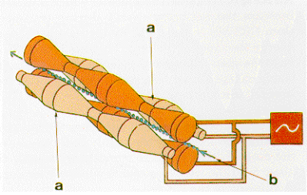
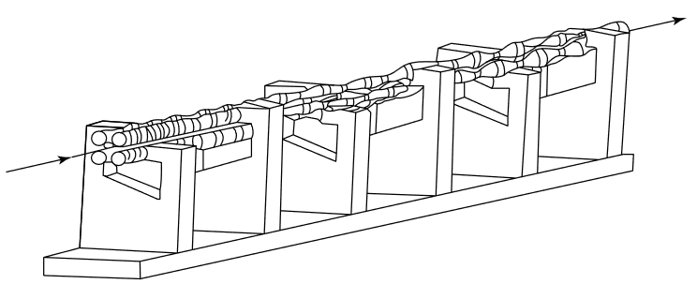
QRF at MSU
Four-Rod RFQ as opposed to Four-Vane RFQ
Used at low frequency (<200 MHz)
Rods of varying diameter instead of vanes
Current comes through “inductive stems”, or charged support structures
Higher current density than Four-Vane RFQ
Very compact
Outer walls have low affect on beam
At high frequency, rods become difficult to cool

Slide 10
References
[1] Wangler, T. (2008) RF Linear Accelerators 2nd Edition. Wiley-VCH. ISBN 3527406808
[2] Lombardi, A. (2006) The Radio Frequency Quadrupole. DOI: 10.5170/CERN-2006-012.201
[3] Kester, et al. (2010). ReA3 – The Rare Isotope Reaccelerator at MSU. Aproceedings – 25th Linear Accelerator Conference LINAC 2010
[4] Vretenar, M. (2009) The Radio Frequency Quadrupole. CAS Darmstadt 2009. URL: http://toddsatogata.net/2019-USPAS/Handouts/Vretenar-RFQ.pdf

