Slide 1
Physics 231
Topic 1: 1D Motion

Slide 2
Current Assignments
Reading Chapter 1.5 and 3 – due Tuesday, Jan 18, beginning of class
Homework Set 1 already open (covers this week) due Thursday, Jan 20, 11 pm
Recommended (not directly graded)
Homework Set 0 this week
Read Chapters 1 and 2

Slide 3
Course Organization Followup
Override requests – sign up after class
Course webpage – check frequently. Message board!
PLC schedule
Office hours
Clickers: Get one! Register it! (list on website)
Grading: scale – see syllabus. Quizzes: 1 pt for wrong answer, 2 pts for right answer.

Slide 4
Key Concepts: 1D motion
Particle model
Position, Coordinate system (1 axis with positive and negative direction), Displacement
Velocity – rate of change of position can have positive or negative direction
Acceleration – rate of change of velocity can have positive or negative direction
Average velocity/acceleration vs instantaneous
Equations for X(t) and v(t) for constant acceleration
Gravity on the surface of the earth provides an acceleration of |g|=9.81 m/s² (if no other forces are acting – free “fall”) towards the center of the earth. Concept of “free fall”.

Slide 5
Key concepts ctd
Displacement vs time x(t) Graph:
Slope is velocity (sign!)
Velocity vs time v(t) Graph:
Area under curve is displacement x (sign!) (change in position)
Slope is acceleration (sign!)
Acceleration vs time a(t) Graph
Area under the curve is change of velocity v (sign!)
Understand how to derive one graph from another

Slide 6
Clicker question
Distance between snapshots in motion diagram for increasing speed
A increases
B stays the same
C decreases

Slide 7
Motion and particle model
Motion diagram: snapshots in time
Same in particle model good model for example for determining the time it takes to cross room, … bad model for: design width of path, size of door, …
t=1s
t=2s
Time t=0s
t=0s
t=1s
t=2s
Notes:
Demo: have someone walk along and a big clock. Call out equidistant time points (1 or 2 seconds) and have student memorize location within a frame shown by hand. Have them then draw the motion diagram. Have them then do the particle model.
Clicker: is person slowing down, going faster, walking with constant speed, cannot tell

Slide 8
Position
For 1D motion we need to define a one axis coordinate system (an x-axis) along the path of motion (particle model!).
The axis features:
Labeled using units of length (for example meters)
Zero is chosen at your convenience
Positive direction: we agree in this class that positive direction will always be to the right or up.
Position of an object is the value of the axis label at its location. We use here the symbol x.
Position may change with time. It is a function of time x(t)
Position
x= -1m
x=1m
x=?
Time
t=0s
t=1s
t=2s
-1 m
0 m
1 m
2 m
3 m
4 m
X
Notes:
DEMO: need to describe position. Have student volunteers with meter markings in hand and repeat exercise. Could film a movie and replay movie and find position at each time.
Draw diagram on overhead
Then show this slide: CLICKER What is position of the person at 2s? 3m, 3.25m 3.5m 3.75m 4m

Slide 9
Position vs time diagram
A moving object has a position at each point in time.
Graph position as a function of time: function x(t)
x
4 m
3 m
2 m
1 m
t
0 s
1 s
2 s
-1 m
Notes:
Can use our example to do a position vs time graph
Write down table with position and time data
I would not spend much time on it at this point and just let it settle in. Do this extensively once velocity is defined.

Slide 10
Displacement
Displacement is a change in position
Suppose there is an initial position at an earlier time x_{i} and a final position at a later time x_{f}
The displacement Δx for this particular part of the motion is: Δx = x_{f} – x_{i}
Note this can be positive or negative (it has a direction)
If the change is towards a larger number (positive direction of the axis) x_{f} is larger than x_{i} and Δx will be positive.
If the change is towards a smaller number (negative direction of the axis) x_{f} is smaller than x_{i} and Δx will be negative
Δx is ONE symbol, just like x or y
Notes:
Go back to position vs time data. Then define displacement as change in position and calculate it for one part of the motion.
Only once an example is calculated show this slide.

Slide 11
Quiz
Maria stands at position x=30 m. 10 s later she is located at position x= -20 m. What was her displacement? A: 50 m B: 20 m C: 0 m D: -20 m E: -50 m
Notes:
After quiz do this STEP BY STEP: drawing, what is given, etc etc (SKETCH on notes)
Could do a few more if this turns out to be difficult. Do one in forward on the negative, one without any displacement …
THEN CALCULATE MARIAS VELOCITY : Moved -50m in 10s so her average velocity between t=0 and t=10s is -50m/10s = -5 m/s convert in miles/h. 1 mile = 1609 m, 1h = 3600 s, so m = (1 mile)/1609 and s=(1h)/3600 -5 m/s=-5 (3600/1609)=

Slide 12
Velocity
Velocity is rate of change of position.
The average velocity for a specific part of an object’s motion beginning at time t_{i} (initial time) ending at a later time t_{f} (final time) is
Unit: m/s (others: km/h, miles/h, ….)
Velocity has a sign and therefore a direction: its the sign of Δx (because Δt is always positive)
Motion towards positive x-axis: positive velocity
Motion towards negative x-axis: negative velocity
Magnitude of velocity |v| is also called “speed”.
Displacement
With Δt=t_{f}-t_{i}
Average Velocity=
with symbols:
Time interval
Distance travelled
Average Speed =
Time interval
Notes:
Do an example in class: the soccer player from the book:

Slide 13
Quiz
Maria stands at position x=30 m. 10 s later she is located at position x= 10 m. What was her average velocity? A: 2 m/s B: 3 m/s C: 0 m/s D: -3 m/s E: -2 m/s
Notes:
After quiz do this STEP BY STEP: drawing, what is given, etc etc (SKETCH on notes)
Could do a few more if this turns out to be difficult. Do one in forward on the negative, one without any displacement …
THEN CALCULATE MARIAS VELOCITY : Moved -50m in 10s so her average velocity between t=0 and t=10s is -50m/10s = -5 m/s convert in miles/h. 1 mile = 1609 m, 1h = 3600 s, so m = (1 mile)/1609 and s=(1h)/3600 -5 m/s=-5 (3600/1609)=

Slide 14
Quiz
Maria stands at position x=30 m. In 10s she walks to x=50 m. In 20 s she then walks back to x=30 m. What was her average velocity? A: 1.5 m/s B: 1.33 m/s C: 0 m/s D: -1.33 m/s E: -1.5 m/s
Notes:
After quiz do this STEP BY STEP: drawing, what is given, etc etc (SKETCH on notes)
Could do a few more if this turns out to be difficult. Do one in forward on the negative, one without any displacement …
THEN CALCULATE MARIAS VELOCITY : Moved -50m in 10s so her average velocity between t=0 and t=10s is -50m/10s = -5 m/s convert in miles/h. 1 mile = 1609 m, 1h = 3600 s, so m = (1 mile)/1609 and s=(1h)/3600 -5 m/s=-5 (3600/1609)=

Slide 15
Clicker question
Maria stands at position x=30 m. In 10s she walks to x=50 m. In 20 s she then walks back to x=30 m. What was her average speed? A: 1.5 m/s B: 1.3 m/s C: 0 m/s D: -1.3 m/s E: -1.5 m/s
Notes:
After quiz do this STEP BY STEP: drawing, what is given, etc etc (SKETCH on notes)
Could do a few more if this turns out to be difficult. Do one in forward on the negative, one without any displacement …
THEN CALCULATE MARIAS VELOCITY : Moved -50m in 10s so her average velocity between t=0 and t=10s is -50m/10s = -5 m/s convert in miles/h. 1 mile = 1609 m, 1h = 3600 s, so m = (1 mile)/1609 and s=(1h)/3600 -5 m/s=-5 (3600/1609)=

Slide 16
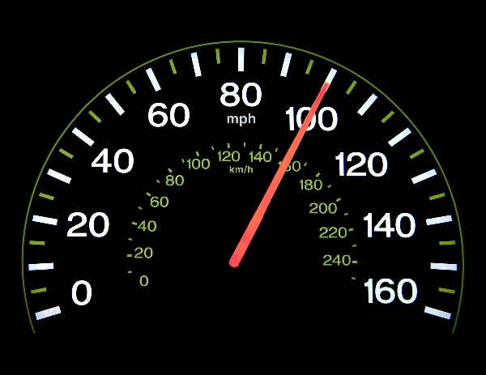
Instantaneous velocity
Officer, it took me 1 h to go 25 miles so my average speed was only 25 mph
Instantaneous speed = speed at one point in time (averaged over very small time interval)

Slide 17
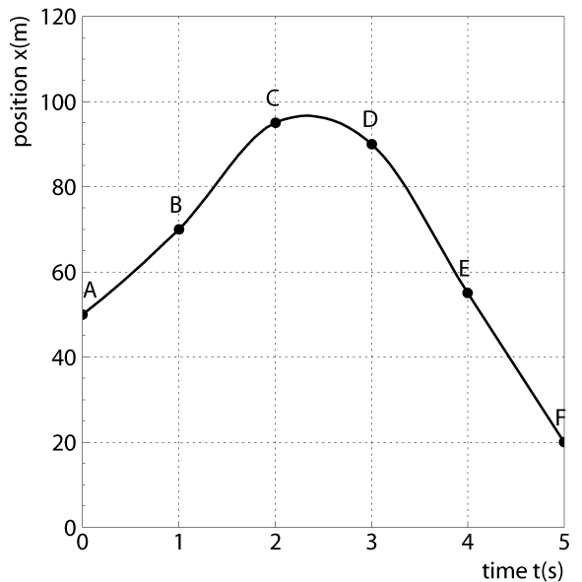
Velocity in position vs time graph
What is the instantaneous velocity at t=2.0 s?
D
The velocity at one point in time is the slope of the tangent to the x-t curve at that time. Calculate slope of green curve:
Δx
Δt
Δx
What is the average velocity for motion from t=0s to t=5.0s? Calculate slope of red curve
Δt
http://www.math.umn.edu/~garrett/qy/TraceTangent.html
Notes:
Demo: let student walk slow to point. Wait, and then run fast back. Let them draw position vs time graph ASSUME CONSTANT SPEED.
Take time with large clock and write down time of arrival, time after wait and time of final arival and write down. Then let them sketch the Position vs time diagram.
Then sketch on board and show how one gets average speed for first part – speed is slope !!! Same for last part Ask what average overall speed is? Clicker quiz
Then show how to do it for continuous curve on slide: draw tangents at different point on board. Then do example on the slide NUMERICALLY: calculate slope
Also show animation of tangent and say slope is positive, negative etc
– then clicker quiz: is velocity >0 =0 <0 at B, C, D, E

Slide 18
Velocity vs time graph
X
t
V
t
Notes:
Ask students to draw velocity(t) diagram from X(t) diagram derived in class (above again)

Slide 19
v (m/s)
v (m/s)
t=1,v=2
2
t=1,v=2
2
0
0
0
T (s)
0
T (s)
Q 1. 2.
a) 1. 1.
b) 1. 2.
c) 2. 1.
d) 2. 2.
1)What is the distance covered in 1 second?
2)What is the area indicated by ?
The area under the v-t curve is equal to
the displacement of the object! Note unit of area: area=2m/s*1s=2m

Slide 20
Acceleration
Acceleration is the rate of change of velocity
NOTE: This word is used differently from everyday use. Acceleration can mean increase, decrease or change of direction of velocity.
When the velocity does not change the acceleration is zero
If velocity changes from v_{i} at time t_{i} to v_{f} at time t_{f} then the average acceleration a is:
Unit: m/s²
Notes:
Introduce acceleration with an example: Race car from rest

Slide 21
Sign of acceleration
As v_{i} and v_{f} can each be positive or negative, acceleration can also be positive or negative
The sign indicates the direction of the change of velocity:
If velocity becomes smaller/more negative then the acceleration is negative (v_{f} < v_{i})
If velocity becomes larger/more positive then the acceleration is positive (v_{f} > v_{i})
Note that negative acceleration DOES NOT mean the object gets slower.
Example: if a car’s velocity changes from -10 m/s to -30 m/s the car is getting faster (moving in negative x direction) and the acceleration is negative as the velocity becomes smaller

Slide 22
Clicker question
A car is moving to the right and breaks so its getting slower.
The acceleration is A positive B zero C negative D don’t know
-1 m
0 m
1 m
2 m
3 m
4 m
X

Slide 23
Clicker question
A car is moving to the left and breaks so its getting slower.
The acceleration is A positive B zero C negative D don’t know
-1 m
0 m
1 m
2 m
3 m
4 m
X

Slide 24
Motion with constant acceleration
For a given acceleration a, an initial position at t=0 x₀ and an initial velocity at t=0 of v₀ we can predict
Velocity at time t
Position at time t
Position changes quadratically !!!
Notes:
Go back to race car example (now worked out acceleration) and ask:
How far did the car go when it reaches a speed of 50 m/s work in detail through that example:

Slide 25
Motion with constant acceleration 2
Handy equation: combine
for final velocity v_{f} and position x_{f} after constant acceleration a for some time t
Eliminate t to relate directly the velocity and the displacement (for example to obtain the velocity after travelling a certain distance)
Notes:
Go back to race car example (now worked out acceleration) and ask:
How far did the car go when it reaches a speed of 50 m/s work in detail through that example:

Slide 26
Acceleration vs time graph
V (m/s)
2
1
t (s)
1
2
What is a(t) graph?
a (m/s²)
Area under the curve from t=0s to t=2s:
A=0.75 m/s² x 2s = 1.5 m/s =1.5 m/s is the change of velocity! In symbols: A=a x Δt = Δv
2
1
t (s)
1
2

Slide 27
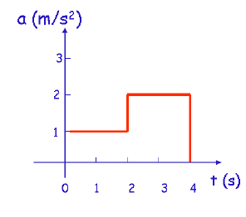
a(t) graph - 2

Slide 28
Example of a=const: Free Fall
Earth’s gravity causes objects on the surface of the earth to accelerate with |a|=g=9.81 m/s² (varies a bit from place to place) IF no other force acts (Free Fall)
Already Galileo found that this is true for any object regardless of its weight (If free fall is a good approximation – no significant air resistance)
Note: “Free Fall” is used differently than in everyday language. The object in free fall does not need to fall – a ball thrown up in the air, once it leaves the hand, is in free fall as no other forces than gravity act, even during its upward motion
Direction is towards the center of the earth (so if that is the negative direction of the position axis then a=-g = -9.81 m/s²)
Notes:
DEMO: reaction sheet. Have 2 students in front of the class measure how far it falls. Question: what is the reaction time? Calculate. X-axis up, a=-g (changes velocity t

Slide 29
Example: ball throw
A ball is thrown vertically into the air with an initial speed of 2 m/s. Neglect air resistance.
How long does it take to reach the highest point?
What is the height it reaches?
Graph x(t), v(t) and a(t)
What is the velocity at the highest point?
What is the acceleration at the highest point?

