Slide 1
Physics 231
Topic: Fluids

Slide 2
Key Concepts
Density, Volume, Mass – density as material property
Pressure – units, how to measure, direction
Hydrostatic pressure in liquid on earth
Buoyancy and Archimedes Principle
How to calculate buoyancy force
Floating and sinking
Continuity equation for incompressible liquid
Sets fluid speed for a given flow along a pipe
Bernoulli equation for flowing fluid
Pressure changes drive velocity changes and compensate gravity to maintain flow along a pipe

Slide 3
Key Equations
Note that these are only useful once you understood the concepts and can derive equations that apply to a specific problem
Pressure: p=F/A
Hydrostatic pressure
Buoyancy force: (upward)
Continuity:
Bernoulli:

Slide 4
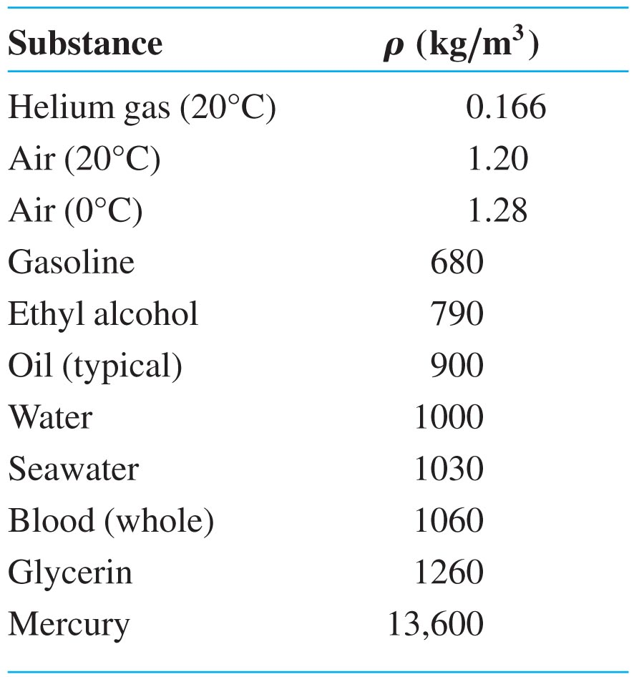
Density
Slide 13-12

Slide 5
Clicker quiz
These balls are sorted by increasing weight. Which has the smallest density ?
A: small ball of gold
Density depends on material not shape or size
B: large ball of aluminum
C: large ball of gold

Slide 6
Clicker quiz
These balls are sorted by increasing weight. Which has the smallest volume ?
A: small ball of gold
B: large ball of aluminum
C: large ball of gold

Slide 7
Clicker quiz
All objects made of the same material have:
A: The same density regardless of their weight and volume
B: The same volume, regardless of their density and mass
C: The same mass, regardless of their density and volume

Slide 8
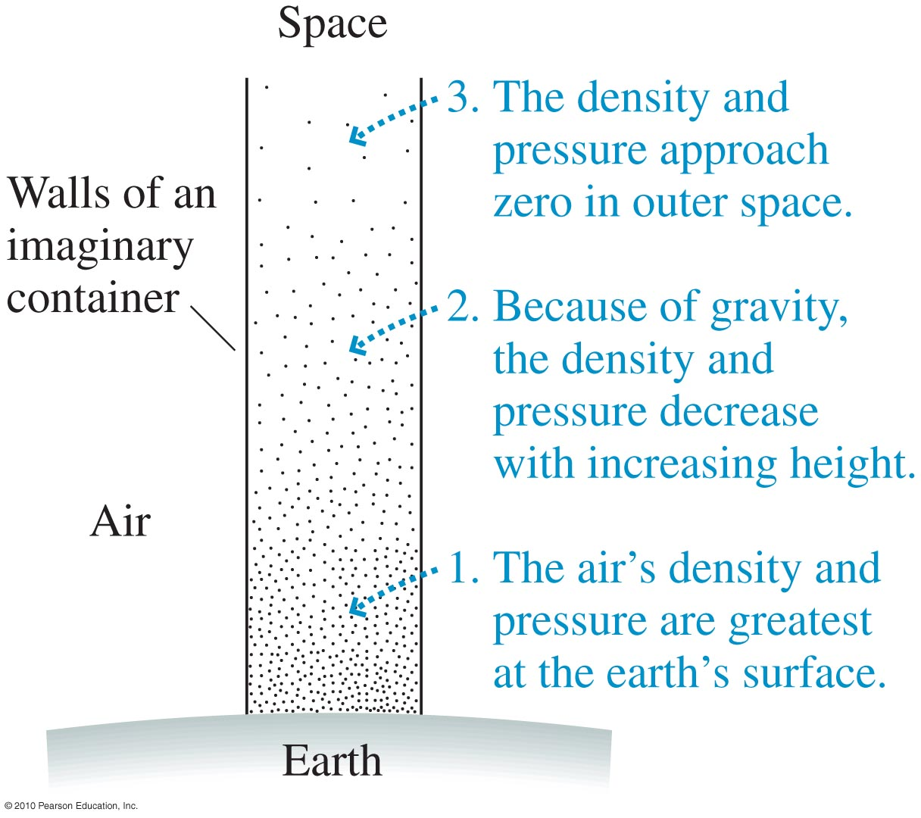
Atmospheric Pressure
patmos = 1 atm = 103,000 Pa
Slide 13-16

Slide 9
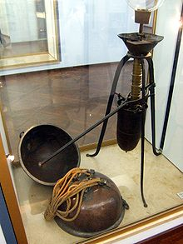
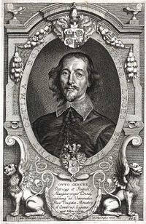
Magdeburg Hemispheres
Otto von Guericke (1602-1686)
German scientist and mayor of Magdeburg
World’s first vacuum pump

Slide 10
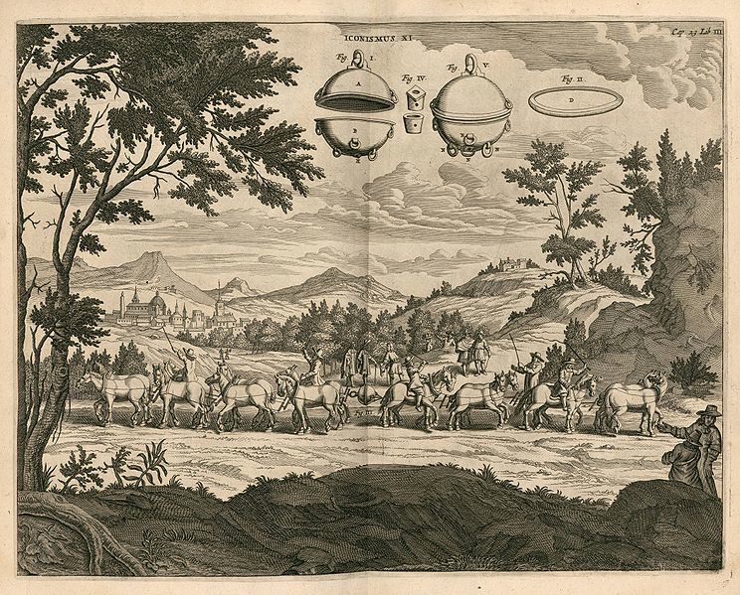

Slide 11
Extra Credit Project
Crush a soda can at home using normal air pressure (see for example): http://scifun.chem.wisc.edu/homeexpts/COLLAPSE.html)
Bring the crushed can to class before April 25
Provide a written estimate of the force that crushed the can
Extra credit: 4% added to quiz score (worth ~ 1 missed lecture)

Slide 12
Example for pressure meter

Slide 13
Clicker Quiz
Which force meter shows the largest pressure?
B
A
C
D
E
E

Slide 14
Clicker Quiz
Which force meter shows the largest pressure?
B
A
They show the same

Slide 15
Clicker Quiz
Which force meter shows the largest pressure?
They also show the same
A
B
C

Slide 16
Slide 13-17

Slide 17
Clicker Quiz
As object is immersed deeper
The volume of displaced fluid:
A: Decreases
B: Stays the same
C: Increases

Slide 18
Clicker Quiz
As object is immersed deeper
The volume of displaced fluid:
A: Decreases
B: Stays the same (correct if neglecting string)
C: Increases (correct if considering string) NOTE: because of string B and C are considered correct !!

Slide 19
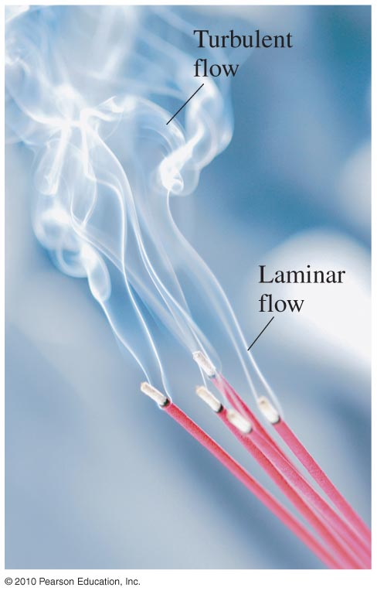
Laminar Flow
http://www.youtube.com/watch?v=blJwTcD1WoU

