Slide 1
Physics 231
Topic: Rotational motion

Slide 2
Key Concepts
For each translational motion quantity (position, velocity, acceleration, force, mass, momentum, kinetic energy) there is a rotational quantity. Same equations apply.
Angular velocity (sign!) and corresponding tangential velocity at radius r
Angular acceleration (sign!) and corresponding tangential acceleration at radius r
Torque and Net Torque
Moment of Inertia
Rotational Kinetic Energy
Angular Momentum – angular momentum conservation
Center of Gravity/Center of Mass

Slide 3
Key concepts
Point mass at radius r
Linear 1D motion
Rotational 1D motion
Position
Angle
Velocity
Angular velocity
Acceleration
Angular acc.
Force
Torque
Mass (inert)
Moment of Inertia
Newtons 2nd law
Newtons 2nd law
Momentum
Angular momentum
Kinetic energy
Rotational kinetic energy

Slide 4
Clicker quiz
A: α < 0
B: α = 0
C: α > 0
F
x

Slide 5
Clicker quiz
A: α < 0
B: α = 0
C: α > 0
F
x

Slide 6
Clicker quiz
A: α < 0
B: α = 0
C: α > 0
F
x

Slide 7
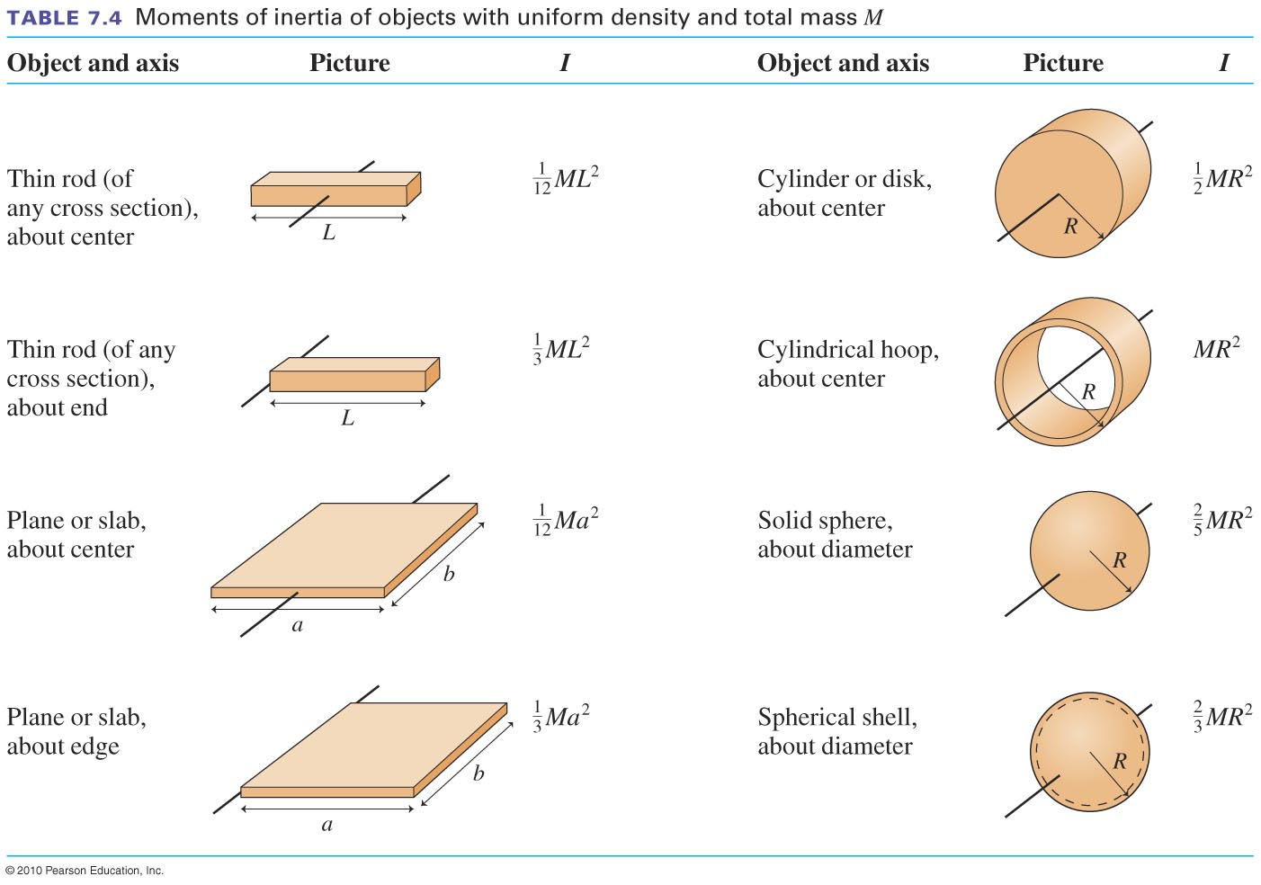
Moments of Inertia of Common Shapes
Slide 7-35

Slide 8
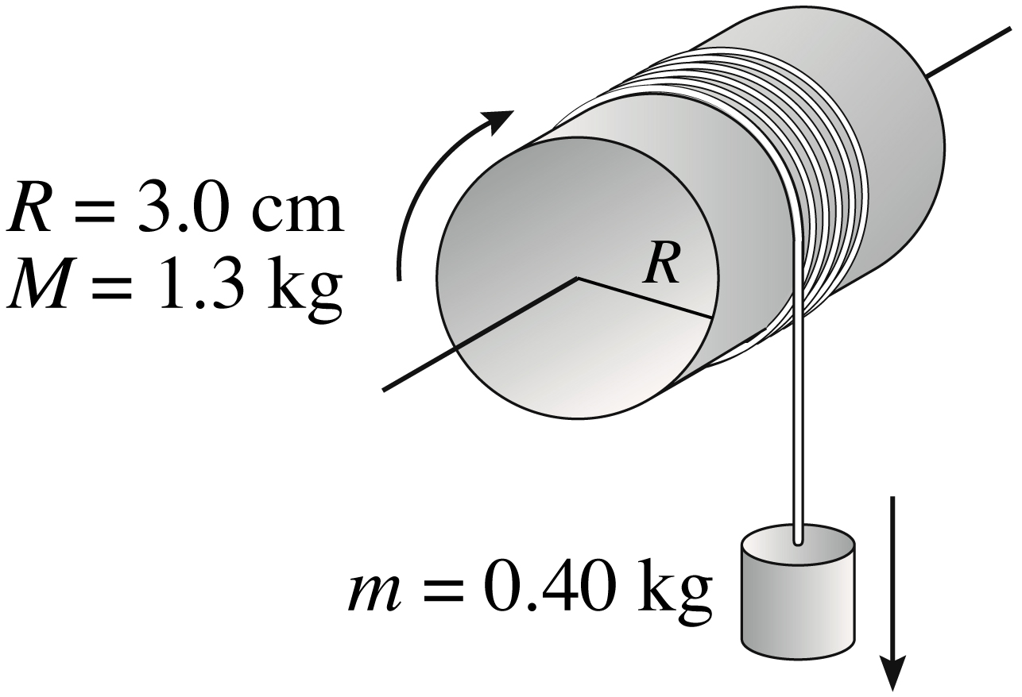
Example Problem
How long does it take the small mass to fall 1.0 m when released from rest?
Slide 7-40

