Slide 1
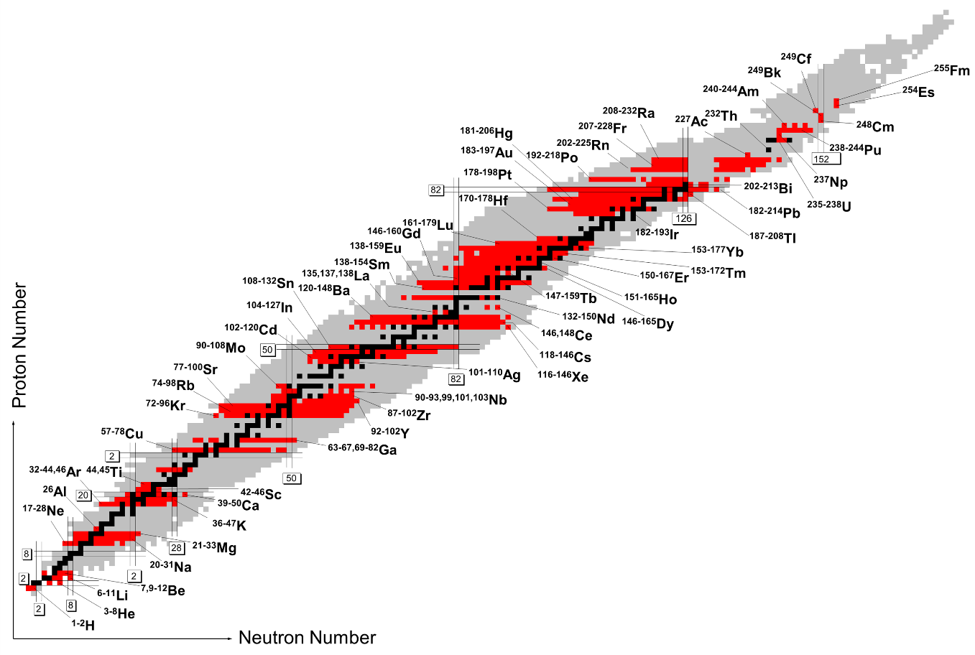
Nuclear moments and charge radii of neutron-deficient francium isotopes and isomers
OVERVIEW
New experimental technique enhances the data collection rate while maintaining high resolution
Francium isotopes with N=116-126 are generally spherical
Onset of collectivity begins at N=118
A. Voss et al., Phys. Rev. C 91, 044307 (2015).
http://www.uni-mainz.de/FB/Chemie/AK-Noertershaeuser/experiments/laserspectroscopy/survey.html

Slide 2
Enhancing data collection rate while maintaining high resolution
Counter-propagating pulsed laser beam (718 nm)
Electro-optic modulator (EOM) minimizes optical pumping
Three RFs are applied to acousto-optic modulator (AOM) that shift carrier laser frequencies
Pulse train is overlapped with neutralized ion bunches
Resulting three laser frequencies feed into separate DAQ channels and spectra are analyzed individually
A. Voss et al., Phys. Rev. C 91, 044307 (2015).

Slide 3
Changes in mean-squared charge radii indicate on-set collectivity at N=118
Figure (a)
Dashed lines: Isodeformation lines
Shaded area: systematic uncertainty
$\left|β_{2}\right|$=0.00 is spherical
Figure (b)
Relative change in mean-squared charge radii for Fr and Pb ground state
Summary:
New laser spectroscopy technique minimizes optical pumping and resolves individual hyperfine structure transitions
Nuclear ground states of francium are governed by spherical structures
Onset of collectivity at N=118 with odd-even staggering
A. Voss et al., Phys. Rev. C 91, 044307 (2015).

