Slide 1
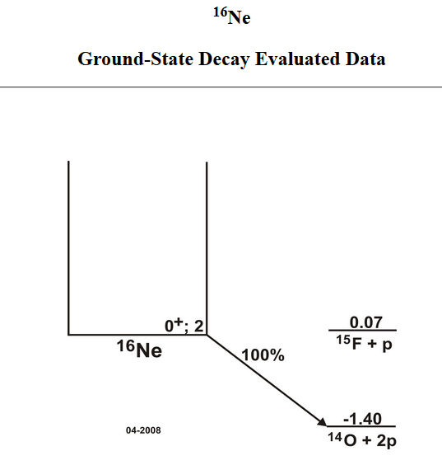
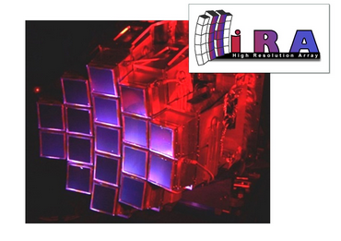
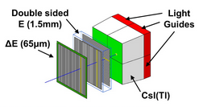
The observation of long-range three-body Coulomb effects in the decay of ¹⁶Ne
Paper by K.W. Brown et al., Phys Rev Lett 113 232501 (2014) Talk by Walter W. Buhro
5/8/2015
Image from TUNL Nuclear Data
Image from HiRA Poster, W.G. Lynch, M.B. Tsang, et al.

Slide 2
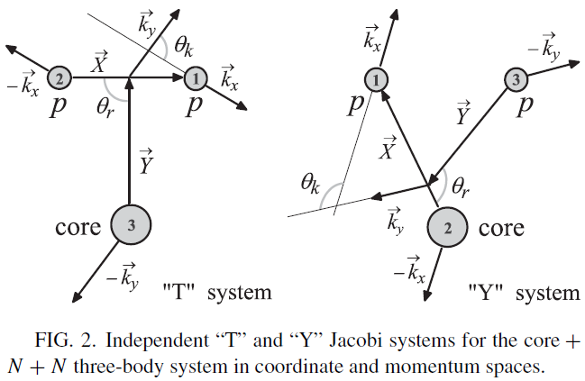
Three-Body Correlations and Long-Range Coulomb Effects
[Figure from L.V. Grigorenko et al., Phys Rev C. 80 034602 (2009)]
[Figure from K.W. Brown et al., PRL 113 232501 (2014)].
Three-Body Correlations.

Slide 3
Outlook
Theoretical and numerical machinery is still being refined
Need more high quality data from other 2p decay systems – e.g. ⁴⁵Fe
Applications beyond just 2p decay:
Formal mathematical 3-body Coulomb scattering problem
(e -> 3e) process in atoms
Exotic molecules composed of three charged constituents
THANK YOU!

Slide 4
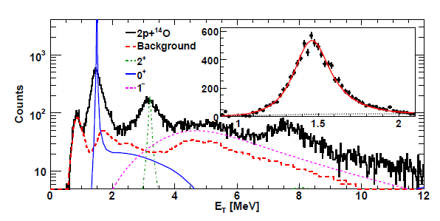
Some extra figures
Measured Excitation Spectra. All of the correlations
shown in the paper are from the ground state at
E_{T}= 1.466 MeV.
[Figure from K.W. Brown et al., PRL 113 232501 (2014)].

