Slide 1
Studies of Pear Shaped Nuclei
using rare isotope beams
May 5th 2015
-Maxwell Cao
Nuclear deformation is a well studied subject; calculated through a multipole expansion of the mass distribution:
Quadrupole deformation: Prolate & Oblate ellipsoids;
Octupole deformation: Reflection-asymmetric (Pear shape)
At present not much experimental data exist for octupole deformed nuclei.
Why do we care?
Physics beyond the Standard Model:
Any measurable atomic electric-dipole moment(EDM) would be enhanced by these octupole deformed nuclei,
Non-zero EDM of an atom means broken T symmetry,
Matter and antimatter asymmetry?
Provide experimental data for nuclear structure theories.
It’s fun to know.

Slide 2
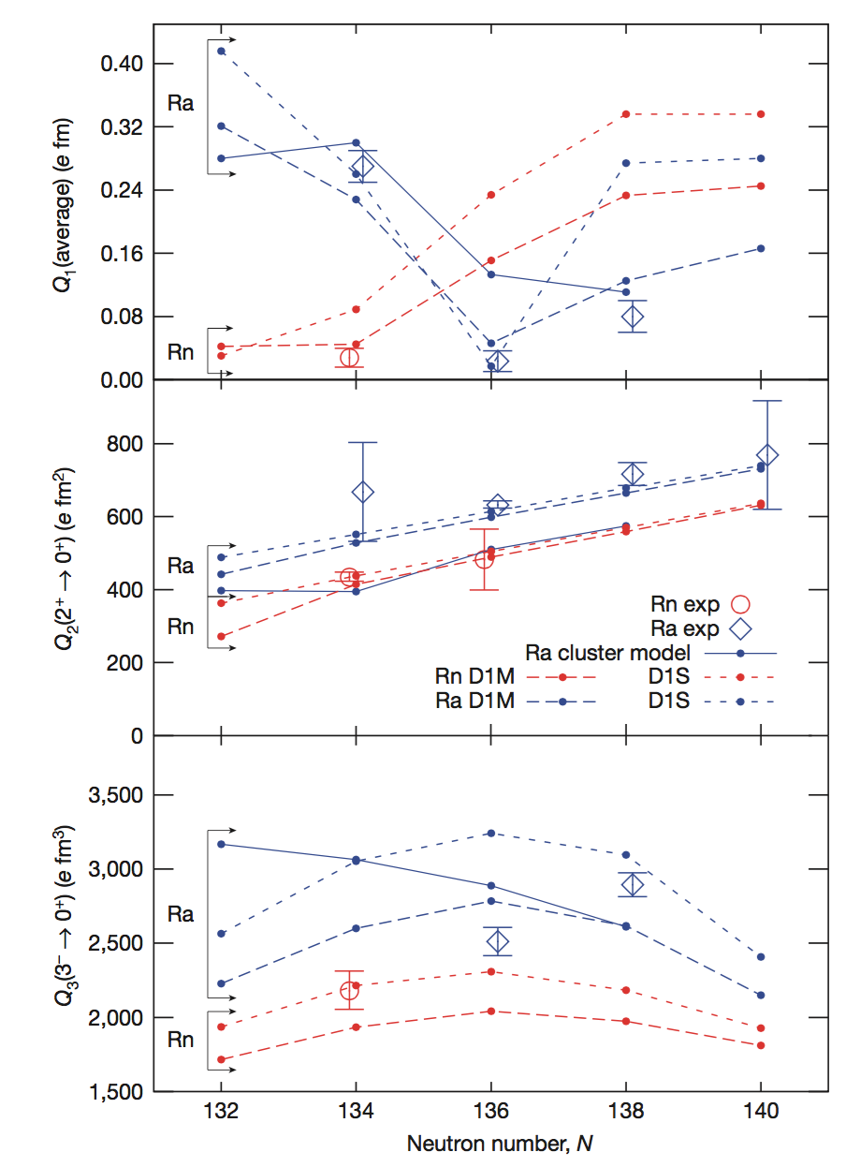
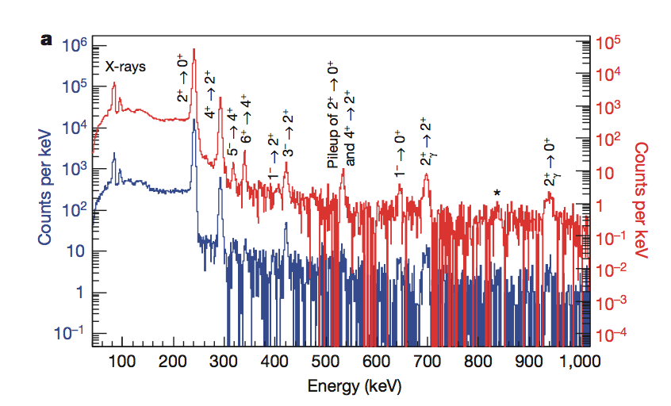
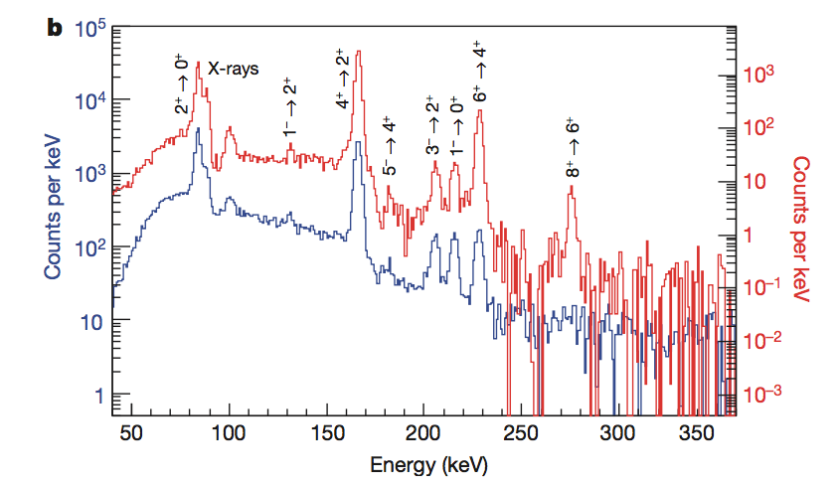
How was it done?
Studies of pear-shaped nuclei using accelerated radioactive beams
Gaffney,L. P. et al. Nature 497, 199-204(2013)
Measuring electric transition moment:
Heavy radioactive rare nuclei (²²⁰Rn & ²²⁴Ra) beams were produced by spallation in a thick uranium carbide target bombarded by protons from the CERN PS Booster,
The beams are then scattered off thin metal foils(⁶⁰Ni, ¹¹²Cd or ¹¹⁴Cd, and ¹²⁰Sn) to be excited and then radiate —Coulomb excitation,
γ-rays emitted were detected by MINIBALL, an array of 24 high-purity germanium detectors. Scattered projectile and target recoils were detected in a highly segmented silicon detector.
²²⁰Rn
²²⁴Ra
²²⁰Rn
²²⁴Ra
Intrinsic moments Qλ are then calculated from the experimental value of the reduced m.e. of electric transition moments <I’||Eλ||I>.
Comparisons with theoretical predictions of cluster model and mean-field calculations have been made.

Slide 3
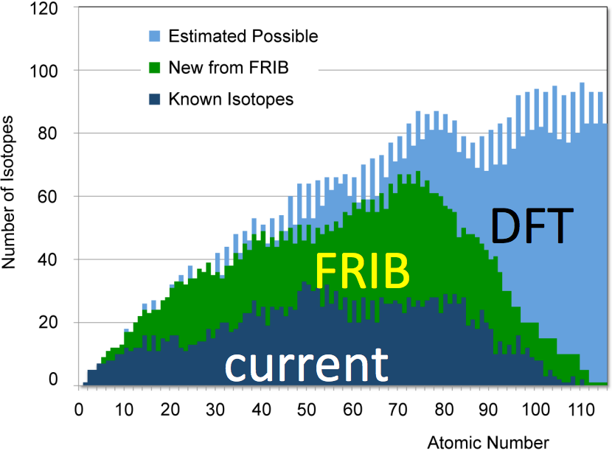
Conclusions
Both ²²⁰Rn, ²²⁴Ra octupole deformation have been observed, the latter exhibit stronger octupole collectivity.
It’s also likely that ^{219,221}Rn have smaller octupole-enhanced EDMs than ^{223,225}Ra. But there could be other Rn isotopes that’s more favorable.
Trends of intrinsic moments derived from this experiment favors mean-field calculations (D1M, D1S) more than Ra cluster model.
What’s next?
Studies on more Rn & Ra isotopes should be made to compare the trends of different models to the data.
Gogny HFB calculations predict that Th and U isotopes with N = 134-136 should have stronger patterns, but current facilities cannot generate such beams with sufficient intensity. FRIB might be able to accomplish.
References:
Gaffney,L. P. et al. Nature 497, 199-204(2013)
Lister, C. J. (Kim)& Butterworth, J. Nature 497, 190-191(2013)

Slide 4
Thank you!
Questions?

