Slide 1
Cluster Structure in Nuclei
Big Question: What nuclei have a cluster structure?
Clusters predicted in excited states close to decay thresholds
Signs should exist in ground states
This work includes the cluster structure of a nucleus and the liquid drop properties
The depth of the nuclear potential determines cluster structure
A large number of cluster nuclei are predicted

Slide 2
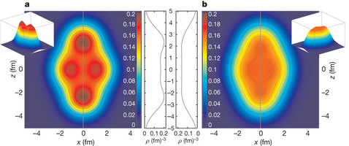
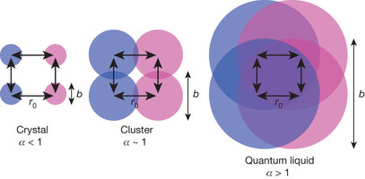
Methods
Theoretical framework of energy density functionals
Gives ground state information across for a variety of nuclides with a small set of global parameters
Two different EDF codes used to examine ²⁰Ne, a 4-α cluster nucleus
Give similar observables except for clustering
Only difference is the depth of the single-nucleon potential used
Difference repeated for ²⁴Mg, ²⁸Si, and ³²S
Depth of the potential related to parameter α that increases with the mass of the nucleus
Cluster states less likely for massive nuclei

Slide 3
Perspectives
Clustering important for the ¹²C Hoyle State
Important for stellar nucleosynthesis of carbon for creation of life
Open questions about the method of clustering and decay modes
Extending the Ikeda diagrams to include neutron-rich nuclei

Slide 4
References
Ebran, J.P., Khan, E., Niksic, T., and Vretenar, D. How atomic nuclei cluster Nature 487 341-344 (2012)
Beck, C. Present status of nuclear cluster physics and experimental perspectives Journal of Physics: Conference Series 569 012002 (2014)

