Slide 1
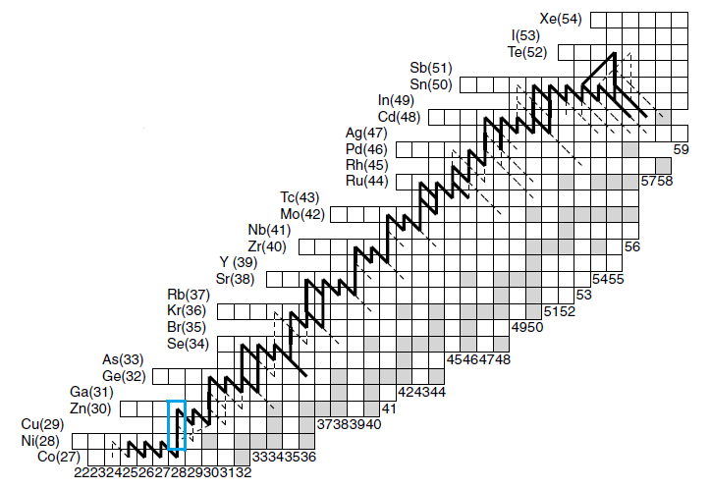
Determining the rp-Process Flow through ⁵⁶Ni
The rp-Process is a series of proton captures and β+ decays along the proton drip line that power type I x-ray bursts on the surface of neutron stars.
⁵⁶Ni is a Waiting Point and imposes a delay
Decay Lifetime: 2.3x10^4 s ; Burst Time: 10 – 100 s
Largest uncertainty in effective lifetime of ⁵⁶Ni is ⁵⁷Cu(p,γ)⁵⁸Zn.
Reducing uncertainty in ⁵⁷Cu(p,γ)⁵⁸Zn will lead to better predictions for burst ashes and light curves.

Slide 2
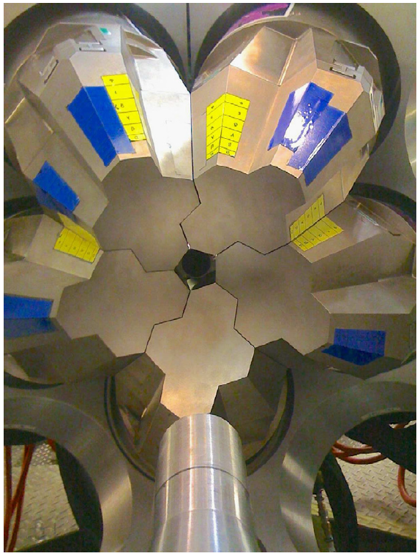
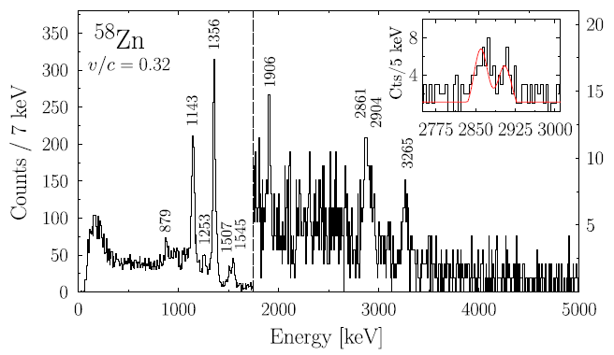
GRETINA Gamma-Ray Energy Tracking In-beam Nuclear Array
d(⁵⁷Cu,⁵⁸Zn)n reaction was induced in a CD₂ target.
Subsequent gamma rays from ⁵⁸Zn de-excitation detected by GRETINA
High purity germanium detectors

Slide 3
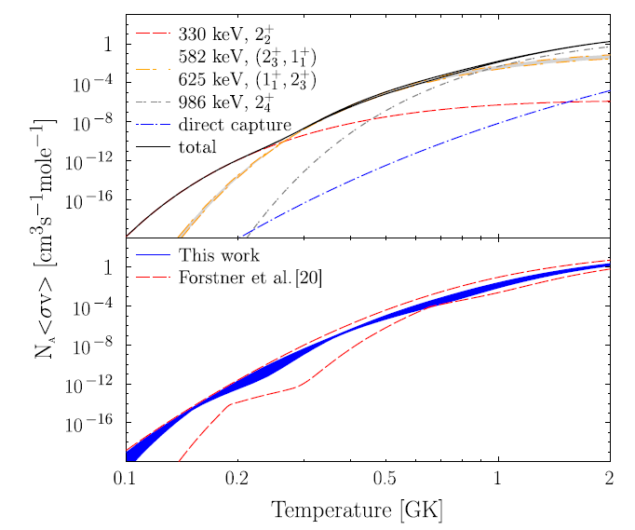
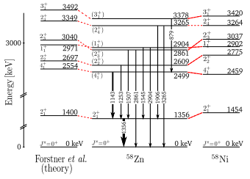
Results
Uncertainty in ⁵⁷Cu(p,γ)⁵⁸Zn rate reduced by 4 orders of magnitude.
Preliminary calculations with an x-ray burst model revealed that this reduces uncertainty in A=56 nuclei production from a factor of 2 to 20%.

Slide 4
References
Langer, C. et al. Determining the rp -Process Flow through Ni 56 : Resonances in Cu 57 ( p , γ ) Zn 58 Identified with GRETINA. Physical Review Letters 113, (2014).
Schatz, H. et al. End Point of the rp Process on Accreting Neutron Stars. Phys. Rev. Lett. 86, 3471–3474 (2001).
Paschalis, S. et al. The performance of the Gamma-Ray Energy Tracking In-beam Nuclear Array GRETINA. Nuclear Instruments and Methods in Physics Research Section A: Accelerators, Spectrometers, Detectors and Associated Equipment 709, 44–55 (2013).

