Slide 1
Green’s Function Monte Carlo Method in a nutshell

Slide 2
Propagate your trial function!
Motivation: VMC
Can we do better?
Projection onto the ground state wave function:
Propagation: Green’s Function is the way to go!
insert completeness
Advantage: Computable and implementable by recursive codes
Notes:
Time step: delta tau ~ 0.5 GeV^{-1}; it can’t be too large because the leading error goes like (delta tau)^3.

Slide 3
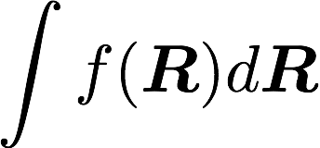
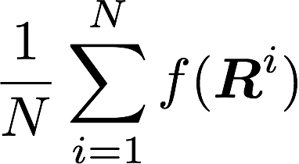
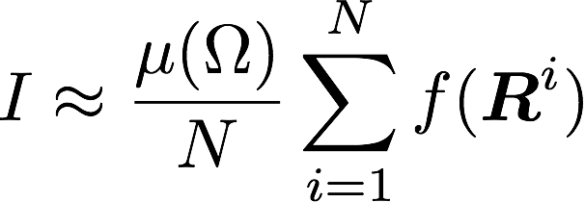
Oops! How to do such integrals?
Analytically? Deterministic numerical integration?
Do the math the Monte Carlo way!
Recipe:
Sampling: “Pick” N points from the integration domain
Averaging: Calculate the mean at the sampled points
“size”
Remark: 1. “error” decreases as 1/$\sqrt{N}.$ 2. Sampling relies on the probability distribution. Metropolis–Hastings algorithm is good for path integrals utilizing Markov properties, and thus often used in QMCs.
Notes:
“does not depend on the number of dimensions of the integral, which is the promised advantage of Monte Carlo integration against most deterministic methods that depend exponentially on the dimension.”
Demonstrate how to estimate Pi from the graph (integrate the indicator function)

Slide 4
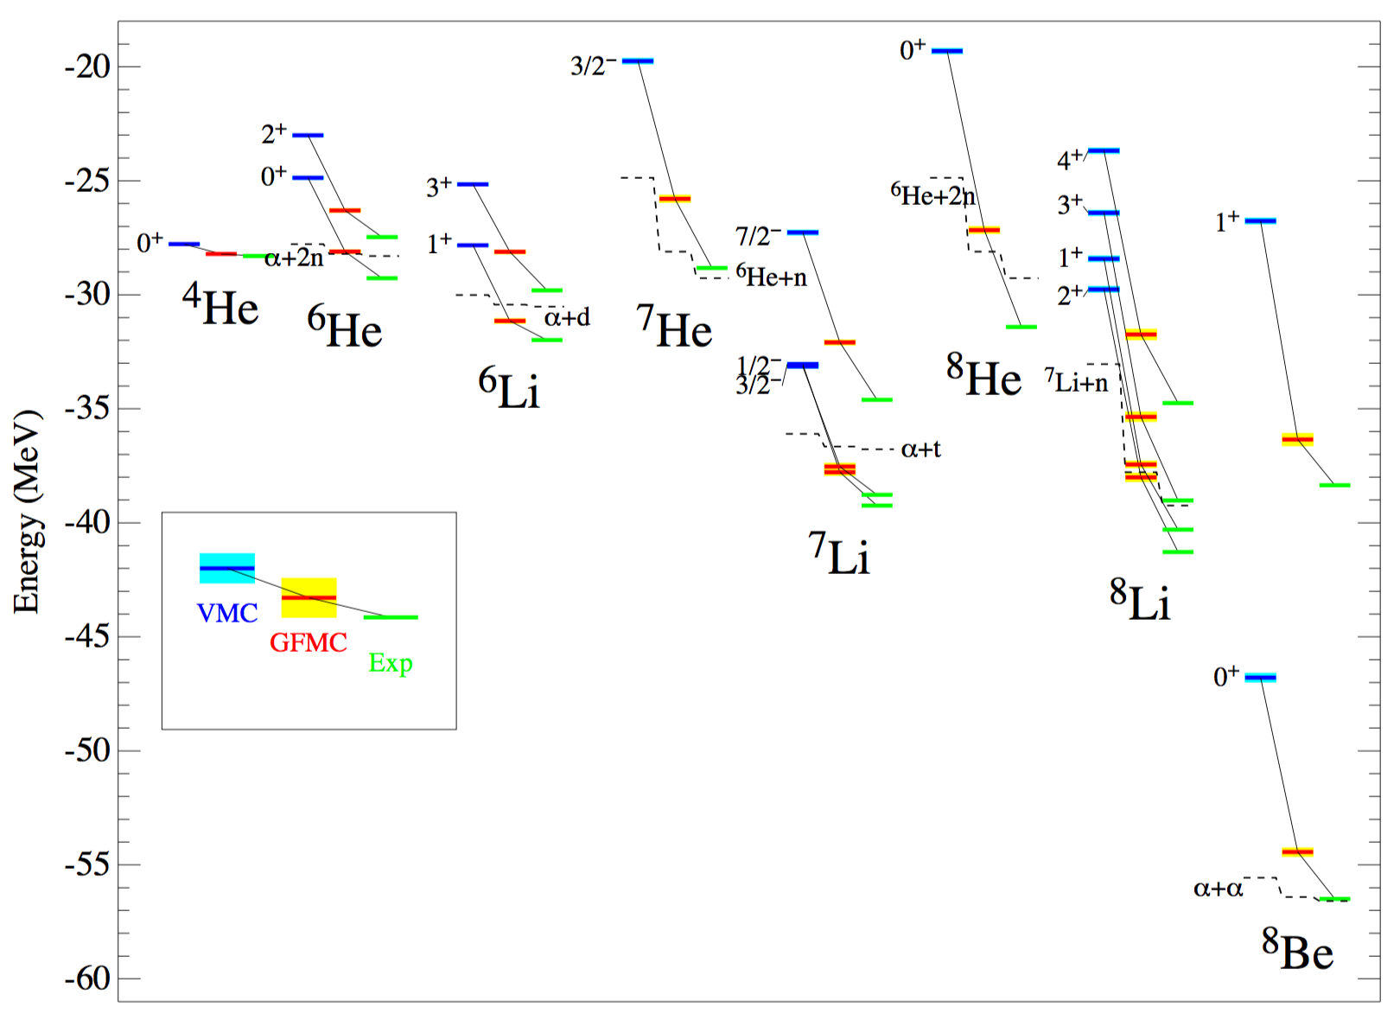
VMC and GFMC Calculations of Light Nuclei
100 – 1000 iterations
GFMC vs VMC: Rapid improvements on energies
Average over the last 9 values for GFMC energies
VMC worse at p-shell than s-shell

Slide 5
References:
Pieper, Steven C. "Quantum Monte Carlo calculations of light nuclei." Nuclear Physics A 751 (2005): 516-532.
Kosztin, I., B. Faber, and K. Schulten. "Introduction to the Diffusion Monte Carlo Method." Am. J. Phys. 64.physics/9702023 (1996): 633.
https://www.alcf.anl.gov/files/abinitioc12esptechreportwrapped.pdf
https://people.nscl.msu.edu/~witek/Classes/PHY802/Many-Body1.pdf

