Slide 1
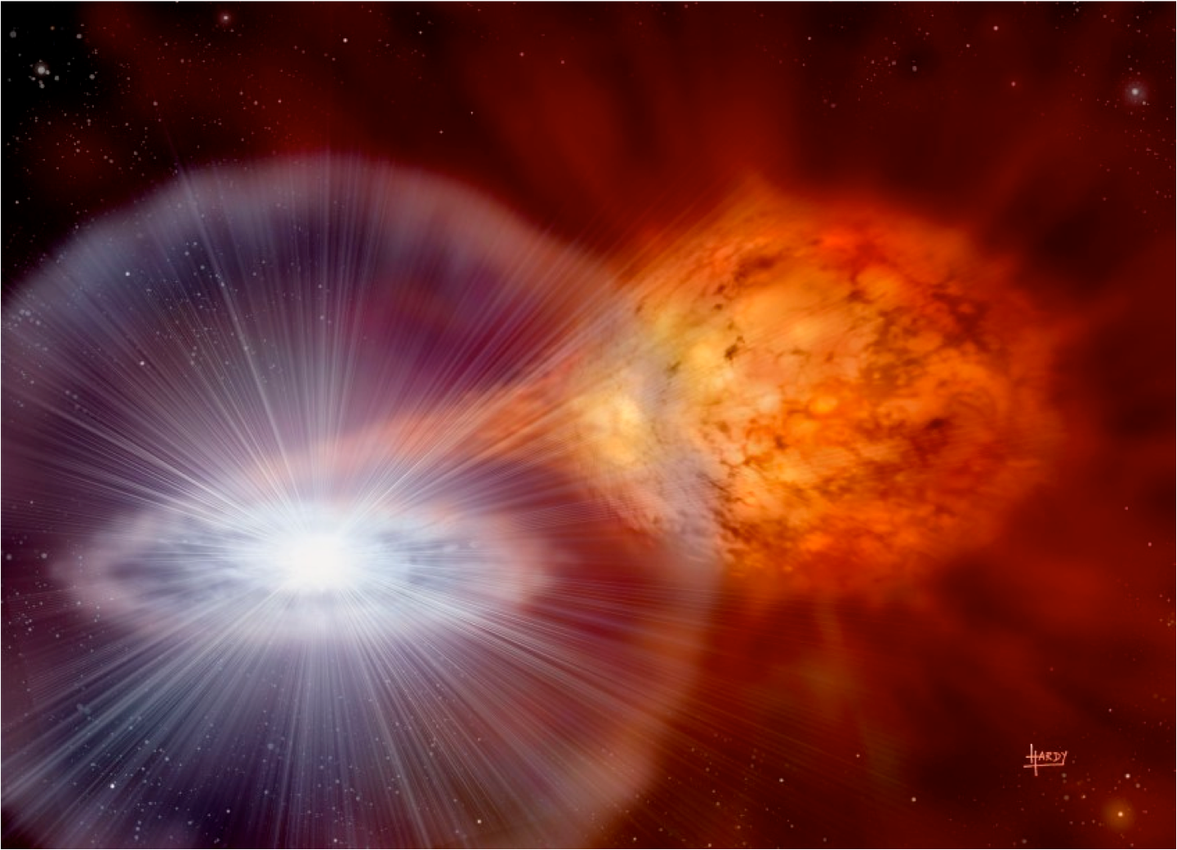
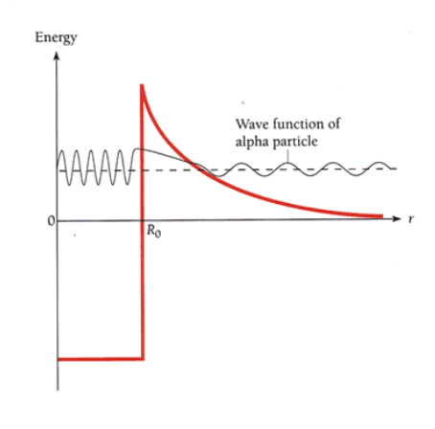
One-proton Breakup of ²⁴Si and the ²³Al( p, γ )²⁴Si Reaction in Type I X-ray Bursts
When binary star systems consist of a neutron star and a main sequence star (similar to our own sun), the neutron star accretes material and causes a nuclear fusion to begin again on its surface.
The proton only needs to overcome the coulomb potential of the ²⁴Si nucleus
Wave function of Proton
Burst occurs at ~1-2 GK ~ 172 KeV/nucleon
How can we measure capture cross-sections for ²³Al(p,γ)²⁴Si without directly measuring in stellar environments?
U ≈ 6 MeV

Slide 2
Inverse kinematics of the ²⁴Si Breakup
Using the cross section of the breakup reaction we can deduce the cross-section for the proton capture reaction via the Asymptotic Normalization Coefficient, which defines the height of the tail of the coulomb potential
We can consider |²⁴Si> = |²³Al>⊗|p> with a binding energy of 3.3 MeV
²⁴Si
P
Using this coefficient we can measure, we can take the ration of the measured cross section with the theoretical cross section for the interaction with the coulomb potential to determine the astrophysical cross section
²³Al

Slide 3
Summary
Astrophysical energies are too low for us to determine proton capture reactions in stellar environments
Cross sections for tunneling are too low in lab environment
Measurements of inverse kinematics allows us to investigate these reactions through breakup reactions by giving a feasible cross section value
A. Banu et al., Phys.Rev. C 86, 015806 (2012), Erratum Phys.Rev. C 86, 039901 (2012)
V.Kroha et al., Czech.J.Phys. 51, 471 (2001).

