Slide 1
Fusion of Halo Nuclei
The Title
Andrew LaJoie
May 8, 2015
PHY 802
Notes:
A visual for the motivation of this paper is a Venn Diagram
Paper seeks to understand what is happening in the center of this diagram

Slide 2
The Quandary
Sub-barrier Fusion of Two-neutron Halo Nuclei
P.R.S. Gomes, et. al.
Effect of Halo Structure on Fusion cross section
Enhancement
Suppression
Different Domains
Sub-Coulomb-barrier energies
Over-barrier energies
Considerations
Spatially Extended Density
Breakup
Incomplete Fusion
Notes:
Primary factors that must be considered
These are Unique to Halo Nuclei Fusion
Demo: 6He shown. 238U shown
A demonstration of the incomplete fusion channel which was originally suggested to inhibit fusion
---This is because the uncharged neutrons carry away part of the projectile’s kinetic energy

Slide 3
The Analysis
So-called Universal Fusion Function (UFF)
Optical model calculation – Potential described by Wong’s formula
Coupled Channel Calculation
Previously, reaction mechanism of halo nuclei at energies below Coulomb Barrier wasn’t completely understood or easily modeled
Author claims UFF rectifies this
Process accounts for breakup channel (animation)
Notes:
UFF is unitless quantity to characterize fusion reaction cross section
Selected Equations illustrate sequence to calculating the UFF
Equation 1: Definition of what author calls UFF
Equation 2: How it must be modified when considering coupled channel (CC) calculations
Equation 3: FF via Wong’s model
Equation 4: Ratio used to isolate the effect of the breakup channel, A represents bound channels, B is set of unbound channels
“x = (E−V_B)/(hω) , with, R_B , V _B and hω, being the barrier radius,
height, and curvature parameters of the fusion (Coulomb) barrier,
respectively”
(From what it sounds like, this hinges on the assumption that the only relevant unbound channel is the breakup from my animation)
Ito paper claims that the reaction mechanism of halo nuclei at LOW INCIDENT ENERGIES is still in question, however at high incident energies, the dynamics can be separated into fast and slow motions

Slide 4
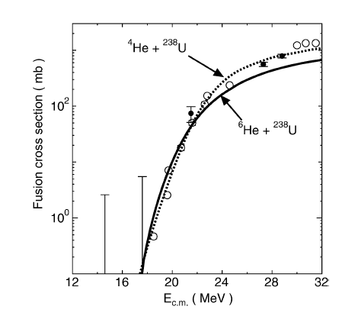
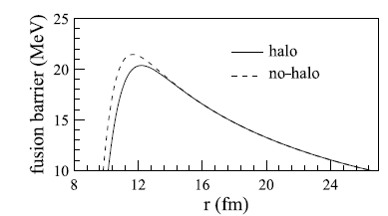
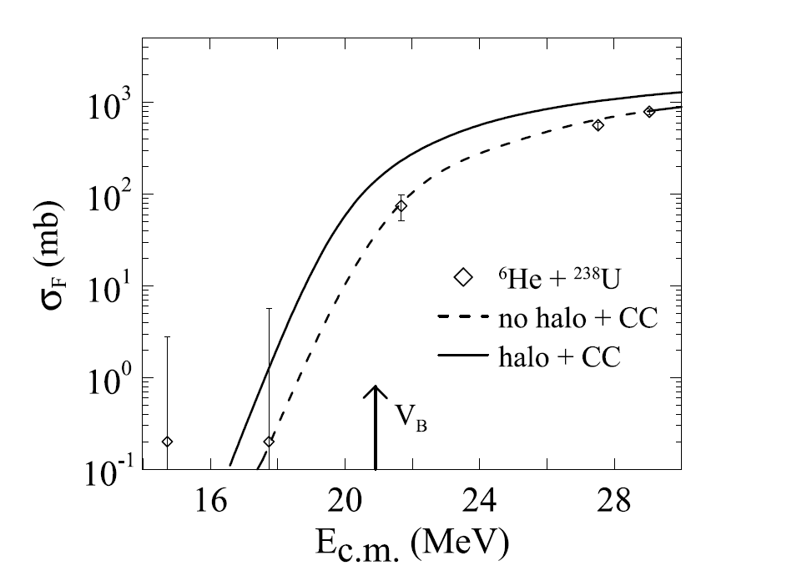
The Takeaway
Suppressed Fusion Cross Section for Neutron Halo Nuclei
M. Ito, et. al.
Author’s Claim
Focus on Sub-barrier energies
Enhancement of Fusion
Above-barrier energies result seems inconsistent with previous authors’
Another Claim
Focus on Above-barrier energies
Suppression of Fusion
Conclusion:
A better understanding can provide insights into
Nuclear Fusion
Halo Nuclei Properties
Results seem inconsistent
Notes:
MY author somewhat touches on this, but it’s fairly unclear from his calculation/plots
CC is for including the first two inelastic excitations for 238U rotational band (only ones that affected results)
Ito’s consideration was primarily in above barrier energy, reaches opposite conclusion
If a friendly, inquisitive, and poorly paid WalMart employee were to ask what this all means:
-The center of the Venn Diagram still needs some work to be done to decipher
-High statistical experimental uncertainty in below-barrier energies (where quantum tunneling allows the fusion process to occur) makes conclusions in this region uncertain
-Different calculation models suggest conflicting suppression and enhancement in above-barrier energies

Slide 5
The References
P.R.S. Gomes, L.F. Canto, J. Lubian, M.S. Hussein
Sub-barrier Fusion of Two-neutron Halo Nuclei
Phys. Lett. B, 695 (2011), p. 320
L.F. Canto, P.R.S. Gomes, J. Lubian, L.C. Chamon, E. Crema
Nucl. Phys. A, 821 (2009), p. 51
C.Y. Wong
Phys. Rev. Lett., 31 (1973), p. 766
R. Raabe, et al.
Nature, 431 (2004), p. 823
M. Ito, K. Yabana, T. Nakatsukasa, M. Ueda
Phys. Lett. B, 637 (2006), P. 53

