Slide 1
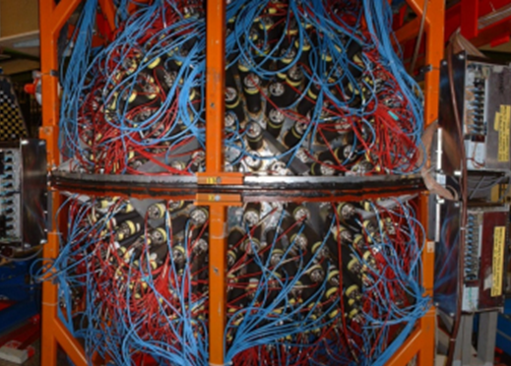
Neutron Skin of ²⁰⁸Pb from Coherent Pion Photoproduction
Neutron Skin
²⁰⁸Pb
(γ, π⁰) measurements
Model-independent correlation
Previous measurements
Crystal Ball detector
Notes:
what:the difference between the root mean square radii for the neutron and proton distributions
why: give constraints on nuclear structure and neutron stars
why Pb: relatively well-understood structure: closed shells
Why this approach: model-independency scattering strong interaction model-dependency
Previous: low precision mainly due to limited coverage

Slide 2
Experiment
Coherent photoproduction: γ + A(gs) → A(gs) + π⁰
Protons and neutrons have the same contribution
π ⁰ → 2γ
Reconstruct the pions momenta by angles and energies
Two-parameter Fermi distribution
ρ(r)=(Z/A) ρ_{p}(r)+(N/A) ρ_{n}(r)
Notes:
ρ_{p} are well determined by electron scattering

Slide 3
Summery
The first determination of a nuclear matter form factor with an electromagnetic probe
The existence of a neutron skin of ²⁰⁸Pb nucleus is confirmed with a thickness
References
C. M. Tarbert et al., Phys. Rev. Lett. 112, 242502 (2014)
A. Starostin et al., Phys. Rev. C 64, 055205 (2001).
B. Krusche, Eur. Phys. J. A 26, 7 (2005).
Notes:
After some math...

