Slide 1
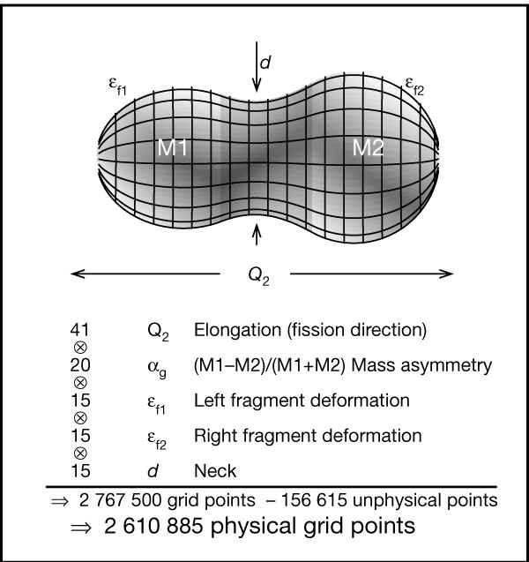
Fission barriers at the end of the chart of nuclides
What are the appropriate degrees of freedom for describing fission of heavy nuclei (171 ≤ A ≤ 330)?
Fission barrier heights for 5239 nuclides between the proton and neutron drip lines were calculated using the following set of only 5 parameters:
Elongation
Neck diameter
Left-fragment spheroidal deformation
Right-fragment spheroidal deformation
Nascent fragment mass asymmetry
P. Möller, Nature 409, 785-790 (2001)

Slide 2
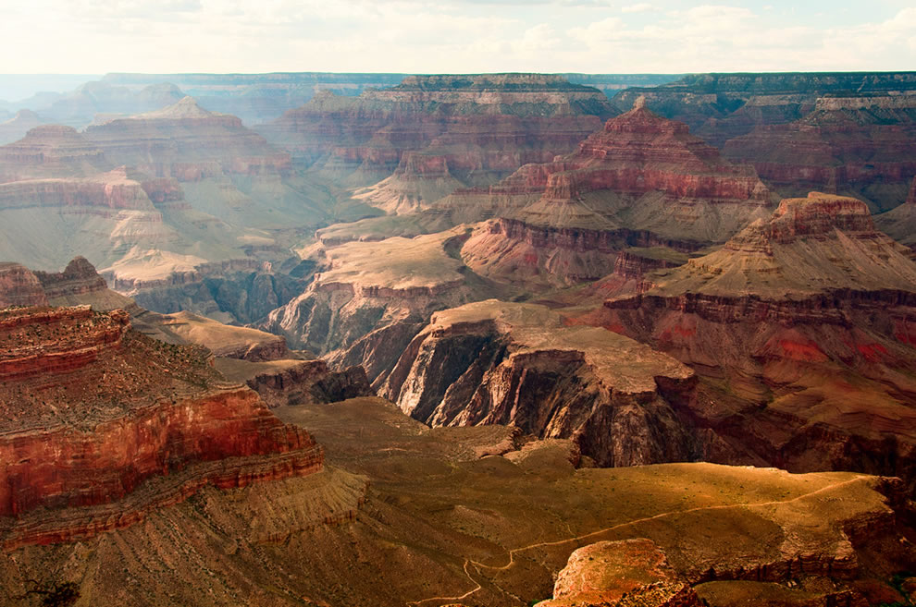
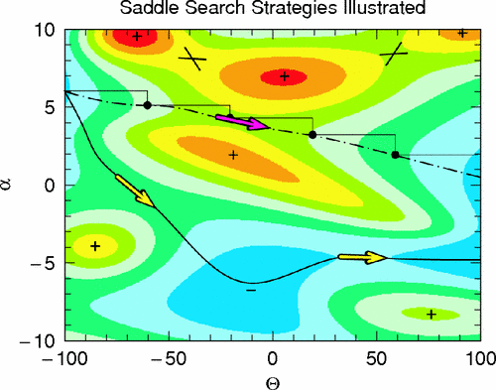
http://nesaranews.blogspot.com/2012/06/pictures-of-grand-canyon-az.html
Retrieved 5-4-15

Slide 3
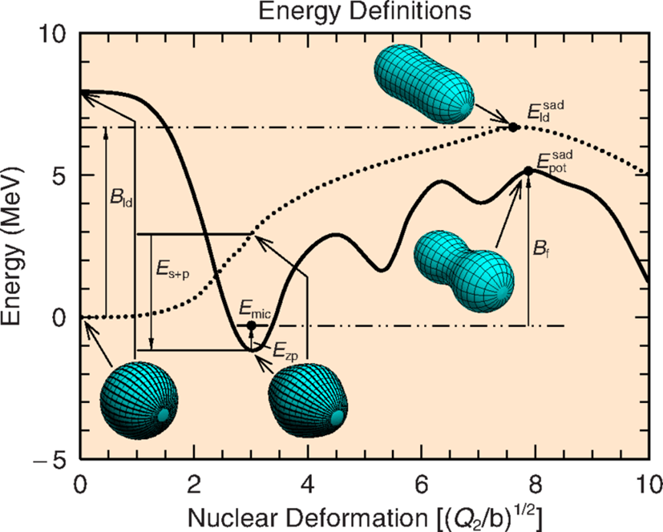
Results and conclusions
A brute-force achievement for modern computing and nuclear theory
Over 5,000,000 different shape configurations were considered, without conventional minimization techniques
Where experimental data is known, theory agrees with experiment to within about 1 MeV

