Slide 1
New Observations from the Hyperfine Structure of ^{49,51}K
Andrew Miller

Slide 2
“Reinversion” of levels
Collinear Laser Spectroscopy at ISOLDE CERN
^{49,51}K: Z=19, N=30,32 (beyond N=28)
Measuring the ground state shows a “reinversion” of the π2s_{1/2} and π1d_{3/2} levels and gives us further constraints on our understanding of the nuclear shell model!

Slide 3
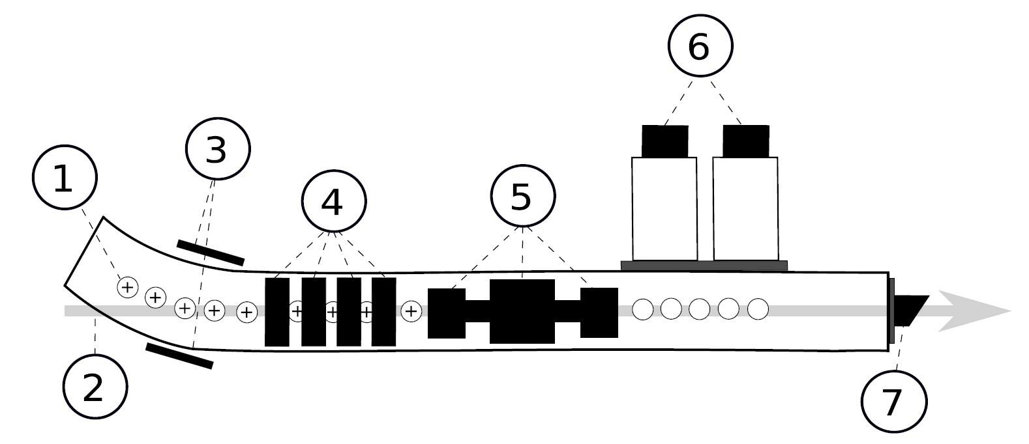
Collinear Laser Spectroscopy
Collinear laser spectroscopy setup (COLLAPS) at ISOLDE. 1) Single charged ions; 2) laser beam; 3) electrostatic deflection plates; 4) post-acceleration electrodes; 5) charge exchange cell (CEC); 6) photomultiplier tubes; 7) brewster window.

Slide 4
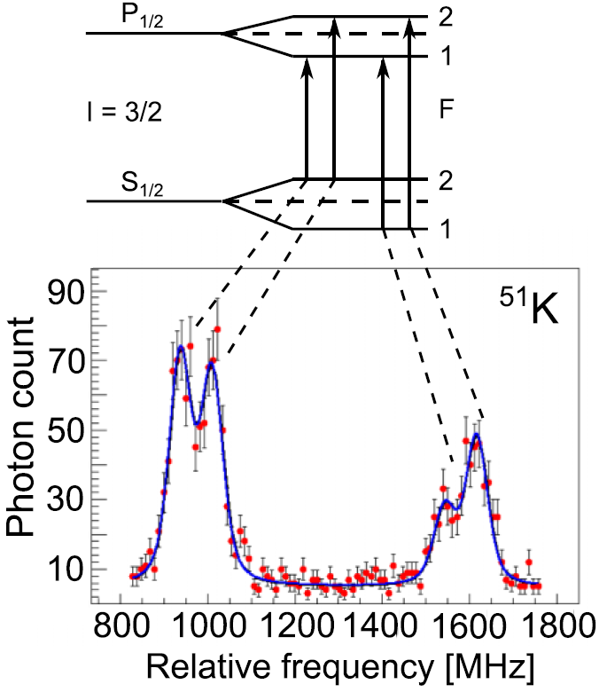
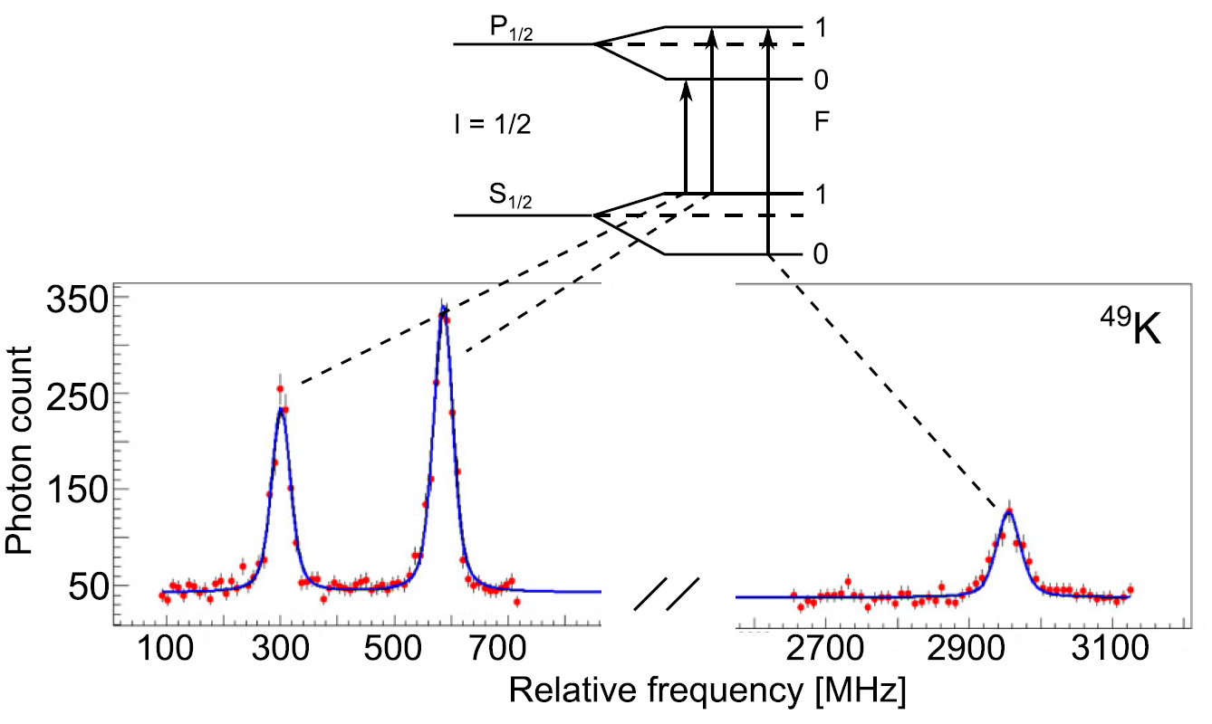
Hyperfine Spectra

Slide 5
References
Spins and Magnetic Moments of ⁴⁹K and ⁵¹K: Establishing the ½⁺ and 3/2⁺ Level Ordering Beyond N = 28. J.Papuga et al. PRL 110, 172503 (2013).
An ion cooler-buncher for high-sensitivity collinear laser spectroscopy at ISOLDE. E. Mané et al. Eur. Phys. J. A 42, 503-507 (2009).
Nuclear charge radii of potassium isotopes beyond N = 28. K. Kreim et. al. PLB 731, 97-102 (2014).

