Slide 1
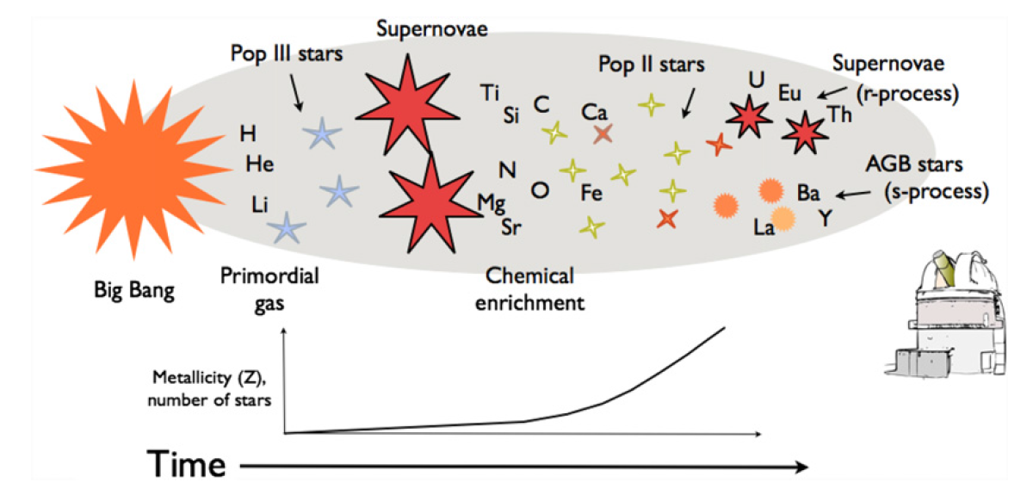
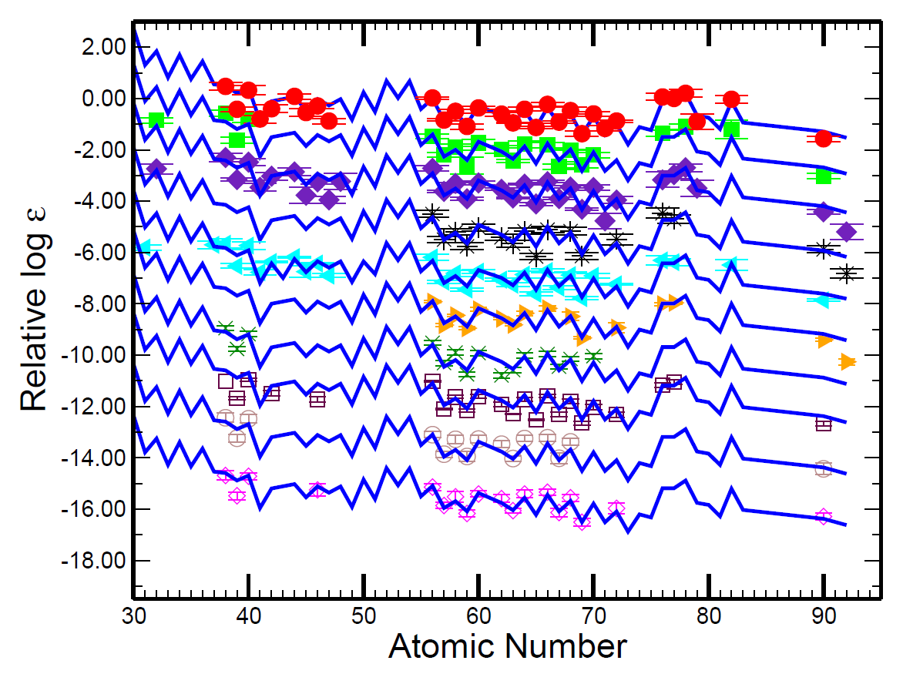
Mysterious Abundances in Metal-poor Stars & The ν-p process
How do we explain the abundances of “lighter heavy” nuclei (38 ≤ Z ≤ 40: Sr-Y-Zr)?
Chemical evolution
Heavy elements (56 ≤ Z < 83) agree
Abundace vs. metallicity trends suggest and additional process (LEPP)
From Jacobson, H. R., & Frebel, A. 2014, Journal of Physics G Nuclear Physics, 41, 044001
Cowan J J, Roederer I U, Sneden C and Lawler J E 2011 r-Process Abundance Signatures in Metal-Poor Halo Stars (Carnegie Observatories Astrophysics Series vol 5) (Pasadena, CA: Carnegie) p 223
Notes:
Chemical evolution a product of stellar nucleosynthesis (p-p chain, CNO cycle, s-, r-, etc. processes)
Heavy elements (56 ≤ Z < 83) agree with the r-process contribution to the solar abundances -> r-process is universal
However, lighter elements’ (26 ≤ Z ≤ 47) abundances do not agree with solar r-process abundances -> there is some additional nucleosynthesis process at work (LEPP)
8%-18%-18% of the SS abundances are missing for Sr-Y-Zr (Z= 38 39 40)
How do we determine abundances? -> stellar spectra
How do we know metal-poor stars are older and not just formed from metal-poor material -> the metal-poor material is older due to isotropy assumption for these timescales
Metal-poor stars should be enriched by only a few nucleosynthesis events => r-process is universal

Slide 2
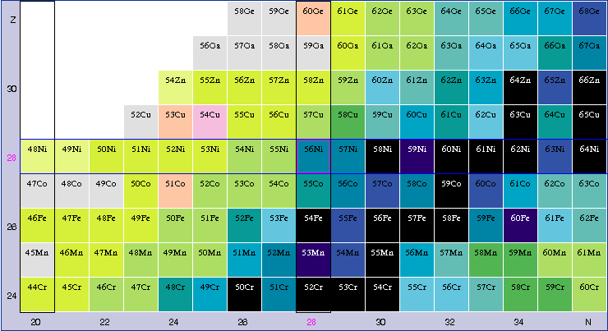
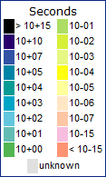
The ν-p Process
Basics:
Free nucleons -> Fe region -> bottlenecks
Neutrinos
Neutron captures
From The Chart of Nuclides (nndc.bnl.gov)
Site: proton-rich material of core-collapse supernova
Notes:
Primary process = independent of initial abundances
Accurately treating neutrino-matter interaction results in proton-rich ejecta
PNS cools by emitting neutrinos
Neutrino driven wind = supersonic outflow powered by neutrino flux
reaction flow beyond 56 Ni 64 Ge is hampered by low p-capture Q-values and long β+ decay half-lives
Proton density is not as high as in rp process
Neutron density ~ 10^14, 10^15 per ccm
Why does SN produce proton rich matter? -> properly accounting for neutrino interactions at these densities and temperatures

Slide 3
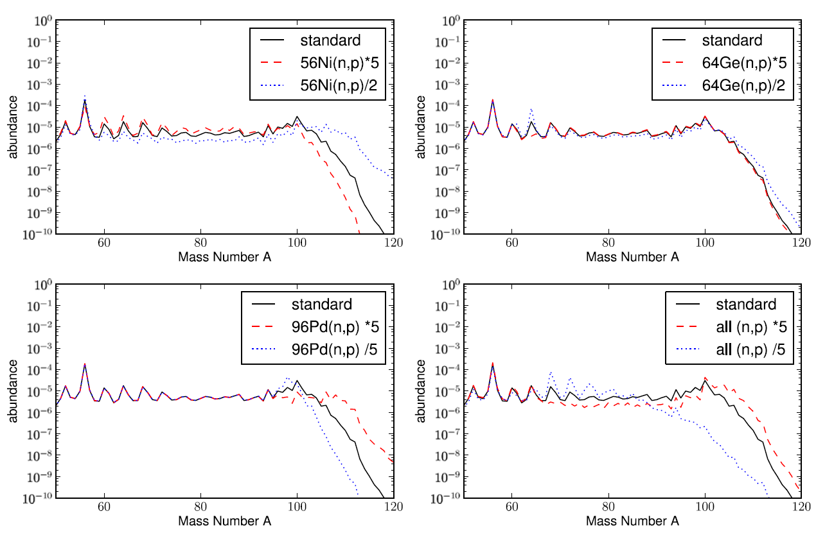
Concluding Remarks
The ν-p process contributes to Sr-Y-Zr abundances
Nuclear physics input
Measure reaction rates and masses
Neutrino physics
Improved supernova models – stalled shock
Fröhlich, C. 2014, Journal of Physics G Nuclear Physics, 41, 044003
Notes:
Contribution to the Sr-Y-Zr abundances from a different process can explain their difference from the observed SS abundance pattern
heavily dependent on SN conditions, neutrino-driven winds

Slide 4
Works Consulted
Cowan J. J., Roederer I. U., Sneden C. and Lawler J. E. 2011 r-Process Abundance Signatures in Metal-Poor Halo Stars (Carnegie Observatories Astrophysics Series vol 5) (Pasadena, CA: Carnegie) p 223
Frebel, A., Aoki, W., Christlieb, N., et al. 2005, , 434, 871
Fröhlich, C. 2014, Journal of Physics G Nuclear Physics, 41, 044003
Jacobson, H. R., & Frebel, A. 2014, Journal of Physics G Nuclear Physics, 41, 044001
Travaglio, C., Gallino, R., Arnone, E., et al. 2004, , 601, 864

Slide 5
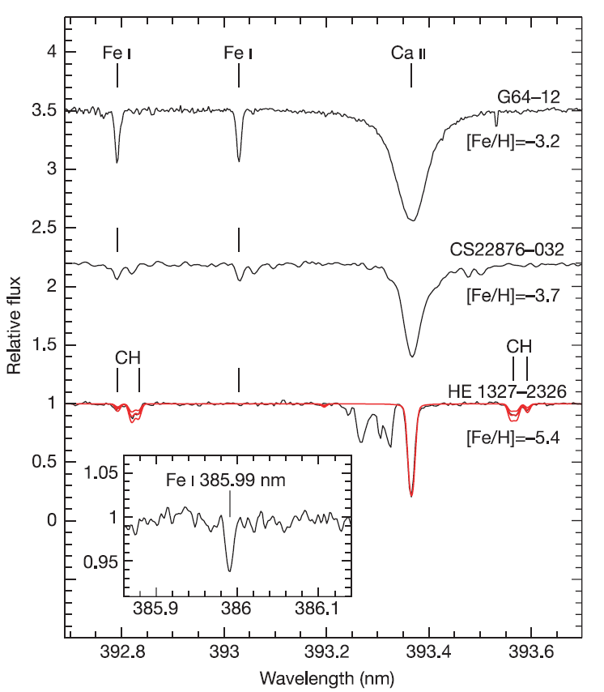
Example Stellar Spectrum
Frebel, A., Aoki, W., Christlieb, N., et al. 2005, , 434, 871

