Slide 1
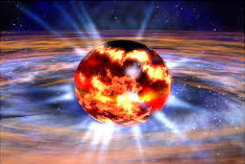
Restrictions on the Nuclear Equation of State
Motivation
Study densities inside of neutron stars and core collapse super novae
How do we do this?
Study directly by smashing two heavy atoms together and measuring observables
Formulate models of the Equation of State (EOS)
Compare the two to get restrictions on the variables that go into the models
Results
Achieved constraints on densities which in turn put bounds on the Equation of State

Slide 2
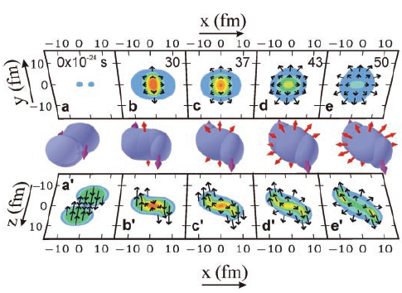
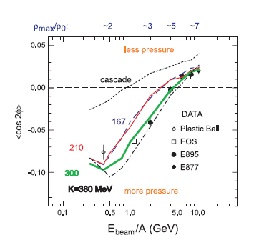
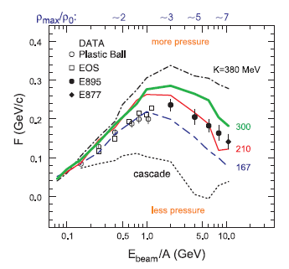
Observables
Transverse Flow (F): Sideways flow of fragments
Elliptic Flow: comparing in-plane and out-of-plane emission rates
Found by using transverse momenta and rapidity
$$〈\cos{2φ}〉$$
Large F amount to larger deflection
Sign of this value reflects out-of-plane and in-plane emission

Slide 3
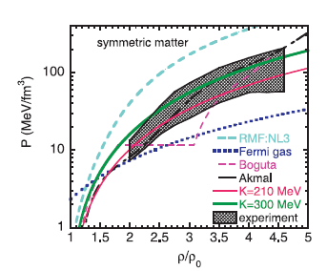
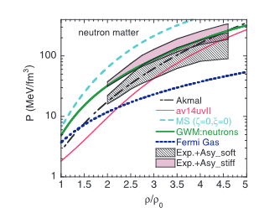
Constraining the EOS
Symmetric Matter
Antisymmetric Matter
Bounds on symmetric matter achieved between 2 to 4.6
EOS with no mean field do not have enough pressure
Strongly repulsive EOS provide too much pressure
Asym matter split into soft and stiff
Large spread between stiff and soft
Need more experiments
P. Danielewicz. “Determination of the Equation of State of Dense Matter”
Han’s Poster

